Slide 1
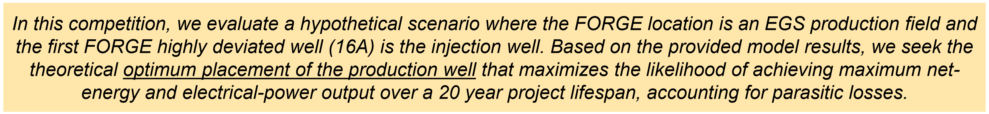
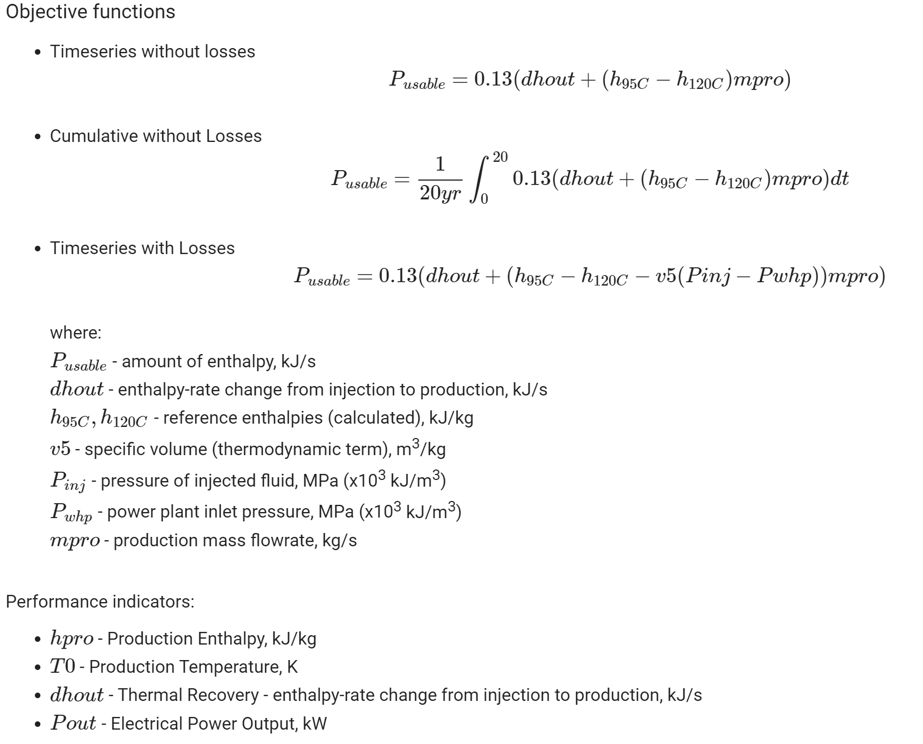
Challenge statement

Slide 2
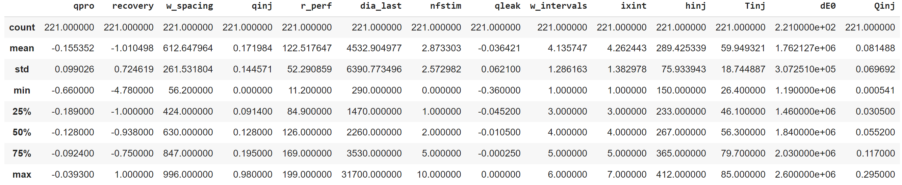
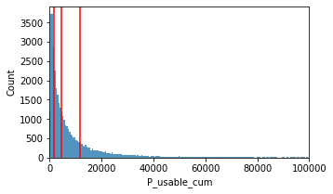
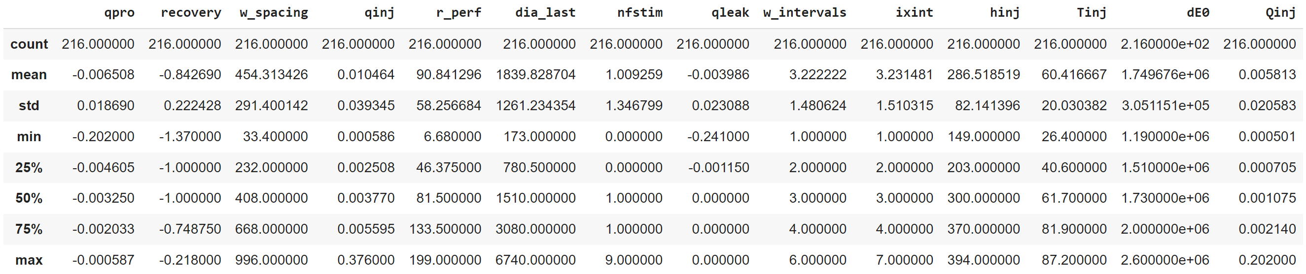

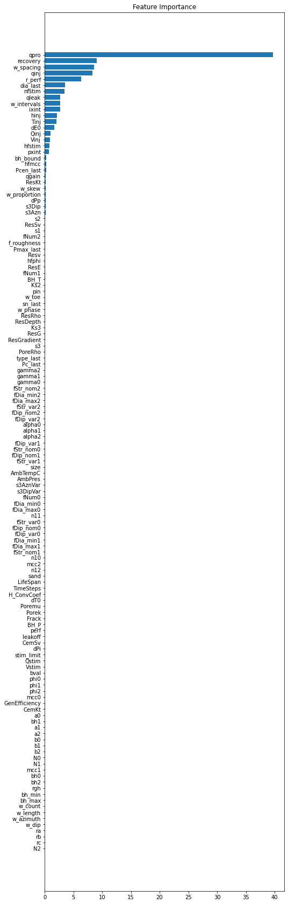
Classification problem solving
Objective function selection Splitting dataset by category based on P_usable calculated
Solving classification problem with ML method based on gradient boosting on decision trees algorithm
Highlighting important features based on ML model output results
The most important parameters for optimal scenario over 20-year project lifespan (P_usable > 10500 kJ/s)
The most important parameters for NOT optimal scenario over 20-year project lifespan (P_usable < 1300 kJ/s)

Slide 3
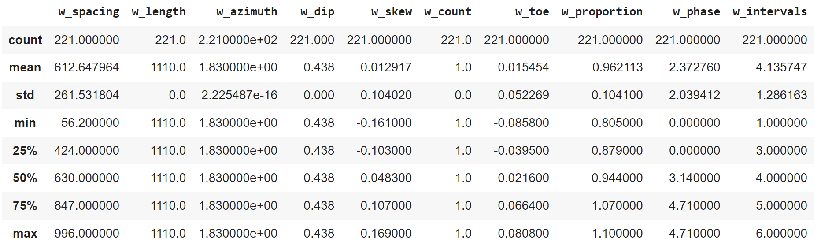
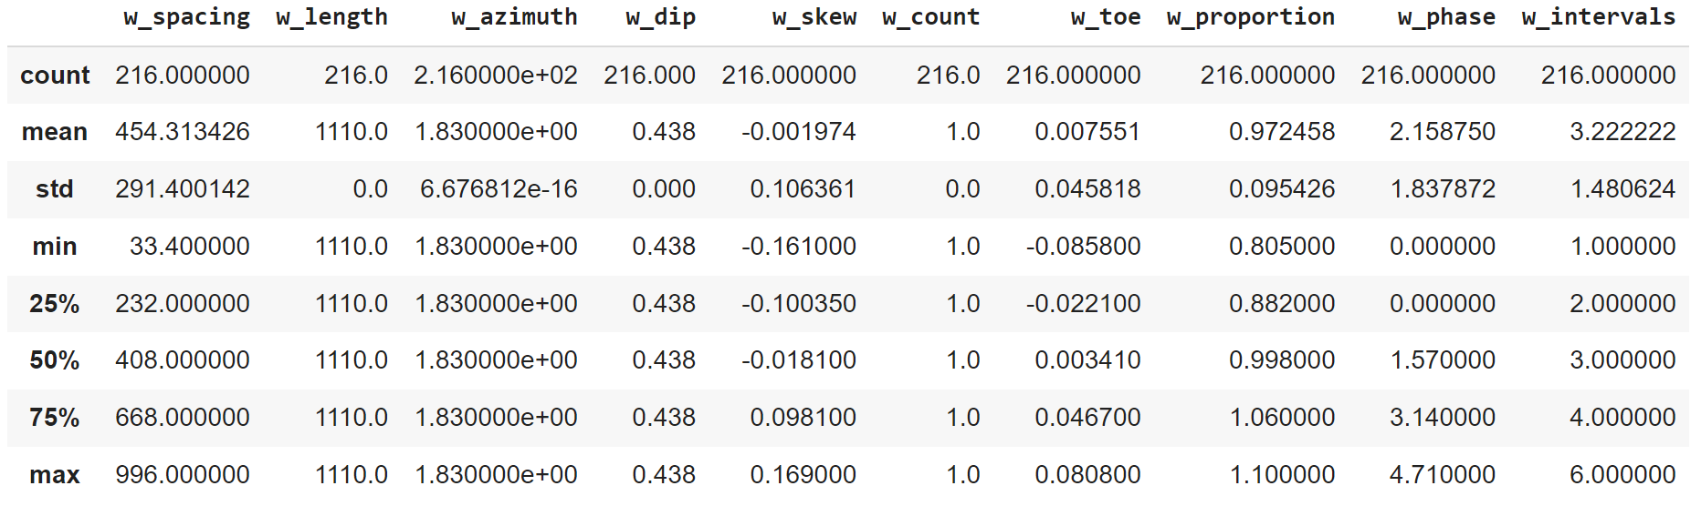
Optimal well placement by category
Well placement parameters for optimal scenario over 20-year project lifespan (P_usable > 10500 kJ/s)
Well placement parameters for NOT optimal scenario over 20-year project lifespan (P_usable < 1300 kJ/s)

