Slide 1

SPE PIVOT 2022
Datathon

Slide 2
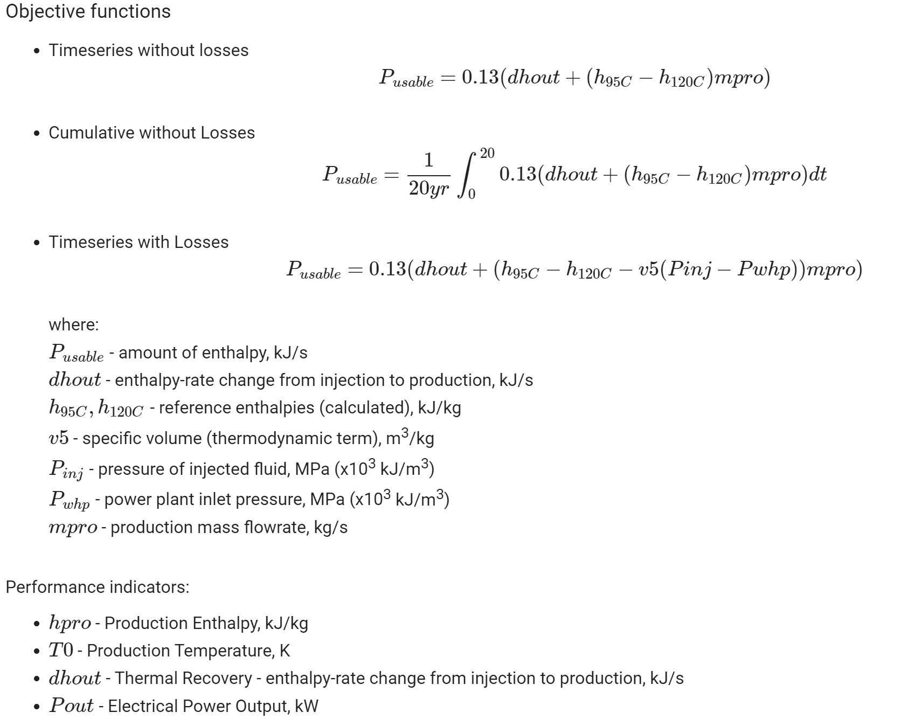

Slide 3
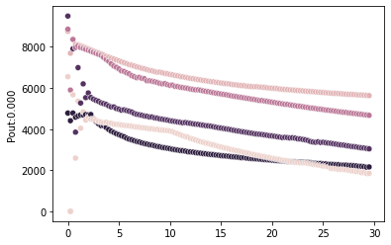
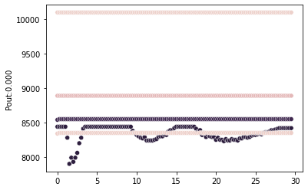
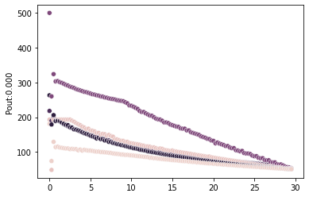
Dataset (timeseries parameters)
Data validation:
Threshold for duplicates – 20 data points
Pout values after 30 years > 50 kW

Slide 4
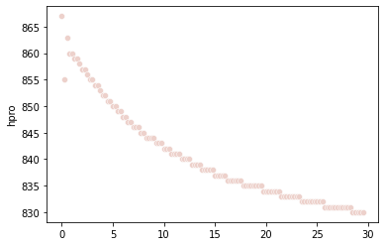
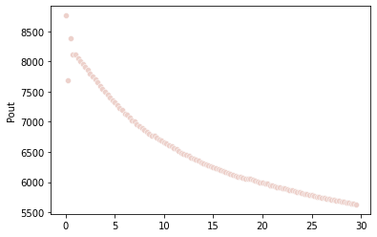
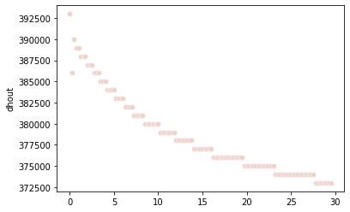
High-performance simulation - Pout
<T0_plot>
no data in 30yr file

Slide 5
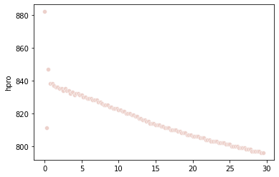
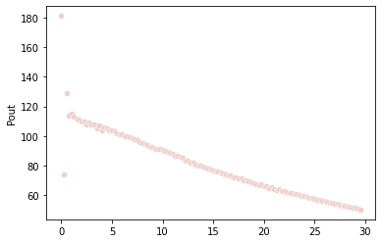
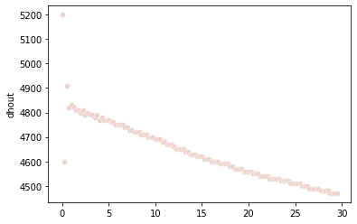
Low-performance simulation - Pout
<T0_plot>
no data in 30yr file

Slide 6
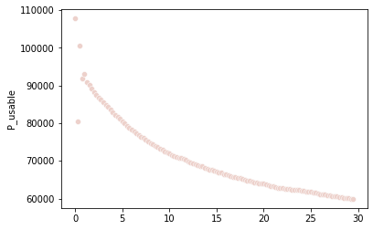

High-performance simulation – P_usable

Slide 7
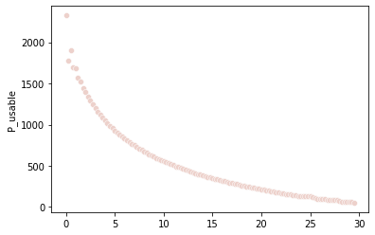
Low-performance simulation – P_usable

Slide 8
First insights
Key parameters for high power output
  Parameter, range
  Parameter, range
  Parameter, range
Key parameters for low power output
  Parameter, range
  Parameter, range
  Parameter, range

Slide 9


Optimization
Parameters:
Reservoir depth
Well spacing
Number of prod wells and inj intervals
Seismic magnitude
Strategy:

Slide 10








Dataset (non-timeseries parameters)

