Slide 1
RetailOps
Enterprise Order & Inventory
Management System
Business Analysis · System Design · SQL Server · BI
Independent, fictional portfolio project
Synthetic case study; SQL tests and Power BI checked locally.

Slide 2
01 | The business problem
A hypothetical retailer operating across Serbia, Croatia and Slovenia
Stock visibility
Fulfillment delays
Decision blind spots
Different channels may see different availability; the business risks overselling and cancellations.
Manual inter-warehouse decisions and isolated courier records make promises difficult to meet.
Fragmented reporting makes margin, late shipment, returns and reorder decisions inconsistent.
Objective: translate these assumptions into measurable, testable system requirements — not just a database schema.
RETAILOPS / INDEPENDENT FICTIONAL PORTFOLIO CASE / SYNTHETIC DATA
2

Slide 3
02 | Discovery, scope & stakeholders
What a Business Analyst defines before the first SQL table
Stakeholders
Scope boundary
Operations sponsor · Warehouse manager · E-commerce product owner · Finance analyst · Procurement lead · DBA / QA
IN: orders, stock reservation, fulfillment, receiving, returns, KPI views.
OUT: payments, live APIs, VAT/FX, RBAC, client-facing frontend.
Business artifacts: BRD · SRS · User stories · RACI/RAID · KPI dictionary
RETAILOPS / INDEPENDENT FICTIONAL PORTFOLIO CASE / SYNTHETIC DATA
3

Slide 4
03 | AS-IS → TO-BE process
The model shows how requirements connect to the future operational workflow
AS-IS (assumed)
TO-BE (proposed)
Spreadsheet stock check
→ Emails to warehouses
→ Manual stock hold
→ Courier portal
→ Weekly spreadsheet report
Validate order + address
→ Domestic-first inventory allocation
→ Atomic stock reservation
→ Warehouse shipment + ledger
→ On-time delivery & BI views
RETAILOPS / INDEPENDENT FICTIONAL PORTFOLIO CASE / SYNTHETIC DATA
4

Slide 5
04 | Traceability from need to evidence
Business problem → requirement → design → implementation → acceptance test
Business need
Requirement
System component
Verification
Stop overselling
→
FR-03 / US-03
Atomic allocation
→
usp_AllocateOrder
UPDLOCK + HOLDLOCK
→
N01 insufficient stock
C01 concurrent last unit
Traceability is what makes this more than a collection of SQL commands.
RETAILOPS / INDEPENDENT FICTIONAL PORTFOLIO CASE / SYNTHETIC DATA
5

Slide 6
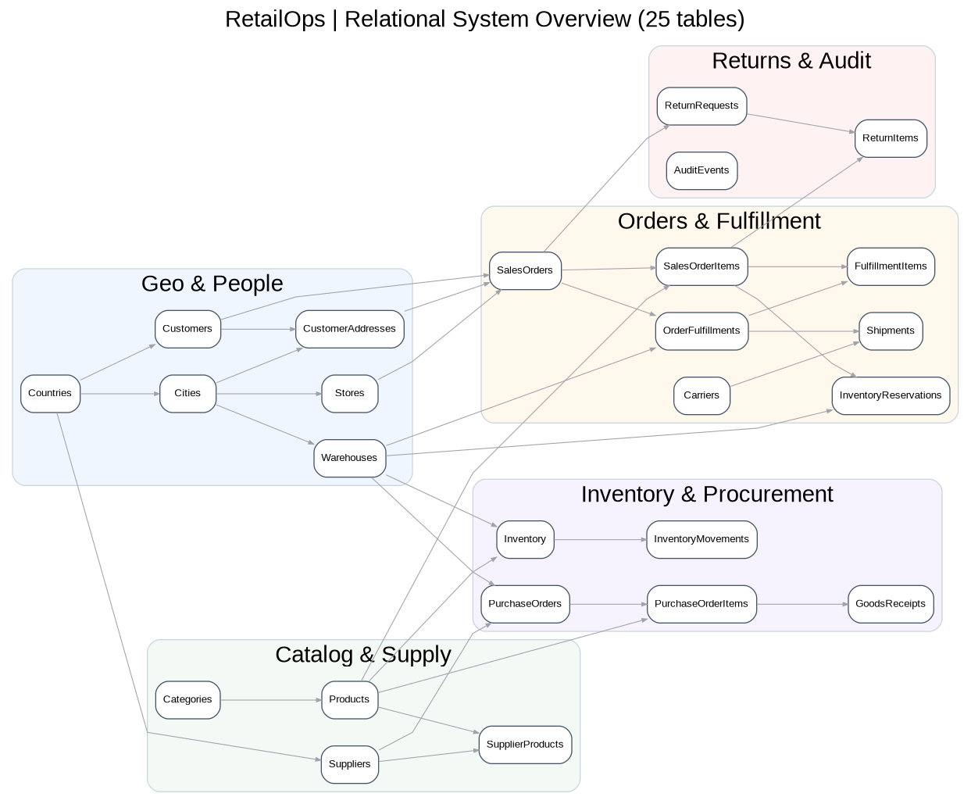
05 | Relational architecture
25 tables across geographies, catalog, orders, fulfillment, inventory, procurement and returns
RETAILOPS / INDEPENDENT FICTIONAL PORTFOLIO CASE / SYNTHETIC DATA
6

Slide 7
06 | Most important technical rule
A successful allocation reserves ALL required quantities — or NONE
1. Validate
2. Lock
Check order, lines and shipping address.
Acquire update/range locks on candidate stock.
3. Reserve
4. Commit / rollback
Prefer domestic stock; split across warehouses if required.
Commit once fully allocated. Otherwise undo the entire attempt.
On hand changes at DISPATCH. Reservation changes at ALLOCATION. Different business events.
RETAILOPS / INDEPENDENT FICTIONAL PORTFOLIO CASE / SYNTHETIC DATA
7

Slide 8
07 | Decision-oriented reporting
Five SQL views → three-page Power BI report → KPI definitions
Sales Performance
Inventory & Supply
Fulfillment
EUR 32.31m net revenue
100,011 orders placed
Monthly trend
Country and channel sales
Approx. 196k available units
30 reorder-alert rows
Warehouse stock comparison
Supplier / procurement indicators
Approx. 97k delivered
80% on-time delivery
2.60 average delivery days
Carrier / country comparison
Important: 100,000 orders are SYNTHETIC. Business outcomes are not real observed improvements.
RETAILOPS / INDEPENDENT FICTIONAL PORTFOLIO CASE / SYNTHETIC DATA
8

Slide 9
08 | Testing, transparency & next steps
Local demo evidence recorded; production readiness is not claimed
Built and documented
Local test results
25-table schema · 7 procedures · 100k-order generator · 5 views · SQL integration and negative tests · BPMN/ERD · BRD/SRS
T01–T08 and N01–N03 passed
C01 rejected competing allocation
Three Power BI pages and screenshots
SQL timings recorded (no proven speedup)
Production extensions: FX + VAT · API / RBAC · Backorders · SLA-cost routing · Monitoring
RETAILOPS / INDEPENDENT FICTIONAL PORTFOLIO CASE / SYNTHETIC DATA
9

