Slide 1
Group 12
Stevania Eilyn Frutiger, Dominique Heller,
Borislav Rakic, Dieter Andreas Studer

Slide 2
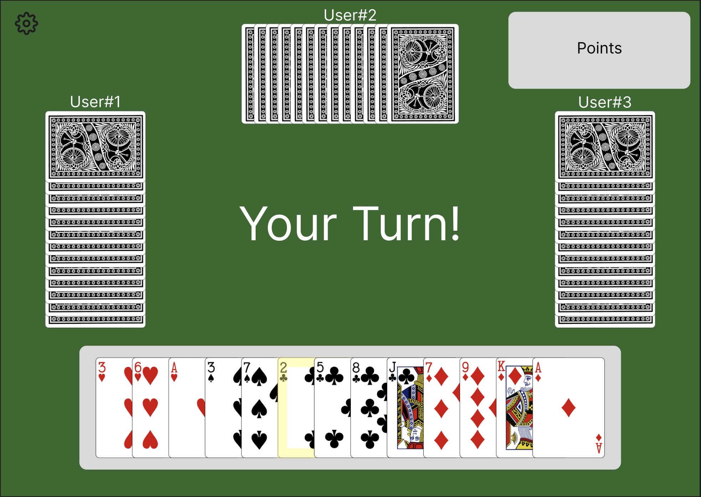
Hearts
4-player card game
The player with the least points wins
Usually, the game is played until someone reaches 100 points.

Slide 3
Why Hearts?
There are many websites hosting this card game
Most of them are either single-player (against computer opponents) or your progress is not saved
We save a user‘s progress and users can see their progress on the leaderboard

Slide 4
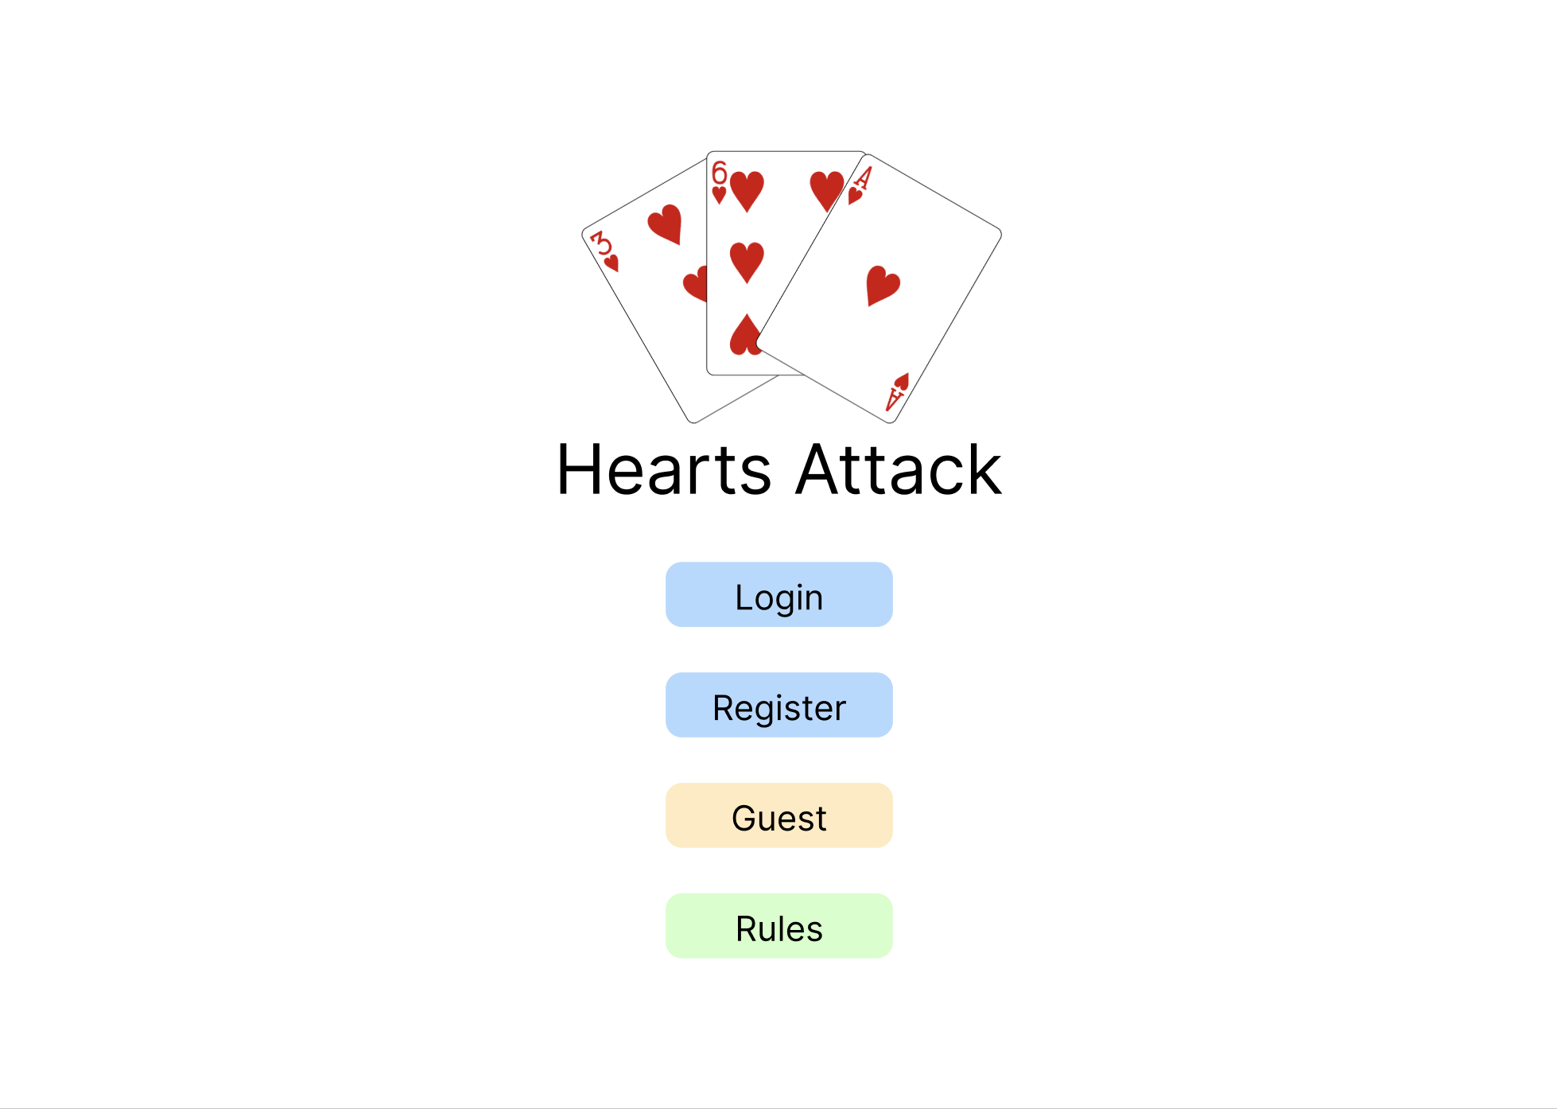
Landing Page
Register or login
„Login“ as guest
View the game‘s rules

Slide 5
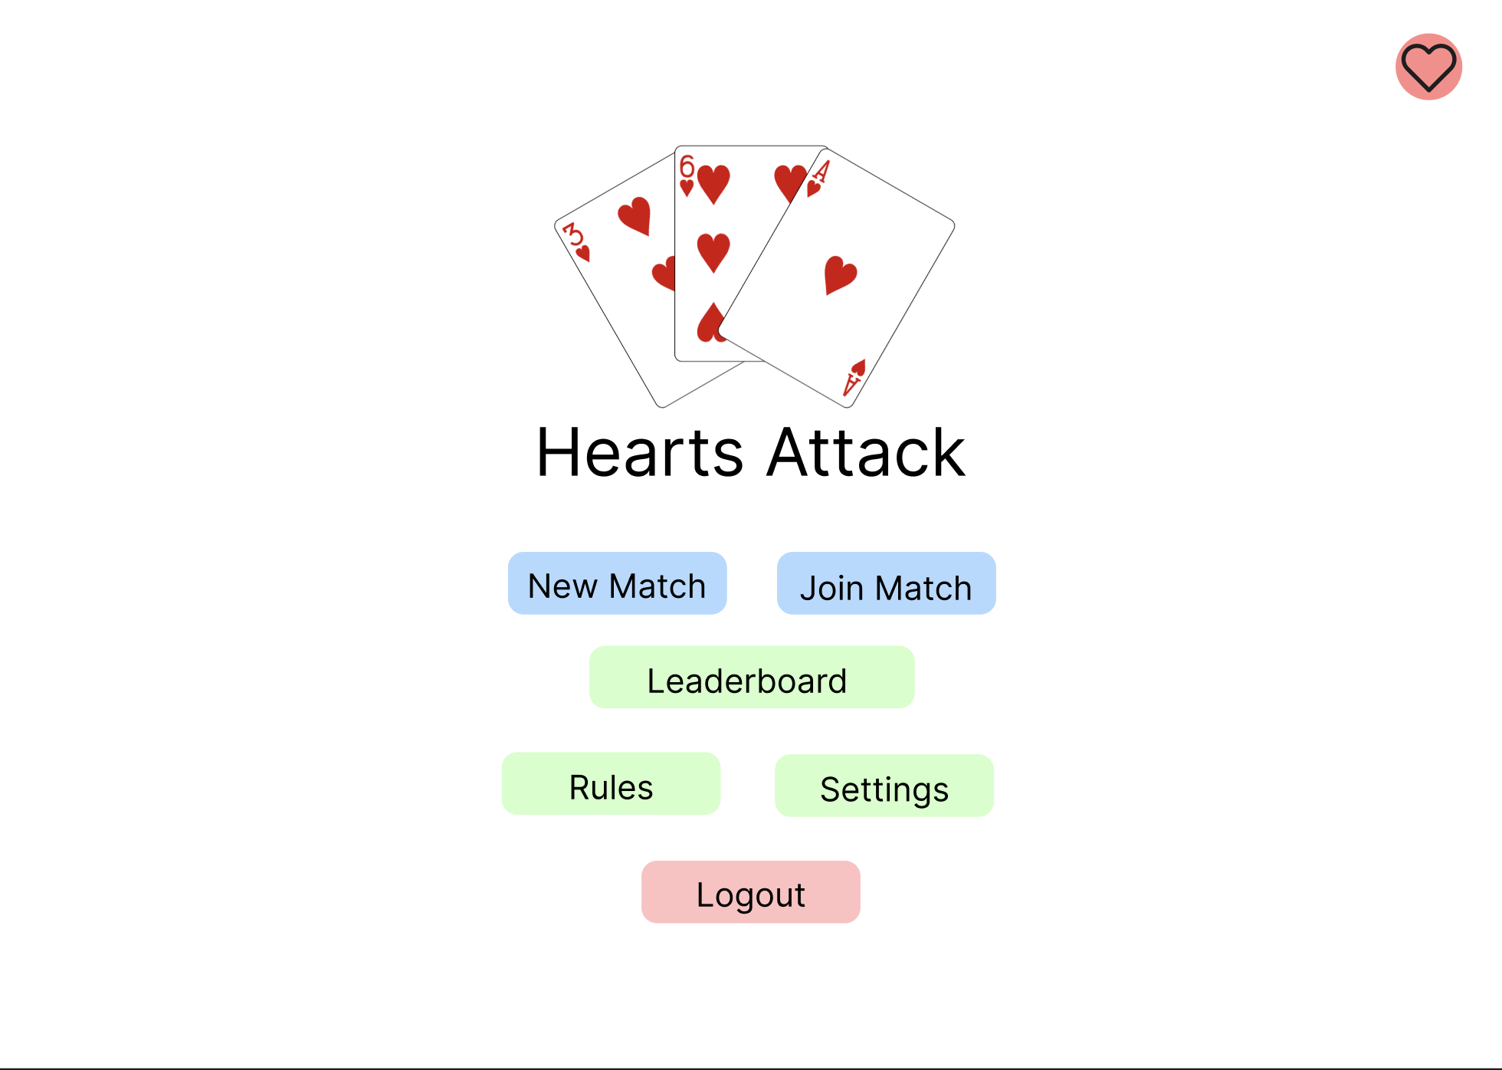
Landing Page (Logged in)
Start a new match or join an existing match
Look at the leaderboard
View the settings page (e.g. the design of the cards)

Slide 6
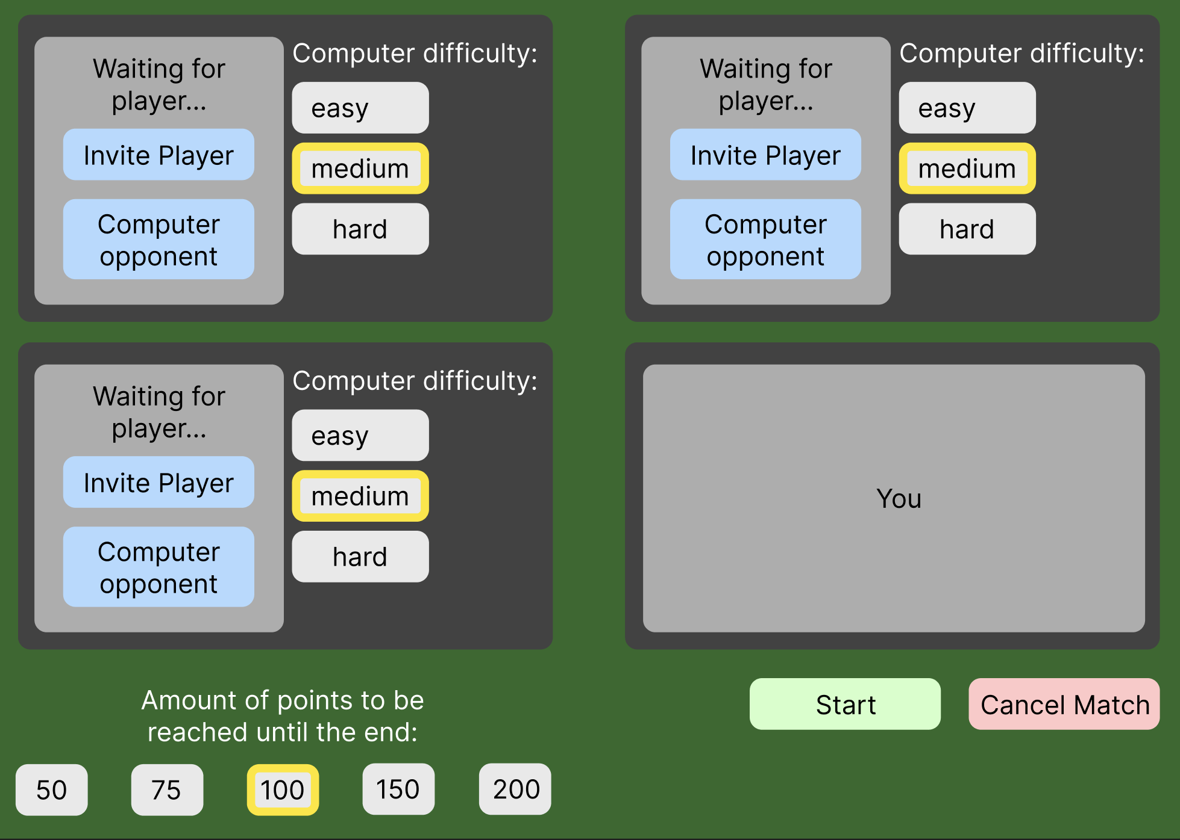
Start Page
Invite or wait for players
Set computer opponents and their difficulty
Set the length of the match

Slide 7
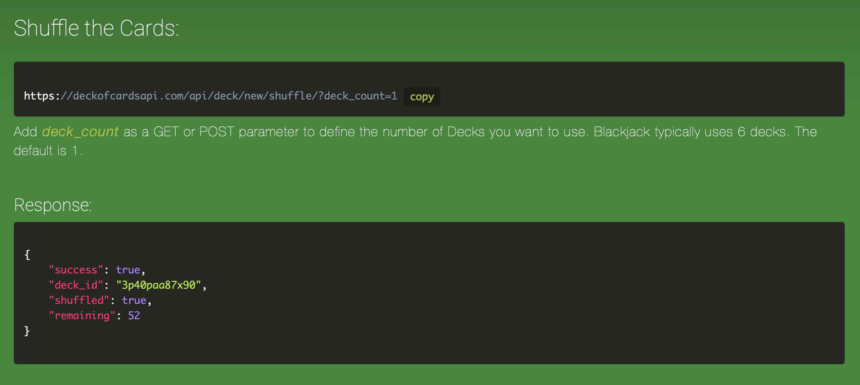
Deck of Cards API
The API provides services for a deck of cards
Decks can be shuffled, cards can be drawn and put on piles, etc.
Images of the cards are also provided

