Slide 1
Reimplement and use on the code.
making images from the author code and applying log-scale to use pandas.
AI part
Kim Young Oh, Kim Min Jae

Slide 2
[Ongoing]
Playing the author’s code.
[To Do]
See if the author's code can extract the model and modify the code to apply the heatmap.

Slide 3
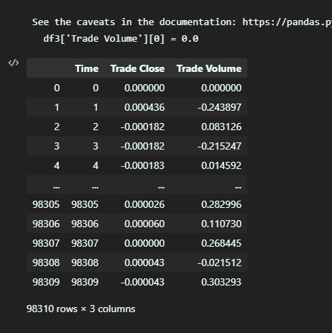
These data is preprocessed data from the author’s paper.
log10 is used by Trade Close and Trade Volume.
log(Pt/Pt-1) is made in the way,
array[i] - array[i-1]
0 index data is exception. So, array[0]-array[0]

Slide 4
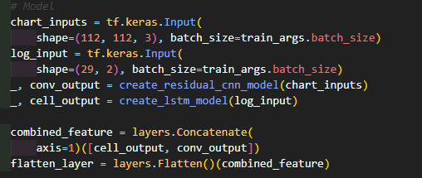
It seems that the two models were merged using tf.keras.

Slide 5
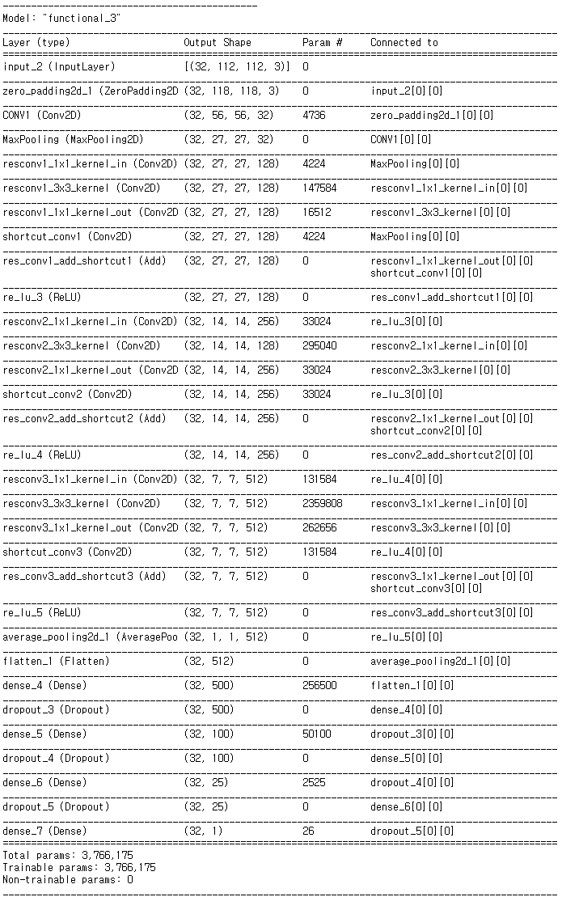
Modification of the original code
[CNN]
conv1_layer (with zero-padding)
↓
Max pooling layer
↓
res-conv_layer
shortcut
ReLU
↓
average_pooling
↓
Output
3 times repeat
cnn_model.summary() →

Slide 6
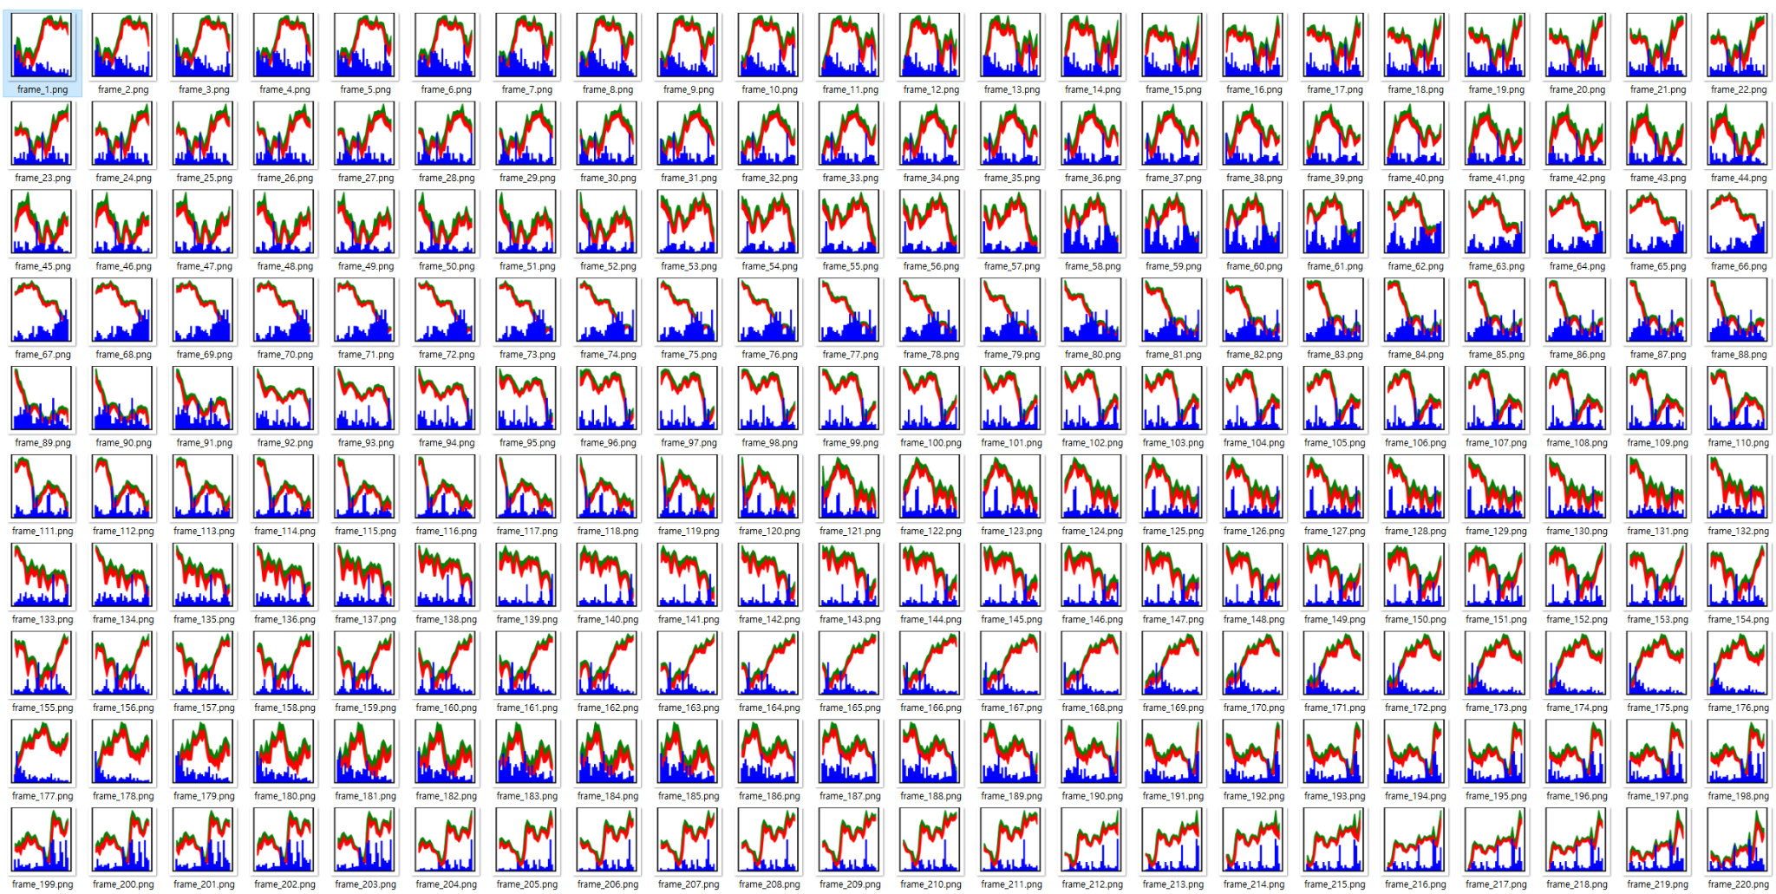
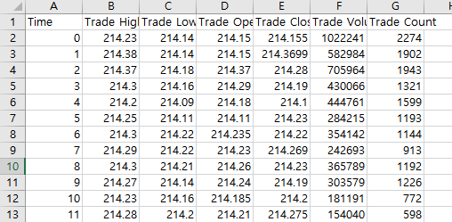
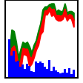
Modification of the original code
[Result]
Input Data: tw_spydata_train.csv
68,800 inputs
loss: mape, rmse, rmae
F-Line Chart & Volume Bar
minute-by-minute(28min)

Slide 7
References
Kim T, Kim HY (2019) Forecasting stock prices with a feature fusion LSTM-CNN model using different representations of the same data. PLoS ONE 14(2): e0212320. https://doi.org/10.1371/journal.pone.0212320
https://github.com/luanft/lstm-cnn-model

