Slide 1
Use AI Code
Training Model -
Train the CNN, LSTM and CNN-LSTM fusion model and save
AI part
Kim Young Oh, Kim Min Jae

Slide 2
[Ongoing]
Use AI code
[To Do]
Train with epoch 100 and save the model
Find how to apply the heatmap on result

Slide 3
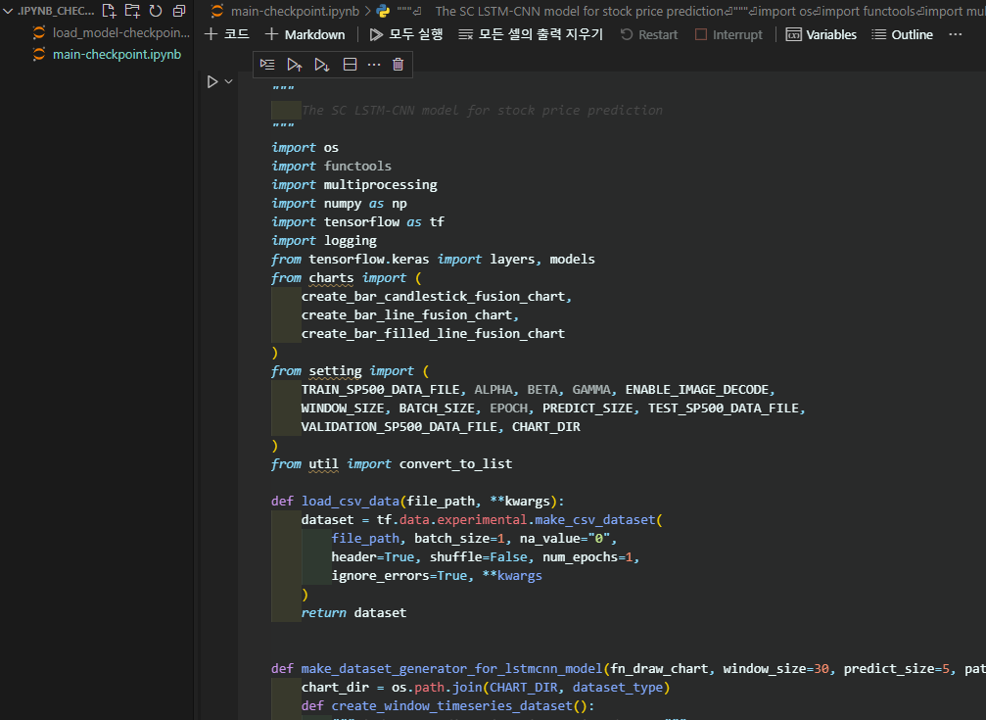
The author's code in .py has been moved to be usable in Jupyter notebooks.

Slide 4
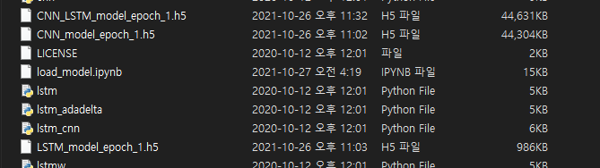
We made epoch = 1 models.
and passed it onto the others.

Slide 5
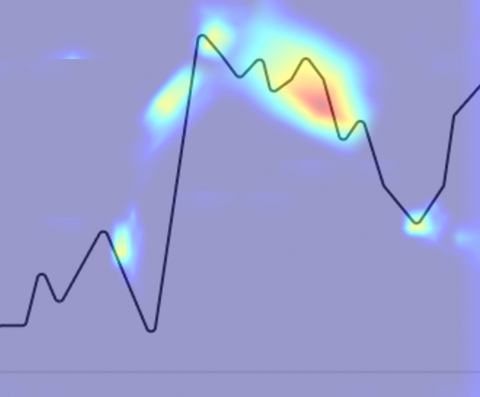
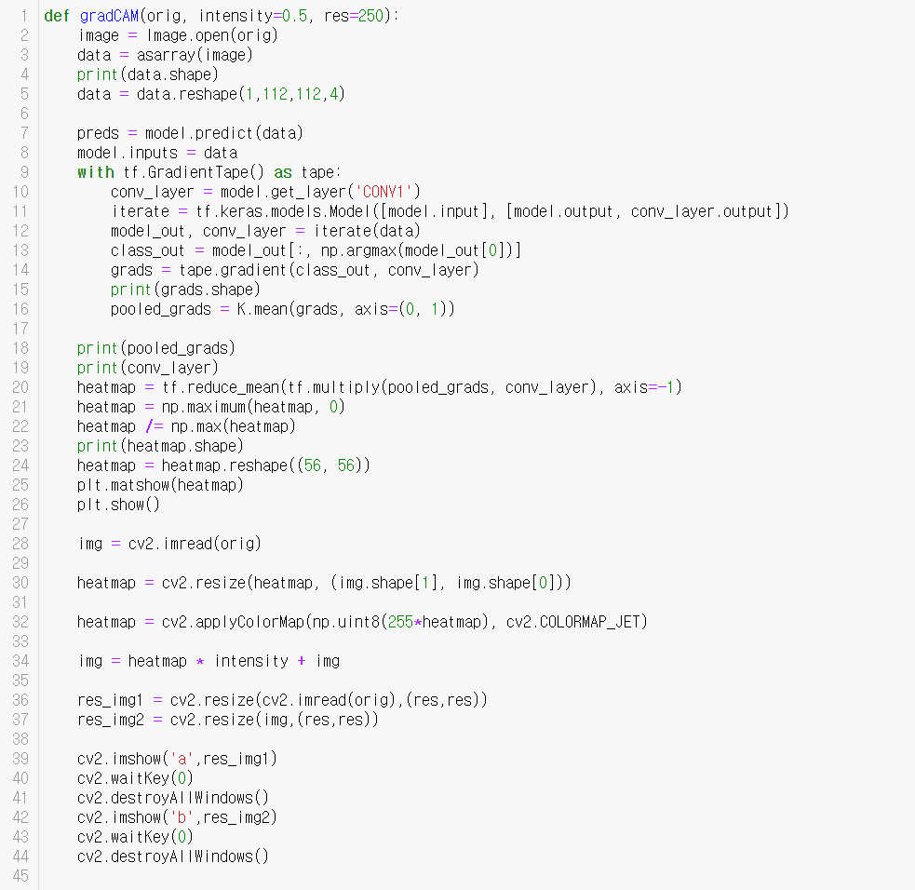
We want to modify the code to find anomaly or make something that displays meaningful sections of the chart.
This is the code we are trying.
But we don't know yet.

Slide 6
References
Kim T, Kim HY (2019) Forecasting stock prices with a feature fusion LSTM-CNN model using different representations of the same data. PLoS ONE 14(2): e0212320. https://doi.org/10.1371/journal.pone.0212320
https://github.com/luanft/lstm-cnn-model

