Slide 1
Dictionary Coding קידוד באמצעות מילון

Slide 2
מקורות
LZ77:
Ziv, J., & Lempel, A. (1977). A universal algorithm for sequential data compression. IEEE Transactions on information theory, 23(3), 337-343.‏
LZSS:
Storer, J. A., & Szymanski, T. G. (1982). Data compression via textual substitution. Journal of the ACM (JACM), 29(4), 928-951.‏
LZ78:
Ziv, J., & Lempel, A. (1978). Compression of individual sequences via variable-rate coding. Information Theory, IEEE Transactions on, 24(5), 530-536.‏
LZW:
Welch, T. A. (1984). A technique for high-performance data compression. Computer, 17(6), 8-19.‏
Presentation partially based upon Lecture Notes on Dictionary Coding
by Dr. Fatima Khalid, Universiti Putra Malaysia (UPM)

Slide 3
Dictionary Coding
Dictionary coding is different from Huffman coding and arithmetic coding.
Both Huffman and arithmetic coding techniques are based on a statistical model (e.g., occurrence probabilities).
In dictionary-based data compression techniques, a symbol or a string of symbols generated from a source alphabet is represented by an index to a dictionary constructed from the source alphabet.

Slide 4
Dictionary Coding
A dictionary is a list of symbols and strings of symbols.
There are many examples of this in our daily lives.
the string “September” vs. “9,”
a social security number vs. a person in the U.S.
Dictionary coding is widely used in text coding.

Slide 5
Dictionary Coding
Consider English text coding.
The source alphabet includes 26 English letters in both lower and upper cases, numbers, various punctuation marks and the space bar.
Huffman or arithmetic coding treats each symbol based on its occurrence probability. That is, the source is modeled as a memoryless source.
It is well known, however, that this is not true in many applications.
In text coding, structure or context plays a significant role.
Very likely that the letter u appears after the letter q.
Likewise, it is likely that the word “concerned” will appear after “As far as the weather is.”

Slide 6
Dictionary Coding
The strategy of the dictionary coding is to build a dictionary that contains frequently occurring symbols and string of symbols.
When a symbol or a string is encountered and it is contained in the dictionary, it is encoded with an index to the dictionary.
Otherwise, if not in the dictionary, the symbol or the string of symbols is encoded in a less efficient manner.

Slide 7
Formulation of Dictionary Coding
Define dictionary coding in a precise manner [bell 1990].
We denote a source alphabet by S.
A dictionary consisting of two elements is defined as ,
P is a finite set of phrases generated from the S,
C is a coding function mapping P onto a set of codewords.

Slide 8
Formulation of Dictionary Coding
The set P is said to be complete if any input string can be represented by a series of phrases chosen from the P.
The coding function C is said to obey the prefix property if there is no codeword that is a prefix of any other codeword.
For practical usage, i.e., for reversible compression of any input text, the phrase set P must be complete and the coding function C must satisfy the prefix property.

Slide 9
Categorization of Dictionary-Based Coding Techniques
The heart of dictionary coding is the formulation of the dictionary.
A successfully built dictionary results in data compression; the opposite case may lead to data expansion.
According to the ways in which dictionaries are constructed, dictionary coding techniques can be classified as static or adaptive.

Slide 10
Static Dictionary Coding
A fixed dictionary,
Produced before the coding process
Used at both the transmitting and receiving ends
It is possible when the knowledge about the source alphabet and the related strings of symbols, also known as phrases, is sufficient.
Merit of the static approach: its simplicity.
Its drawbacks lie on
Relatively lower coding efficiency
Less flexibility compared with adaptive dictionary techniques

Slide 11
Static Dictionary Coding
An example of static algorithms occurs is diagram coding.
A simple and fast coding technique.
The dictionary contains:
all source symbols and
some frequently used pairs of symbols.
In encoding, two symbols are checked at once to see if they are in the dictionary.
If so, they are replaced by the index of the two symbols in the dictionary, and the next pair of symbols is encoded in the next step.
If not, then the index of the first symbol is used to encode the first symbol. The second symbol is combined with the third symbol to form a new pair, which is encoded in the next step.
The diagram can be straightforwardly extended to n-gram. In the extension, the size of the dictionary increases and so is its coding efficiency.

Slide 12
Adaptive Dictionary Coding
A completely defined dictionary does not exist prior to the encoding process and the dictionary is not fixed.
At the beginning of coding, only an initial dictionary exists.
It adapts itself to the input during the coding process.
All adaptive dictionary coding algorithms can be traced back to two different original works by Ziv and Lempel [ziv 1977, ziv 1978].
The algorithms based on [ziv 1977] are referred to as the LZ77 algorithms.
Those based on [ziv 1978] are the LZ78 algorithms.

Slide 13
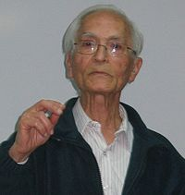
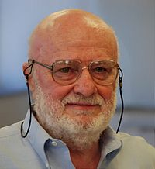
Yaacov Ziv
Avraham Lempel

Slide 14
Parsing Strategy
Once we have a dictionary,
Need to examine the input text and find a string of symbols that matches an item in the dictionary.
Then the index of the item to the dictionary is encoded.
This process of segmenting the input text into disjoint strings (whose union equals the input text) for coding is referred to as parsing.
Obviously, the way to segment the input text into strings is not unique.

Slide 15
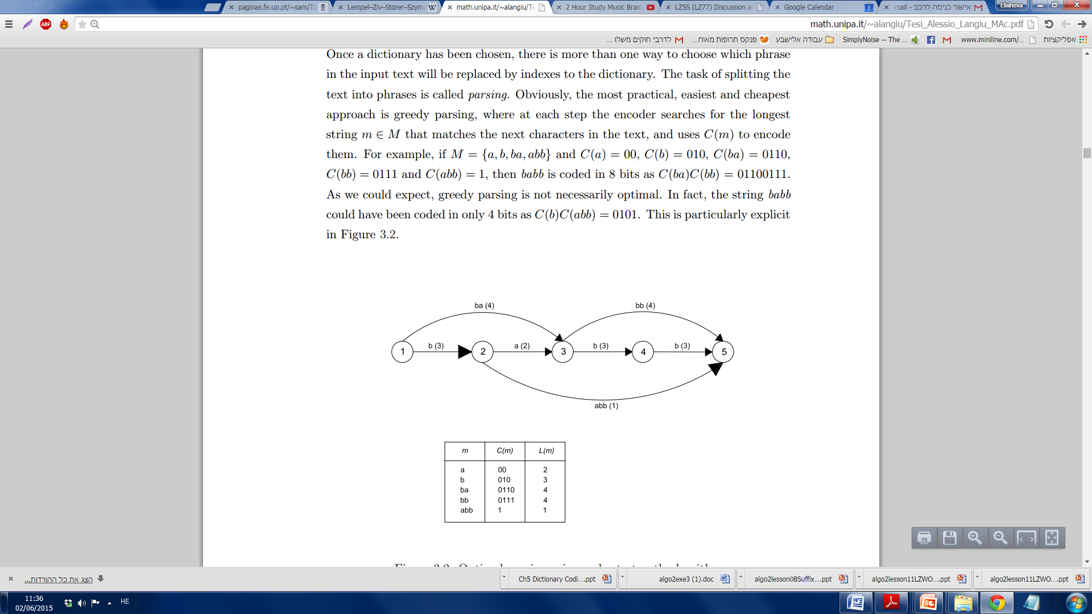
Parsing Strategy Example
Dictionary:
String to encode: babb
Greedy coding: 0110.0111
Optimal coding: 010.1

Slide 16
Parsing Strategy
In terms of the highest coding efficiency, optimal parsing is essentially a shortest-path problem [Bell 1990].
In practice, however, a method called greedy parsing is used in all the LZ77 and LZ78 algorithms.
With greedy parsing, the encoder searches for the longest string of symbols in the input that matches an item in the dictionary at each coding step.
Greedy parsing may not be optimal, but it is simple in implementation.

Slide 17
Parsing Strategy Example
Consider a dictionary, D, whose phrase set is .
The codewords assigned to these strings are
Now the input text: abbaab.
Using greedy parsing, we then encode the text as , which is a 10-bit string: In above representations, the periods are used to indicate the division of segments in the parsing.
This, however, is not an optimum solution. Obviously, the following parsing will be more efficient, i.e., , which is a 6- bit string:

Slide 18
Sliding Window (LZ77) Algorithms
Introduction
The dictionary used is actually a portion of the input text, which has been recently encoded.
The text that needs to be encoded is compared with the strings of symbols in the dictionary.
The longest matched string in the dictionary is characterized by a pointer (sometimes called a token), which is represented by a triple of data items: <offset, length, next symbol>
Note that this triple functions as an index to the dictionary.
In this way, a variable-length string of symbols is mapped to a fixed-length pointer.

Slide 19
Introduction
There is a sliding window in the LZ77 algorithms. The window consists of two parts: a search buffer and a look-ahead buffer.
The search buffer contains: the portion of the text stream that has recently been encoded --- the dictionary.
The look-ahead buffer contains: the text to be encoded next.
The window slides through the input text stream from beginning to end during the entire encoding process.
The size of the search buffer is much larger than that of the look-ahead buffer.
The sliding window: usually on the order of a few thousand symbols.
The look-ahead buffer: on the order of several tens to one hundred symbols.

Slide 20
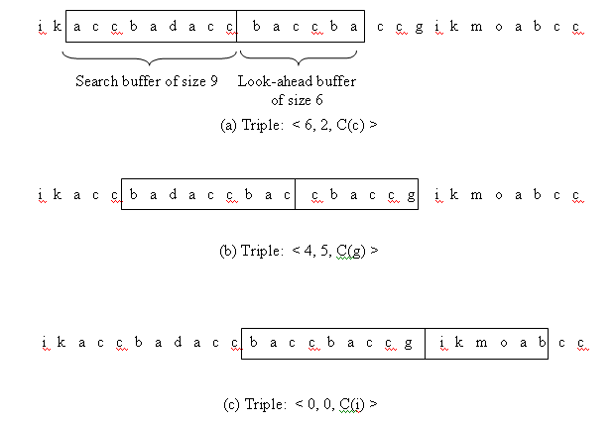
Encoding Example

Slide 21
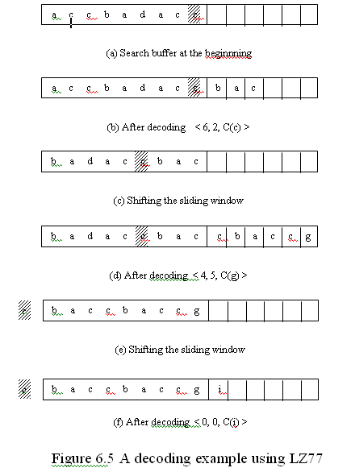
Decoding Example
<6,2,c>
<4,5,g>
<0,0,i>
baccbaccgi

Slide 22
Summary of the LZ77 Approach
The first symbol in the look-ahead buffer is the symbol or the beginning of a string of symbols to be encoded at the moment. Let us call it the symbol s.
In encoding, the search pointer moves to the left, away from the symbol s, to find a match of the symbol s in the search buffer. When there are multiple matches, the match that produces the longest matched string is chosen. The match is denoted by a triple <i, j, k>.

Slide 23
Summary of the LZ77 Approach
The first item in the triple, “i”, is the offset, which is the distance between the pointer pointing to the symbol giving the maximum match and the symbol s.
The second item, “j”, is the length of the matched string.
The third item, “k”, is the codeword of the symbol following the matched string in the look-ahead buffer.
At the very beginning, the content of the search buffer can be arbitrarily selected. For instance, the symbols in the search buffer may all be the space symbol.

Slide 24
Summary of the LZ77 Approach
Denote the size of the search buffer by SB, the size of the look-ahead buffer by L and the size of the source alphabet by A. Assume that the natural binary code is used. Then we see that the LZ77 approach encodes variable-length strings of symbols with fixed-length codewords.
Specifically, the offset “i” is of coding length ,
the length of matched string “j” is of coding length ,
and the codeword “k” is of coding length .

Slide 25
Summary of the LZ77 Approach
The length of the matched string is equal to
because the search for the maximum matching can enter into the look-ahead buffer.
The decoding process is simpler than the encoding process since there is no comparison involved in the decoding.
The most recently encoded symbols in the search buffer serve as the dictionary used in the LZ77 approach. The merit of doing so is that the dictionary is adapted to the input text well.

Slide 26
Summary of the LZ77 Approach
The limitation of the approach is that if the distance between the repeated patterns in the input text stream is larger than the size of the search buffer, then the approach cannot utilize the structure to compress the text.
A window with a moderate size, say, , can compress a variety of texts well. Several reasons have been analyzed in [bell 1990].
Many variations have been made to improve coding efficiency of the LZ77 approach.

Slide 27
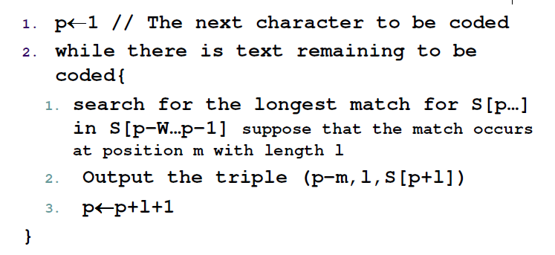
LZ77 Encoding Pseudocode

Slide 28
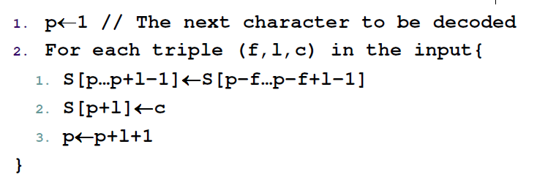
LZ77 Decoding Pseudocode

Slide 29
Disadvantages of the LZ77 Approach
Performance bottleneck:
When encoding, it has to perform string comparisons against the look-ahead buffer for every position in the text window.
(Decoding time is negligible.)
Using a triplet for no matching, e.g. <0,0,i>

Slide 30
Storer-Szymanski 1982 LZSS: Improving LZ77
If the encoded block is longer than the bock itself, do not encode it!
Allows symbols and pointers to be mixed.
Does not encode next symbol.
Uses a bit flag (0-1) to indicate whether the next code-word is a symbol or a pointer:
<0,offset,length>
<1,symbol>

Slide 31
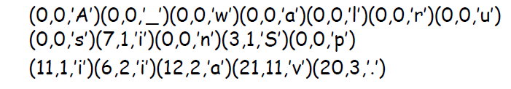
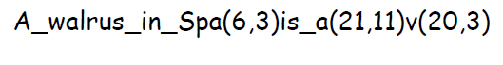
LZSS Example
String:
A_walrus_in_Spain_is_a_walrus_in_vain.
LZ77:
LZSS:
.
מספר הביטים | השיטה
304 | ASCII
289 | LZ77
219 | LZSS
כמה ביטים ידרשו לקידוד לפי LZ77?
כמה לקידוד לפי ASCII רגיל?
כמה לקידוד לפי LZSS?
(נניח מספר ביטים SB:5, L:4, A:8)
LZ77- שיפור של כ- 5% LZSS- שיפור של כ- 28%

Slide 32
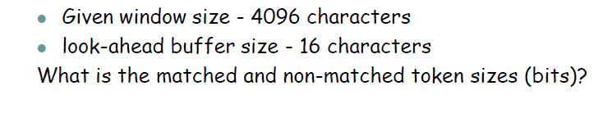
LZSS Exercise

Slide 33
LZ78 Algorithms
Introduction
Limitations with LZ77:
If the distance between two repeated patterns is larger than the size of the search buffer, the LZ77 algorithms cannot work efficiently.
The fixed size of both buffers implies that the matched string cannot be longer than the sum of the sizes of the two buffers, meaning another limitation on coding efficiency.
Increasing the sizes of the search buffer and the look-ahead buffer seemingly will resolve the problems. A close look, however, reveals that it also leads to increases in the number of bits required to encode the offset and matched string length as well as an increase in processing complexity.

Slide 34
Introduction
LZ78:
No use of the sliding window.
Use encoded text as a dictionary which, potentially, does not have a fixed size.
Each time a pointer (token) is issued, the encoded string is included in the dictionary.
Once a preset limit to the dictionary size has been reached, either the dictionary is fixed for the future (if the coding efficiency is good), or it is reset to zero, i.e., it must be restarted.
Instead of the triples used in the LZ77, only pairs are used in the LZ78. Specifically, only the position of the pointer to the matched string and the symbol following the matched string need to be encoded.

Slide 35
LZ78 Encoding Example
String: baccbaccacbcabccbbacc
Index | Coding Pair | Encoded symbols
1 | < 0, b > | b
2 | < 0, a > | a
3 | < 0, c > | c
4 | < 3, b > | cb
5 | < 2, c > | ac
6 | < 3, a > | ca
7 | < 4, c > | cbc
8 | < 2, b > | ab
9 | < 3, c > | cc
10 | < 1, b > | bb
11 | < 5, c > | acc

Slide 36
Encoding and Decoding
Encoding:
In general, as the encoding proceeds, the entries in the dictionary become longer and longer. First, entries with single symbols come out, but later, more and more entries with two symbols show up. After that more and more entries with three symbols appear. This means that coding efficiency is increasing.
Decoding:
Since the decoder knows the rule applied in the encoding, it can reconstruct the dictionary and decode the input text stream from the received pairs.

Slide 37
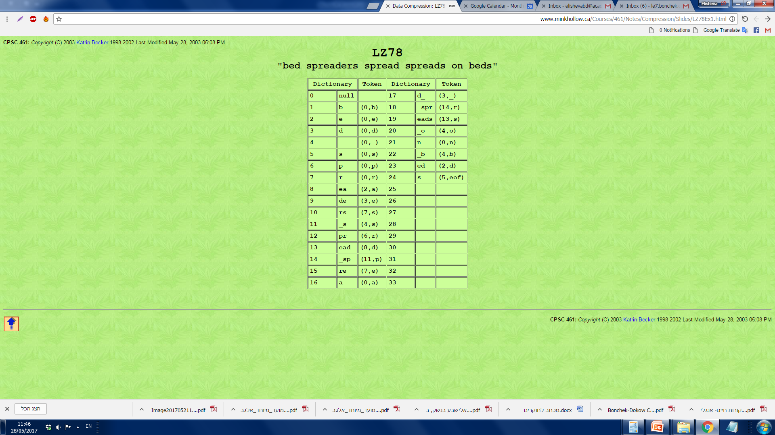
LZ78 Encoding Example
String: bed spreaders spread spreads on beds
© http://www.minkhollow.ca/Courses/461/Notes/Compression/Slides/LZ78Ex1.html

Slide 38
LZW Algorithm
Both the LZ77 and LZ78 approaches, when published in 1977 and 1978, respectively, were theory-oriented.
The effective and practical improvement over the LZ78 in [Welch 1984] brought much attention to the LZ dictionary coding techniques. The resulting algorithm is referred to the LZW algorithm.
It removed the second item in the double (the index of the symbol following the longest matched string) and hence, it enhanced coding efficiency. In other words, the LZW only sends the indexes of the dictionary to the decoder.

Slide 39
LZW Encoding Example 1
String: accbadaccbaccbacc
S={a,b,c,d,}
1.3.3.2.1.4.5.7.11.8.6.14.3
Index | Entry | Input Symbols | Encoded Index
1 2 3 4 | a b c d | Initial dictionary
5 6 7 8 9 10 11 12 13 14 15 16 | ac cc cb ba ad da acc cba accb bac ccb bacc | a c c b a d ac cb acc ba cc bac c | 1 3 3 2 1 4 5 7 11 8 6 14 3

Slide 40
LZW Decoding Example 1
Endcoded string: 1.3.3.2.1.4.5.7.11.8.6.14.3
S={a,b,c,d,}
Initially, the decoder has the same dictionary (the top four rows in the table) as that in the encoder.
Once the first index 1 comes, the decoder decodes a symbol a.
The second index is 3, which indicates that the next symbol is c.
From the rule applied in encoding, the decoder knows further that a new entry ac has been added to the dictionary with an index 5.
The next index is 3. It is known that the next symbol is also c.
It is also known that the string cc has been added into the dictionary as the sixth entry.
In this way, the decoder reconstructs the dictionary and decodes the input text stream.
accbadaccbaccbacc

Slide 41
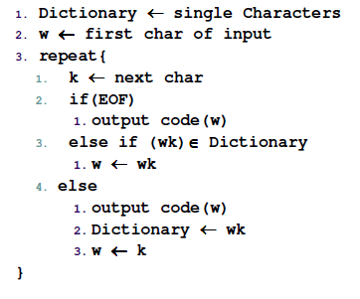
LZW Encoding Pseudocode

Slide 42
LZW Encoding Pseudocode
initialize dictionary with single symbols
w = “”
while( K = GetNextChar )
if ( w + K is in the dictionary )
w = w + K
else
output CODE(w)
add w + K to the dictionary
w = K
Notes:
http://cs.carleton.edu/faculty/jondich/courses/cs337_w02/assignments/lzw.html

Slide 43
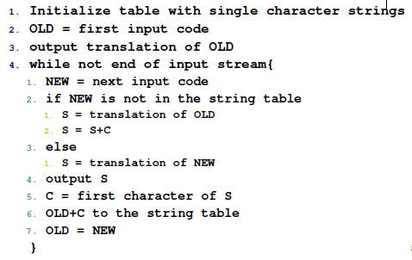
LZW Decoding Pseudocode
*

Slide 44
LZW Decoding Pseudocode
Initialize dictionary D with single symbols
code = GetNextCode
w = D(code)
output w
while( code = GetNextCode )
if( code exists in D )
tmp = w
w = D(code)
add tmp + w[0] to D
else
add w + w[0] to D
w = D(code)
output w
*
Notes:
http://cs.carleton.edu/faculty/jondich/courses/cs337_w02/assignments/lzw.html

Slide 45
LZW Example 2
String: wabba_wabba_woo_woo
S={_,a,b,o,w,}
5.2.3.3.2.1.6.8.11.4.4.1.5.15
Index | Entry | Input Symbols | Encoded Index
1 2 3 4 5 | _ a b o w | Initial dictionary
6 7 8 9 10 11 12 13 14 15 16 17 18 | wa ab bb ba a_ a_w wab bba a_wo oo o_ _w wo | w a b b a _ wa bb a_w o o _ w oo | 5 2 3 3 2 1 6 8 11 4 4 1 5 15

Slide 46
Explaining Case *
There is a single exception to this decompression algorithm:
Suppose there is a string consisting of a string w and a character c (w + c) already defined in the table.
If the input stream sees a sequence of wcwcw, the compression algorithm will produce a code before the decompressor puts it in the table.

Slide 47
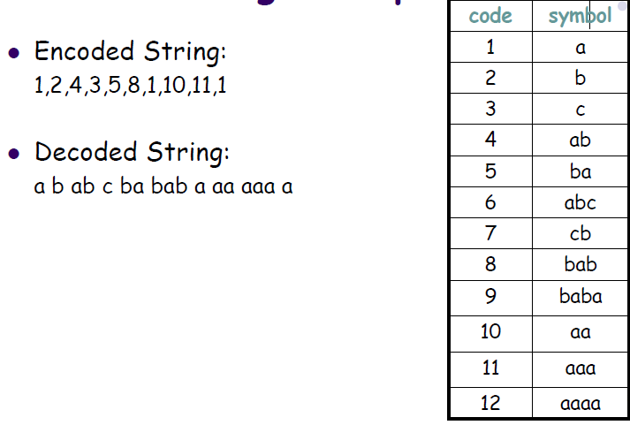
LZW Example 3 *

Slide 48
Comparing LZ Dictionary Coding to Huffman Coding
Huffman Coding is proven to be optimal, for codes that assign a fixed codeword to every symbol.
LZ Dictionary Coding is greedy, and does not promise optimality. In practice, it achieves good compression.
Huffman Coding requires two passes (one for statistical analysis to build the code, and one for encoding).
LZ Dictionary Coding requires one pass- the code is built while encoding.
Huffman Coding has overhead storage- the code tree must be stored with the encoded string.
LZ Dictionary Coding does not require storing the dictionary, it is part of the string.

Slide 49
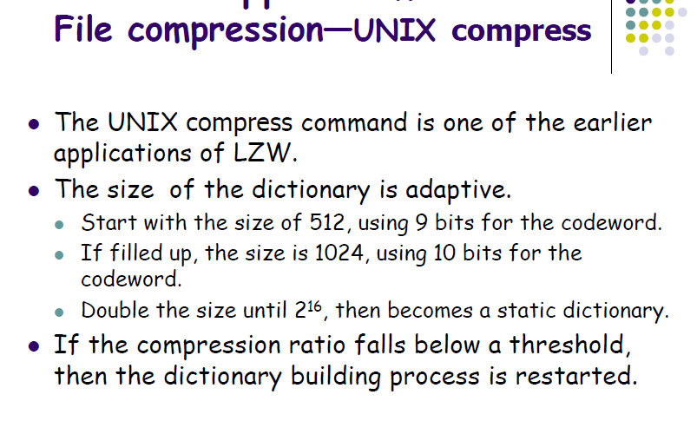
Applications

Slide 50
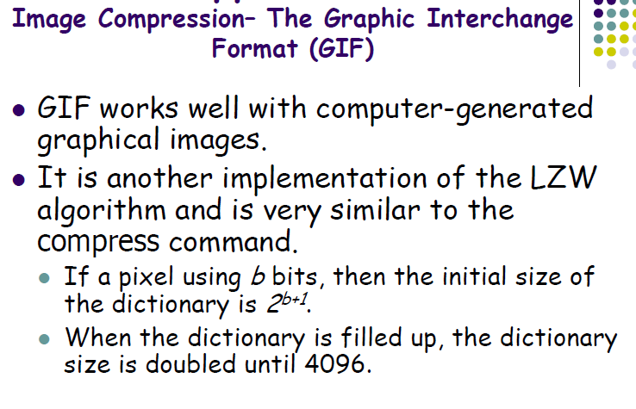
Applications

Slide 51
LZ77 Implementation
LZ77 encoding with Suffix Trees algorithm:
Input: D, dictionary, a m-character string. S, n-character string to encode. Output: LZ77 description of S.
Build an ST for D
Number each node v with cv, the smallest suffix number on v’s sub-tree; cv is the left-most position of D of any copy of the sub-string in the path from the root to v
To get the description (position, length) for sub-string S[i ... m]:
a) Follow the (only) path matching the prefix of S[i ... m]
b) Search ends at point p, with depth depth(p)
c) Output token ( cp, depth(p), S[j] ), with j=i+depth(p).
(position, length, symbol)

Slide 52
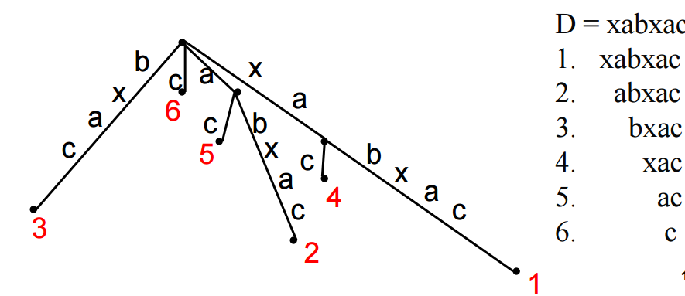
LZ77 Suffix Tree Example

