Slide 1

Development of an AR Plane Wall Color
Yasin Aden, Pau Francino, Boris Llona and Roger Weber

Slide 2
Agenda
The Idea
The Explanation
The Outcome

Slide 3
The IdEA
Braintorming & Evaluating
Educational, Makebility & Effort
Decision: AR Plane Changer

Slide 4
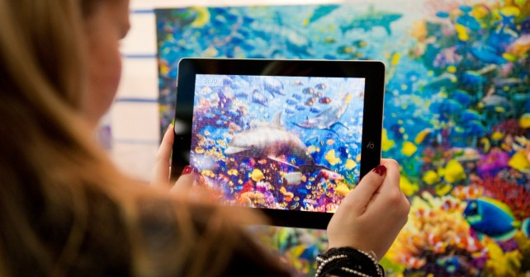
The IDEA

Slide 5
Explanation: THE OBJECTS
Camera
Buttons for user toggling planes
UI
Plane/Wall
Detects vertical planes/walls
Able to change color/pattern based on users needs

Slide 6
EXpLANATION: AR Foundation
AR Foundation
AR Core
AR Core XR Plugin

Slide 7
Plane Detection
AR Camera – main camera
AR Session – Input and lifecycle of application
AR Plane Manager Script – Takes plane prefab and visualize plane
Prefabs: ARPlane, Mesh Visulizer/Collider/Filter/Renderer and Line Renderer
Notes:
The plane prefab visualizes the plane using the following components: AR Plane, AR Plane Mesh visualizer, Mesh collider, Mesh filter and Mesh renderer. We also added a Line renderer to keep track of different planes.

Slide 8
UI
UI Canvas aligning Buttons
Buttons for each color
OnClick event updating Current Mesh Renderer
Notes:
The plane prefab visualizes the plane using the following components: AR Plane, AR Plane Mesh visualizer, Mesh collider, Mesh filter and Mesh renderer. We also added a Line renderer to keep track of different planes.

Slide 9
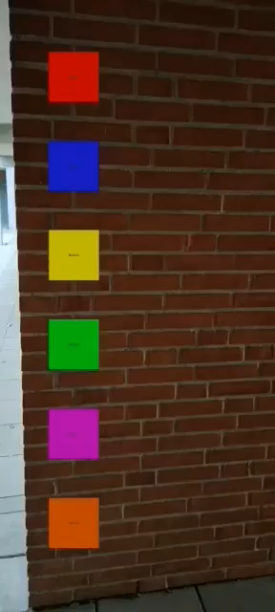
The Outcome
Demonstration
Vertical wall
Buttons for different colors

Slide 10
Thank you very much for listening!
Are there any questions, commends or feedbacks?

