Slide 1
Calorie Consumption During Bicycle Work: A Statistical Analysis of an Incomplete Dataset
Nuno Chicória, Boris Shilov, Murat Cëm Kose, Yibing Liu, Robin Vermote

Slide 2
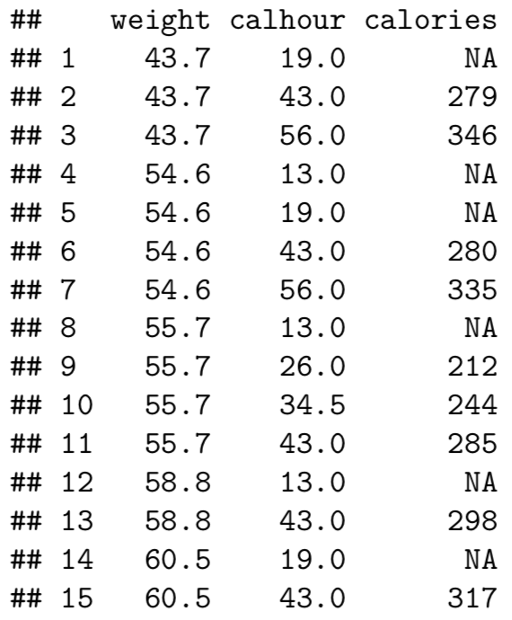
Dataset
24 individuals
Performing work using a bicycle ergometer
Response Variable: heat production (calories)
Explanatory Variables: workout intensity (calhour), weight

Slide 3
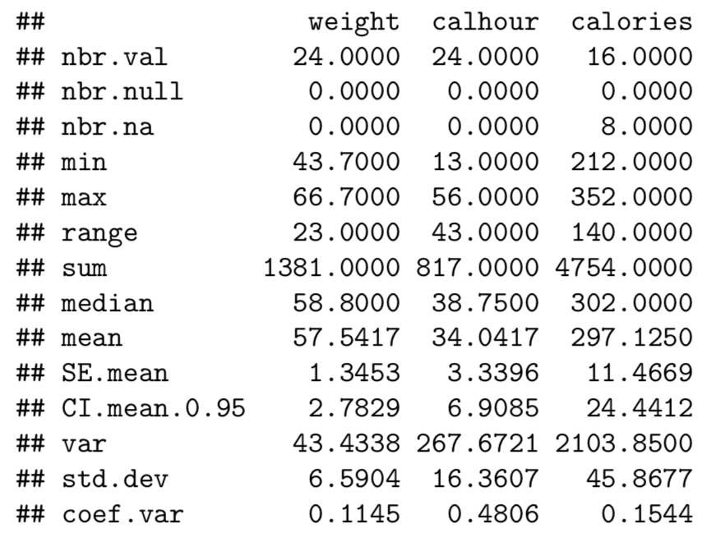
Data Exploration

Slide 4
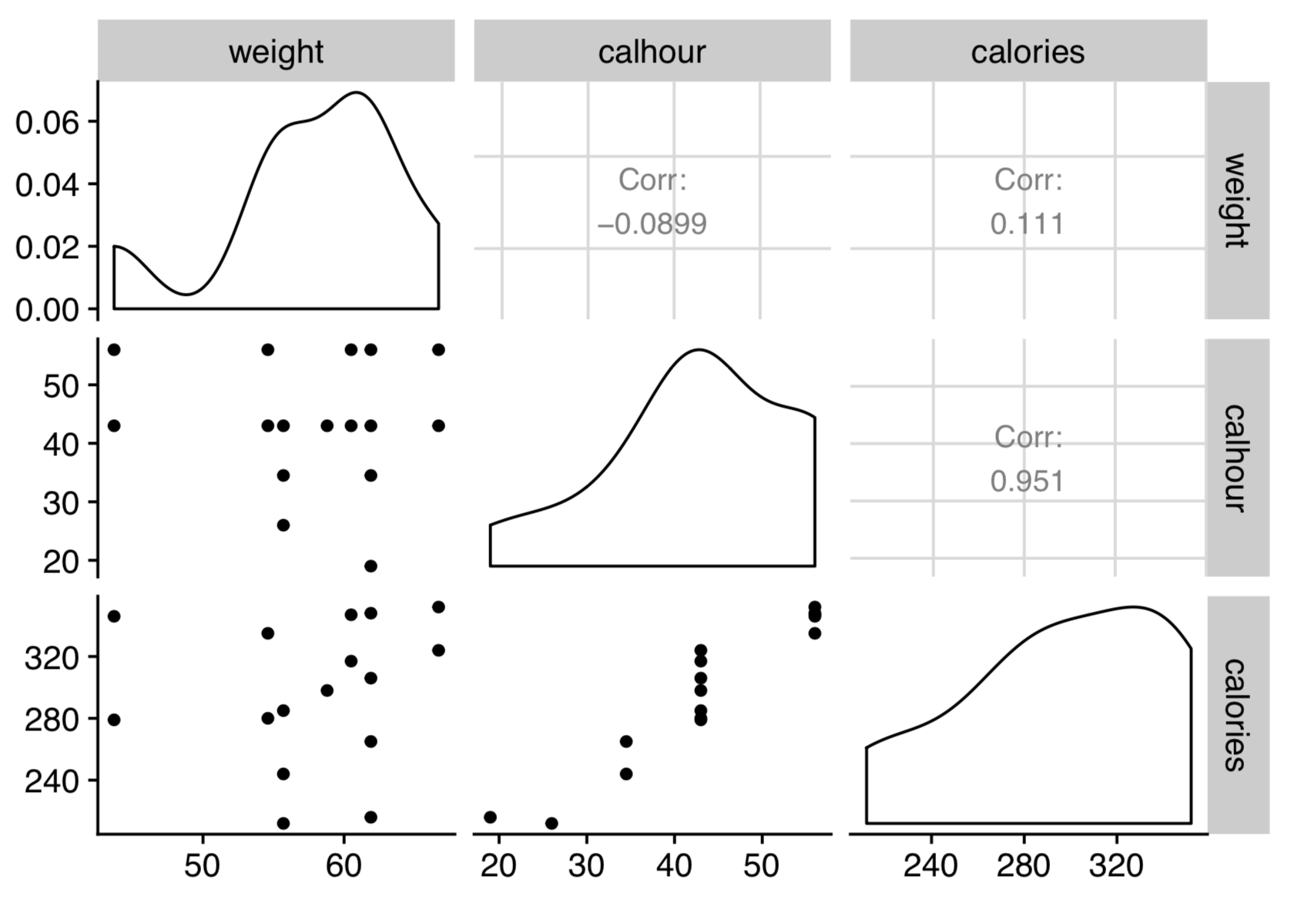
Data Exploration

Slide 5
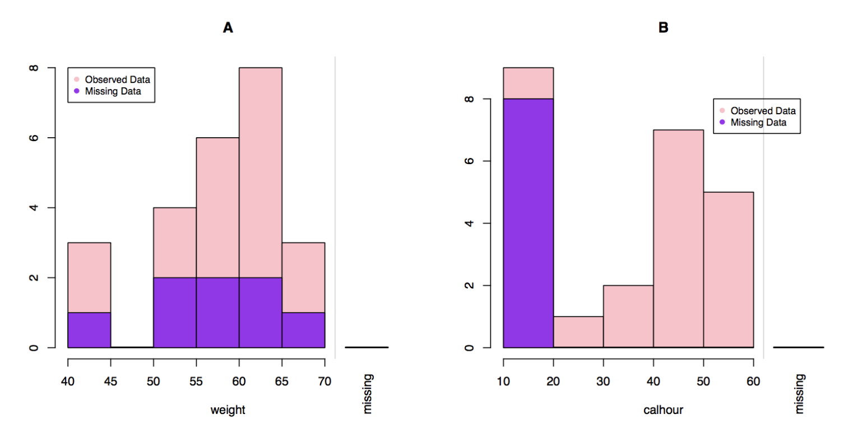
Missing Data Exploration

Slide 6
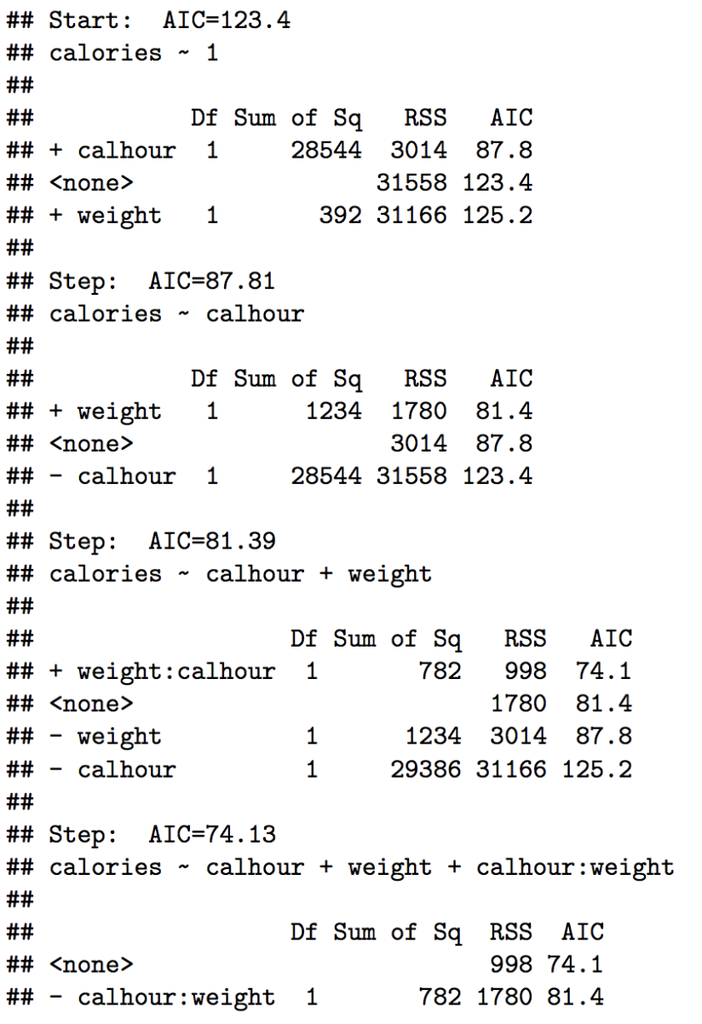
Model Construction

Slide 7
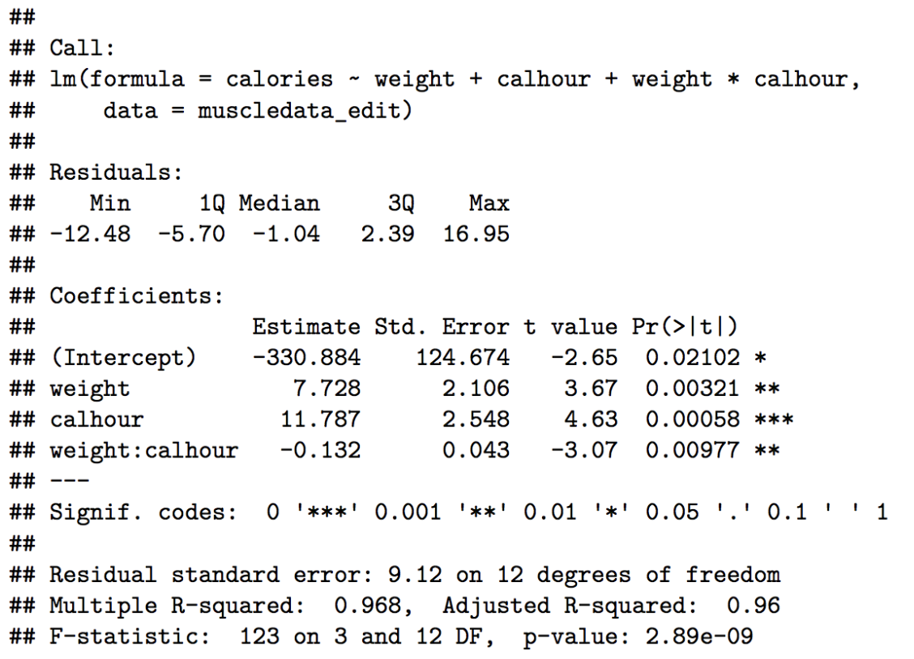
Model Construction (Complete Case)

Slide 8
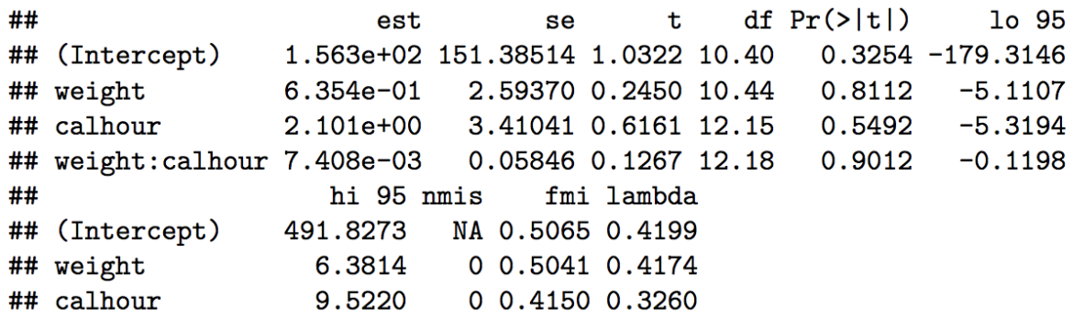
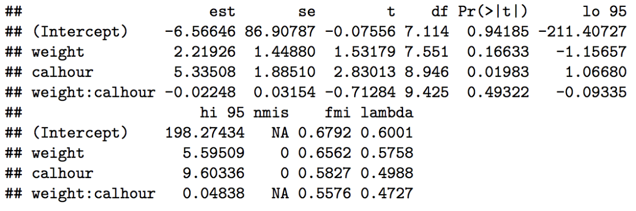
Model Construction (Multiple Imputation)
Predictive Mean Matching
Bayesian Linear Regression

Slide 9
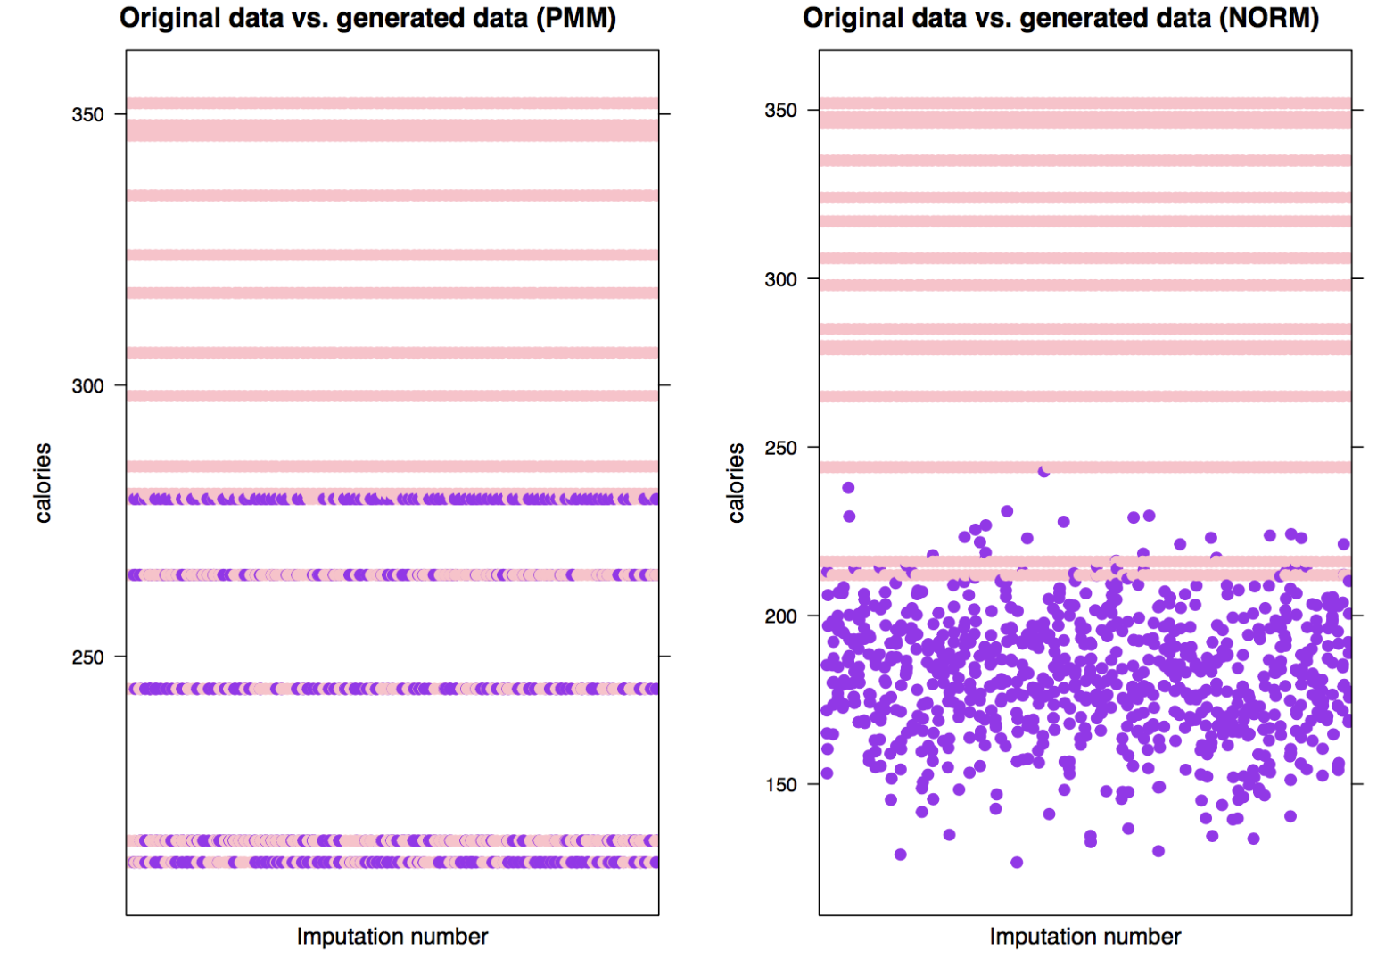
Models Comparisons (MI PMM vs MI NORM)

Slide 10
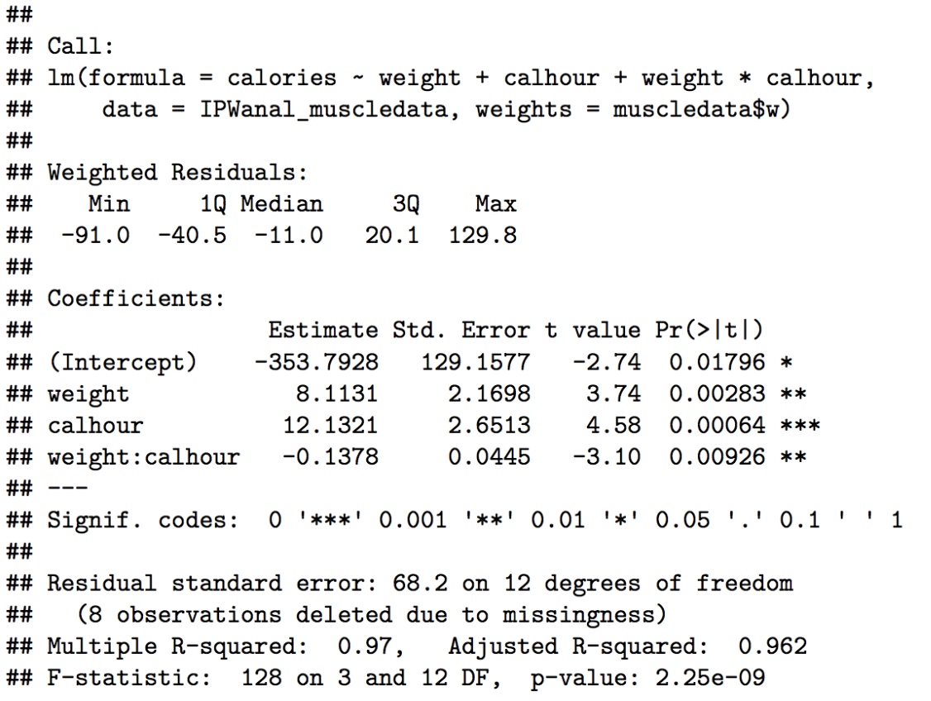
Model Construction (IPW)

Slide 11
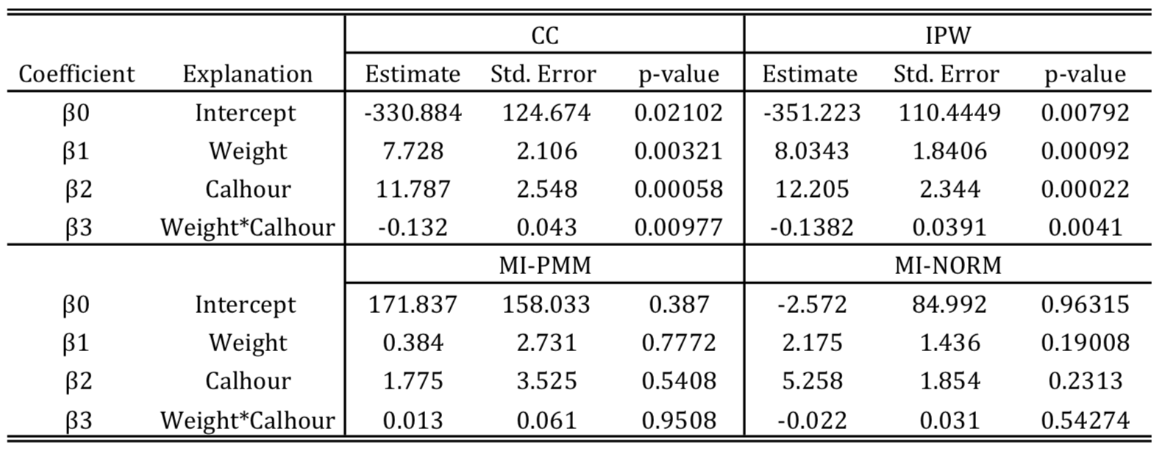
Models Summary

Slide 12
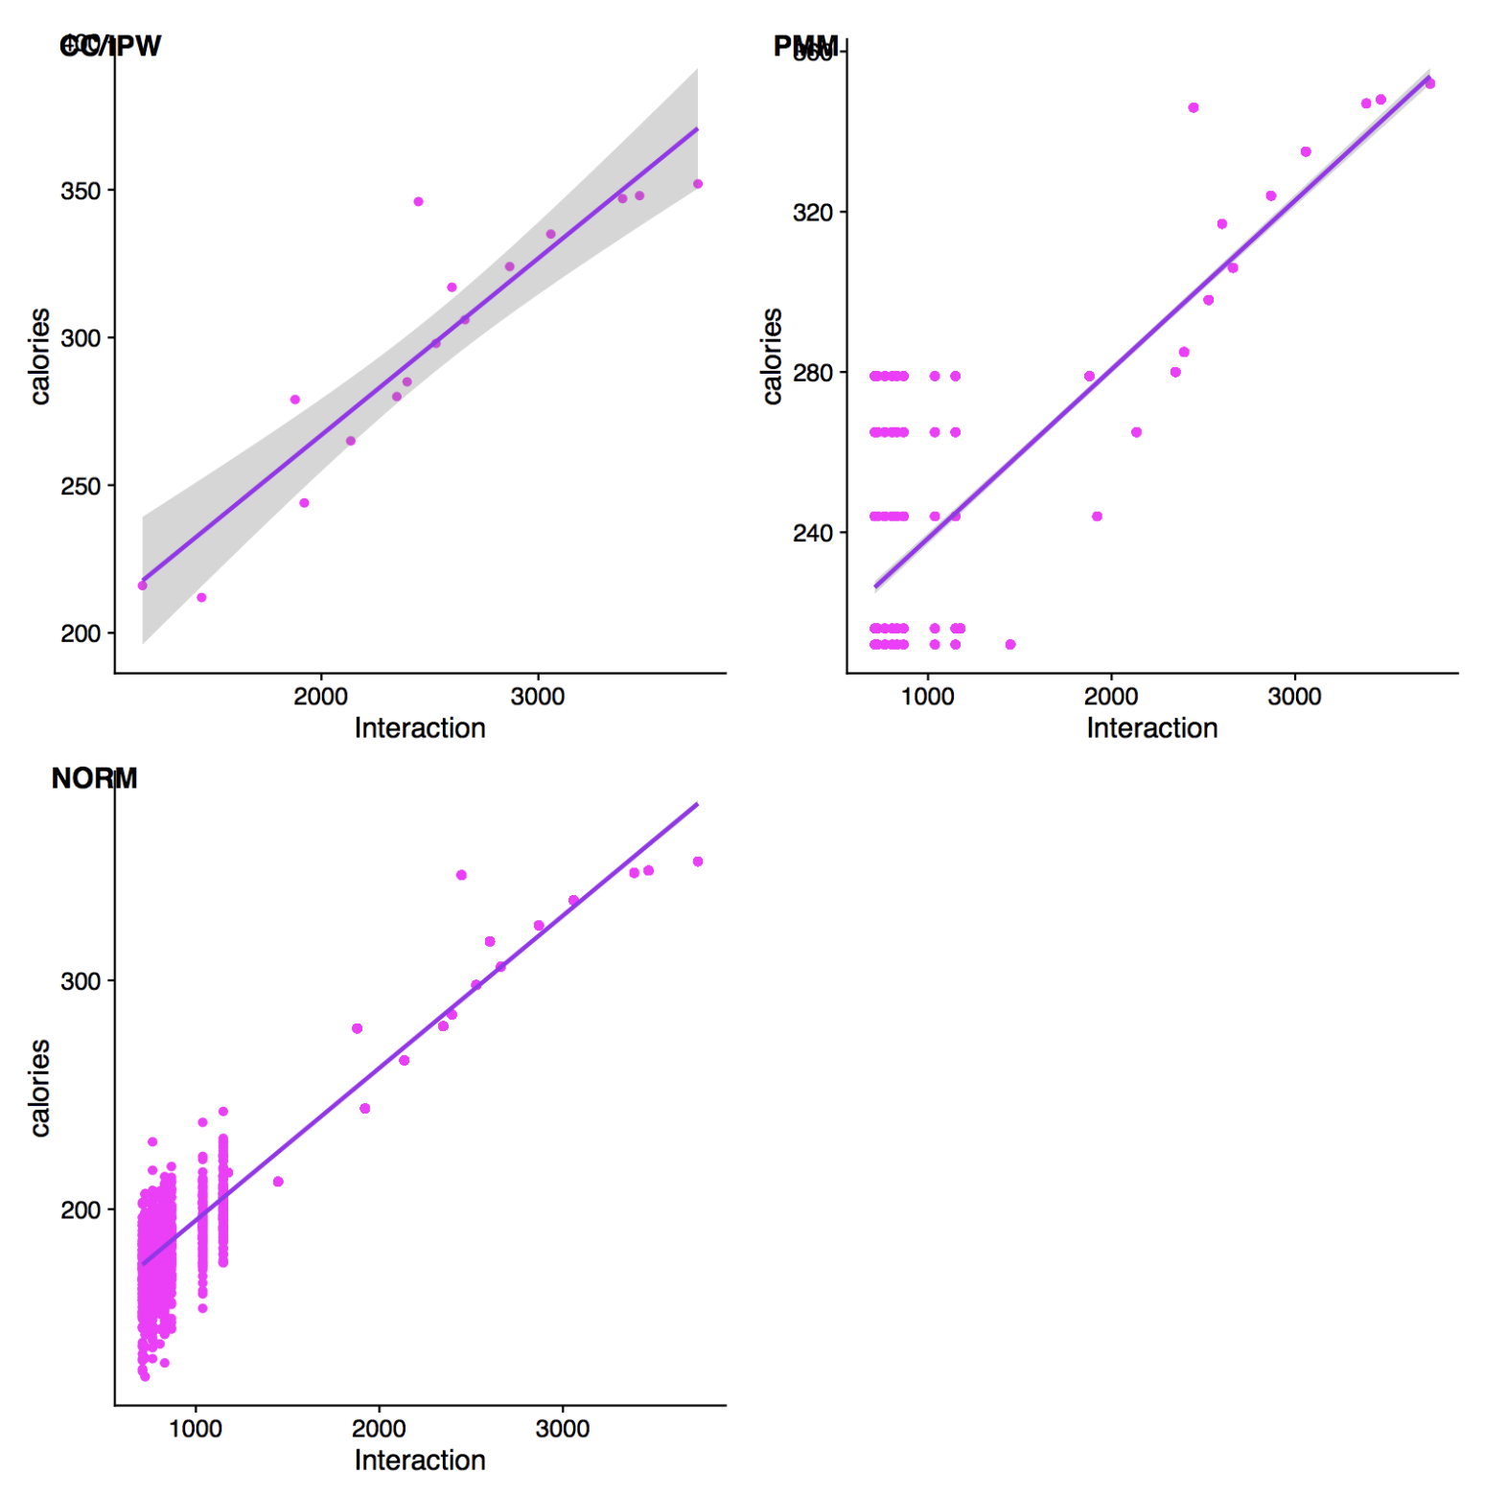
Models Comparisons (Interaction vs Calories)

Slide 13
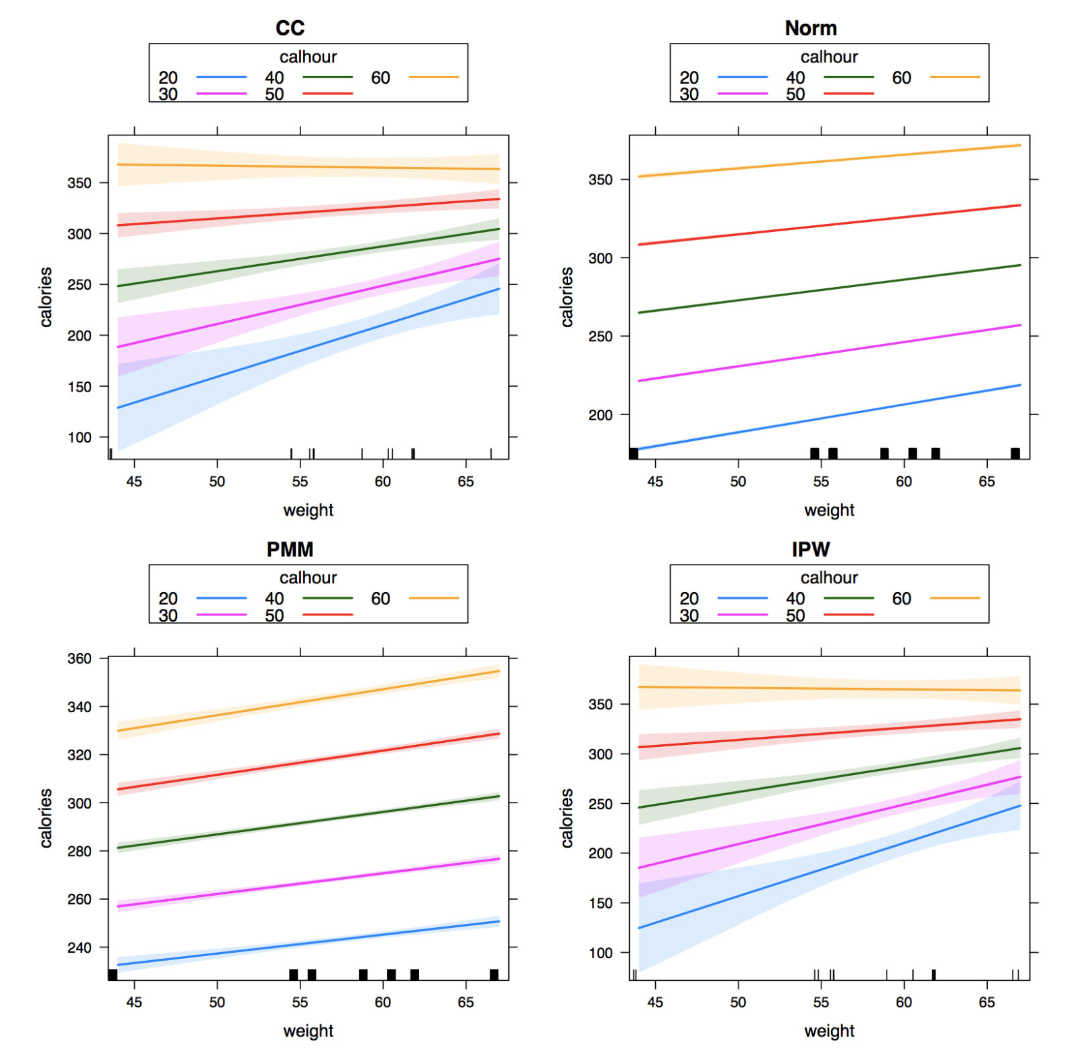
Model Comparisons (Interaction Effect)

Slide 14
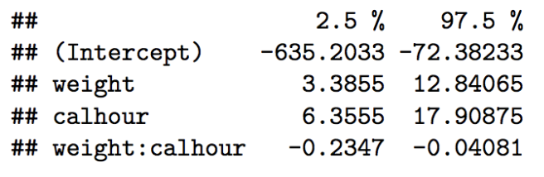
Final Model
Confidence Intervals

