Slide 1

Python Scripting for ParaView
Utkarsh Ayachit
Kitware Inc.

Slide 2
Motivation
Scripting
  Makes automation possible
  Used for batch processing
  Only means to visualize on supercomputers
Python
  Cross-platform, easily extensible
  Object-oriented
  Supported by a huge community of avid developers and programmers
  Packages available for different domains eg. scipy, numpy

Slide 3
Compiling ParaView for Python support
CMake Variables
  PARAVIEW_ENABLE_PYTHON: ON
    Must be ON to enable python support
  PARAVIEW_USE_MPI: ON | OFF
    Must be ON for MPI enabled server/pvbatch
  PARAVIEW_BUILD_QT_GUI: ON | OFF
    Must be ON to build the ParaView’s Qt-based UI
Binaries provided on www.paraview.org are built with python support enabled.

Slide 4
Python in ParaView
Standard python interpreter (python)
  Set PYTHON_PATH to directory containing ParaView modules
  Import relevant ParaView modules
ParaView’s python client (pvpython)
  Python interpreter with ParaView initialization plus sets the path to ParaView modules
ParaView’s batch client (pvbatch)
  Same as pvpython without remote server connection capabilities
  Can be run in parallel (using mpirun etc.)
ParaView GUI (paraview)
  GUI provides python shell comparable to pvpython
Python for data processing
  Python Programmable filter

Slide 5
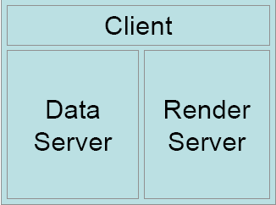
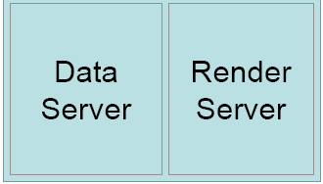
ParaView Configurations
Standalone
(pvpython)
Batch
(pvbatch)

Slide 6
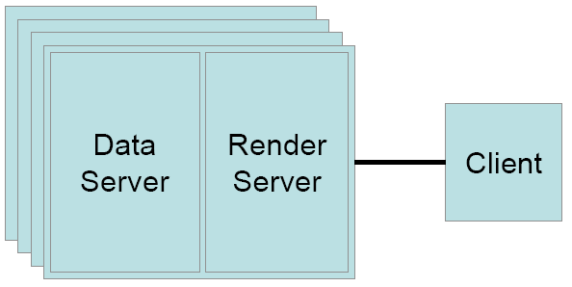
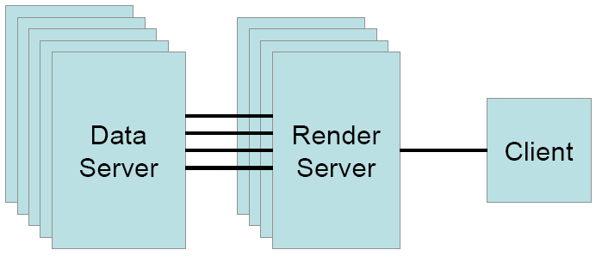
ParaView Configurations
Client – Server
(pvpython + pvserver)
Client – Render Server – Data Server
(pvpython + pvdataserver + pvrenderserver)

Slide 7
Getting started with pvpython
Import ParaView’s python module
>>> from paraview import servermanager
Connect to a server
  For standalone operation (or batch mode)
  >>> servermanager.Connect()
  For additional help on Connect
  >>> help(servermanager.Connect)
  Connect() returns a connection object on success or None on failure

Slide 8
servermanager.Connect()
Connect to pvserver running on amber
>>> connection = servermanager.Connect(“amber”)
Connect to pvdataserver running on amber at port 10234 and pvrenderserver running on destiny at port 10235
>>> connection = servermanager.Connect(“amber”,10234,“destiny”,“10235”)
Sets servermanager.ActiveConnection to the connection object
To disconnect from the server
>>> servermanager.Disconnect()

Slide 9
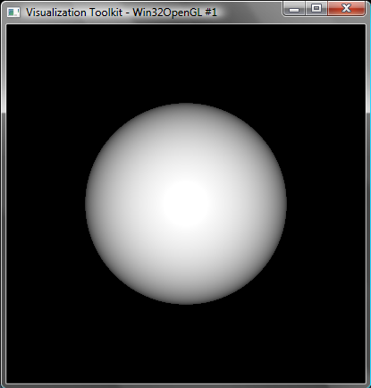
Creating a simple visualization (sphere.py)
Create a sphere
>>> sphere= servermanager.sources.SphereSource()
Create a view to show the sphere
>>> view = servermanager.CreateRenderView()
Show the sphere in the view
>>> repSphere = servermanager.CreateRepresentation(sphere, view)
Render
>>> view.ResetCamera()
>>> view.StillRender()

Slide 10
servermanager sub-modules
servermanager module sub-modules:
  sources – collection of data sources/readers eg. ConeSource, SphereSource, ExodusIIReader etc.
  filters – collection of data processors eg. Cut, Clip, Contour, ShrinkFilter etc.
  rendering – collection of rendering items eg. RenderView, PVLookupTable etc.
  animation – collection of animation components eg. AnimationScene etc.
List all available classes:
>>> dir(servermanager.sources)
Documentation for each class:
>>> help(servermanager.sources.SphereSource)

Slide 11
help(servermanager.sources.SphereSource)
class SphereSource(SourceProxy)
The Sphere source can be used to add a polygonal sphere to the 3D scene. The
output of the Sphere source is polygonal data with point normals defined.
----------------------------------------------------------------------
Data descriptors defined here:
Center
This property specifies the 3D coordinates for the center of the sphere.
EndPhi
The value of this property can be adjusted to form only a portion of a
sphere. The value is measured in degrees.
EndTheta
The value of this property can be adjusted to form only a portion of a
sphere. This value is measured in degrees.
PhiResolution
The value of this property represents the number of divisions between Start
Phi and End Phi on the sphere. (See the Start Phi and End Phi properties.)
The phi divisions are similar to latitude lines on the earth.
…

Slide 12
Changing Parameters
help(obj or class) can be used to obtain the list of available parameters
Getting the current value
>>> param = sphere.Radius
>>> center0 = sphere.Center[0]
Setting a new value
>>> sphere.Radius = 10
>>> sphere.Center[0] = 120.0333
>>> sphere.Center = [120, 130, 121.09]
>>> reprSphere.Representation = “Wireframe”
Parameter values can be specified when instantiating
>>> sphere = servermanager.sources.SphereSource(Radius=10.5,
Center=[10, 10, 10] )

Slide 13
Using Filters
Filters are available in servermanager.filters sub-module
Similar to creating sources, with required Input
>>> shrink = servermanager.filters.ShrinkFilter(Input=sphere)
>>> shrink.ShrinkFactor = 0.8
>>> repShrink = servermanager.CreateRepresentation(shrink, view)
>>> view.StillRender()

Slide 14
More about filters
List available filters
>>> dir(servermanager.filters)
Help about any filter
>>> help(servermanager.filters.Calculator)

Slide 15
Connecting to a particular output port
Connecting to the first output port
>>> shrink.Input = inFilter
>>> shrink.Input = servermanager.OutputPort(inFilter, 0)
Connecting to any other output port
>>> shrink.Input = servermanager.OutputPort(inFilter, 1)

Slide 16
Rendering
Views
  Window to display data in
  servermanager.CreateRenderView() creates a render view suitable for the active connection type
Representations
  Maps the data from a source to a view
  Has parameters that control the appearance eg. LookupTable, Color etc.
  servermanager.CreateRepresentation(source, view) creates representation suitable to show the data produced by the source in the given view
Notes:
Talk about views and representations, some common properties (like visibility)

Slide 17
Color by an array
To color by an array one must do the following:
  Specify the array to color with
  >>> repShrink.ColorAttributeType = “POINT_DATA”
  >>> repShrink.ColorArrayName = “Normals”
  Specify the scalar lookup table to map data to colors
  >>> lut = servermanager.rendering.PVLookupTable()
  >>> repShrink.LookupTable = lut
  Setup data-to-color mapping
    RGBPoints is a list of 4-tuples (scalar value, red, green, blue)
  >>> lut.RGBPoints = [0.0, 0, 0, 1, 1.0, 1, 0, 0]
Notes:
Stuff about LUT and coloring by an array already known

Slide 18
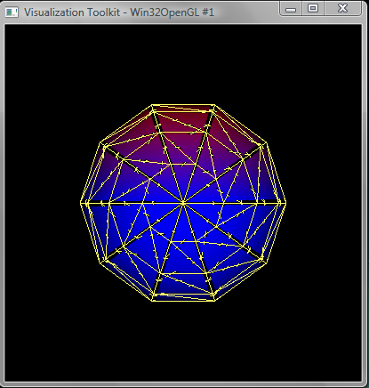
Script with scalar coloring (shrink.py)
…
reprShrink = servermanager.CreateRepresentation(shrink, view)
# Now set up the scalar coloring. We want to color by the 1st component of the
# "Normals" array.
# Choose the attribute type. Acceptable values are "POINT_DATA" (or 0),
# "CELL_DATA" (or 1)
reprShrink.ColorAttributeType = "POINT_DATA"
# Select the name of the array to color with.
reprShrink.ColorArrayName = "Normals"
# Now create a lookup-table to map the scalar values to colors.
lut = servermanager.rendering.PVLookupTable()
lut.RGBPoints = [0.0, 0.0, 0.0, 1.0,
1.0, 1.0, 0.0, 0.0]
# Since we want to color by the 1st component of the normals vector
lut.VectorComponent = 1
lut.VectorMode = "Component" ;# Another acceptable value is "Magnitude" to
# color by vector magnitude.
# Assign the lut to the representation
reprShrink.LookupTable = lut
…

Slide 19
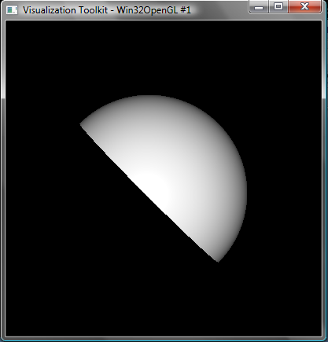
Clipping a dataset (clip.py)
# Create the clip filter
>>> clipper = servermanager.filters.Clip(Input=sphere)
# Create the implicit plane that is used to define the
# clip function
>>> plane = servermanager.implicit_functions.Plane()
>>> plane.Normal = [0.5, 0.5, 0.0]
# Assign the clip function
>>> clipper.ClipFunction = plane
>>> repClip = servermanager.CreateRepresentation(clipper, view)
# Reset camera and render
>>> view.ResetCamera()
>>> view.StillRender()

Slide 20
Data Information
Classes in sources/filters are merely proxies for server-side VTK objects
Data processing is done on the server, hence data is available on the server alone
DataInformation provides an API to obtain information about the data on the client without fetching the entire data to the client
Notes:
Now we don’t know what arrays we have, how to find that out?

Slide 21
Fetching Data Information
Update the source/filter
>>> shrink.UpdatePipeline()
Need to update the source after any changes in parameters
Rendering (view.StillRender()) automatically updates all sources in visible pipelines
Fetch the data information
>>> di = shrink.GetDataInformation()

Slide 22
Data Information Classes
vtkPVDataInformation (http://www.paraview.org/ParaView3/Doc/Nightly/html/classvtkPVDataInformation.html)
  Information about vtkDataObject
vtkPVDataSetAttributesInformation (http://www.paraview.org/ParaView3/Doc/Nightly/html/classvtkPVDataSetAttributesInformation.html)
  Information about attributes associated with points/cells etc.
vtkPVArrayInformation (http://www.paraview.org/ParaView3/Doc/Nightly/html/classvtkPVArrayInformation.html)
  Information about data arrays

Slide 23
Accessing Data Information
Data-type information
>>> di.GetDataSetTypeAsString()
Accessing point attributes
>>> pdi = di.GetPointDataInformation()
Accessing arrays available as point attributes (vtkPVDataSetAttributesInformation)
>>> num_arrays = pdi.GetNumberOfArrays()
Accessing information about an array (vtkPVArrayInformation)
>>> pa = pdi.GetArrayInformation(“Normals”)
>>> pa = pdi.GetArrayInformation(0)
>>> name = pa.GetName()
>>> num_comps = pa.GetNumberOfComponents()
>>> num_tuples = pa.GetNumberOfTuples()
>>> range = pa.GetComponentRange(0) ;# -1 for vector magnitude

Slide 24
Readers
Available in the servermanager.sources sub-module
Specify the filename (or filenames) using the FileName or FileNames parameter
Readers may provides options to select which attribute arrays to load
Soon a method will be available to create choose a reader give the filename. Currently, user has to select which reader to create to read the file
Notes:
Do we add the reader module?

Slide 25
Common Readers
Reader | File Format | Description
PVDReader | *.pvd | ParaView Data Files
XMLUnstructuredGridReader | *.vtu | VTK unstructured grid files (xml)
XMLPUnstructuredGridReader | *.pvtu | Parallel VTK unstructured grid files (xml)
LegacyVTKFileReader | *.vtk | Legacy VTK files
Ensight | *.case | EnSight files
ExodusIIReader | *.ex2, exo .. | Exodus files
Extensive readers list:
http://paraview.org/OnlineHelpCurrent/ParaViewReaders.html

Slide 26
Reading a *.vtk file (readVTKfile.py)
# Create the reader and set the filename.
reader = servermanager.sources.LegacyVTKFileReader(FileNames=filename)
view = servermanager.CreateRenderView()
repr = servermanager.CreateRepresentation(reader, view)
reader.UpdatePipeline()
dataInfo = reader.GetDataInformation()
pointDataInfo = dataInfo.GetPointDataInformation()
arrayInfo = pointDataInfo.GetArrayInformation("displacement9")
if arrayInfo:
range = arrayInfo.GetComponentRange(-1) # get the range for the magnitude of
# displacement9
lut = servermanager.rendering.PVLookupTable()
lut.RGBPoints = [range[0], 0.0, 0.0, 1.0,
range[1], 1.0, 0.0, 0.0]
lut.VectorMode = "Magnitude"
repr.LookupTable = lut
repr.ColorArrayName = "displacement9"
repr.ColorAttributeType = "POINT_DATA"

Slide 27
Reading a file series (readVTKfileSeries.py)
filenames = […]
reader = servermanager.sources.LegacyVTKFileReader(FileNames=filenames)
warpVector = servermanager.filters.WarpVector(Input=reader)
warpVector.SelectInputVectors[4] = "displacement"
view = servermanager.CreateRenderView()
repr = servermanager.CreateRepresentation(warpVector, view)
# This is a helper function to animate over the timesteps provided by the
# reader.
servermanager.AnimateReader(reader, view)

Slide 28
Read an Exodus file (readExodusFile.py)
Create reader
>>> reader = servermanager.sources.ExodusIIReader()
>>> reader.FileName = “…/can.ex2”
Update the reader information: causes the reader to read meta-data from the file
>>> reader.UpdatePipelineInformation()
List available point arrays
>>> reader.PointResultArrayInfo
Property name= PointResultArrayInfo
value=[‘DISPL’, ‘0’, ‘VEL’, ‘0’, ‘ACCL’, ‘0’]
Turn on a few arrays
>>> reader.PointResultArrayStatus = [‘DISPL’, ‘1’, ‘VEL’, ‘1’]

Slide 29
Datasets with Time
Readers which provide time-support have TimestepValues parameter
>>> reader.TimestepValues
Property name= TimestepValues value = [0.0, 0.00010007373930420727, 0.00019990510190837085, ...]
To request a particular time
  reader.SMProxy.UpdatePipeline(time) can be used to force the pipeline to update with the given time
  View has a ViewTime parameter which is the time the view will request from all visible pipelines

Slide 30
Animating through available time steps
>>> reader = servermanager.ExodusIIReader(…)
…
>>> tsteps = reader.TimestepValues
>>> for cur_time in tsteps:
>>> view.ViewTime = cur_time
>>> view.ResetCamera()
>>> view.StillRender()
AnimateReader() can be used to animate through time steps. If optional filename is specified then the animation will be saved out as an avi or a series of images.
>>> servermanager.AnimateReader(reader, view, “c:/temp/movie.png”)

Slide 31
Writers
Available in servermanager.writers sub-module.
Name of the file to write is specified using FileName attribute.
Writers may provide additional attributes eg. DataMode to write ASCII or binary files etc.
Similar to readers, we will soon add API to automatically choose the writer based on the file extension specified.

Slide 32
Common Writers
Reader | File Format | Description
PVDWriter | *.pvd | ParaView Data Files
XMLUnstructuredGridWriter | *.vtu | VTK unstructured grid files (xml)
XMLPUnstructuredGridWriter | *.pvtu | Parallel VTK unstructured grid files (xml)
DataSetWriter | *.vtk | Legacy VTK files
ExodusIIWriter | *.ex2, exo.. | Exodus files
Extensive writers list:
http://paraview.org/OnlineHelpCurrent/ParaViewWriters.html

Slide 33
Writing a file series (writeVTKfileSeries.py)
# Essential to call UpdatePipelineInformation() so that reader reads meta data
# before getting the timestep values.
reader.UpdatePipelineInformation()
timesteps = reader.TimestepValues.GetData()
index = 0
for time in timesteps:
outfile = "/tmp/output%d.vtu" % index
# Update the reader to the current time-step.
warpVector.SMProxy.UpdatePipeline(time);
writer = servermanager.writers.XMLUnstructuredGridWriter(Input = warpVector,\
FileName=outfile)
writer.UpdatePipeline() ;# triggers the writing
index+=1

Slide 34
Accessing data directly
In client-server configurations, the python script is run on the client while the data processing and hence the data is on the server
Generally use DataInformation to obtain information about the data on the client
servermanager.Fetch() can be used to deliver data to the client
Modes of operation for Fetch()
  Append all of the data together and bring it to the client (only available for polygonal and unstructured datasets). Note: Do not do this if data is large otherwise the client will run out of memory.
  Bring data from a given process to the client.
  Use a reduction algorithm and bring its output to the client. For example, find the minimum value of an attribute.

Slide 35
servermanager.Fetch
To fetch the appended data on the client:
>>> data = servermanager.Fetch(source)
To fetch data from a particular processes
>>> dataP1 = servermanager.Fetch(source, 1)
To fetch the sum of values for each attribute arrays
>>> mm =servermanager.filters.MinMax()
>>> mm.Operation = “SUM”
>>> sumdata = servermanager.Fetch(source, mm, mm)
  sumdata is polydata with 1 point (and 1 cell) with cell/point arrays containing the sum of all the values in that array across all the processess.

Slide 36
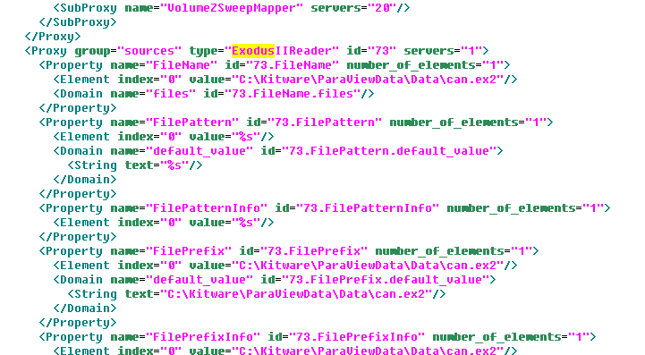
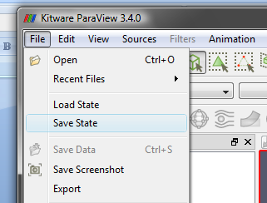
State Files
ParaView state files capture the state of the client including all pipeline objects, their parameter values, animation setup.
State files a human-readable XML files which can be edited for minor tweaking such as changing data file names etc.

Slide 37
Loading state saved from GUI (loadState.py)
servermanager.LoadState(filename)
# Obtain the first render view (for multiple view use GetRenderViews())
view = servermanager.GetRenderView()
view.StillRender()
# ProxyManager is use to access objects created by loading the state file.
pxm = servermanager.ProxyManager()
# Print the list of available sources/filters loaded from the state.
sources_map = pxm.GetProxiesInGroup("sources")
for proxy_name in sources_map.keys():
print proxy_name
# Now we want to change the PhiResolution for the Sphere1
print "Changing Phi and Theta resolution of the sphere to 20."
sphere1 = pxm.GetProxy("sources", "Sphere1")
sphere1.PhiResolution = 20
sphere1.ThetaResolution = 20

Slide 38
Loading state saved from GUI (loadState.py)
# The state file has a animation set up. To play the animation locate the
# animation scene and then simply call Play() on it.
animation_map = pxm.GetProxiesInGroup("animation")
animation_scene = None
for proxy in animation_map.values():
if proxy.GetXMLName() == "AnimationScene":
animation_scene = proxy
if animation_scene:
animation_scene.Play()

Slide 39
Scripting for pvbatch
Same as pvpython except
  It can be run in parallel
  One cannot connect to remote server (only servermanager.Connect() calls are supported)
The python script is run on the 0th node

Slide 40
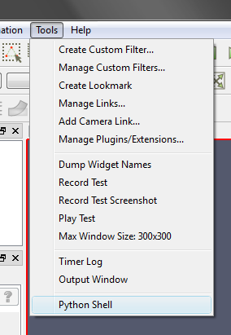
Scripting from within GUI
Things to remember
  Don’t use servermanager.Connect() or servermanager.Disconnect(). All connection related operation have to be done using the GUI
  servermanager.ActiveConnection is automatically setup to refer to the connection made by the GUI
  The python shell and the GUI are both working on the same engine hence changes in one will have effects on the other

Slide 41
Scripting from within GUI (gui.py)
# Create a sphere
sphere = servermanager.sources.SphereSource(PhiResolution=20, ThetaResolution=20)
# Register the sphere so that the GUI can access it through the proxy manager.
servermanager.Register(sphere, registrationName="SphereFromPython")
# Get the first render view in the GUI.
gui_view = servermanager.GetRenderView()
# Show the sphere in that view.
repr1 = servermanager.CreateRepresentation(sphere, gui_view)
# Make the GUI aware of this representation.
servermanager.Register(repr1)
repr1.Representation = "Wireframe“
# Create a new view
view2 = servermanager.CreateRenderView()
servermanager.Register(view2)
repr2 = servermanager.CreateRepresentation(sphere, view2)
servermanager.Register(repr2)
view2.ResetCamera()

Slide 42
Register/UnRegister
Register(object, [registrationGroup=“..”, registrationName=“…”)
  Registers an object so that the GUI becomes aware of it
  registrationName is the name with which the object appears in the GUI
  If registrationGroup is not specified, the group is inferred from the type of the object
  Returns a tuple (group, name) which which the object is registered on success
UnRegister(object, [registrationGroup=“...”, registrationName=“…”)
  Unregisters a previously registered object
  The GUI treats the object as if it were deleted

Slide 43
Saving state from python
State of all those objects that are registered can be saved
Objects not registered are ignored
To be able to load saved state from GUI it is essential that default explicit registrationGroup is not specified.
  >>> servermanager.Connect()
  # Set up pipeline, views etc.
  ….
  # Register all objects
  >>> servermanager.Register(source, ..)
  >>> servermanager.Register(view, …)
  # Save state
  >>> servermanager.SaveState(“…/state.pvsm”)

Slide 44
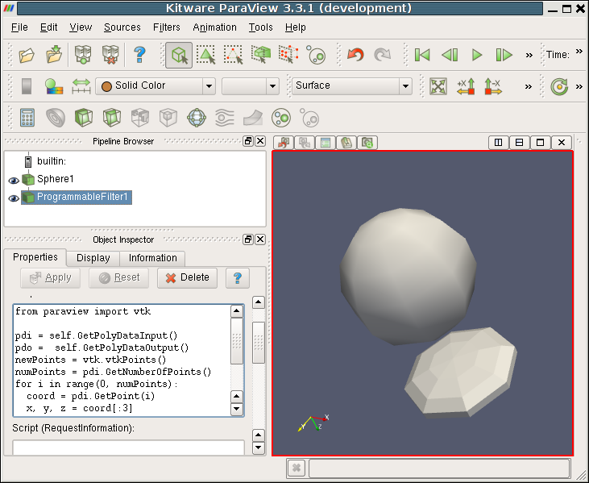
Python Programmable Filter
Used to write custom filters using Python
Python is used to data processing
servermanager module is not accesible either use paraview.vtk or vtk for creating VTK filters etc.
Notes:
TODO: Update image to a recent paraview

Slide 45
Python Programmable Filter
>>> pdi = self.GetPolyDataInput()
>>> pdo = self.GetPolyDataOutput()
>>> newPoints = vtk.vtkPoints()
>>> numPoints = pdi.GetNumberOfPoints()
>>> for i in range(0, numPoints):
>>> coord = pdi.GetPoint(i)
>>> x, y, z = coord[:3]
>>> x = x * 1
>>> y = y * 1
>>> z = 1 + z*0.3
>>> newPoints.InsertPoint(i, x, y, z) pdo.SetPoints(newPoints)

Slide 46
Additional Resources
Python scripting:
  http://www.paraview.org/Wiki/ParaView/Python_Scripting
Python programmable filter:
  http://www.paraview.org/Wiki/Python_Programmable_Filter

Slide 47
Conclusion
Python is the main scripting language for ParaView
Python can be used to write pure client side code as well as for server side data processing (using programmable filter)
paraview.servermanager module provides components used for client-side programming. It also has several demo*() functions which can be used as guidelines for writing custom scripts
paraview.vtk or simply vtk modules are provided for server side python programming. These provide access to VTK classes through python
We are constantly working on improving the scripting API to make is easier to use and more python friendly

