Slide 1

PokemonTool
by Myron Kolodiy and Boris Valerstein

Slide 2
Pokemon
Fictional creatures called Pokemon
The card game
Each Pokemon has a card
Pokemon have
Health Points
Statuses
Burn, Confuse, Poison, Paralysis, Sleep

Slide 3
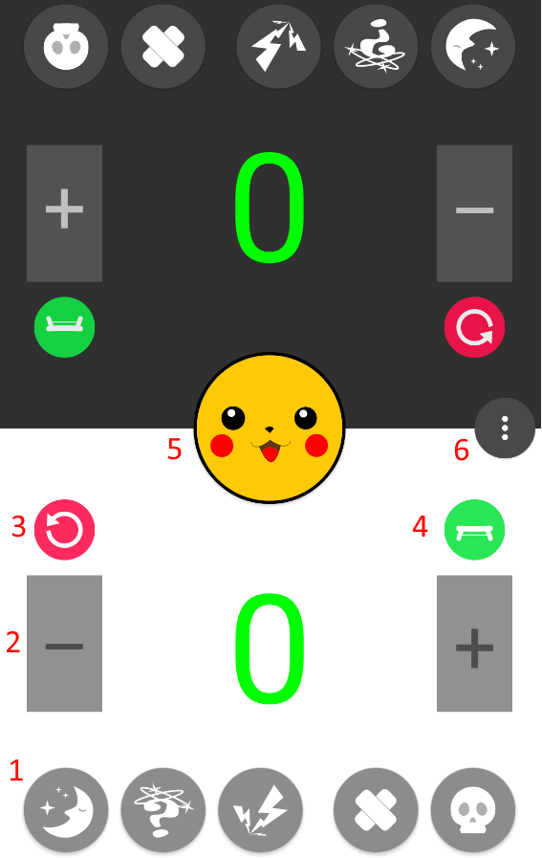
Application
Assist players with Pokemon The Card Game

Slide 4
Features
Status
Health Indicator
Refresh
Bench
Coin Flip
Menu
Database

Slide 5
Database
Record statistics for each status
Counter increase per status toggle
Update database every 5 minutes
To avoid overload
Reset counters

Slide 6
Lessons Learned
Avoid tools without documentation
Git is a powerful collaborative tool
Android development is fun

