Slide 1

PokemonTool
by Myron Kolodiy and Boris Valerstein

Slide 2
Pokémon
Fictional creatures called Pokémon
The card game
Each Pokémon has a card
Pokémon have
Health Points
Statuses
Burn, Confuse, Poison, Paralysis, Sleep

Slide 3
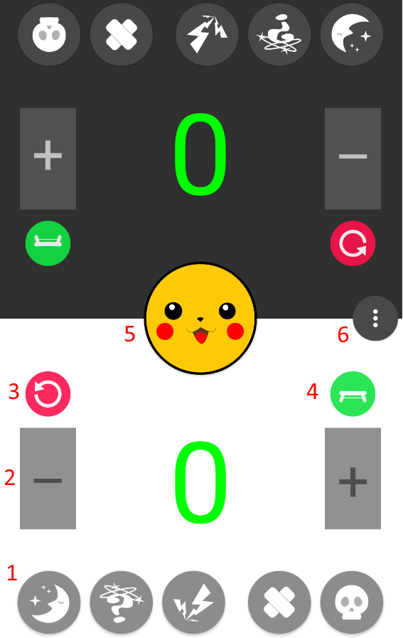
Application
Assist players with Pokémon Trading Card Game

Slide 4
Features
Status
Health Indicator
Refresh
Bench
Coin Flip
Menu
Database

Slide 5
Database
Record statistics for each status
Counter increase per status toggle
Update database every 5 minutes
To avoid overload
Reset counters

Slide 6
Lessons Learned
Avoid tools without documentation
GitHub is a powerful collaborative tool
Android development is fun
Android is established yet evolving system
Perfecting UI is time consuming
Use Fragments
OS may destroy & re-create the running app

