Slide 1
Toptal Devops
node3tierapp project

Slide 2
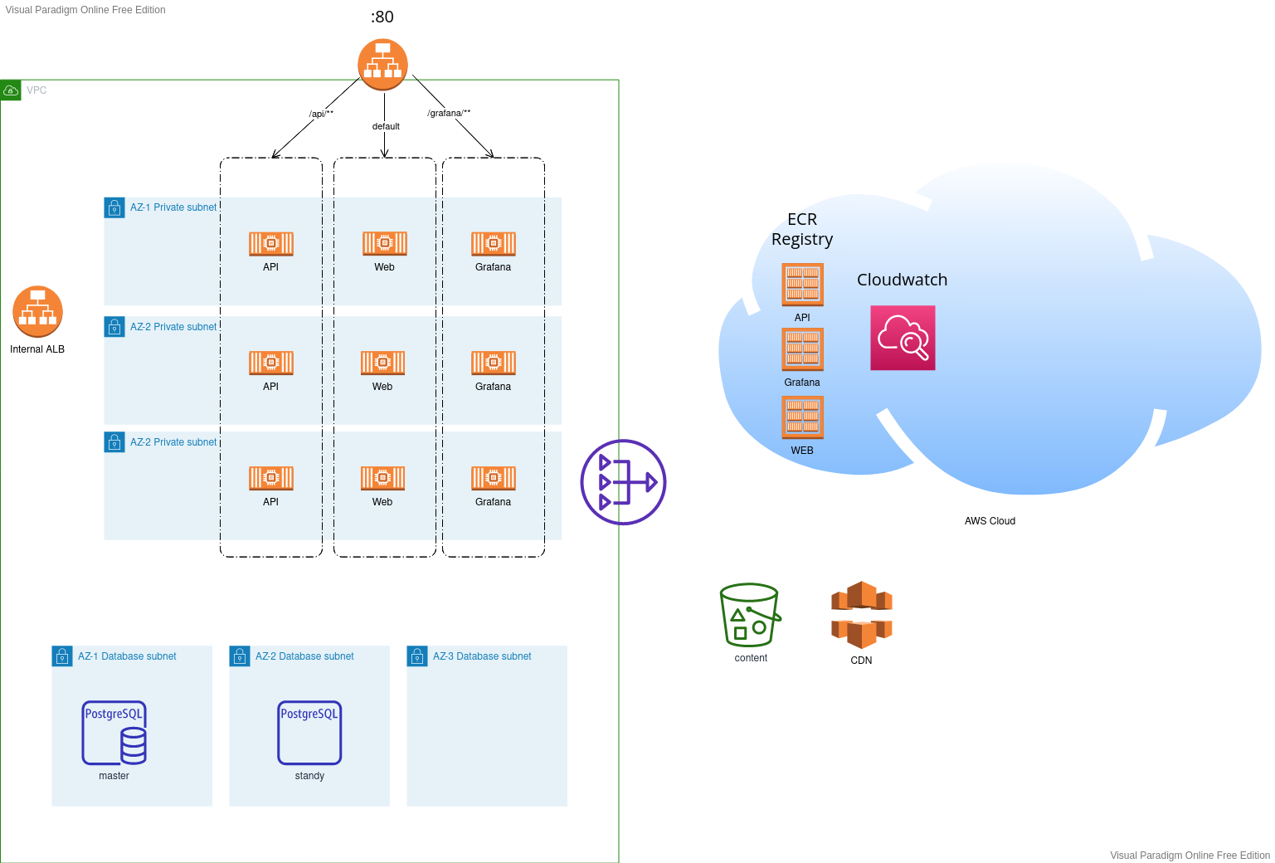
Architecture

Slide 3
GIT Workflow
Tag
Master
rebase/merge
review code
Feature
branch
Commits in master are deployed in DEVELOPMENT
Tags are deployed in STAGING
QA validated tags in staging are deployed to PRODUCTION

Slide 4
Next steps: Domain/HTTPS
Use Custom DNS domain
each env own domain
prod: *.mydomain.com/mydomain.com
stg: *.stg.mydomain.com/stg.mydomain.com
dev: *.dev.mydomain.com/dev.mydomain.com
specific domain for api component
api.dev.mydomain
Create certificates from a well-known authorities, maybe use Let’s encrypt

Slide 5
Next steps: CI/CD
Split pipeline in different github actions jobs
Create staging/production environments
Deploy feature branches of WEB component in custom DNS domain for testing
feature-add-dog-gif.dev.mydomain.com
Add VPC private endpoint to ECR

Slide 6
Next steps: CDN
Implement a cache expiration strategy. Different options to discuss depending on the use case:
Force distribution invalidation
Use different filename on each deployment
Use custom cdn DNS domain, something like cdn.myapp.com using Route 53 alias.

Slide 7
Next steps: Database
Evaluate and implement Point in time restore.
RDS AWS private link

Slide 8
Next steps: Monitoring
Move Grafana to its management VPC
Specific domain for api component
grafana.mydomain
Only allow certain IPs access to monitoring VPC
Add alarms to detect problems in real time

