Slide 1
Valeo Assessment

Slide 2
Problem statement
Given a set of images and masks (annotations) build a model to be able to predict for the testing set.
Produce metrics to assay the project
Data
Images from different cameras around the car:
All same shape
3 channels
FV, MVL, MVR and RV
Annotations for all the images, masks that indicates the presence of a curve
Test set with no annotations
ADDITIONALLY – some calibrations for the inputs.

Slide 3
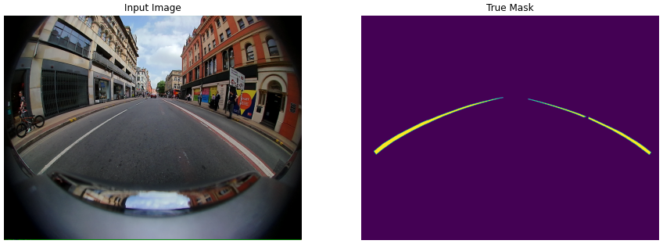
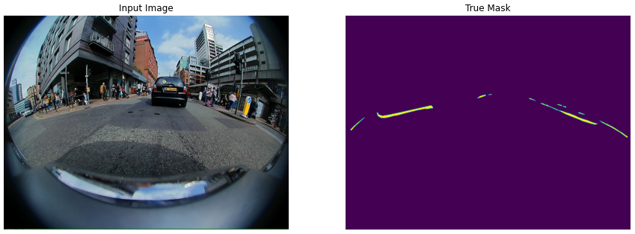
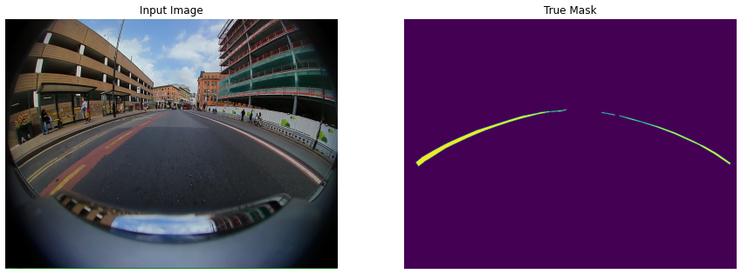
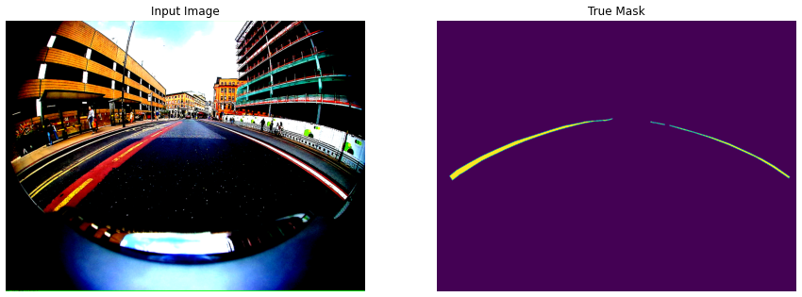
Some Examples

Slide 4
Facing the assessment
First thougths:
“Simple tasks I just need a segmentation model”
“U-Net can do the trick”
“If it takes too long I can reduce both sample size and image resolution”
Hardware constraints:
Own computer, with no GPU Python configuration.
Input reduced – 10000 first images filtered by type of image:
FV (I tested with this ones)
Size reduced:
512x512
256x256
128x128
64x64
32x32
Easy models – tested on pretrained models VGG16 and VGG19
Training:
10 Epochs to produce some results in feasible timw
Reality
“I am sure the problem is easy, but why the *** is not working?”
“Oh… not again pls… logits and labels must have the same shape”
“Let’s add 3 conv blocks, with max pooling and then just use stride to reverse the size… Why the predictions are white masks? 8x8 train images… oups”

Slide 5
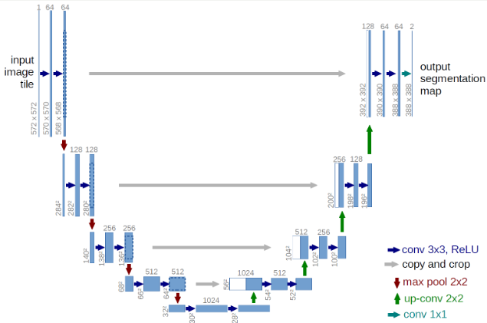
Architecture to face the assessment
U-Net (typical image)
First U-Net structure:
One convolutional block
Two conv layers
n_filters = 2 (default)
3x3 (default)
No padding
No striding
Not dropout
MaxPooling configured but not executed
One upsampling block
Reverse behaviour.
Further iterations I scaled the number of Conv blocks and upsampling blocks.

Slide 6
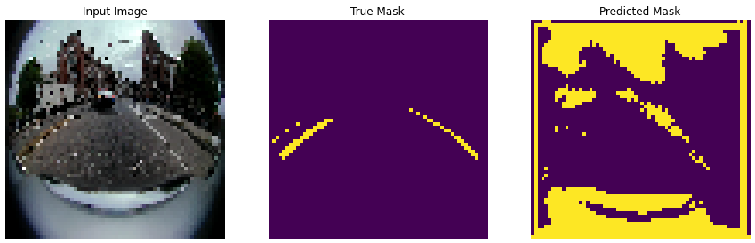
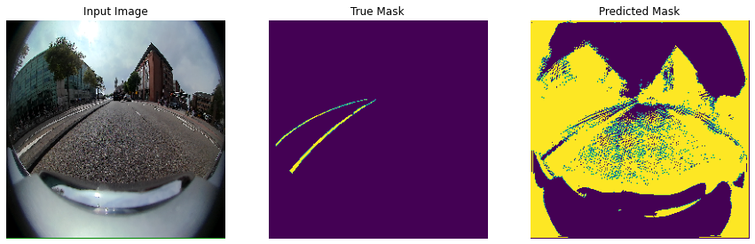
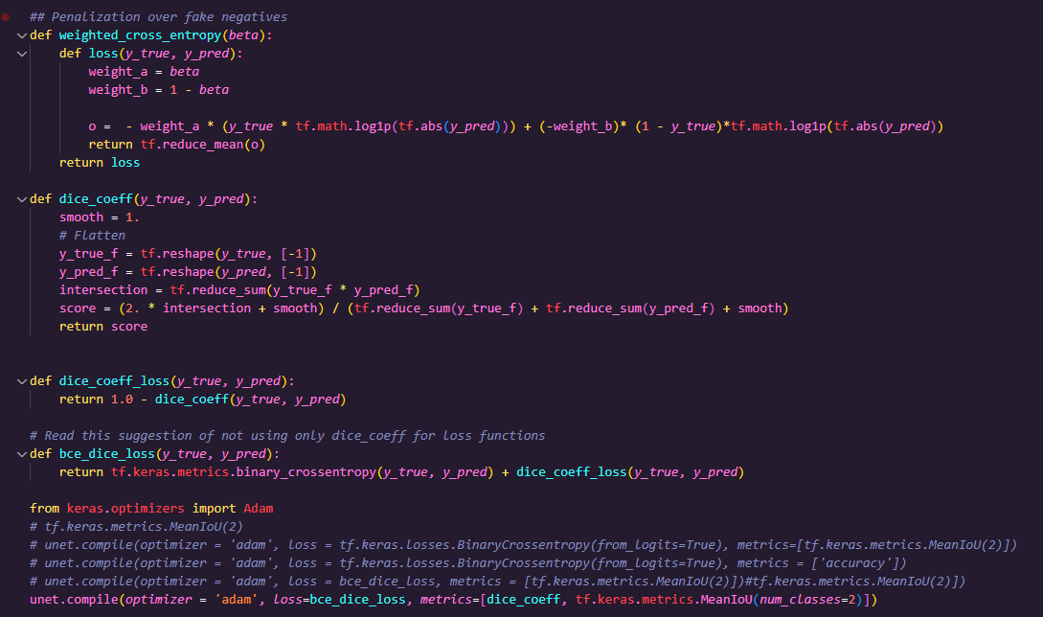
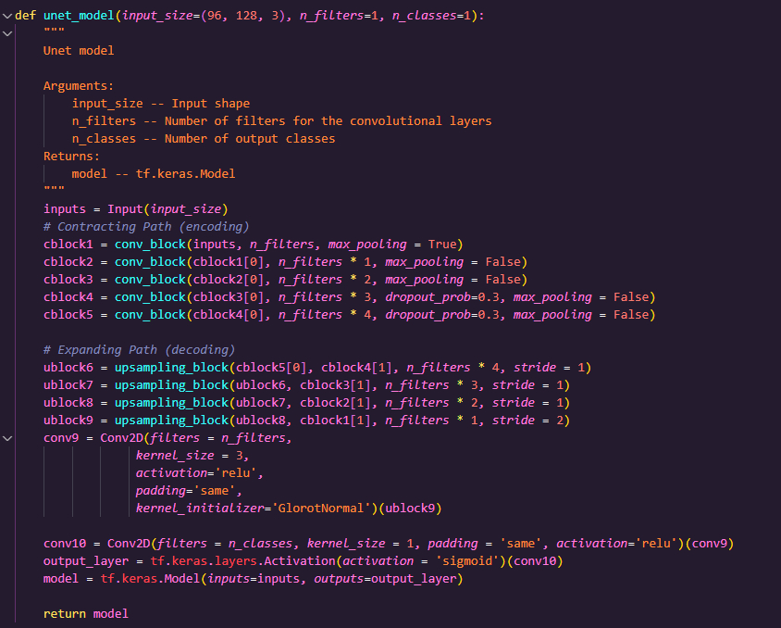
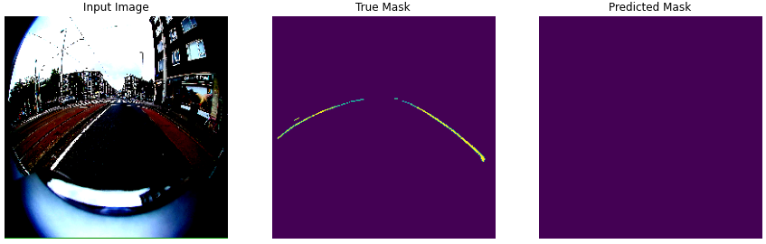
Dice coeff + binary_cross_entropy as loss function
More convolutional blocks

Slide 7
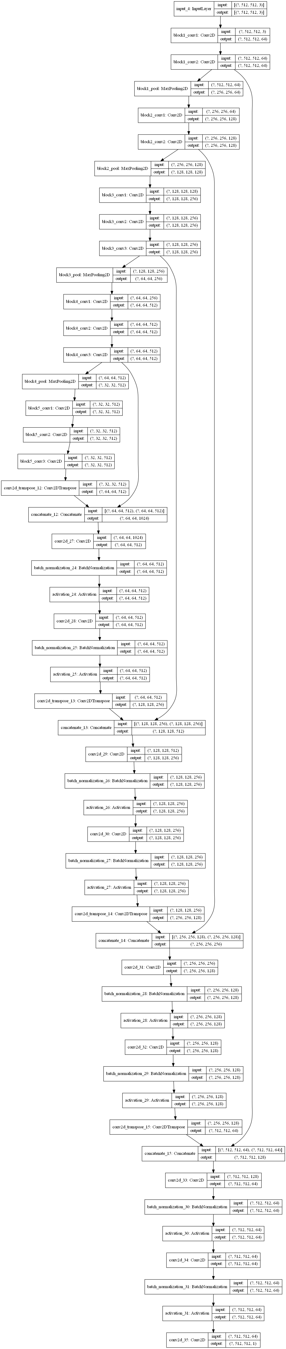
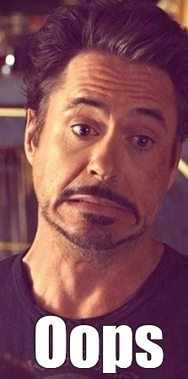
Next clear step
Pretrained model:
https://www.kaggle.com/code/reemrashwan/u-net-to-predict-pneumothorax
VGG16(VGG19) - https://www.kaggle.com/code/basu369victor/transferlearning-and-unet-to-segment-rocks-on-moon/notebook
Unfortunately, both in pure keras and not in tensorflow 2.0

Slide 8
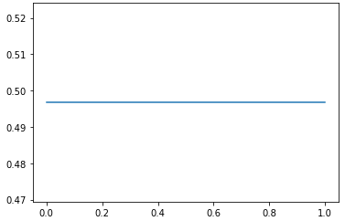
Metrics
Accuracy – oups! Extremely unbalanced dataset, thus not useful even 99% of accuracy means nothing
mIoU – show in a Notebook
Binary problema with mIoU around 50%... Equals nothing.

Slide 9
Thank you very much for the opportunity!!
It was great playing with CV, although my results are terrible.

