Slide 1
Valeo Assessment

Slide 2
Problem statement
Given a set of images and masks (annotations) build a model to be able to predict for the testing set.
Produce metrics to assay the project
Data
Images from different cameras around the car:
All same shape
3 channels
FV …
Annotations for all the images, masks that indicates the presence of a curve
Test set with no annotations
ADDITIONALLY – some calibrations for the inputs.

Slide 3
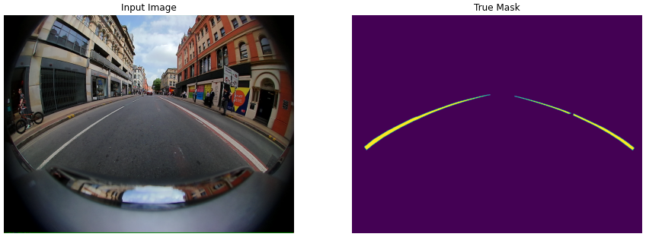
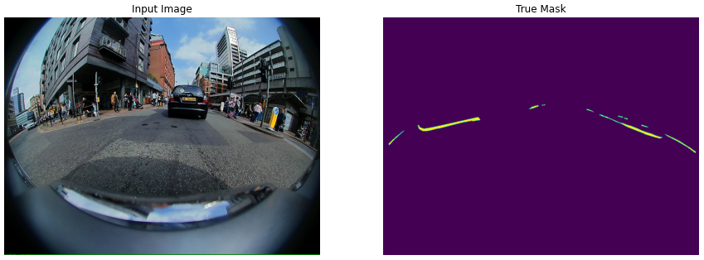
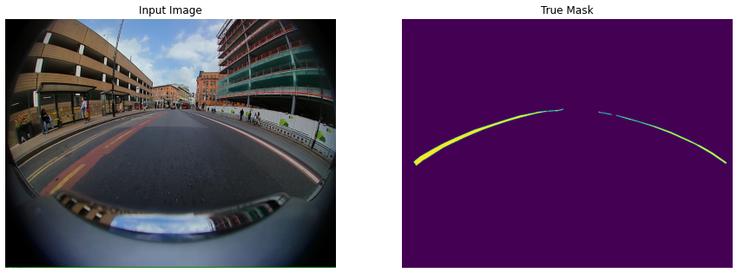
Some Examples

Slide 4
Facing the assessment
First thougths:
“Simple tasks I just need a segmentation model”
“U-Net can do the trick”
“If it takes too long I can reduce both sample size and image resolution”
Hardware constraints:
Own computer, with no GPU Python configuration.
Input reduced – 10000 images
Size reduced:
256x256
128x128
64x64
32x32
Easy models – tested on pretrained models VGG16 and VGG19
Training:
10 Epochs to produce some results in feasible timw
Reality
“I am sure the problem is easy, but why the *** is not working?”
“Oh… not again pls… logits and labels must have the same shape”
“Let’s add 3 conv blocks, with max pooling and then just use stride to reverse the size… Why the predictions are white masks? 8x8 train images… oups”

Slide 5
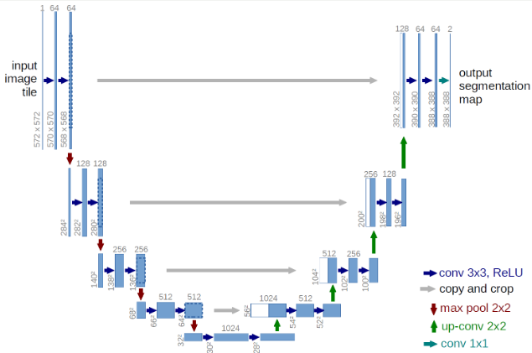
Architecture to face the assessment
U-Net (typical image)
First U-Net structure:
One convolutional block
Two conv layers
n_filters = 8 (default)
3x3 (default)
No padding
No striding
Not dropout
MaxPooling configured but not executed
One upsampling block
Reverse behaviour.
Further iterations I scaled the number of Conv blocks and upsampling blocks.

Slide 6
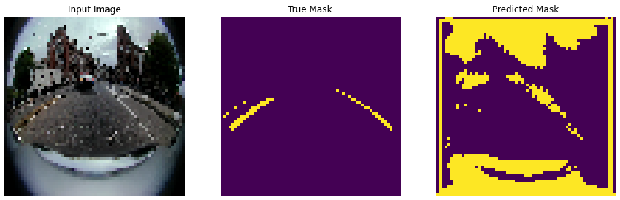
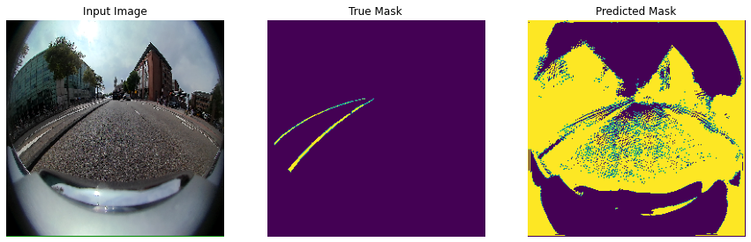

Slide 7
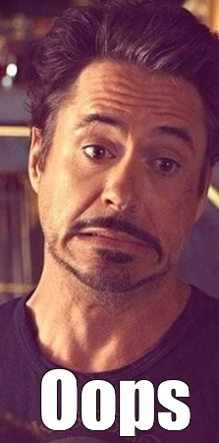

Slide 8
Metrics

Slide 9
Now you can use any emoji as an icon!
And of course it resizes without losing quality and you can change the color.
How? Follow Google instructions https://twitter.com/googledocs/status/730087240156643328
✋👆👉👍👤👦👧👨👩👪💃🏃💑❤😂😉😋😒😭👶😸🐟🍒🍔💣📌📖🔨🎃🎈🎨🏈🏰🌏🔌🔑 and many more...

