Slide 1
STORM SURGE
FORMULATIONS
MEX (local) regression
Surge shoaling equation (a & b)
Parametrical solution based on stationary runs (sims from UNAM)
Quick numerical model, e.g. SLOSH (not in this ppt)
1, 2 and 3 implemented in climada

Slide 2
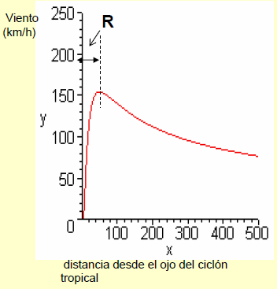
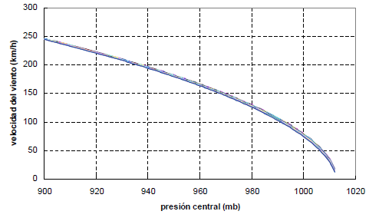



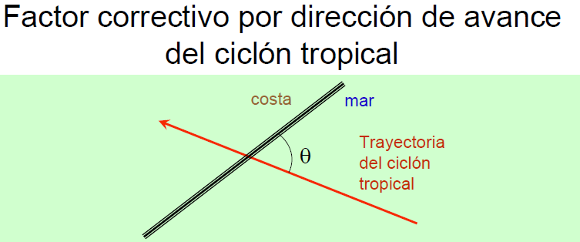
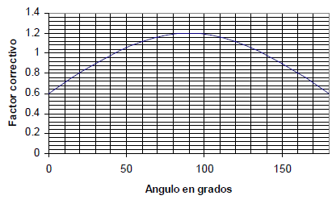
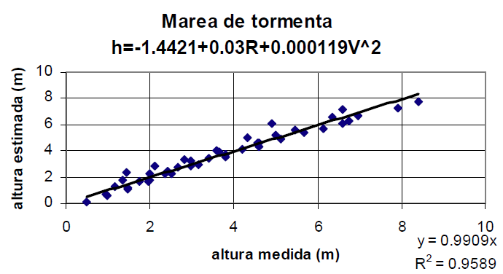


1. Regression from CENAPRED

Slide 3
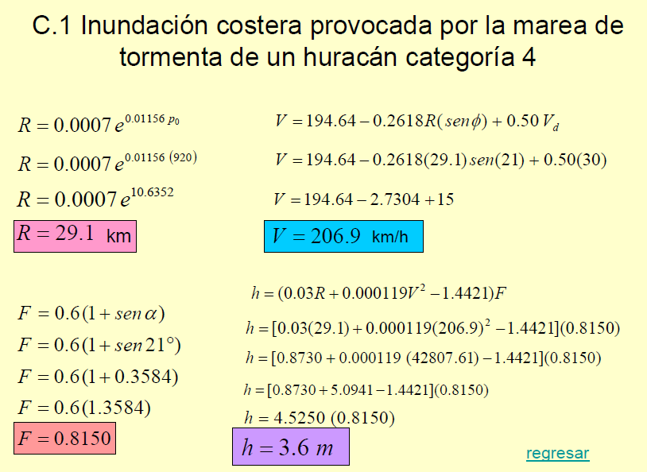
Example for testing (activate with “check_code” in the code)

Slide 4
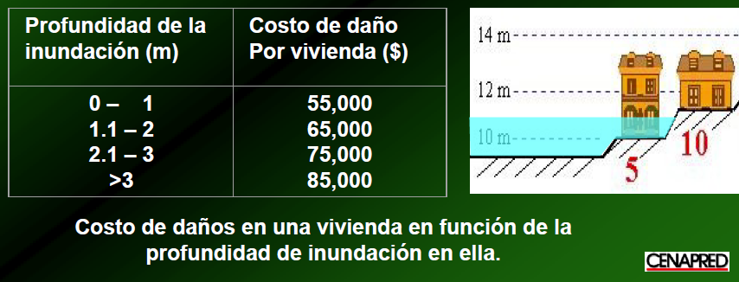
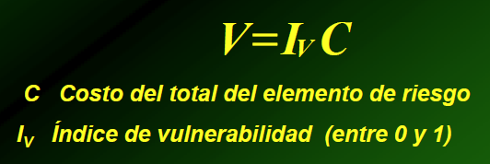
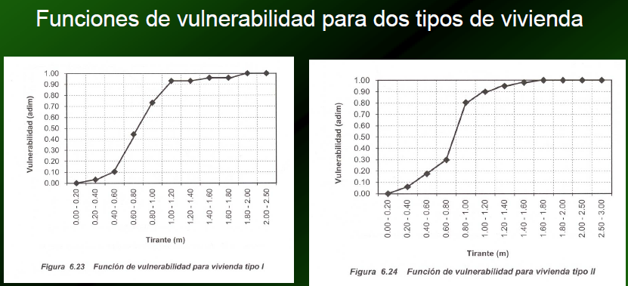

Slide 5
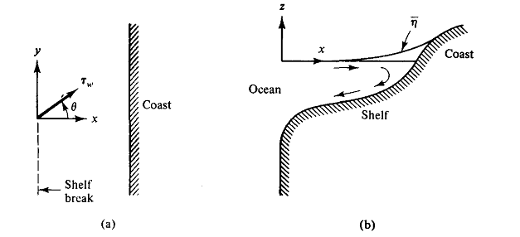
2. Parametrical solution based on 1D long wave equation
2.1. With representative bathymetry profile
2.2. with mean slope
Sea level pressure effect
SS spatial variation is supposed stationary and symmetric, only depending on the pressure gradient. The model used is Dean and Dalrymple (1984):
b) Wind thrust (explain in page 157, Dean and Dalrymple, 1984)
The shear stress produced by the wind on the sea surface generates a elevation of the water level at the coastline known as Storm Surge. Although its modeling is complex (e.g., Jacobsen, 2013), the long wave equations can be used to described it on the continental shelf (Freeman et al., 1957) or a lagoon.
The model used is comprehensively explained in Dean & Darlymple (1984). The wind stress over the water surface is (SPM, 1984):
The wind stress acting on the transect is
The sea level surface can be obtained from the following equation

Slide 6
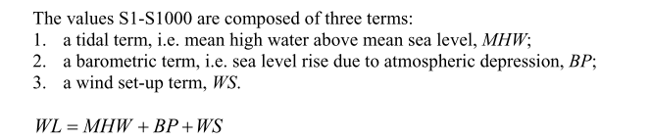

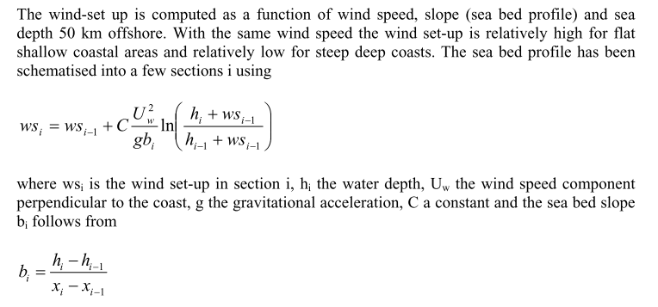
2. Parametrical solution based on 1D long wave equation
2.1. With representative bathymetry profile
2.2. Analytical solution for a mean slope – from DIVA
Vafeidis et al DIVA database documentation

Slide 7

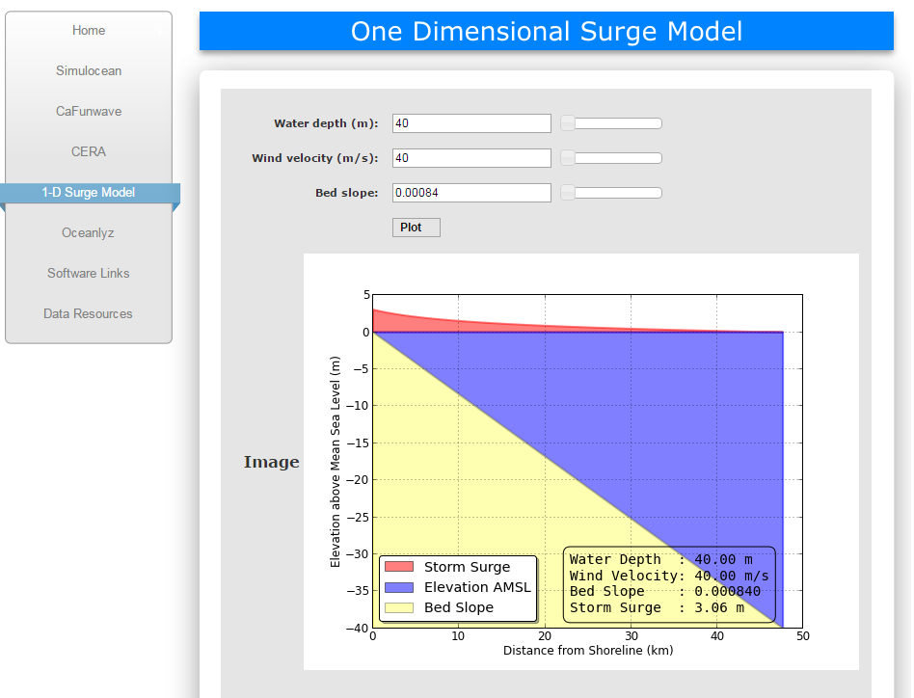
With mean slope
http://www.coastalhazards.org/1-d-surge-model.html

Slide 8


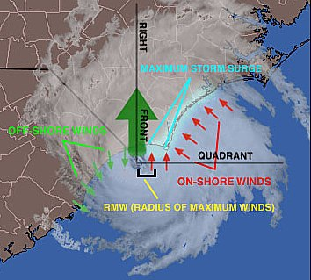
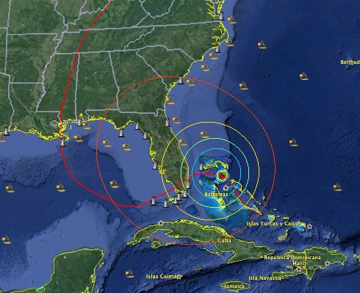
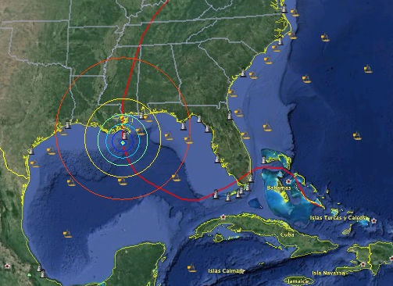
Definition of Hazards
Annual Expected Damages
Cost / Benefit of Solutions
Protection service from the ecosystems
Analysis of different scenarios
CLIMADA
Wind speed
Rainfall
Storm Surge
Waves
Hazards:

Slide 9
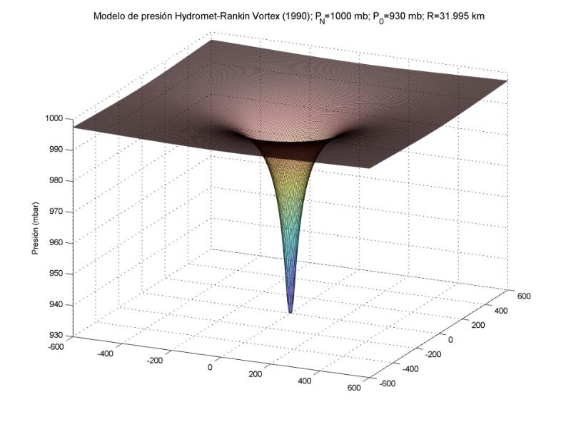
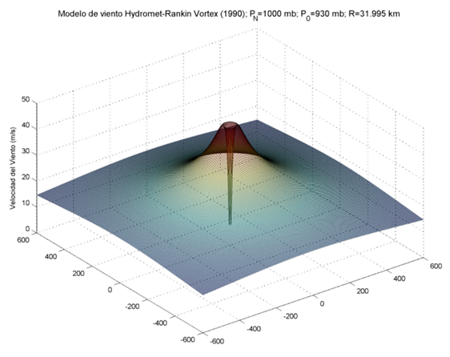
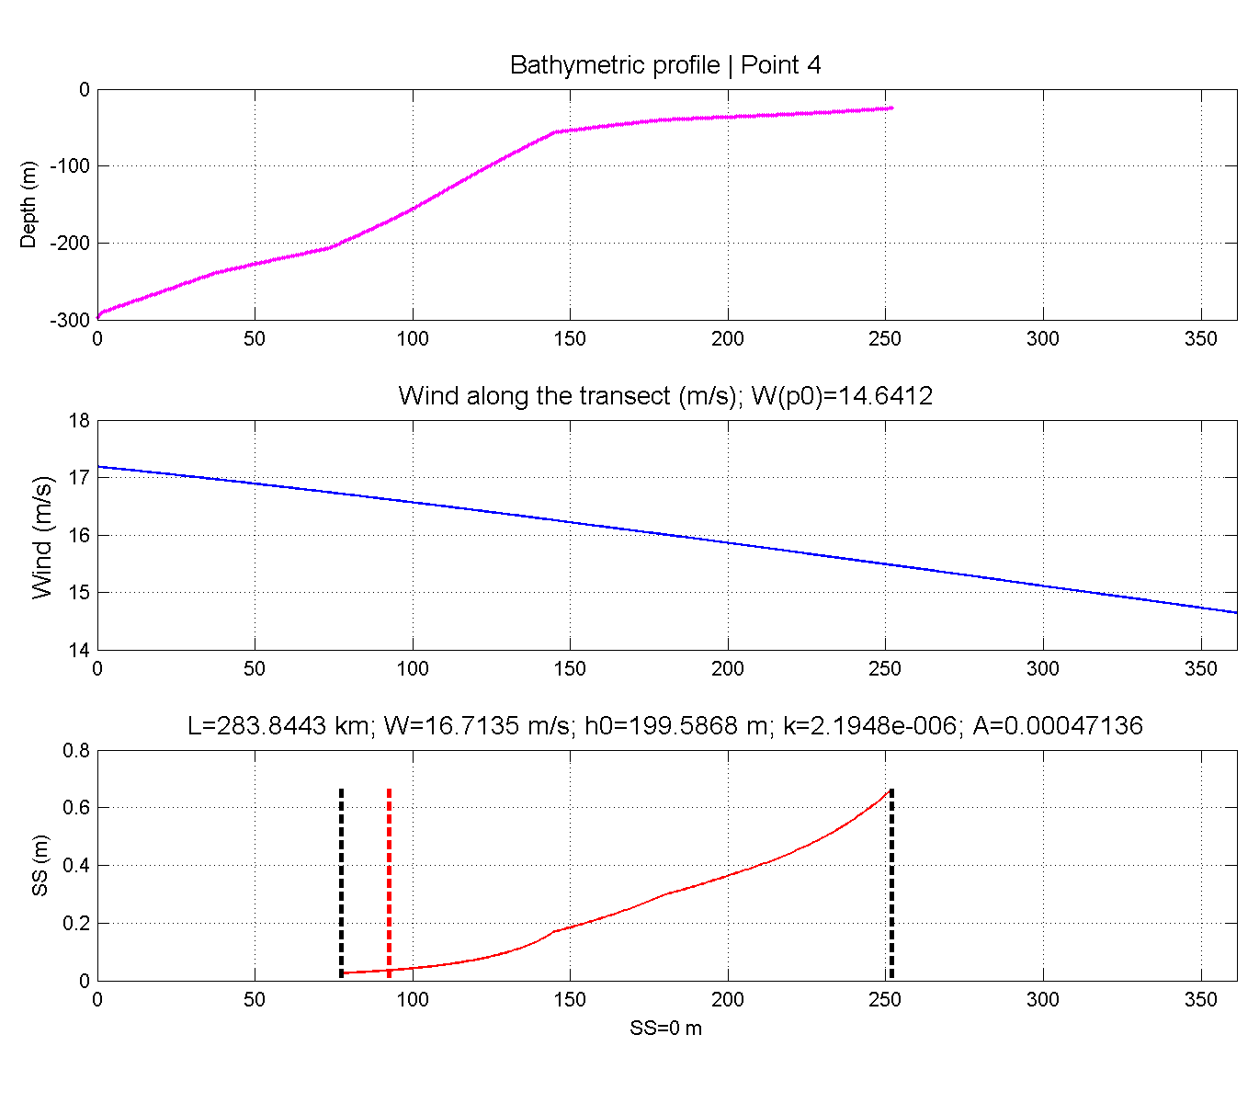
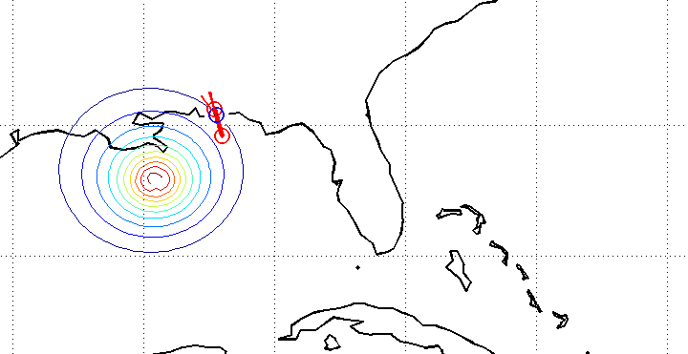
From hurricane parameters:
Wind
Pressure
3 Wave Models
Bretschneider (1990),
Young (1988),
Shore Protection Manual (SPM 1984)
1D approach for SS
Dean & Darlymple (1984)
To be complemented with numerical modeling

Slide 10
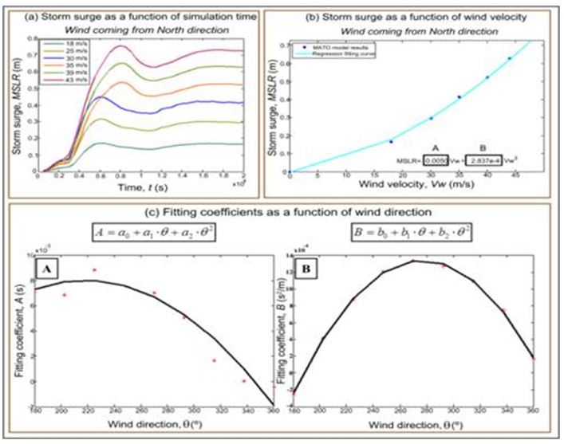

3. Parametrical solution based on ‘stationary’ runs
$$SS(∅,t)=A\left(∅,t\right)V+B\left(∅,t\right)V^{2}$$

Slide 11
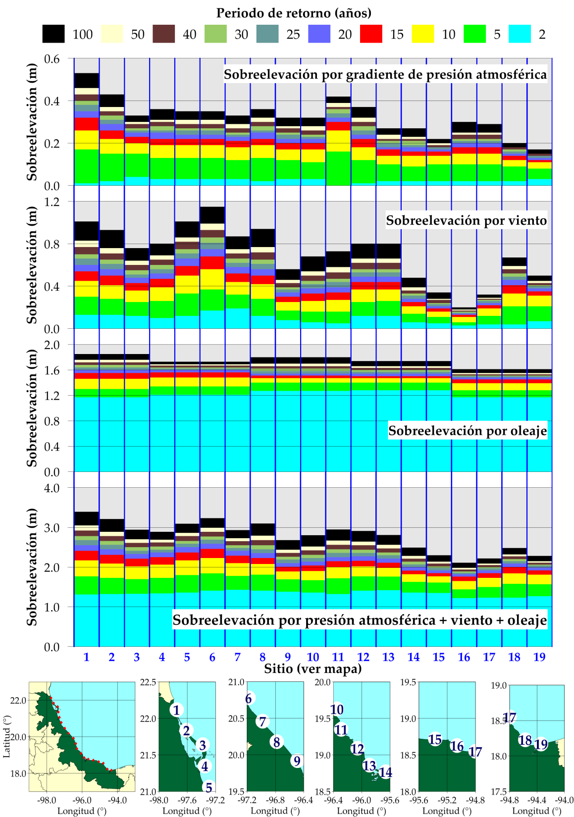

Slide 12
OTHER SURGE MODELS
http://www.oas.org/cdmp/hazmap/taos/taosdoc/taosfull.htm
Caribbean Disaster Mitigation Project

