Slide 1
The Arbiter of Storms (TAOS)
A tool for coastal vulnerability assessment
Horace H. P. Burton and Selvin DeC. Burton
Caribbean Institute for Meteorology and Hydrology

Slide 2
Storm surge definition
The increase in water levels resulting from the passage of a tropical cyclone
Surge is an oceanic event responding to meteorological and other driving forces

Slide 3
Surge Components
Height depends on complex interaction of several factors including:
  wind field
  pressure anomaly
  size and speed of motion of the system
  bottom topography near the storm's landfall point
  astronomical tides
  maximum wind speed, which is closely related to the minimum sea-level pressure, is the most important factor

Slide 4
Storm Surge Hazard Components
Still Water Level at Shoreline
Wave Runup
Wave Setup
Wave Crest
(Total Water Level)
Wind Setup
Pressure Setup
Mean Low Water
Astronomical Tide
Shoreline at Mean Low Tide

Slide 5
Surge components
Pressure setup - increase in water level due to the lower atmospheric pressure in the interior of a storm
Wind setup - increase in water level due to the force of the wind on the water.
Wave setup - increase in still water levels resulting from mass transport by breaking waves
Astronomical tides - increase due to lunar and solar tides. This effects is typically small in the Caribbean.

Slide 6
Surge components
Wave runup- area where the inertia of breaking waves carries water up a beach
Still water level at shoreline- highest water level at a point on the shoreline, if wave action is smoothed out
Storm surge heights vary from as little as 1 m or less to 5 m or more depending on factors contributing to the surge

Slide 7
The Arbiter of Storms (TAOS)
A PC-based storm hazard model
for assessing storm surge and wind hazards
from tropical storms
Developed by Charles Watson
Licensed to OAS

Slide 8
CIMH and TAOS model
CIMH is institutional home for TAOS/L in region
First version of TAOS/L installed at CIMH in December 1994
Experience with model has led to enhancement and changes to model
Latest version of model installed in July 1999

Slide 9
Model description
Input data
  Terrain - derived from a number of sources including satellite data
  Storm track or wind field data
    location, maximum wind, minimum pressure, eye diameter
  Surface characteristics
    Frictional values for land and water

Slide 10
Model description
Three processing modules which are coupled
  Wind / atmosphere
    computes wind at 5 metres above surface
  Water flow
    computes storm surge heights
  Wave
    generates wave heights in deep water

Slide 11
Model description
Output data
  Storm surge heights
  Maximum wind field
  Time series for surge, wind and wave at selected locations
  Maximum Envelopes of Water/Wind (MEOWs)

Slide 12
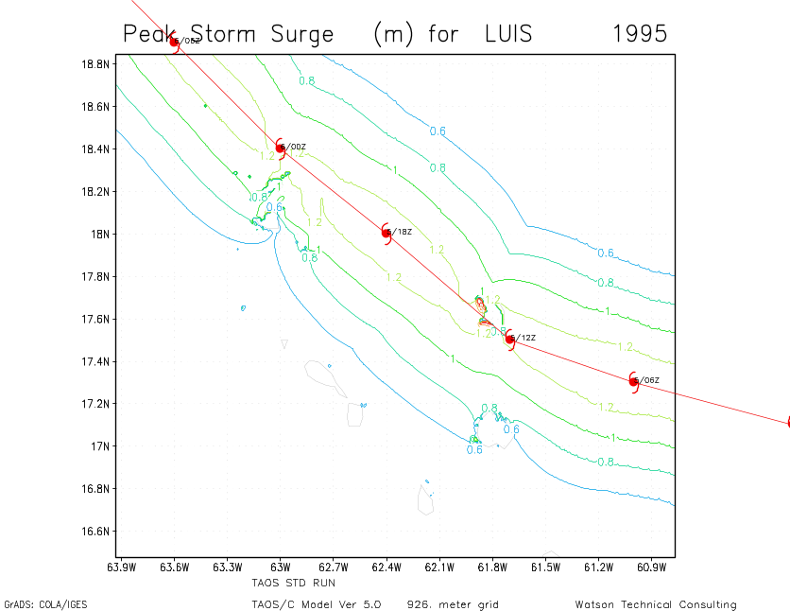
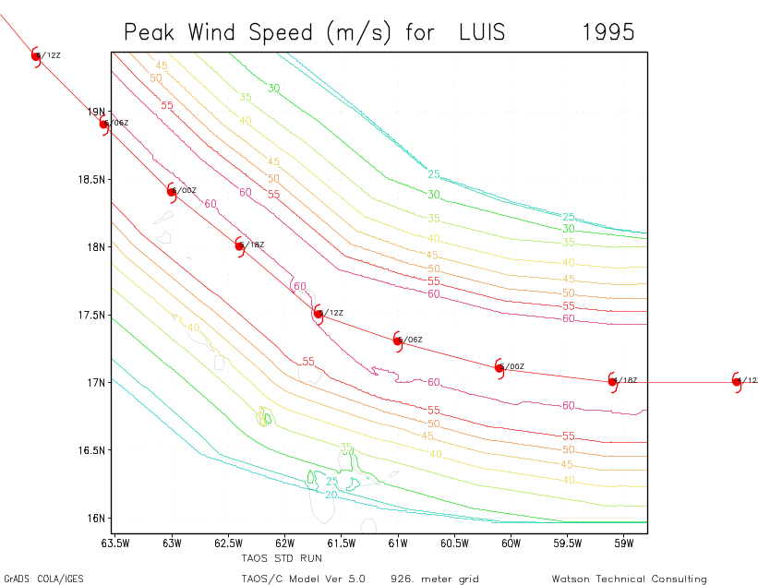
TAOS/L Output - Luis 1995
Wind Speed
1 m
contour
60 m/s
contour
Storm Surge
Antigua

Slide 13
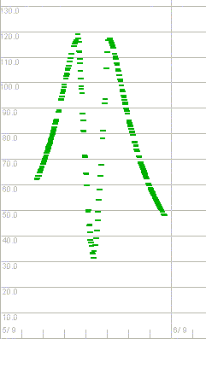
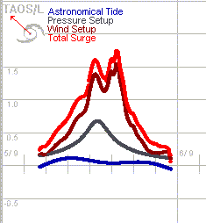
TAOS/L Output - Luis 1995
Wind Speed
Storm Surge

Slide 14
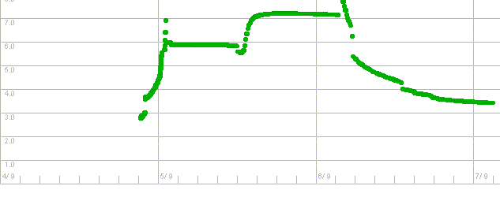
TAOS/L Output - Luis 1995
Wave Heights

Slide 15
MEOWs
Maximum water level (or wind speed) for a storm of a chosen intensity, forward speed and track
Produced by running the model for multiple storm tracks, spaced a fixed distance apart, for a selected intensity, speed and direction
Results of runs are combined into a single map showing, for each point on the map, the maximum value generated across all the model runs.

Slide 16
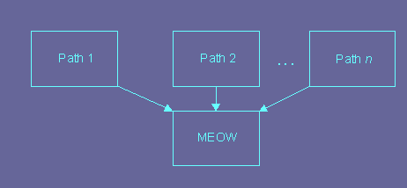
MEOWs

Slide 17
Model validation
TAOS results generally consistent with those of SLOSH and French model
TAOS model estimates generally within 0.3 m of observations 80% of time and less than 0.6 m of observations 90% of time

Slide 18
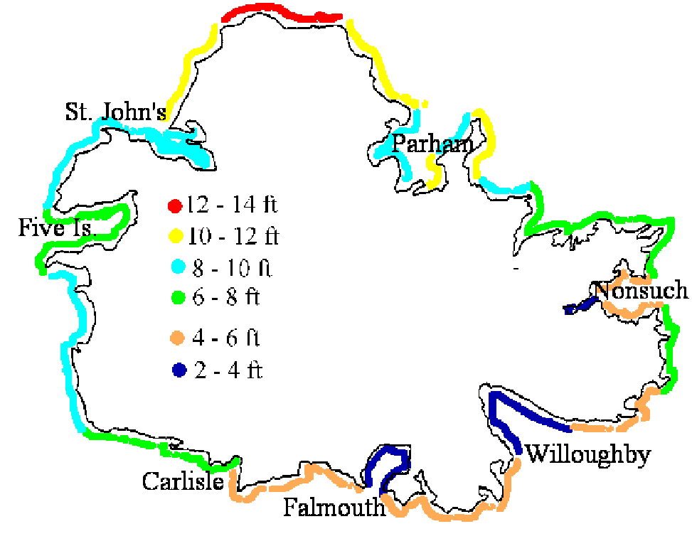
Model validation - Luis 1995
Estimated Storm Surge (ft)
Luis 1995

Slide 19
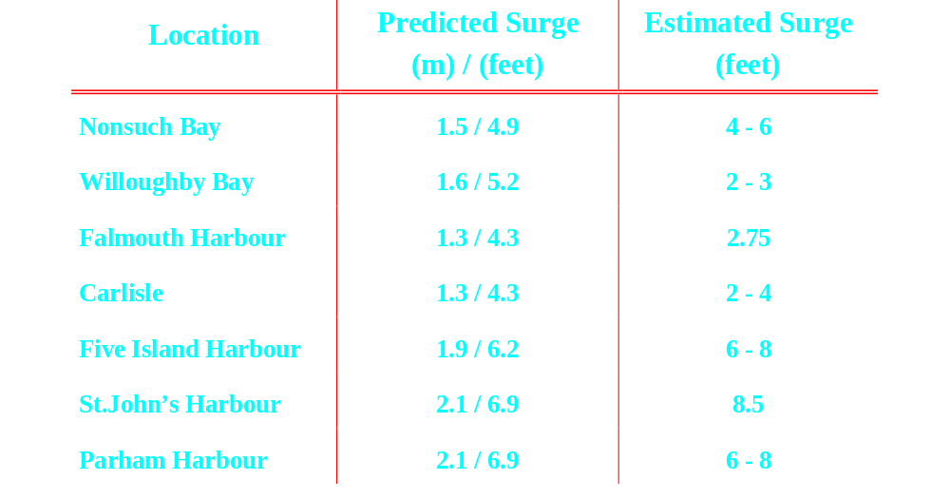
Model validation - Luis 1995

Slide 20
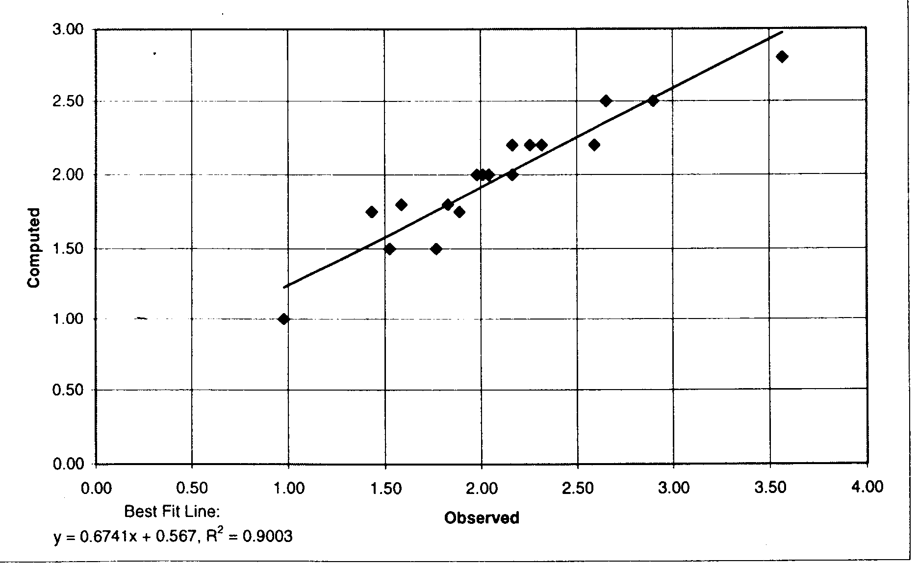
Model validation - Marilyn 1995
Errors: (metres)
Maximum 0.77
Average 0.19
Median 0.13

Slide 21
Advantages of TAOS/L Model
Integrates wind, wave and storm surge hazards
Bathymetric and topographic data easily updated
Small run times allowing for use in real time
Simple input data taken from NHC advisories
GIS-compatible results

Slide 22
Application of output
Emergency managers
  Identify high risk areas for storm surge and prepare evacuation plans
Physical planners
  Locating safe housing and urban expansion areas

Slide 23
Application of output
Builders and home owners
  Retrofitting existing structures to acceptable levels of risk or to build new structures to appropriate design standards
Insurance industry
  Accurately estimate the risk for a property and set rates that differentiate by risk level

