Slide 1
CSC 172
DATA STRUCTURES

Slide 2
CSC 172 GOAL :
GOOD COMPUTER PROGRAMS

Slide 3
Prerequisites
We assume that you can write computer programs in some language.
We hope you have taken, or are currently taking MTH150

Slide 4
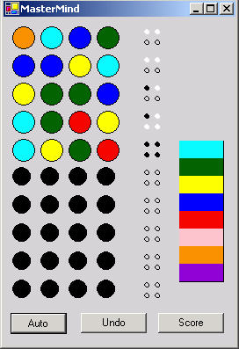
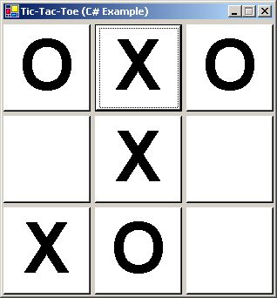
Can you write a program to win at “tic-tac-toe” . . .
. . . or “master mind”?

Slide 5

Can you write a program to find a path through a maze . . .
. . . or generate one?

Slide 6
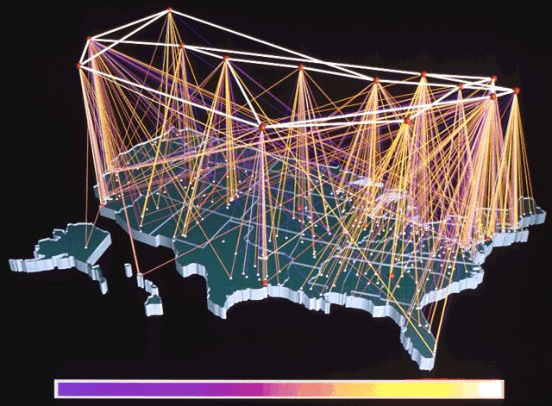
Can you write a program to find the best route for. . .
. . . airtravel, electrical power, internet packets, phone calls?

Slide 7
Can you write a program to evaluate expressions like:
1 + 3
4 – 2
7 * 5
8 / 2

Slide 8
Can you write a program to evaluate expressions like:
1 + 3 * 2
2 / 4 – 2
7 - 2 * 5 + 3
8 / 2 + 1

Slide 9
Can you write a program to evaluate expressions like:
(1 + 3) * 2
2 / (4 – 2^4)
(7 - 2) * (5 + 3)^3
8 / (2 + 1)^2^2
How about with “arbitrary” complexity?

Slide 10
Given the code for an algorithm can you estimate how much time and memory it will take to process a given amount of data?

Slide 11
ABSTRACTION

Slide 12
“Computer Science is a science of abstraction – creating the right model for thinking about a problem and devising the appropriate mechanizable techniques to solve it.”
- A. Aho

Slide 13
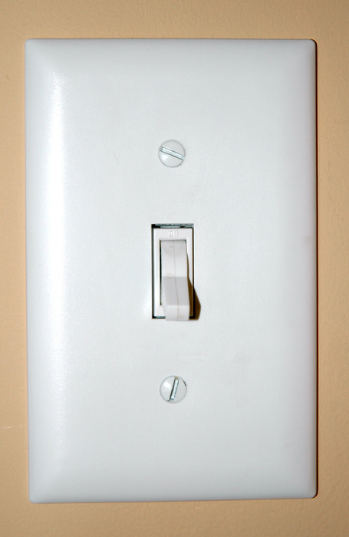

Slide 14
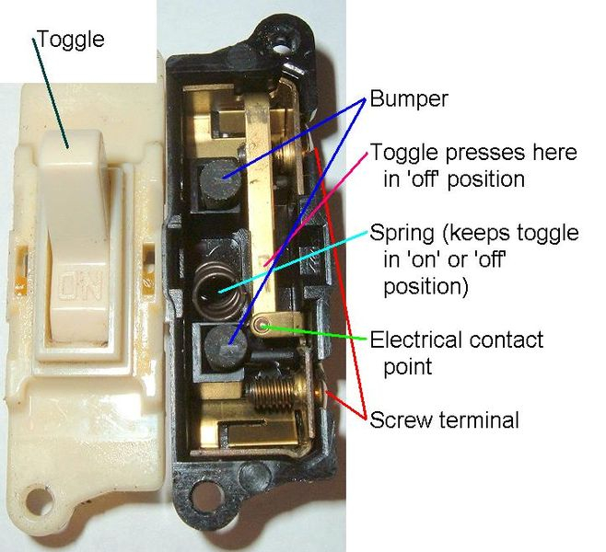

Slide 15
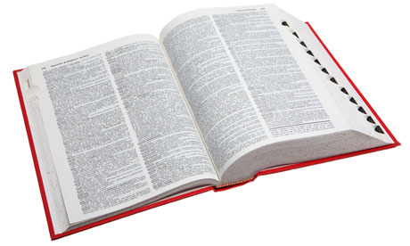

Slide 16
public interface Dictionary { public void insert(String word, String def); public void delete(String word); public String lookup(String word);
}

Slide 17
THE QUICK, THE FAT,
AND THE UGLY

Slide 19
ANALYSIS VS. MEASUREMENT

Slide 20
I have two programs.
They both do the same thing.
I measure their run time.

Slide 21
I have two programs.
They both do the same thing.
I measure their run time.
Prog1 takes 1 sec to process a 1GB array and 2.25 sec to process a 1.5GB array.
Prog2 takes 3 sec to process a 1GB array and 3.585 sec to process a 1.5GB array.
Which should I use on my 100GB array?

Slide 22
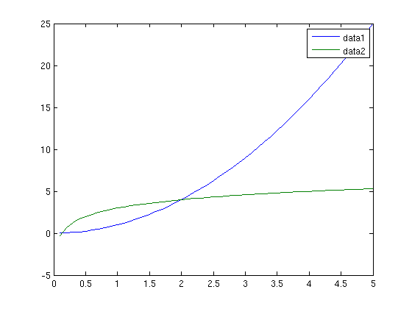

Slide 24
ANALYTICAL PROCESS

Slide 26
STANDARD TECHNIQUES

Slide 28
DATA STRUCUTRES:
LISTS, STACKS, QUEUES, TREES, HEAPS, HASHES, GRAPHS, SETS

Slide 30
ALGORITHMS:
SORTING, GREEDY, BACKTRACKING, RANDOMIZED, DYNAMIC PROGRAMMING

Slide 32
MATHEMATICS:
PROOF BY INDUCTION,
RECURRENCE RELATIONS

Slide 34
TIERED APPROACH:
LISP FOR “ABSTRACTION”
JAVA FOR “PRACTICAL”,
C FOR “LOW LEVEL”

Slide 36
Instructor: Ted Pawlicki
732 Computer Studies pawlicki@cs.rochester.edu
275-4198

Slide 37
SYLLABUS REVIEW

Slide 39
WORKSHOP PREFERENCE

