Slide 1
CSC 172
DATA STRUCTURES

Slide 2
Runtime Analysis

Slide 3
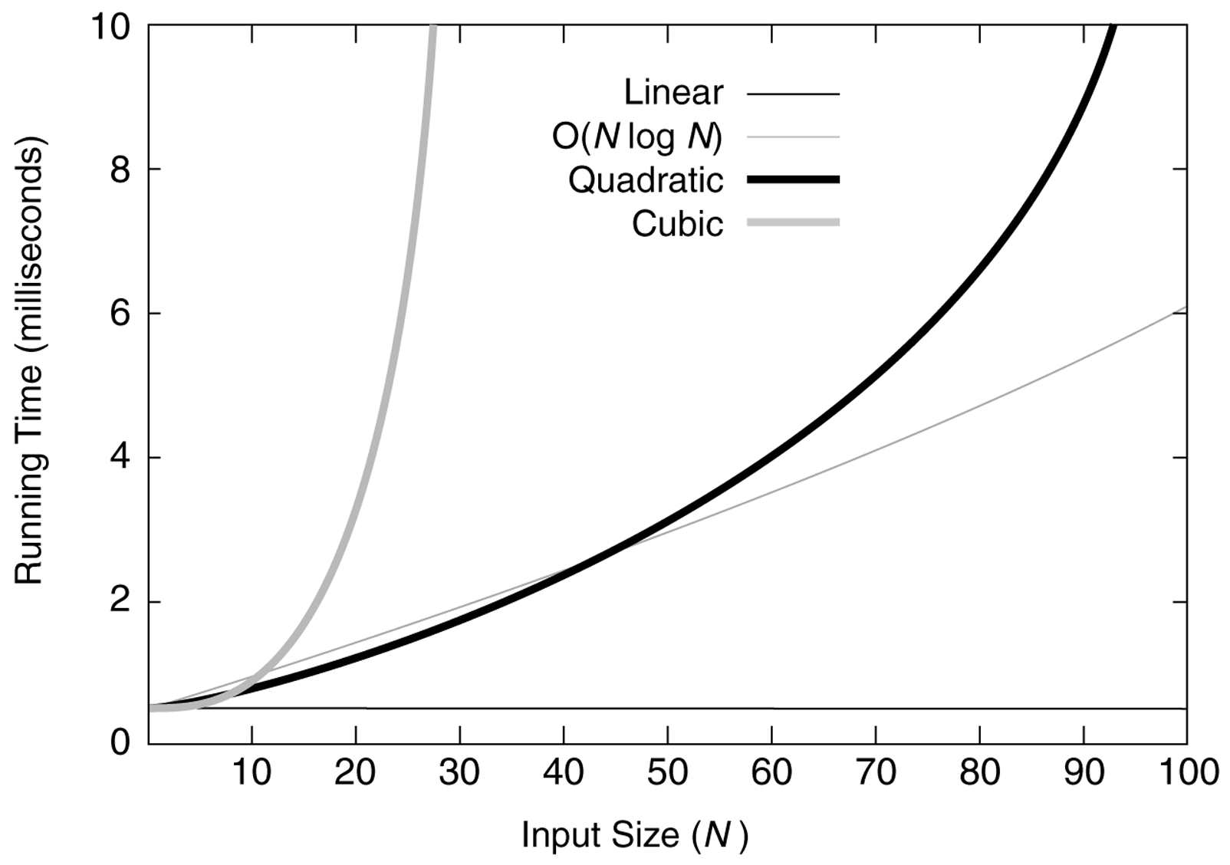

Slide 4
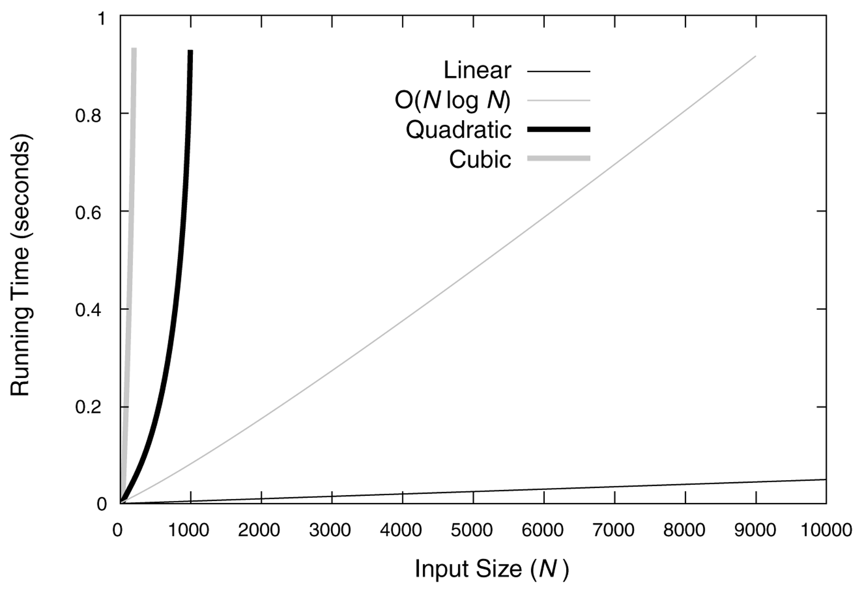

Slide 5
Big-Oh
Notes:
Big-Oh is a notation that abstracts away the unknowable constant factors and focuses on growth rate.
We say “T(n) is O(f(n))” if for large n, T(n) is no more than proportional to f(n)
Formally
There exists constants n₀ and c > 0 such that for all n>=n₀, we have T(n) <= cf(n)
n₀ and c are called “witnesses” to the fact that T(n) is O(f(n))

Slide 6
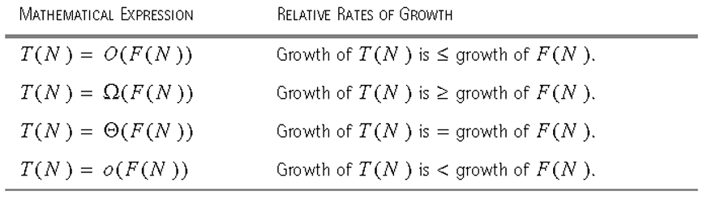

Slide 7
Example
10n²+50n+100 is O(n²)
Pick witnesses
n₀==10
c == 16
Then for any n >= 10, 10n²+50n+100 <= 16n²

Slide 8
10n²+50n+100 and n²

Slide 9
10n²+50n+100 and n²
n₀==10

Slide 10
10n²+50n+100 and n² and 16n²
n₀==10

Slide 11
More Formal Example
10n²+50n+100 is O(n²)
Pick one witness
n₀==1
10n²+50n+100 <= Cn²
10n²+50n+100 <= 10n² + 50n + 100n
10n²+50n+100 <= 10n² + 150n
10n²+50n+100 <= 10n² + 150n²
10n²+50n+100 <= 160n²
c == 160

Slide 12
Example
n¹⁰ is O(2^{n})
n¹⁰<2^{n}
Is the same as saying
log₂(n¹⁰) < log₂(2^{n})
10 log₂n < n
False for n = 32, true n = 64
So, with c==1 and n0 == 64, n¹⁰ < 1 * 2^{n}

Slide 13
10log₂(n) and n

Slide 14
General Rules
Any Polynomial is big-oh of its leading term with coefficient of 1
The base of a logarithm doesn’t matter.
log_{a}n is O(log_{b}n) for any bases a and b because
log_{a}n= log_{b}n log_{a}b , (i.e. n₀==1, c = log_{a}b)
Logs grow slower than powers [log n is O(n^{1/10})]
Exponentials (c^{n}, c>1) grow faster than poly
n¹⁰ is O(1.0001^{n})
Generally, polynomial time is tolerable
Generally, exponential time is intolerable

Slide 15
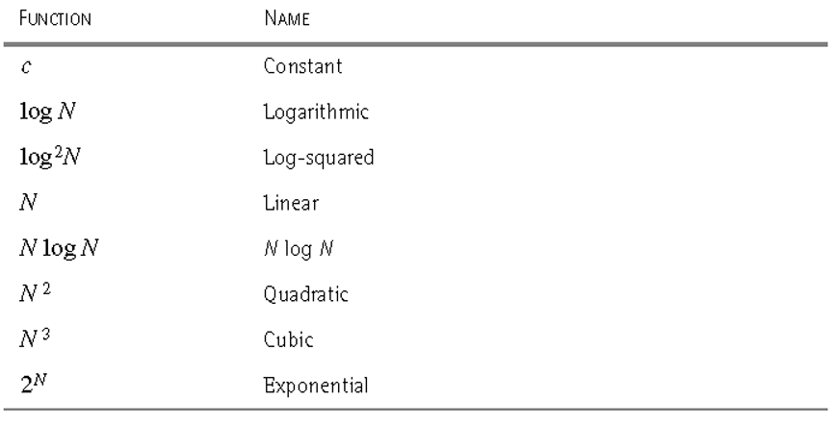

Slide 16
CONSIDER TWO ALGORITHMS
Slow Algorithm, Fast Computer
Fast Algorithm, Slow Computer
Notes:
Alg #1 T(n) is O(n^3)
Alg #2 T(n) is O(n)

Slide 17
TWO ALGORITHMS
n
Alpha21164A, “C”, O(n^3)
TRS-80, “BASIC”,
O(n)
10
0.6 microsec
200 millisecs
100
0.6 millisecs
2.0 sec
1000
0.6 sec
20 sec
10,000
10 min
3.2 min
100,000
7 days
32 min
1,000,000
19 years
5.4 hrs

Slide 18
PROBLEM SIZE
Max Problem (Bently)
1.3n³
10n²
47nlog₂n
48n
Sec
920
10,000
1.0*10⁶
2.1*10⁷
min
3600
77,000
4.9*10⁷
1.3*10⁹
hr
14,000
6.0*10⁵
2.4*10⁹
7.6*10¹⁰
day
41,000
2.9*10⁶
5.0*10¹⁰
1.8*10¹²

Slide 19
Disproving Big-Oh
Proof by contradiction
n³ is not O(n²)
If it were then n₀ and c would exist n³ < cn²
Choose n₁ at least as large as n₀
Choose n₁ at least as large as 2c
If n₁³ <= cn₁² then n₁ <= c
But n₁ >= 2c

Slide 20
Runtime of programs
Measure some “size” of the input
the value of some integer
The length of a string or array

Slide 21
Program Analysis
Basis cases (simple statements) constant time
  Assignments
  Break, continue, return
  System.in.println()
Induction
  Loops
  Branching (if, if-else)
  functions
Notes:
We “abstract” to the number of significant primitive (constant time) operations.
O(1) + O(1) = O(2) == O(1)
Loops are the cost of the body times the number of iterations
for if statements, take the max of the alternatives
analyze functions separately and abstract

Slide 22
Program Analysis
Basis cases (simple statements) constant time
  Assignments // O(c1) == O(1)
  Break, continue, return // O(c2) == O(1)
  System.in.println() // O(c3) == O(1)
Induction
  Loops
  Branching (if, if-else)
  functions
Notes:
We “abstract” to the number of significant primitive (constant time) operations.
O(1) + O(1) = O(2) == O(1)
Loops are the cost of the body times the number of iterations
for if statements, take the max of the alternatives
analyze functions separately and abstract

Slide 23
Program Analysis
Basis cases (simple statements) constant time
  Assignments // O(c1) == O(1)
  Break, continue, return // O(c2) == O(1)
  System.in.println() // O(c3) == O(1)
Induction
  Loops // multiply the Big-Oh of the body by the number of times around the loop.
  Branching (if, if-else) // use the Max of the branches
  Functions // calculate as if it were a separate program
Notes:
We “abstract” to the number of significant primitive (constant time) operations.
O(1) + O(1) = O(2) == O(1)
Loops are the cost of the body times the number of iterations
for if statements, take the max of the alternatives
analyze functions separately and abstract

Slide 24
Structure Tree
Nodes are complex statements
Children are constituent statements

Slide 25
PROGRAMMING EXERCISE
Write a JAVA method to convert ints to strings containing the binary representation
if (n == 5) return “101”;
if (n==12) return “1100”;
public static String int2bin(int n);

Slide 26
public String int2bin(int n) {
String rval;
while (n>0) {
if((n%2) == 0)
rval = “0” + rval;
else
rval =“1” + rval ;
n=/2;
}
return rval;
}

Slide 27
1
2
3
4
5
6
7
8
9
public String int2bin(int n) {
String rval;
while (n>0) {
if((n%2) == 1)
rval += “0”;
else
rval +=“1”;
n=/2;
}
return rval;
}

Slide 28
1
2
3
4
5
6
7
8
9
public String int2bin(int n) {
String rval;
while (n>0) {
if((n%2) == 1)
rval += “0”;
else
rval +=“1”;
n=/2;
}
return rval;
}
1-9

Slide 29
1
2
3
4
5
6
7
8
9
public String int2bin(int n) {
String rval;
while (n>0) {
if((n%2) == 1)
rval += “0”;
else
rval +=“1”;
n=/2;
}
return rval;
}
1-9
1
2-8
9

Slide 30
1
2
3
4
5
6
7
8
9
public String int2bin(int n) {
String rval;
while (n>0) {
if((n%2) == 1)
rval += “0”;
else
rval +=“1”;
n=/2;
}
return rval;
}
1-9
1
2-8
9
? times
3-7

Slide 31
1
2
3
4
5
6
7
8
9
public String int2bin(int n) {
String rval;
while (n>0) {
if((n%2) == 1)
rval += “0”;
else
rval +=“1”;
n=/2;
}
return rval;
}
1-9
1
2-8
9
? times
3-7
3-6
7

Slide 32
1
2
3
4
5
6
7
8
9
public String int2bin(int n) {
String rval;
while (n>0) {
if((n%2) == 1)
rval += “0”;
else
rval +=“1”;
n=/2;
}
return rval;
}
1-9
1
2-8
9
? times
3-7
3-6
7
O(1) + max
4
6

Slide 33
1
2
3
4
5
6
7
8
9
public String int2bin(int n) {
String rval;
while (n>0) {
if((n%2) == 1)
rval += “0”;
else
rval +=“1”
n=/2;
}
return rval;
}
1-9
1
2-8
9
? times
3-7
3-6
7
O(1) + max
4
6
O(1)
O(1)

Slide 34
1
2
3
4
5
6
7
8
9
public String int2bin(int n) {
String rval;
while (n>0) {
if((n%2) == 1)
rval += “0”;
else
rval +=“1”;
n=/2;
}
return rval;
}
1-9
1
2-8
9
? times
3-7
O(1)
O(1)
O(1)
3-6
7
O(1) + max
4
6
O(1)
O(1)

Slide 35
1
2
3
4
5
6
7
8
9
public String int2bin(int n) {
String rval;
while (n>0) {
if((n%2) == 1)
rval += “0”;
else
rval +=“1”;
n=/2;
}
return rval;
}
1-9
1
2-8
9
log₂n times
3-7
O(1)
O(1)
O(1)
3-6
7
O(1) + max
4
6
O(1)
O(1)

Slide 36
1
2
3
4
5
6
7
8
9
public String int2bin(int n) {
String rval;
while (n>0) {
if((n%2) == 1)
rval += “0”;
else
rval +=“1”;
n=/2;
}
return rval;
}
O(log₂n)
1-9
O(1)
O(log₂n)
O(1)
1
2-8
9
log₂n times
3-7
O(1)
O(1)
O(1)
3-6
7
O(1) + max
4
6
O(1)
O(1)

