Slide 1
CSC 172
DATA STRUCTURES

Slide 2
LINKED LISTS

Slide 3
public interface Dictionary { public void insert(Object item); public void delete(Object item); public Object lookup(Object item);
}

Slide 4
Self-referential data types
class Node {
private Object data; // the “data”
private Node next; // the “link”
}
data
next

Slide 5
Linked List
A linked list “has-a” reference to a node
  The “head” of the list
  The ending node has “null” for the next
head
data
next
data
Next
null

Slide 6
Linked List
pubic class LinkedList {
private Node first ;
// methods for insert, delete, lookup
}
head
data
next
data
Next
null

Slide 7
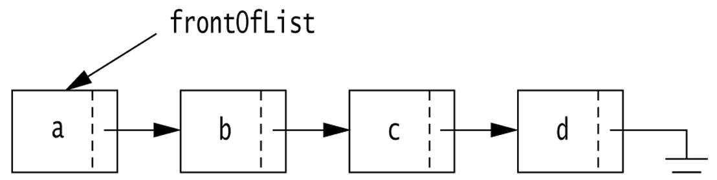
Basic Linked List

Slide 8
Exercise 1
Implement a method
public static void printList(Node front){}
That traverses and prints the list

Slide 9
public static void printList(Node front) {
while (front != null) {
System.out.println((front.data).toString());
front = front.next;
}
}

Slide 10
public static void printList(Node front) {
if (front == null) return;
else {
System.out.println((front.data).toString());
printList(front.next);
}
}

Slide 11
Exercise 1b
Implement a method
public String toString(){}
That traverses and prints the list

Slide 12
public String toString() {
Node temp = front;
String rvalue = “”;
while (front != null) {
rvalue += (front.data).toString();
front = front.next;
}
return rvalue;
}

Slide 13
Exercise 2
Implement a method
public static void printList(Node front){}
That traverses and prints the list in reverse

Slide 14
public static void printList(Node front) {
if (front == null) return;
else {
printList(front.next);
System.out.println(front.data.toString());
}
}

Slide 15
Exercise 3
Implement a method
public static Object lookup(Node front, Comparable searchobj){
// return null if not found }

Slide 16
public static Object lookup(Node front,
Comparable searchobj) {
while (front != null) {
if(seachobj.equals(front.data))
return front.data;
front = front.next;
}
return null;
}

Slide 17
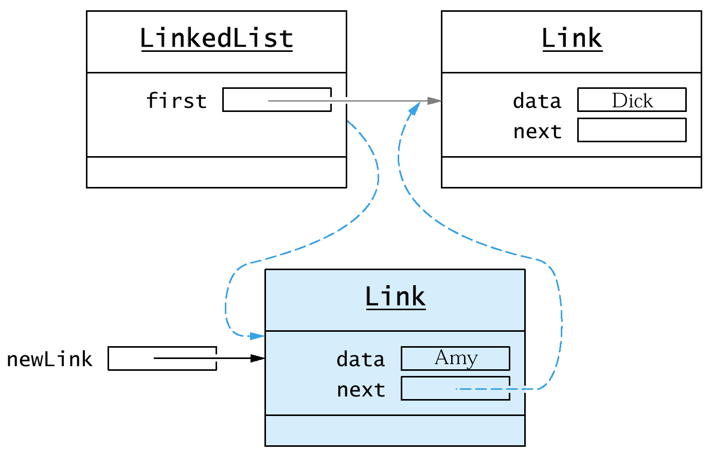
Exercise 4: Adding a first node
public Node addFirst(Object obj)

Slide 18
Adding a first node
public void addFirst(Object obj){
Node newLink = new Node();
newLink.data = obj;
newLink.next = first;
first = newLink;
}

Slide 19
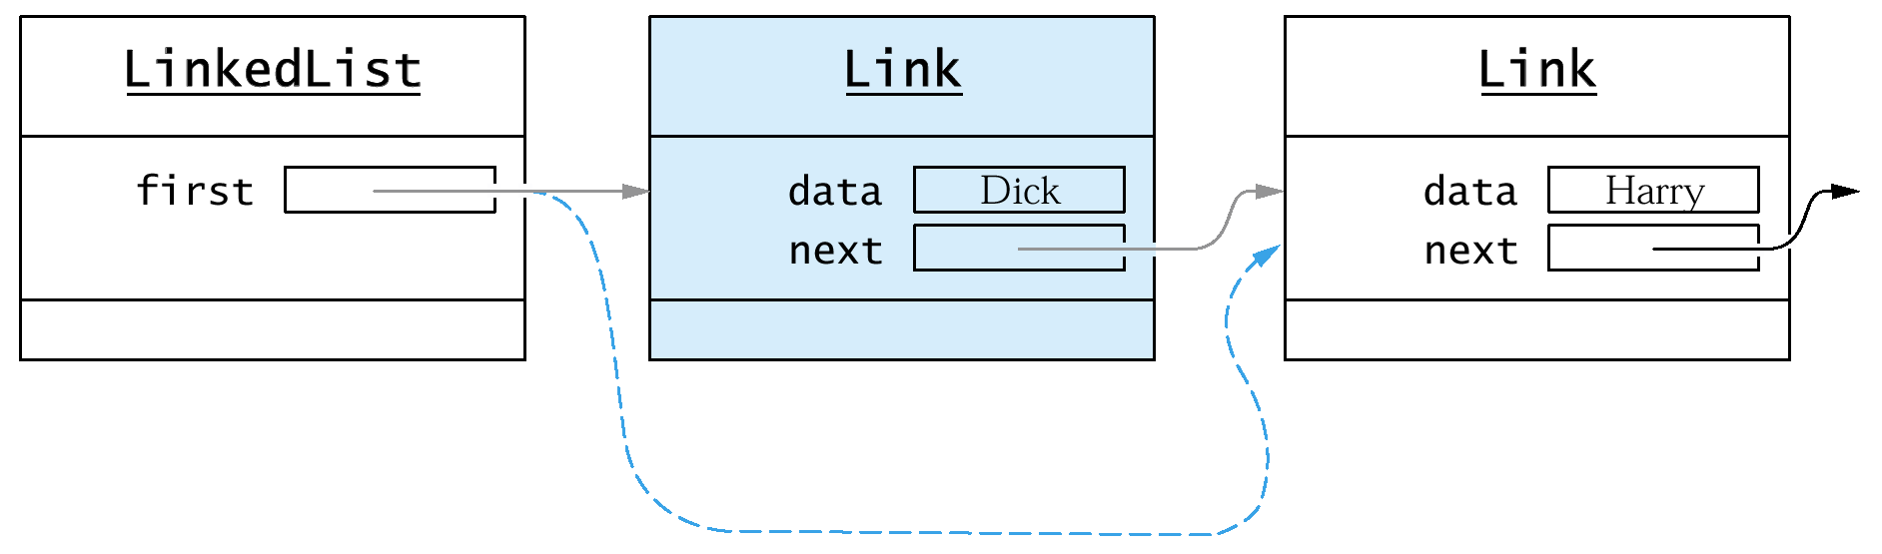
Exercise 5:
Deleting a first node
public Object removeFirst() {}

Slide 20
Deleting a first node
public Object removeFirst(){
if (first == null)
throw new NoSuchElementException();
Object obj = first.data;
first = first.next;
return obj;
}

Slide 21
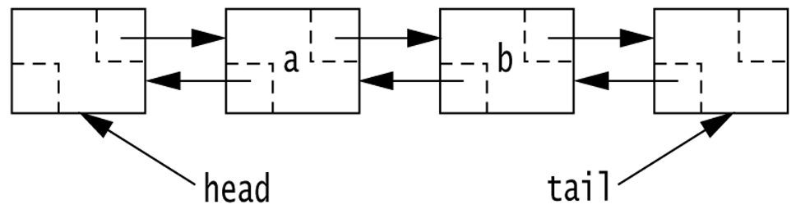
Doubly Linked List
Ex 6 : Write the “DoubleNode” class

Slide 22
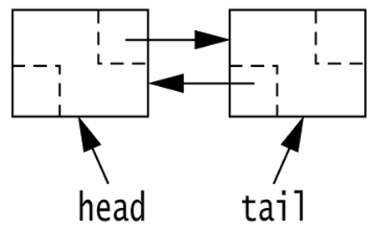
An empty Doubly Linked List
How does this (the existence of head & tail) change traverse & print?

Slide 23
Double Node
class Dnode {
private Object data; // the “data”
private Dnode prev; // the “link”
private Dnode next; // the “link”
}
prev
data
next

Slide 24
Double List Class
class Dlinkedlist {
private Dnode head; // the “link”
private Dnode tail; // the “link”
// Exercise : write the constructor
}

Slide 25
Constructor
public Dlinkedlist() {
head = new Dnode();
tail = new Dnode();
head.prev = null;
head.next = tail;
tail.prev = head;
tail.next = null;
}

Slide 26
Double List Class
class Dlinkedlist {
private Dnode head; // the “link”
private Dnode tail; // the “link”
// Exercise : write boolen isEmpty()
}

Slide 27
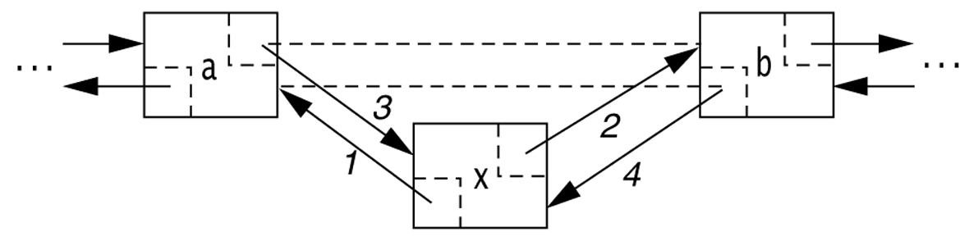
Deletion
Ex 7: Write a method to delete from doubly linked list
assume comparable Objects
public void delete(Comparable obj)

Slide 28
public void delete (Comparable obj) {
Node current = head;
while (current != tail) {
if (obj.equals(current.data)) {
(current.next).prev = current.prev;
(current.prev).next = current.next;
return;
}
current = current.next;
}
}

Slide 29
Insertion
Ex 8: Write a method to insert into doubly linked list
public void insertAfter(Node n, Comparable obj)

Slide 30
public void insertAfter(Node n, Object obj){
Node newNode = new DoubleNode();
newNode.data = obj;
newNode.prev = n;
newNode.next = n.next;
(newNode.prev).next = newNode;
(newNode.next).prev = newNode;
}

Slide 31
Double List Class
class Dlinkedlist {
private Dnode head; // the “link”
private Dnode tail; // the “link”
// Ex: write boolen lookup(Object o)
// Data objects have a “key”
}

Slide 32
class DictionaryEntry {
String word ; // The “key”
String [] definitions ; // The “data”
}

Slide 33
public DictionaryEntry lookup(String w){
Node current = first;
while (current != last) {
If (w.equals(current.data.word))
return (current.data);
current = current.next ;
}
return null; // not found
}

Slide 34
public DictionaryEntry lookup(String w){
Node current = first;
while (current != last) {
If (w.equals(current.data.word))
return (current.data);
current = current.next ;
}
return null; // not found
}

