Slide 1
CSC 172
DATA STRUCTURES

Slide 2
LISTS
We have seen lists:
public class Node {
Object data;
Node next;
}
φ

Slide 3
TREES
Now, look at trees:
public class Node {
Object data;
Node left;
Node right;
}
φ
φ
φ
φ
φ
φ
φ
φ

Slide 4
ROOTED TREES
Collection of nodes, one of which is the root
Nodes != root have a unique parent node
Each non-root can reach the root by following parent links one or more times

Slide 5
DEFINITIONS
If node p is the parent of node c
then c is a child of p
Leaf : no children
Interior node : has children
Path : list of nodes (m₁,m₂,…,m_{k}) such that each is the parent of the following
path “from m₁ to m_{k}”
Path length = k-1, number of links, not nodes

Slide 6
If there is a path from m to n, then m is an ancestor of n and n is a descendant of m
Note m == n is possible
Proper ancestors, descendants : m != n
Height of a node n is the length of the longest path from n to a leaf
Height of a tree is the height of its root
Depth of a node is the length of the path from the root to n
Subtree rooted at n is all the descendants of n

Slide 7
The children of any given note are often ordered “from the left”
Child c₁ is to the left of c₂ then all the nodes in the subtree rooted at c₁ are “to the left” of those in the subtree rooted at c₂
Nodes may have labels, which are values or data associated with the nodes

Slide 8
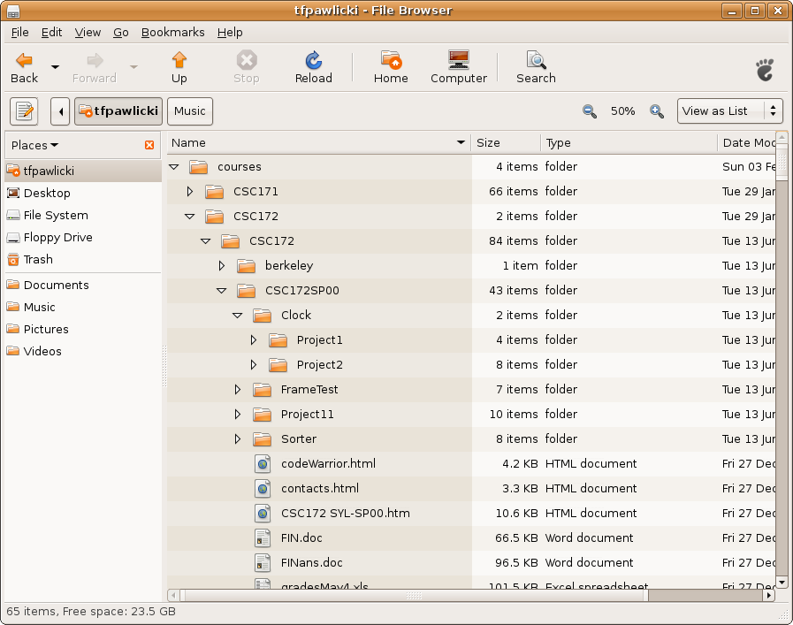
Example: UNIX File Systems

Slide 9
Example: UNIX File Systems
/
…
/bin
/dev
/usr
.
/dev/term
/dev/sound
/dev/tty01
/usr/anna
/usr/jon
/usr/ted

Slide 10
Example: Expression Trees
Labels are operands or operators
Leaves : operands
Interior nodes : operators
Children are roots of sub-expressions to which the operator is applied

Slide 11
(x+1)*(x-y+4)
*
+
-
x
1
-
4
x
y

Slide 12
Example Musical Time Span Reduction

Slide 13
Recursion on Trees
Many algorithms to process trees are designed with a basis (leaves) and induction (interior nodes)
Example: If we have an expression tree we can get
infix
(operator between operands - common)
prefix
(operator before operands – like function calls)
postfix
(operator after operands – good for compilers)

Slide 14
Expression Tree to Postfix
Basis
For a leaf, just print the operand
Induction:
For an interior node
apply algorithm to each child from left
print the operator

Slide 15
(x+1)*(x-y+4)
*
+
x
1
-
4
x 1 + x y – 4 - *
x
y

Slide 16
TREE DATA STRUCTURES

Slide 17
BINARY TREES
Some trees are binary:
public class Node {
Object data;
Node left;
Node right;
}
φ
φ
φ
φ
φ
φ
φ
φ

Slide 18
Some trees are not binary
/
…
/bin
/dev
/usr
.
/dev/term
/dev/sound
/dev/tty01
How do we implement
such trees?
/usr/anna
/usr/jon
/usr/ted

Slide 19
LMC-RS
Leftmost-Child, Right-Sibling Tree Representation
Each node has a reference to
It’s leftmost child
It’s right sibling – the node immediately to the right having the same parent
Advantage: represents trees without limits or pre-specified number of children
Disadvantage: to find the i^{th} child of node n, you must traverse a list n long

Slide 20
LMC-RS
public class Node {
Object data;
Node l_child;
Node r_sibling;
}
φ
φ
φ
φ
φ
φ
φ
φ

Slide 21
Proving Tree Properties
Structural Induction
Basis = leaves (one-node trees)
Induction = interior nodes (trees with => 2 nodes)
Assume the statement holds for the subtrees at the children of the root and prove the statement for the whole tree

Slide 22
Tree Proof Example
Consider a LMC-RS tree
S(T): T has one more φ reference than it has nodes
Basis: T is a single node – 2 φ references
φ
φ

Slide 23
Induction
T has a root r and one or more sub trees T₁, T₂,…,T_{k}
BTIH: each of these trees, by itself has one more φ than nodes
How many nodes all together?
How many φ references?
How many nodes do I add to make one tree?
How many φ references do we reduce to make one tree?

Slide 24
One more node
One more φ
Still “k” extra
φ
?
φ
?
φ
?
φ
T₁
n₁ nodes
n₁+1 φ
T₂
n₂ nodes
n₂+1 φ
T_{k}
n_{k} nodes
n_{k}+1 φ
…

Slide 25
One more node
One more φ
Still “k” extra
How many less?
φ
?
?
φ
?
T₁
n₁ nodes
n₁+1 φ
T₂
n₂ nodes
n₂+1 φ
T_{k}
n_{k} nodes
n_{k}+1 φ
…

Slide 26
Example: Pair Quiz
S(T): A full binary tree of height h
has (2^{h+1} – 1) nodes
Basis?
Induction?

Slide 27
Example:
S(T): A full binary tree of height h has 2^{h+1} – 1 nodes
Basis?
Nodes = 1, height == 0, 2⁰⁺¹-1 = 1
Induction?

Slide 28
Height = h+1
T₁
h height
2 ^{h+1}-1 nodes
T₂
h height
2 ^{h+1}-1 nodes

Slide 29
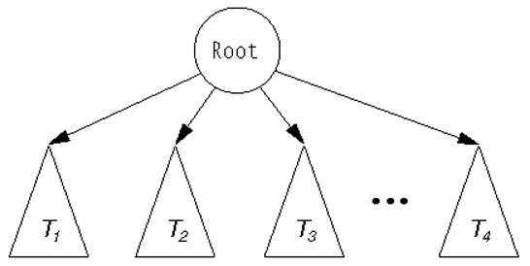
A tree viewed recursively

Slide 30
Binary Tree
public class BinTree {
Object data;
BinTree leftChild;
BinTree rightChild;
….// accessor methods
}

Slide 31
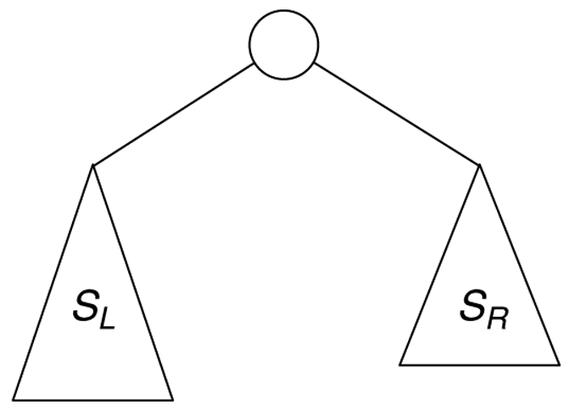
Exercise:Size of a tree
Recursive view
S_{T} = S_{L} + S_{R} + 1

Slide 32
Size of a Tree Quiz
public static int size (BinaryNode t) {
}

Slide 33
Size of a Tree
public static int size (BinaryNode t) {
if (t == null)
return 0 ;
else
return 1 + size(t.left) + size(t.right);
}

Slide 34
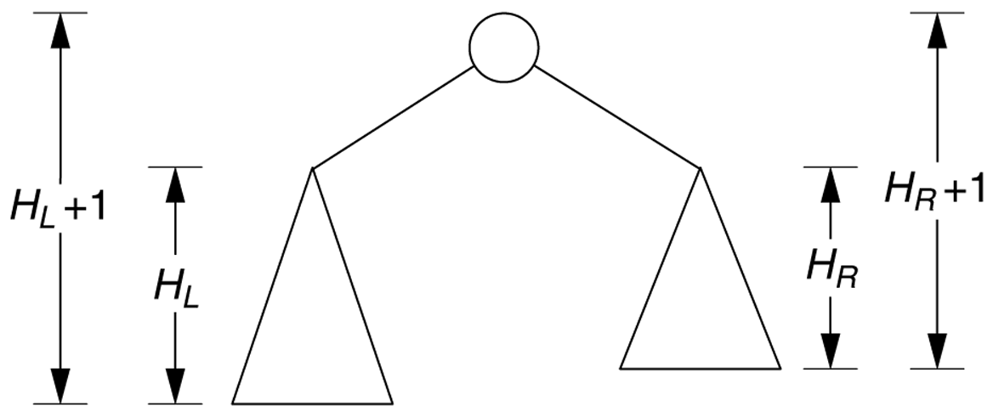
Height of a tree
Recursive view of height calculation
H_{T} = Max(H_{L},H_{R}) + 1;

Slide 35
Height of a Tree
public static int height (BinaryNode t) {
if (t == null) return -1 ;
else
return
1 + Math.max(height(t.left))
,(height(t.right));
}

Slide 36
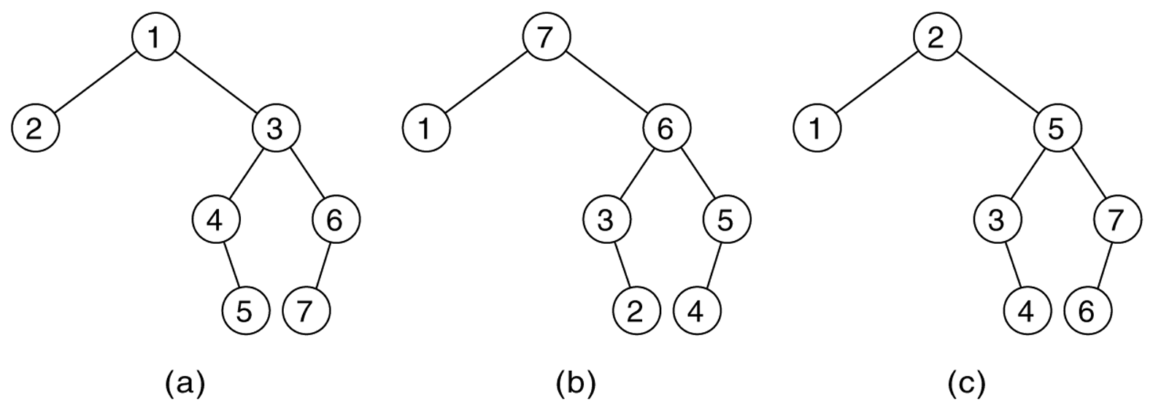
Tree Traversal
Preorder
Postorder
Inorder

Slide 37
Preorder
public void printPreOrder() {
}

Slide 38
Preorder
public void printPreOrder() {
System.out.println(element);
if (left != null)
left.printPreOrder();
if (right != null)
right.printPreOrder();
}

Slide 39
Inorder
public void printInOrder() {
}

Slide 40
Inorder
public void printInOrder() {
if (left != null)
left.printInOrder(); System.out.println(element);
if (right != null)
right.printInOrder();
}

Slide 41
Postorder
public void printPostOrder() {
}

Slide 42
Postorder
public void printPostOrder() {
if (left != null)
left.printPostOrder();
if (right != null)
right.printPostOrder();
System.out.println(element);
}

