Slide 1
CSC 172
DATA STRUCTURES

Slide 2
A PROBLEM WITH BSTs
Common operations on balanced BST are O(log(n))
Alas, when the tree goes out of balance, performance degrades (worst case : chain O(n))
There are several data structures that modify the BST to maintain balance.

Slide 3
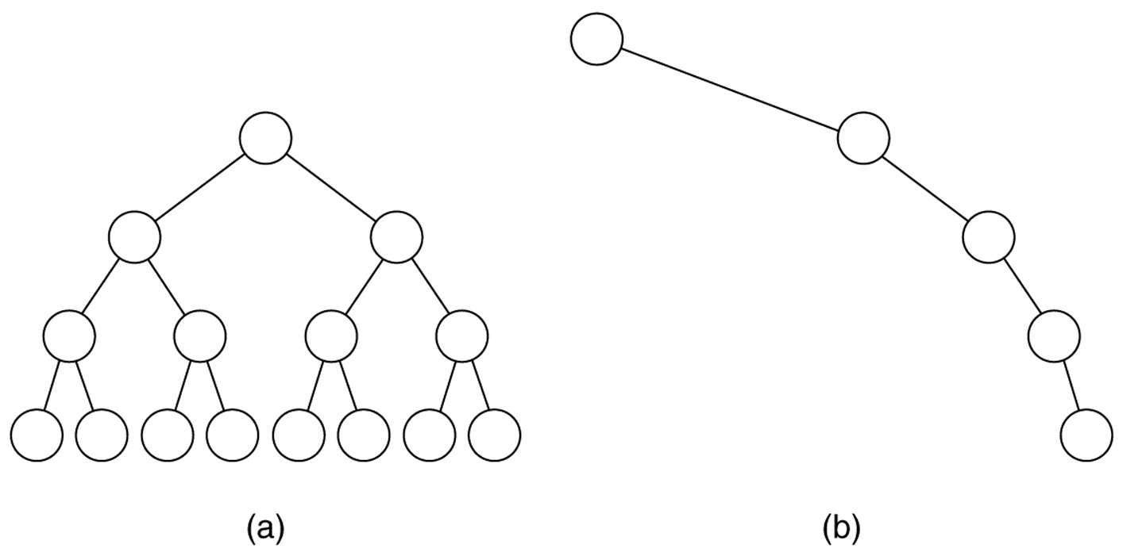
BST Structure : Log & Linear

Slide 4
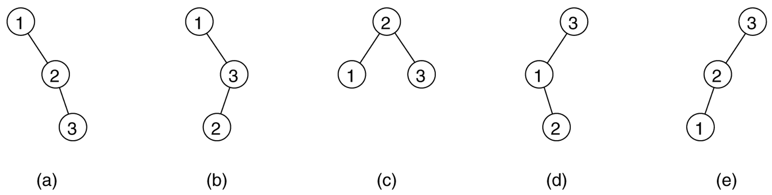
Permutations of 1,2,3

Slide 5
AVL Trees
The first balanced binary search tree
Named after discoverers
Adelson-Velskii and Landis.
DEFINITION:
An AVL tree is a binary search tree with the additional balance property that, for any node in the tree, the height of the left and right subtrees can differ by at most 1. (Height of an empty subtree is –1).

Slide 6
AN AVL TREE
3
What is the height?
12
2
1
8
16
1
0
0
-1
4
10
14
0
0
-1
-1
-1
-1
2
6
What if we insert “7”?
-1
-1
-1
-1

Slide 7
NOT AN AVL TREE
Out of
balance
4
12
3
1
8
16
2
0
0
-1
4
10
14
0
1
-1
-1
-1
-1
2
6
-1
-1
-1
0
7
-1
-1

Slide 8
AVL THEOREM
An AVL tree of n element has height O(log n)
In fact, An AVL tree of height H has at least F_{H+3} –1 nodes, where F_{i} is the i^{th} Fibonacci number

Slide 9
AVL THEOREM
Let S_{H} be the size of smallest AVL tree of height H.
Clearly S₀=1 and S₁=2
S_{H} must have subtrees of height H-1 and H-2
These subtrees must have fewest nodes for height
So, S_{H} = S_{H-1} + S_{H-2} + 1
Minimum number AVL trees are Fibonacci trees

Slide 10
Smallest AVL Tree of height H
H
H-2
H-1
S_{H-2}
S_{H-1}

Slide 11
Adds can unbalance a BST
Only nodes on the path from the root to the insertion point can have their balances altered
If we restore the unbalance node, we balance the tree

Slide 12
AN AVL TREE
3
If we insert 7
We unbalance
the whole tree
12
2
1
8
16
1
0
0
-1
4
10
14
0
0
-1
-1
-1
-1
2
6
-1
-1
-1
-1
What if we insert “15”?

Slide 13
AN AVL TREE
3
If we insert 7
We unbalance
the whole tree
12
2
2
8
16
1
0
1
-1
4
10
14
0
0
-1
-1
-1
0
2
6
15
-1
-1
-1
-1
-1
-1
What if we insert “15”?

Slide 14
4 cases
Insertion in left sub-tree of left child
Insertion in right sub-tree of left child
Insertion in left sub-tree of right child
Insertion in right sub-tree of right child
1 & 4 are symmetric
2 & 3 are symmetric

Slide 15
Cases 1 & 4
Insertion extends
Tree ‘A’
k₂
k₁
H
H-2
C
H-2
H-2
A
B

Slide 16
Cases 1 & 4
Insertion extends
Tree ‘A’
“Rotation” fixes
balance
k₂
k₁
H-2
C
H-2
H-1
A
B

Slide 17
Cases 1 & 4
Insertion extends
Tree ‘A’
“Rotation” fixes
balance
k₁
k₂
H
H-2
H-1
A
H-2
C
B

Slide 18
Cases 2 & 3
Insertion extends
Tree ‘B’
k₂
k₁
H
H-2
C
H-2
H-2
A
B

Slide 19
Cases 2 & 3
Insertion extends
Tree ‘B’
k₂
k₁
H-2
C
H-1
H-2
A
B

Slide 20
Cases 2 & 3
Insertion extends
Tree ‘B’
“Rotation”
Does not fix
balance
k₁
k₂
H-2
H-2
A
H-1
C
B

Slide 21
Double Rotation
If x is out of balance for cases 2&3
Rotate between X’s child and grandchild
Rotate between X and it’s new child

Slide 22
Cases 2 & 3
Insertion extends
Tree ‘B’
k₂
k₁
H
H-2
C
H-2
H-2
A
B

Slide 23
Cases 2 & 3
Insertion extends
Tree ‘B’ or ‘C’
k₂
k₁
H
k₃
H-2
D
H-3
H-2
A
B
C

Slide 24
Cases 2 & 3
Rotate grandchild
With child
Insertion extends
Tree ‘B’ or ‘C’
k₂
k₁
k₃
H-2
D
H-2
H-2
A
B
C

Slide 25
Cases 2 & 3
Rotate grandchild
With child
Insertion extends
Tree ‘B’ or ‘C’
k₂
Rotate X with
new child
k₃
k₁
H-2
D
H-2
C
H-2
A
B

Slide 26
Cases 2 & 3
Rotate grandchild
With child
Insertion extends
Tree ‘B’ or ‘C’
k₃
Rotate X with
new child
k₂
k₁
H-2
H-2
H-2
A
B
C
D

Slide 27
Implementation
Do this in lab
Insert
Fixup
Rotate
Need to keep track of balance

Slide 28
Rotation
private void rotateLeft(Node p) {
Node r = p.right;
p.right = r.left;
if (r.left != null) r.left.parent = p;
r.parent = p.parent;
if (p.parent == null) {root = r; r.parent = null;}
else if (p.parent.left == p) p.parent.left = r;
else p.parent.right = r;
r.left = p;
p.parent = r;
}

Slide 29
root
element
left
right
parent
50
φ
φ
80
φ
φ
φ

Slide 30
p
r
root
element
left
right
parent
50
φ
φ
Entry r = p.right;
80
φ
90
φ
φ

Slide 31
p
r
root
element
left
right
parent
50
φ
φ
φ
Entry r = p.right;
p.right = r.left;
80
φ
90
φ
φ

Slide 32
p
r
root
element
left
right
parent
50
φ
φ
φ
Entry r = p.right;
p.right = r.left;
if (r.left != null) r.left.parent = p;
if (p.parent == null)root = r;
r.parent = p.parent;
80
φ
φ
90
φ
φ

Slide 33
p
r
root
element
left
right
parent
50
φ
φ
φ
Entry r = p.right;
p.right = r.left;
if (r.left != null) r.left.parent = p;
r.parent = p.parent;
if (p.parent == null) root = r;
else if …
else …
r.left = p;
80
φ
90
φ
φ

Slide 34
p
r
root
element
left
right
parent
50
φ
φ
φ
Entry r = p.right;
p.right = r.left;
if (r.left != null) r.left.parent = p;
r.parent = p.parent;
if (p.parent == null){ root = r; ..}
else if …
else …
r.left = p;
p.parent = r;
80
φ
90
φ
φ

Slide 35
Node class
private static class Node {
Object element;
char balanceFactor = ‘=‘; // new nodes are balanced
// we could set this to R or L indicating child with > height
Node left = null, right = null, parent;
Node (Object element, Node parent) {
this.element = element;
this.parent = parent;
}
}

Slide 36
50
R
20
80
L
R
10
70
100
=
=
=
92
50
=
=

Slide 37
public boolen add(Object o){
if (root == null) {
root = new Node(o,null);
size++;
return true;
}// empty tree
else {
Node temp = root,
ancestor = null; // we keep track of nearest unbalanced ancestor
int comp;
while (true) {
comp = ((Comparable)o).compareTo(temp.element);
if (comp == 0) return false;

Slide 38
if (comp < 0) {
if (temp.balanceFactor != ‘=‘) ancestor = temp;
if (temp.left != null) temp = temp.left;
else {
temp.left = new Node(o,temp);
fixAfterInsertion(ancestor,temp.left);
size++;
}
}// comp < 0

Slide 39
else { // comp > 0
if (temp.balanceFactor != ‘=‘) ancestor = temp;
if (temp.right != null) temp = temp.right;
else {
temp.rig = new Node(o,temp);
fixAfterInsertion(ancestor,temp.right);
size++;
}
}// comp < 0
}// while
}// root not null
}//method add

Slide 40
Adjusting paths
50
=
25
70
=
=
15
30
60
90
=
=
=
=
55
=

Slide 41
Adjusting paths
50
R
25
70
=
L
15
30
60
90
=
=
L
=
55
=

Slide 42
protected void adjustPath(Entry to, Entry inserted) {
Object o = inserted.element;
Node temp = inserted.parent;
while (temp != to) {
if (((Comparable)o).compareTo(temp.element)<0)
temp.balanceFactor = ‘L’;
else
temp.balanceFactor = ‘R’;
temp= temp.parent
}// while
} //adjust path

Slide 43
protected void fixAfterInsertion(Node ancestor, Entry inserted) {
Object o = inserted element;
if (ancestor == null) {
if (((Comparable)o).compareTo(root.element)<0)
root.balanceFactor = ‘L’;
else
root.balanceFactor = ‘R’;
adjustPath(root,inserted);
} // Case 1: all ancestor of inserted element have ‘=‘ balanceFactor

Slide 44
if ((ancestor.balanceFactor == ‘L’ &&
((Comparable)o).compareTo(ancestor.element)>0)||
(ancestor.balanceFactor == ‘R’ &&
((Comparable)o).compareTo(ancestor.element)<0)){
ancestor.balanceFactor = ‘=’;
adjustPath(ancestor,inserted);
} // Case 2: insertion causes ancestor’s balanceFactor to ‘=‘

Slide 45
if ((ancestor.balanceFactor == ‘R’ &&
((Comparable)o).compareTo(ancestor.right.element)>0){
ancestor.balanceFactor = ‘=’;
rotateLeft(ancestor);
adjustPath(ancestor.parent,inserted);
} // Case 3: ancestor’s balance factor = ‘R’
// and o > ancestor’s right child

Slide 46
if ((ancestor.balanceFactor == ‘L’ &&
((Comparable)o).compareTo(ancestor.left.element)<0){
ancestor.balanceFactor = ‘=’;
rotateRight(ancestor);
adjustPath(ancestor.parent,inserted);
} // Case 4: ancestor’s balance factor = ‘L’
// and o < ancestor’s right child

Slide 47
if (ancestor.balanceFactor == ‘L’ &&
((Comparable)o).compareTo(ancestor.left.element)>0){
rotateLeft(ancestor.left);
rotateRight(ancestor);
adjustLeftRight(ancestor,inserted);
} // Case 5: ancestor’s balanceFactor = ‘L’
// and o > ancestor’s left child

Slide 48
else{
rotateRight(ancestor.right);
rotateLeft(ancestor);
adjustRightLeft(ancestor,inserted);
} // Case 6: ancestor’s balanceFactor = ‘R’
// and o < ancestor’s right child
}// fixAfterInsertion

Slide 49
protected void adjustLeftRight(Entry ancestor, Entry inserted) {
Object o = inserted.element;
if (ancestor.parent == inserted) ancestor.balanceFactor = ‘=‘;
else if (((Comparable)o).compareTo(ancestor.parent.element)<0){
ancestor.balanceFactor = ‘R’;
adjustPath(ancestor.parent.left,inserted);
}// o < ancestor’s parent
else {
ancestor.balanceFactor = ‘=’;
ancestor.parent.left.balanceFactor = ‘L’;
adjustPath(ancestor,inserted);
}// while
} //adjustLeftRight

Slide 50
AdjustLeftRight Case 1
50
40
L
=
30
30
50
=
=
=
40
=

Slide 51
AdjustLeftRight Case2
50
L
20
90
=
=
10
40
70
100
=
=
=
=
5
15
30
45
Rotate Left around 20
Right around 50
=
=
=
=
35
=

Slide 52
AdjustLeftRight Case2
40
=
20
50
=
R
10
30
45
90
=
R
=
=
5
15
35
70
100
=
=
=
=
=

Slide 53
AdjustLeftRight Case3
50
L
20
90
=
=
10
40
70
100
=
=
=
=
5
15
30
45
Rotate Left around 20
Right around 50
=
=
=
=
42
=

Slide 54
AdjustLeftRight Case3
40
=
20
50
L
=
10
30
45
90
=
=
L
=
5
15
42
70
100
=
=
=
=
=

Slide 55
protected void adjustRightLeft(Entry ancestor, Entry inserted) {
Object o = inserted.element;
if (ancestor.parent == inserted) ancestor.balanceFactor = ‘=‘;
else if (((Comparable)o).compareTo(ancestor.parent.element)>0){
ancestor.balanceFactor = ‘L’;
adjustPath(ancestor.parent.right,inserted);
}// o < ancestor’s parent
else {
ancestor.balanceFactor = ‘=’;
ancestor.parent.right.balanceFactor = ‘R’;
adjustPath(ancestor,inserted);
}// while
} //adjustRightLeft

