Slide 1
Quicksort
CSC 172

Slide 2
Quicksort
The basic quicksort algorithm is recursive
  Chosing the pivot
  Deciding how to partition
  Dealing with duplicates
Wrong decisions give quadratic run times run times
Good decisions give n log n run time

Slide 3
The Quicksort Algorithm
The basic algorithm Quicksort(S) has 4 steps
If the number of elements in S is 0 or 1, return
Pick any element v in S. It is called the pivot.
Partition S – {v} (the remaining elements in S) into two disjoint groups
L = {x ∈ S – {v}|x ≤ v}
R = {x ∈ S – {v}|x ≥ v}
4. Return the results of Quicksort(L) followed by v followed by Quicksort(R)

Slide 4
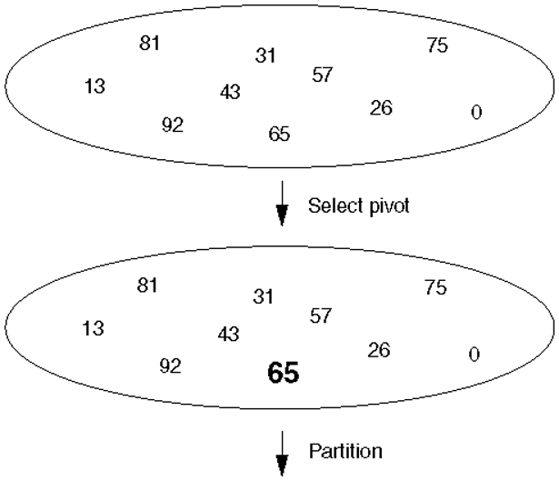

Slide 5
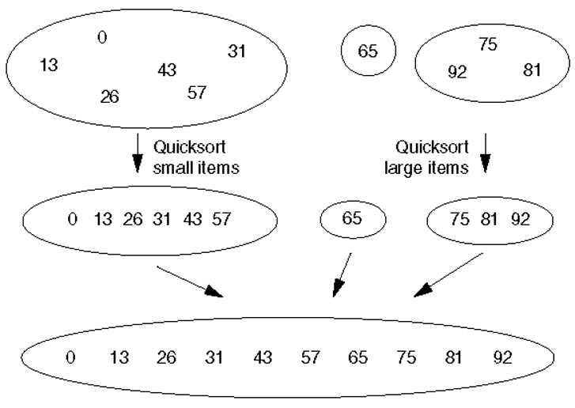

Slide 6
Write The Quicksort Algorithm
The basic algorithm Quicksort(S) has 4 steps
If the number of elements in S is 0 or 1, return
Pick any element v in S. It is called the pivot.
Partition S – {v} (the remaining elements in S) into two disjoint groups
L = {x ∈ S – {v}|x ≤ v}
R = {x ∈ S – {v}|x ≥ v}
Return the results of Quicksort(L) followed by v followed by Quicksort(R)
(assume partition(pivot,list) & append(l1,piv,l2))

Slide 7
public static Node qsort(Node n) {
Node list = n;
if ((list == null) || (list.next == null)) return list;
Comparable pivot = list.data;
list = list.next;
Node secondList = partition(pivot,list);
return append(qsort(list),pivot,qsort(secondList));
}

Slide 8
Some Observations
Multibase case (0 and 1)
Any element can be used as the pivot
The pivot divides the array elements into two groups
  elements smaller than the pivot
  elements larger than the pivot
Some choice of pivots are better than others
The best choice of pivots equally divides the array
Elements equal to the pivot can go in either group

Slide 9
Example
85 | 24 | 63 | 45 | 17 | 31 | 96 | 50

Slide 10
Example
85 | 24 | 63 | 45 | 17 | 31 | 96 | 50

Slide 11
Example
85 | 24 | 63 | 45 | 17 | 31 | 96 | 50
24 | 45 | 17 | 31 | 50 | 85 | 63 | 96

Slide 12
Example
85 | 24 | 63 | 45 | 17 | 31 | 96 | 50
24 | 45 | 17 | 31 | 50 | 85 | 63 | 96
24 | 45 | 17 | 31
85 | 63 | 96

Slide 13
Example
85 | 24 | 63 | 45 | 17 | 31 | 96 | 50
24 | 45 | 17 | 31 | 50 | 85 | 63 | 96
24 | 45 | 17 | 31
85 | 63 | 96

Slide 14
Example
85 | 24 | 63 | 45 | 17 | 31 | 96 | 50
24 | 45 | 17 | 31 | 50 | 85 | 63 | 96
24 | 45 | 17 | 31
85 | 63 | 96
24 | 17 | 31 | 45

Slide 15
Example
85 | 24 | 63 | 45 | 17 | 31 | 96 | 50
24 | 45 | 17 | 31 | 50 | 85 | 63 | 96
24 | 45 | 17 | 31
85 | 63 | 96
24 | 17 | 31 | 45
24 | 17
45

Slide 16
Example
85 | 24 | 63 | 45 | 17 | 31 | 96 | 50
24 | 45 | 17 | 31 | 50 | 85 | 63 | 96
24 | 45 | 17 | 31
85 | 63 | 96
24 | 17 | 31 | 45
24 | 17
45

Slide 17
Example
85 | 24 | 63 | 45 | 17 | 31 | 96 | 50
24 | 45 | 17 | 31 | 50 | 85 | 63 | 96
24 | 45 | 17 | 31
85 | 63 | 96
24 | 17 | 31 | 45
17 | 24
45

Slide 18
Example
85 | 24 | 63 | 45 | 17 | 31 | 96 | 50
24 | 45 | 17 | 31 | 50 | 85 | 63 | 96
24 | 45 | 17 | 31
85 | 63 | 96
24 | 17 | 31 | 45
17 | 24
45
24

Slide 19
Example
85 | 24 | 63 | 45 | 17 | 31 | 96 | 50
24 | 45 | 17 | 31 | 50 | 85 | 63 | 96
24 | 45 | 17 | 31
85 | 63 | 96
24 | 17 | 31 | 45
17 | 24
45

Slide 20
Example
85 | 24 | 63 | 45 | 17 | 31 | 96 | 50
24 | 45 | 17 | 31 | 50 | 85 | 63 | 96
24 | 45 | 17 | 31
85 | 63 | 96
17 | 24 | 31 | 45
45

Slide 21
Example
85 | 24 | 63 | 45 | 17 | 31 | 96 | 50
24 | 45 | 17 | 31 | 50 | 85 | 63 | 96
24 | 45 | 17 | 31
85 | 63 | 96
17 | 24 | 31 | 45

Slide 22
Example
85 | 24 | 63 | 45 | 17 | 31 | 96 | 50
24 | 45 | 17 | 31 | 50 | 85 | 63 | 96
17 | 24 | 31 | 45
85 | 63 | 96

Slide 23
Example
85 | 24 | 63 | 45 | 17 | 31 | 96 | 50
17 | 24 | 31 | 45 | 50 | 85 | 63 | 96
85 | 63 | 96

Slide 24
Example
85 | 24 | 63 | 45 | 17 | 31 | 96 | 50
17 | 24 | 31 | 45 | 50 | 85 | 63 | 96
85 | 63 | 96

Slide 25
Example
85 | 24 | 63 | 45 | 17 | 31 | 96 | 50
17 | 24 | 31 | 45 | 50 | 85 | 63 | 96
85 | 63 | 96

Slide 26
Example
85 | 24 | 63 | 45 | 17 | 31 | 96 | 50
17 | 24 | 31 | 45 | 50 | 85 | 63 | 96
85 | 63 | 96
85 | 63

Slide 27
Example
85 | 24 | 63 | 45 | 17 | 31 | 96 | 50
17 | 24 | 31 | 45 | 50 | 85 | 63 | 96
85 | 63 | 96
85 | 63

Slide 28
Example
85 | 24 | 63 | 45 | 17 | 31 | 96 | 50
17 | 24 | 31 | 45 | 50 | 85 | 63 | 96
85 | 63 | 96
63 | 85

Slide 29
Example
85 | 24 | 63 | 45 | 17 | 31 | 96 | 50
17 | 24 | 31 | 45 | 50 | 85 | 63 | 96
85 | 63 | 96
63 | 85
85

Slide 30
Example
85 | 24 | 63 | 45 | 17 | 31 | 96 | 50
17 | 24 | 31 | 45 | 50 | 85 | 63 | 96
85 | 63 | 96
63 | 85

Slide 31
Example
85 | 24 | 63 | 45 | 17 | 31 | 96 | 50
17 | 24 | 31 | 45 | 50 | 85 | 63 | 96
63 | 85 | 96

Slide 32
Example
85 | 24 | 63 | 45 | 17 | 31 | 96 | 50
17 | 24 | 31 | 45 | 50 | 63 | 85 | 96

Slide 33
Example
17 | 24 | 31 | 45 | 50 | 63 | 85 | 96

Slide 34
Running Time
What is the running time of Quicksort?
Depends on how well we pick the pivot
So, we can look at
Best case
Worst case
Average (expected) case

Slide 35
Worst case
(give me the bad news first)
What is the worst case?
What would happen if we called Quicksort (as shown in the example) on the sorted array?

Slide 36
Example
17 | 24 | 31 | 45 | 50 | 63 | 85 | 96

Slide 37
Example
17 | 24 | 31 | 45 | 50 | 63 | 85 | 96

Slide 38
Example
17 | 24 | 31 | 45 | 50 | 63 | 85 | 96
17 | 24 | 31 | 45 | 50 | 63 | 85 | 96

Slide 39
Example
17 | 24 | 31 | 45 | 50 | 63 | 85 | 96
17 | 24 | 31 | 45 | 50 | 63 | 85 | 96
17 | 24 | 31 | 45 | 50 | 63 | 85

Slide 40
Example
17 | 24 | 31 | 45 | 50 | 63 | 85 | 96
17 | 24 | 31 | 45 | 50 | 63 | 85 | 96
17 | 24 | 31 | 45 | 50 | 63 | 85

Slide 41
Example
17 | 24 | 31 | 45 | 50 | 63 | 85 | 96
17 | 24 | 31 | 45 | 50 | 63 | 85 | 96
17 | 24 | 31 | 45 | 50 | 63 | 85

Slide 42
Example
17 | 24 | 31 | 45 | 50 | 63 | 85 | 96
17 | 24 | 31 | 45 | 50 | 63 | 85 | 96
17 | 24 | 31 | 45 | 50 | 63 | 85
17 | 24 | 31 | 45 | 50 | 63
How high will this tree call stack get?

Slide 43
Worst Case
T(n) = T(n-1) + n
For the recursive call
For the comparisons
in the partitioning

Slide 44
Worst case expansion
T(n) = T(n-1) + n
T(n) = T(n-2) + (n-1) + n
T(n) = T(n-3) + (n-2) + (n-1) + n
….
T(n) = T(n-(n-1)) + 2 + 3 + … + (n-2)+(n-1) +n
T(n) = 1 + 2 + 3 + … + (n-2)+(n-1) +n
T(n) = n(n+1)/2 = O(n²)

Slide 45
Best Case
Intuitively, the best case for quicksort is that the pivot partitons the set into two equally sized subsets and that this partitioning happens at every level
Then, we have two half sized recursive calls plus linear overhead
T(n) = 2T(n/2) + n
O(n log n)
Just like our old friend, MergeSort

Slide 46
Best Case
More precisely, consider how much work is done at each “level”
We can think of the quick-sort “tree”
Let s_{i}(n) denote the sum of the input sizes of the nodes at depth i in the tree

Slide 47
Example
15 | 7 | 9 | 3 | 13 | 5 | 11 | 2 | 14 | 6 | 10 | 1 | 12 | 4 | 8

Slide 48
Example
15 | 7 | 9 | 3 | 13 | 5 | 11 | 2 | 14 | 6 | 10 | 1 | 12 | 4 | 8

Slide 49
Example
7 | 3 | 6 | 2 | 5 | 1 | 4 | 8 | 15 | 9 | 13 | 11 | 14 | 10 | 12

Slide 50
Example
7 | 3 | 6 | 1 | 5 | 2 | 4 | 8 | 15 | 9 | 13 | 11 | 14 | 10 | 12
7 | 3 | 6 | 1 | 5 | 2 | 4
15 | 9 | 13 | 11 | 14 | 10 | 12

Slide 51
Example
7 | 3 | 6 | 1 | 5 | 2 | 4 | 8 | 15 | 9 | 13 | 11 | 14 | 10 | 12
7 | 3 | 6 | 1 | 5 | 2 | 4
15 | 9 | 13 | 11 | 14 | 10 | 12

Slide 52
Example
7 | 3 | 5 | 1 | 6 | 2 | 4 | 8 | 15 | 9 | 13 | 11 | 14 | 10 | 12
3 | 1 | 2 | 4 | 7 | 5 | 6
9 | 11 | 10 | 12 | 15 | 13 | 14

Slide 53
Example
7 | 3 | 5 | 1 | 6 | 2 | 4 | 8 | 15 | 9 | 13 | 11 | 14 | 10 | 12
3 | 1 | 2 | 4 | 7 | 5 | 6
9 | 11 | 10 | 12 | 15 | 13 | 14
3 | 1 | 2
7 | 5 | 6
9 | 11 | 10
15 | 13 | 14

Slide 54
Example
7 | 3 | 5 | 1 | 6 | 2 | 4 | 8 | 15 | 9 | 13 | 11 | 14 | 10 | 12
3 | 1 | 2 | 4 | 7 | 5 | 6
9 | 11 | 10 | 12 | 15 | 13 | 14
3 | 1 | 2
7 | 5 | 6
9 | 11 | 10
15 | 13 | 14

Slide 55
Example
7 | 3 | 5 | 1 | 6 | 2 | 4 | 8 | 15 | 9 | 13 | 11 | 14 | 10 | 12
3 | 1 | 2 | 4 | 7 | 5 | 6
9 | 11 | 10 | 12 | 15 | 13 | 14
1 | 2 | 3
5 | 6 | 7
9 | 10 | 11
13 | 14 | 15

Slide 56
Example
7 | 3 | 5 | 1 | 6 | 2 | 4 | 8 | 15 | 9 | 13 | 11 | 14 | 10 | 12
3 | 1 | 2 | 4 | 7 | 5 | 6
9 | 11 | 10 | 12 | 15 | 13 | 14
1 | 2 | 3
5 | 6 | 7
9 | 10 | 11
13 | 14 | 15
1
3
5
7
9
11
13
15

Slide 57
What is size at each level?
n
7 | 3 | 5 | 1 | 6 | 2 | 4 | 8 | 15 | 9 | 13 | 11 | 14 | 10 | 12
n-1
3 | 1 | 2 | 4 | 7 | 5 | 6
9 | 11 | 10 | 12 | 15 | 13 | 14
n-3
1 | 2 | 3
5 | 6 | 7
9 | 10 | 11
13 | 14 | 15
n-7
1
3
5
7
9
11
13
15
What is the general rule?

Slide 58
Best Case, more precisely
S₀(n) = n
S₁(n) = n - 1
S₂(n) = (n – 1) – 2 = n – (1 + 2) = n-3
S₃(n) = ((n – 1) – 2) - 4 = n – (1 + 2 + 4) = n-7
…
S_{i}(n) = n – ( 1 + 2 + 2²+ … + 2^{i-1}) = n - 2^{i} + 1
Height is O(log n)
No more than n work is done at any one level
Best case time complexity is O(n log n)

Slide 59
Average case QuickSort
Because the run time of quicksort can vary, we would like to know the average performance.
The cost to quicksort N items equals N units for the partitioning plus the cost of the two recursive calls
The average cost of each recursive call equals the average over all possible sub-problem sizes

Slide 60
Average cost of the recursive calls

Slide 61
Recurrence Relation
Notes:
Subtract Eq3 from Eq2 to get Eq4

Slide 62
Telescoping
……

Slide 63
So,
Nth Harmonic number is O(log N)

Slide 64
Intuitively
f(x)= 1/x
1/2
1/3
area =
log(x)
1
2
3
n

Slide 65
Picking the Pivot
A fast choice is important
NEVER use the first (or last) element as the pivot!
Sorted (or nearly sorted) arrays will end up with quadratic run times.
The middle element is reasonable x[(low+high)/2]
but there could be some bad cases

Slide 66
Median of three partitioning
Take the median (middle value) of the
first,
last,
middle

Slide 67
In place partitioning
Pick the pivot
Swap the pivot with the last element
Scanning
  Run i from left to right
  when i encounters a large element, stop
  Run j from right to left
  when j encounters a small element, stop
If i and j have not crossed, swap values and continue scanning
If i and j have crossed, swap the pivot with element i

Slide 68
Example
8 | 1 | 4 | 9 | 6 | 3 | 5 | 2 | 7 | 0
Quicksort(a,low,high)
Quicksort(a,0,9)

Slide 69
Example
8 | 1 | 4 | 9 | 6 | 3 | 5 | 2 | 7 | 0

Slide 70
Example
8 | 1 | 4 | 9 | 6 | 3 | 5 | 2 | 7 | 0

Slide 71
Example
8 | 1 | 4 | 9 | 0 | 3 | 5 | 2 | 7 | 6

Slide 72
Example
8 | 1 | 4 | 9 | 0 | 3 | 5 | 2 | 7 | 6
i
j

Slide 73
Example
8 | 1 | 4 | 9 | 0 | 3 | 5 | 2 | 7 | 6
i
j

Slide 74
Example
2 | 1 | 4 | 9 | 0 | 3 | 5 | 8 | 7 | 6
i
j

Slide 75
Example
2 | 1 | 4 | 9 | 0 | 3 | 5 | 8 | 7 | 6
i
j

Slide 76
Example
2 | 1 | 4 | 9 | 0 | 3 | 5 | 8 | 7 | 6
i
j

Slide 77
Example
2 | 1 | 4 | 9 | 0 | 3 | 5 | 8 | 7 | 6
i
j

Slide 78
Example
2 | 1 | 4 | 9 | 0 | 3 | 5 | 8 | 7 | 6
i
j

Slide 79
Example
2 | 1 | 4 | 5 | 0 | 3 | 9 | 8 | 7 | 6
i
j

Slide 80
Example
2 | 1 | 4 | 5 | 0 | 3 | 9 | 8 | 7 | 6
i
j

Slide 81
Example
2 | 1 | 4 | 5 | 0 | 3 | 9 | 8 | 7 | 6
i
j

Slide 82
Example
2 | 1 | 4 | 5 | 0 | 3 | 9 | 8 | 7 | 6
i
j

Slide 83
Example
2 | 1 | 4 | 5 | 0 | 3 | 9 | 8 | 7 | 6
j
i

Slide 84
Example
2 | 1 | 4 | 5 | 0 | 3 | 6 | 8 | 7 | 9
j
i
Now, Quicksort(a,low,i-1) and Quicksort(a,i+1,high)

Slide 85
Java Quicksort
public static void quicksort(Comparable [] a) {
quicksort(a,0,a.length-1);
}

Slide 86
public static void quicksort(Comparable [] a,int low, int high) {
if (low + CUTOFF > high) insertionSort(a,low,high);
else {
int middle = (low + high)/2;
if (a[middle].compareTo(a[low]) < 0) swap(a,low,middle);
if (a[high].compareTo(a[low]) < 0) swap(a,low,high); if (a[high].compareTo(a[middle]) < 0) swap(a,middle,high);
swap(a,middle,high-1);
Comparable pivot = a[high-1];

Slide 87
int i,j;
for (i=low,j=high-1;;) {
while(a[++i].compareTo(pivot) < 0) ;
while(pivot.compareTo(a[--j]) < 0) ;
if (i >= j) break;
swap(a,i,j);
}
swap(a,i,high-1);
quicksort(a,low,i-1);
quicksort(a,i+1;high);
}
}

