Slide 1
CSC 172
DATA STRUCTURES

Slide 2
GRAPHS
A set of nodes
A set of arcs (pairs of nodes)

Slide 3


Slide 4
Structure of the Internet
NAP
Backbone 1
Europe
Backbone 4, 5, N
Japan
NAP
Regional A
Backbone 2
NAP
NAP
Backbone 3
Australia
Regional B
SOURCE: CISCO SYSTEMS

Slide 5
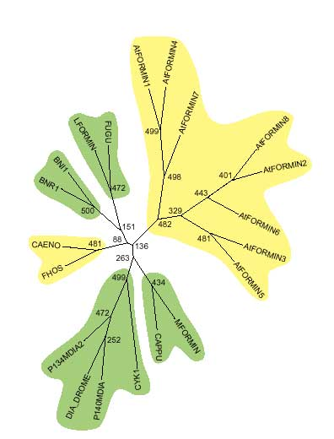
Biology

Slide 6

Economics

Slide 7
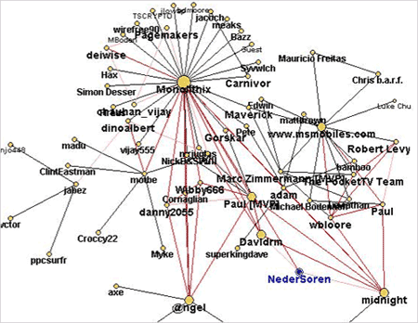
Sociology

Slide 8
Sociology

Slide 9
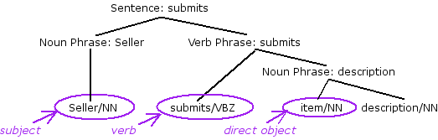
Language

Slide 10
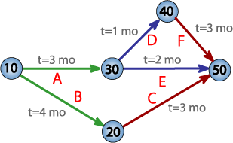
Business

Slide 11
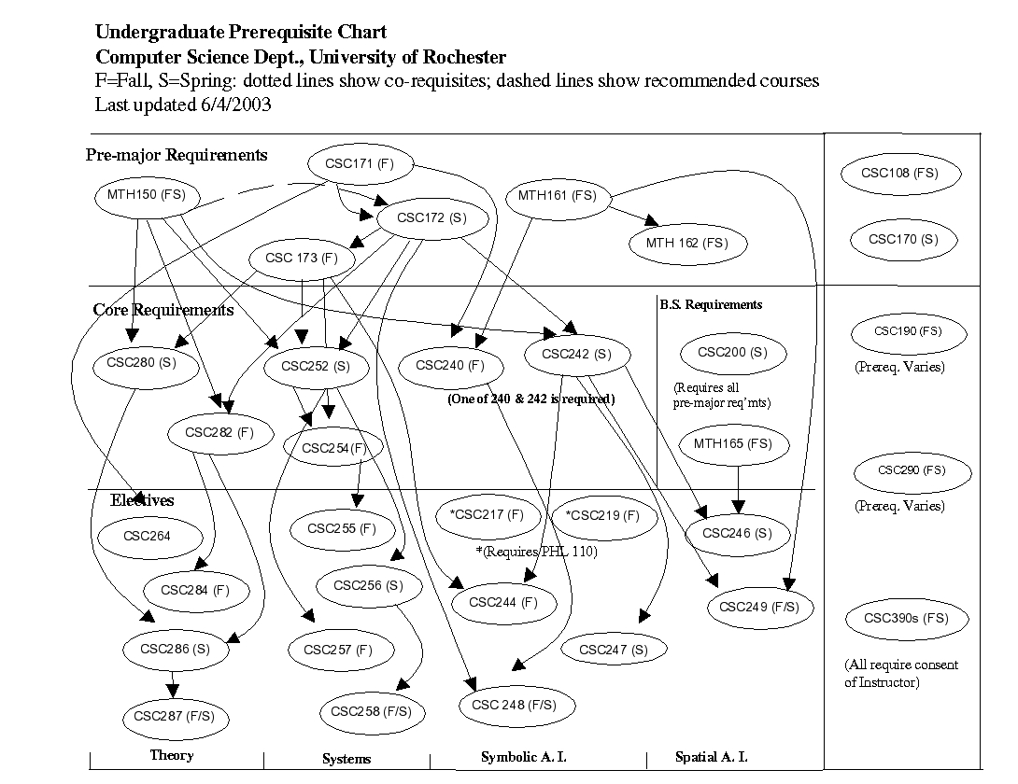
CSC PRE-REQUISITES

Slide 12
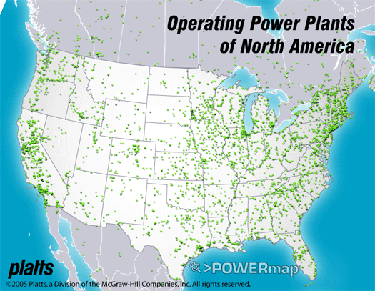

Slide 13
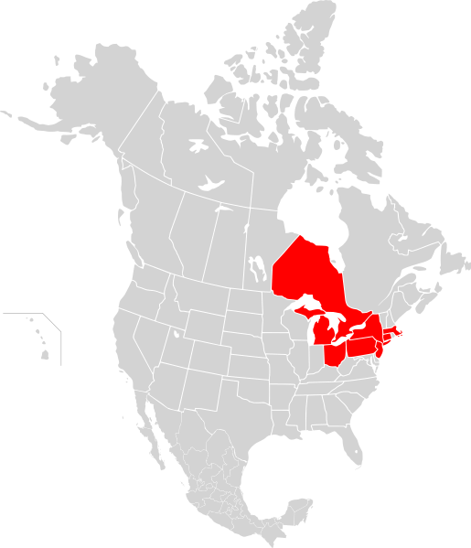
Northeast Blackout Aug 14, 2003

Slide 14
A generating plant in Eastlake, Ohio, a suburb of Cleveland, went off-line amid high electrical demand, and strained high-voltage power lines, located in a distant rural setting, later went out of service when they came in contact with "overgrown trees." The cascading effect that resulted ultimately forced the shutdown of more than 100 power plants.

Slide 15
Aug 14, 2003 , 12:15 p.m. Incorrect telemetry renders inoperative the Ohio-based MISO's state estimator, a power flow monitoring tool. An operator corrects the problem but forgets to restart the tool.
1:31 p.m. The Eastlake, Ohio generating plant shuts down. The plant is owned by FirstEnergy, a company that had experienced extensive recent maintenance problems, including a major nuclear-plant incident in 1985.

Slide 16
FirstEnergy did not take remedial action or warn other control centers until it was too late, because a computer software bug in the energy management system prevented alarms from showing on their control system. The alarm system failed silently without being noticed by the operators, unprocessed events (that had to be checked for an alarm) started to queue up and the primary server failed within 30 minutes. Then all applications (including the stalled alarm system) were automatically transferred to the backup server, which also failed. After this time (14:54), all applications on these two servers stopped working. Another effect of the failing servers was that the screen refresh rate of the operators' computer consoles slowed down from 1-3 seconds to 59 seconds per screen.

Slide 17
GRAPHS
GRAPH G= (V,E)
V: a set of verticies (nodes)
E: a set of edges connecting verticies ∈ V
An edge is a pair of nodes
Example:
V = {a,b,c,d,e,f,g}
E = {(a,b),(a,c),(a,d),(b,e),(c,d),(c,e),(d,e),(e,f)}
a
b
c
d
e
f
g

Slide 18
GRAPHS
Labels (weights) are also possible
Example:
V = {a,b,c,d,e,f,g}
E = {(a,b,4),(a,c,1),(a,d,2),
(b,e,3),(c,d,4),(c,e,6),
(d,e,9),(e,f,7)}
4
a
b
1
2
c
3
4
6
d
e
9
7
f
g

Slide 19
DIGRAPHS
Implicit directions are also possible
Directed edges are arcs
Example:
V = {a,b,c,d,e,f,g}
E = {(a,b),(a,c),(a,d),
(b,e),(c,d),(c,e),
(d,e),(e,f),(f,e)}
a
b
c
d
e
f
g

Slide 20
Sizes
By convention
n = number of nodes
m = the larger of the number of nodes and edges/arcs
Note : m>= n

Slide 21
Complete Graphs
An undirected graph is complete if it has as many edges as possible.
a
a
b
a
b
a
b
a
a
b
n=1
m=0
n=2
m=1
n=3
m=3
n=4
m=6
What is the general form?
Basis is = 0
Every new node (nth) adds (n-1) new edges
(n-1) to add the nth

Slide 22
In general

Slide 23
Paths
In directed graphs, sequence of nodes with arcs from each node to the next.
In an undirected graph: sequence of nodes with an edge between two consecutive nodes
Length of path – number of edges/arcs
If edges/arcs are labeled by numbers (weights) we can sum the labels along a path to get a distance.

Slide 24
Cycles
Directed graph: path that begins and ends at the same node
Simple cycle: no repeats except the ends
The same cycle has many paths representing it, since the beginning/end point may be any node on the cycle
Undirected graph
Simple cycle = sequence of 3 or more nodes with the same beginning/end, but no other repetitions

Slide 25
Representations of Graphs
Adjacency List
Adjacency Matrices

Slide 26
Adjacency Lists
An array or list of headers, one for each node
Undirected: header points to a list of adjacent (shares and edge) nodes.
Directed: header for node v points to a list of successors (nodes w with an arc v → w)
Predecessor = inverse of successor
Labels for nodes may be attached to headers
Labels for arcs/edges are attached to the list cell
Edges are represented twice

Slide 27
Graph
a
a
b
b
c
d
c
d

Slide 28
Adjacency Matrices
Node names must be integers [0…MAX-1]
M[k][j]= true iff there is an edge between nodes k and j (arc k → j for digraphs)
Node labels in separate array
Edge/arc labels can be values M[k][j]
Needs a special label that says “no edge”

Slide 29
a
b
GRAPH
c
1
1
1
1
d
1
1
0
0
1
0
1
1
1
0
1
1

Slide 30
Connected Components

Slide 31
Connected components
a
b
a
b
c
c
d
e
d
e
f
g
f
g
An unconnected graph
(2 components)
A connected graph

Slide 32
Why Connected Components?
Silicon “chips” are built from millions of rectangles on multiple layers of silicon
Certain layers connect electrically
Nodes = rectangles
CC = electrical elements all on one current
Deducing electrical elements is essential for simulation (testing) of the design

Slide 33
Minimum-Weight Spanning Trees
Attach a numerical label to the edges
Find a set of edges of minimum total weight that connect (via some path) every connectable pair of nodes
To represent Connected Components we can have a tree

Slide 35
4
a
b
1
2
c
3
4
6
d
e
9
2
7
f
g
8

Slide 36
4
a
b
1
2
c
3
4
6
d
e
9
2
7
f
g
8

Slide 37
4
a
b
1
2
c
3
d
e
2
7
f
g

Slide 38
Representing Connected Components
Data Structure = tree, at each node
Parent pointer
Height of the subtree rooted at the node
Methods =
Merge/Find
Find(v) finds the root of the tree of which graph node v is a member
Merge(T1,T2) merges trees T1 & T2 by making the root of lesser height a child of the other

Slide 39
Connected Component Algorithm
Start with each graph node in a tree by itself
Look at the edges in some order
If edge {u,v} has ends in different trees (use find(u) & find(v)) then merge the trees
Once we have considered all edges,
each remaining tree will be one CC

Slide 40
Run Time Analysis
Every time a node finds itself on a tree of greater height due to a merge, the tree also has at least twice as many nodes as its former tree
Tree paths never get longer than log₂n
If we consider each of m edges in O(log n) time
we get O(m log n)
Merging is O(1)

Slide 41
Proof
S(h): A tree of height h, formed by the policy of merging lower into higher has at least 2^{h} nodes
Basis: h = 0, (single node), 2⁰ = 1
Induction: Suppose S(h) for some h >= 0

Slide 42
Consider a tree of height h+1
t₂
t₁
Each have height of
At least h
BTIH: T₁ & T₂ have at least 2^{h} nodes, each
2^{h} + 2^{h =} 2^{h+1}

Slide 43
Kruskal’s Algorithm
An example of a “greedy” algorithm
“do what seems best at the moment”
Use the merge/find MWST algorithm on the edges in ascending order
O(m log m)
Since m <= n2, log m <= 2 log n, so O(m log n) time

Slide 44
Find the MWST
A
10
1
F
B
8
7
9
5
2
6
11
12
E
C
4
3
D

Slide 45
Find the minimum cycle
1 + 2 + 3 + 4 + 5 == 15
A
10
1
F
B
8
7
9
5
2
6
11
12
E
C
4
3
D

Slide 46
Traveling Salesman Problem
Find a simple cycle, visiting all nodes, of minimum weight
Does “greedy” work?

Slide 47
Find the minimum cycle
A
10
1
F
B
8
7
9
5
2
6
11
12
E
C
4
3
D

Slide 48
Find the minimum cycle
1 + 2 + 3 + 4 + 5 +10 == 25
A
10
1
F
B
8
7
9
5
2
6
11
12
E
C
4
3
D

Slide 49
Find the minimum cycle
1 + 2 + 3 + 6 + 5 + 7 = 24
A
10
1
F
B
8
7
9
5
2
6
11
12
E
C
4
3
D

