Slide 1
CSC 172
DATA STRUCTURES

Slide 2
SHORTEST WEIGHTED PATH
Traversing a graph
Depth First Search (recursion)
Breath First Search (Queue)
Priority First Search (Priority Queue / Heap)
Dijkstra's Algorithm for Shortest path

Slide 3
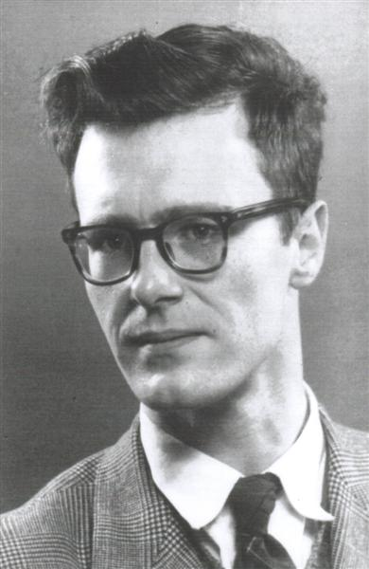
Dijkstra'sAlgorithm
1. Select an unknown vertex with smallest distance. Declare it known.
2. Update all paths from the newly known vertex.

Slide 5
4
a
b
1
2
c
3
4
6
d
e
9
2
7
f
g
8

Slide 6
4
a
b
1
2
c
3
4
6
d
e
9
2
7
f
g
8

Slide 7
4
a
b
1
2
c
3
d
e
2
7
f
g

Slide 8
Representing Connected Components
Data Structure = tree, at each node
Parent pointer
Height of the subtree rooted at the node
Methods =
Merge/Find
Find(v) finds the root of the tree of which graph node v is a member
Merge(T1,T2) merges trees T1 & T2 by making the root of lesser height a child of the other

Slide 9
Connected Component Algorithm
Start with each graph node in a tree by itself
Look at the edges in some order
If edge {u,v} has ends in different trees (use find(u) & find(v)) then merge the trees
Once we have considered all edges,
each remaining tree will be one CC

Slide 10
Run Time Analysis
Every time a node finds itself on a tree of greater height due to a merge, the tree also has at least twice as many nodes as its former tree
Tree paths never get longer than log₂n
If we consider each of m edges in O(log n) time
we get O(m log n)
Merging is O(1)

Slide 11
Proof
S(h): A tree of height h, formed by the policy of merging lower into higher has at least 2^{h} nodes
Basis: h = 0, (single node), 2⁰ = 1
Induction: Suppose S(h) for some h >= 0

Slide 12
Consider a tree of height h+1
t₂
t₁
Each have height of
At least h
BTIH: T₁ & T₂ have at least 2^{h} nodes, each
2^{h} + 2^{h =} 2^{h+1}

Slide 13
Kruskal’s Algorithm
An example of a “greedy” algorithm
“do what seems best at the moment”
Use the merge/find MWST algorithm on the edges in ascending order
O(m log m)
Since m <= n2, log m <= 2 log n, so O(m log n) time

Slide 14
Find the MWST
A
10
1
F
B
8
7
9
5
2
6
11
12
E
C
4
3
D

Slide 15
Find the minimum cycle
1 + 2 + 3 + 4 + 5 == 15
A
10
1
F
B
8
7
9
5
2
6
11
12
E
C
4
3
D

Slide 16
Traveling Salesman Problem
Find a simple cycle, visiting all nodes, of minimum weight
Does “greedy” work?

Slide 17
Find the minimum cycle
A
10
1
F
B
8
7
9
5
2
6
11
12
E
C
4
3
D

Slide 18
Find the minimum cycle
1 + 2 + 3 + 4 + 5 +10 == 25
A
10
1
F
B
8
7
9
5
2
6
11
12
E
C
4
3
D

Slide 19
Find the minimum cycle
1 + 2 + 3 + 6 + 5 + 7 = 24
A
10
1
F
B
8
7
9
5
2
6
11
12
E
C
4
3
D

