Slide 1
CSC 172
DATA STRUCTURES

Slide 2
DYNAMIC PROGRAMMING
TABULATION
MEMMOIZATION

Slide 3
Dynamic Programming
If you can mathematically express a problem recursively, then you can express it as a recursive algorithm.
However, sometimes, this can be inefficiently expressed by a compiler
  Fibonacci numbers
To avoid this recursive “explosion” we can use dynamic programming

Slide 4
Fibonacci Numbers

Slide 5

Fibonacci Numbers

Slide 6
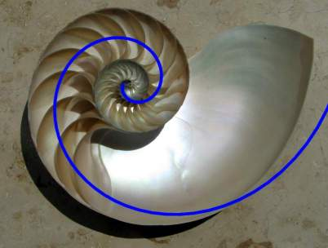
Fibonacci Numbers

Slide 7
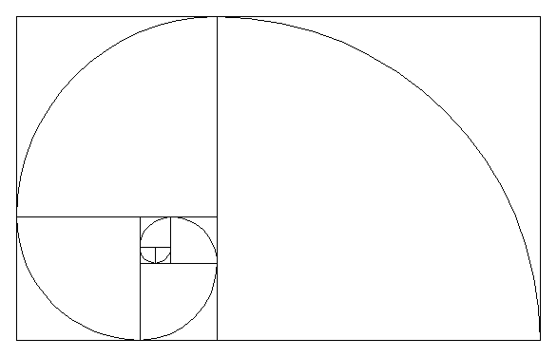
Fibonacci Numbers

Slide 8
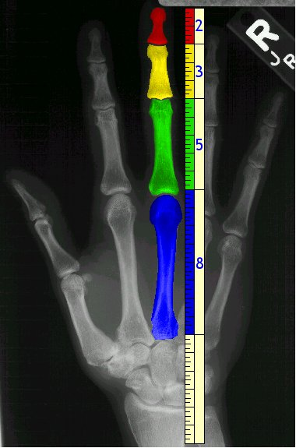
Fibonacci Numbers

Slide 9
Fibonacci Numbers
static int F(int x) {
if (x<1) return 1;
if (x<=2) return 1;
return F(x-1) + F(x-2);
}

Slide 10
Fibonacci Numbers
static int F(int x) {
if (x<1) return 1;
if (x<=2) return 1;
return F(x-1) + F(x-2);
}

Slide 11
Tabulation aka Dynamic Programming
Build a table of partial results.
The trick is to save answers to the sub-problems in an array.
Use the stored sub-solutions to solve the larger problems
Some problems exhibit optimal substructure

Slide 12
int knownF[] = new int[maxN];
knownF[0] = knownF[1] = 1;
int F(int x) {
if (knownF[x] != 0)
return knownF[x];
int t = F(x-1) + F(x-2);
return knownF[x] = t;
}

Slide 13
ROD CUT PROBLEM
Given a rod of length n and a table of prices p[i] determine the maximum revenue obtainable by cutting the rod into various configurations
  A rod of length n can be cut in how many different ways, assuming integer length cuts?
Example of an optimization problem
Contains optimal substructure

Slide 14

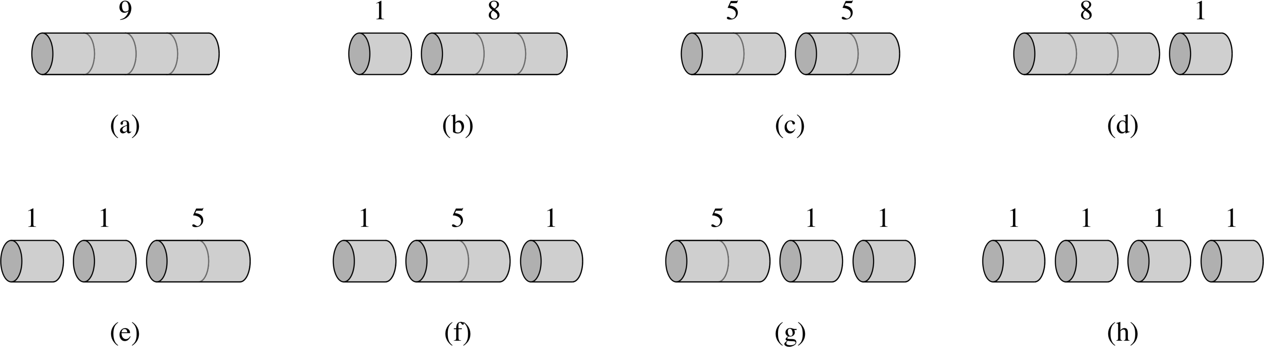
ROD CUT PROBLEM

Slide 15
int RodCut(int[] p, int n) {
if (n=<0) return 0;
int q = -1;
for (int j=1;j<n;j++)
q = max(q,RodCut(p,n-i));
return q;
}

Slide 16
int RodCut(int[] p, int n) {
if (n=<0) return 0;
int q = -1;
for (int j=1;j<n;j++)
q = max(q,RodCut(p,n-i));
return q;
}
// What is the run time?

Slide 17
int RodCut(int[] p, int n) {
if (n=<0) return 0;
int q = -1;
for (int j=1;j<n;j++)
q = max(q,RodCut(p,n-i));
return q;
}

Slide 18
int RodCut(int[] p, int n) {
if (n=<0) return 0;
int q = -1;
for (int j=1;j<n;j++)
q = max(q,RodCut(p,n-i));
return q;
}

Slide 19
int known[] = new int[N];
for(int j=0;j<N;j++) known[j]=-1;
int DynRC(int[] p, int n) {
if (known[n] >= 0)
return known[n];
if (n == 0 ) q = 0 ;
else
q = -1;
for (int j=0;j<n;j++)
q = max(q,p[i]+DynRC(p,n-i))
return known[n] = q;
}

Slide 20
int DynRC_BU(int[] p, int n) {
int known[] = new int[n];
for (int j=1;j<n;j++)
q = -1;
for (int k=1;k<j;k++)
q = max(q,p[i]+p[j-k])
known[j] = q ;
return known[n] = q;
}

Slide 21
Example Problem: Making Change
For a currency with coins C₁,C₂,…C_{n} (cents) what is the minimum number of coins needed to make K cents of change?
US currency has 1,5,10, and 25 cent denominations
  Anyone got a 50-cent piece?
  We can make 63 cents by using two quarters, one dime & 3 pennies
  What if we had a 21 cent piece?

Slide 22
63 cents
25,25,10,1,1,1
Suppose a 21 cent coin?
21,21,21 is optimal

Slide 23
Recursive Solution
If we can make change using exactly one coin, then that is a minimum
Otherwise for each possible value j compute the minimum number of coins needed to make j cents in change and K – j cents in change independently. Choose the j that minimizes the sum of the two computations.

Slide 24
public static int makeChange (int[] coins, int change){
int minCoins = change;
for (int k = 0;k<coins.length;k++)
if (coins[k] == change) return 1;
for (int j = 1;j<= change/2;j++) {
int thisCoins = makeChange(coins,j)
+makeChange(coins,change-j);
if (thisCoins < minCoins)
minCoins = thisCoins;
}
return minCoins;
}// How long will this take?

Slide 25
How many calls?
63¢
1¢
62¢
2¢
61¢
31¢
32¢
. . .

Slide 26
How many calls?
63¢
1¢
2¢
3¢
4¢
61¢
62¢
. . .

Slide 27
How many calls?
63¢
1¢
2¢
3¢
4¢
61¢
62¢
. . .
1¢
1¢

Slide 28
How many calls?
63¢
1¢
2¢
3¢
4¢
61¢
62¢
. . .
1¢
1¢
1¢
2¢
3¢
4¢
. . .
61¢

Slide 29
How many times do you call for 2¢?
63¢
1¢
2¢
3¢
4¢
61¢
62¢
. . .
1¢
1¢
1¢
2¢
3¢
4¢
. . .
61¢
1¢
1¢

Slide 30
Some Solutions
1(1) & 62(21,21,10,10)
2(1,1) & 61(25,25,10,1)
. . . .
21(21) & 42(21,21)
….
31(21,10) & 32(21,10,1)

Slide 31
Improvements?
Limit the inner loops to the coins
1 & 21,21,10,10
5 & 25,21,10,1,1
10 & 21,21,10,1
21 & 21,21
25 & 25,10,1,1,1
Still, a recursive branching factor of 5
How many times do we solve for 52 cents?

Slide 32
public static int makeChange (int[] coins, int change){
int minCoins = change;
for (int k = 0;k<coins.length;k++)
if (coins[k] == change) return 1;
for (int j = 1;j<= coins.length;j++) {
if (change < coins[j]) continue;
int thisCoins = 1+makeChange(coins,change-coins[j]);
if (thisCoins < minCoins) minCoins = thisCoins;
}
return minCoins;
}// How long will this take?

Slide 33
How many calls?
63¢
62¢
58¢
53¢
42¢
38¢
52¢
48¢
43¢
32¢
13¢
61¢
57¢
52¢
41¢
37¢

Slide 34
DP for change making
Find optimum solution for 1 cent
Find optimum solution for 2 cents using previous
Find optimum solution for 3 cents using previous
…etc.
At any amount a, for each denomination d, check the minimum coins for the (previously calculated) amount a-d
We can always get from a-d to a with one more coin

Slide 35
public static int makeChange (int[] coins, int differentcoins, int maxChange, int[] coinsUsed, int [] lastCoin){
coinsUsed[0] = 0; lastCoin[0]=1;
for (int cents = 1; cents <= maxChange; cents++) {
int minCoins = cents; int newCoin = 1;
for (int j = 0;j<differentCoins;j++) {
if (coins[j] > cents) continue;
if (coinsUsed[cents – coins[j]]+1 < minCoins){
minCoins=coinsUsed[cents – coins[j]]+1;
newCoin = coins[j];
}
}
coinsUsed[cents] = minCoins;
lastCoin[cents] = newCoin;
}

Slide 36
Dynamic Programming solution
O(NK)
  N denominations
  K amount of change
By backtracking through the lastCoin[] array, we can generate the sequence needed for the amount in question.

Slide 37
LONGEST COMMON SUBSEQUENCE
Suppose we have two lists and we want to know the difference between them?
-file systems
-web sites
-DNA sequences

Slide 38
LONGEST COMMON SUBSEQUENCE
Consider strings from {a,b,c}
What is the LCS of abcabba and cbabac ?

Slide 39
LONGEST COMMON SUBSEQUENCE
Consider strings from {a,b,c}
What is the LCS of abcabba and cbabac ?
baba
cbba

Slide 40
c b a b a c
a b c a b b a
c b a b a c

Slide 41
c b a b a c
a b c a b b a
c b a b a c

Slide 42
c b a b a c
baba
a b c a b b a
cbba
c b a b a c

Slide 43
Recursive LCS Length
To find the length of an LCS of lists x and y we
need to find the lengths of the LCSs of all pairs of
prefixes, one from x and one from y.
Suppose x = (a1,a2,...am) , y=(b1,b2,....bn)
i is between 0 and m, j between 0 and n

Slide 44
BASIS: if i+j = 0, then LCS is null L(0,0)=0
INDUCTION:
Consider i and j and suppose we have already computed L(g,h) for any g and h such that g+h < i+j. There are 3 cases
(1) If either i or j is 0 then, L(i,j)=0
(2) If i>0 and j>0 and ai != bj then L(i,j)
= max(L(i,j-1),L(i-1,j)
(3) If i>0 and j>0 and ai==bj then L(i,j)
= 1 + L(i-1,j-1)

Slide 45
BASIS: if i+j = 0, then LCS is null L(0,0)=0
INDUCTION:
Consider i and j and suppose we have already computed L(g,h) for any g and h such that g+h < i+j. There are 3 cases
(1) If either i or j is 0 then, L(i,j)=0
(2) If i>0 and j>0 and ai != bj then L(i,j)
= max(L(i,j-1),L(i-1,j)
(3) If i>0 and j>0 and ai!=bj then L(i,j)
= 1 + L(i-1,j-1)

Slide 46
Recursive LCS Length
The algorithm works, but is exponential in the small of m and n.
If we start with L(3,3) we end up calling L(0,0) twenty time
We can build a 2D table and store the intermediate results and get a runtime O(mn)

Slide 47
Intuitively
c 6
a 5
b 4
a 3
b 2
c 1
0
0 1 2 3 4 5 6 7
a b c a b b a

Slide 48
Intuitively
c 6 0 1 2 3 3 3 3 4
a 5 0 1 2 2 3 3 3 4
b 4 0 1 2 2 2 3 3 3
a 3 0 1 1 1 2 2 2 3
b 2 0 0 1 1 1 2 2 2
c 1 0 0 0 1 1 1 1 1
0 0 0 0 0 0 0 0 0
0 1 2 3 4 5 6 7
a b c a b b a

Slide 49
Intuitively
c 6 0 1 2 3 3 3 3 4
a 5 0 1 2 2 3 3 3 4
b 4 0 1 2 2 2 3 3 3
a 3 0 1 1 1 2 2 2 3
b 2 0 0 1 1 1 2 2 2
c 1 0 0 0 1 1 1 1 1
0 0 0 0 0 0 0 0 0
0 1 2 3 4 5 6 7
a b c a b b a

Slide 50
for (int j = 0 ; j <= n; j++)
L[0][j] = 0;
for (int i = 1 ; I <m;i++) {
L[i][0] = 0;
for(int j = 1 ; j <=n; j++)
if (a[i] != b[j])
if (L[i-1][j] >= L[i][j-1])
L[i][j] = L[i-1][j];
else
L[i][j] = L[i][j-1];
else /* a[i] == a[j] */
L[i][j] = 1 + L[i-1][j-1]
}

