Slide 1
CSC 172
DATA STRUCTURES

Slide 2
P NP NPC

Slide 3
Computers are fast, but some problems still take a long time

Slide 4
Computers are fast, but some problems still take a long time
Example : 7 x 13 = 91

Slide 5
Computers are fast, but some problems still take a long time
Example : 7 x 13 = 91
7 x 13 = ? (multiplication) , ? x ? = 91 (factoring)

Slide 6
Computers are fast, but some problems still take a long time
Example : 7 x 13 = 91
7 x 13 = ? (multiplication) , ? x ? = 91 (factoring)
Giant numbers : 100 digits
RSA factoring challenge (google)
Rsa, cryptography, factoring

Slide 7
RSA CHALLENGE
RSA-640
Status: Factored
Decimal Digits: 193
31074182404900437213507500358885679300373460228427
27545720161948823206440518081504556346829671723286
78243791627283803341547107310850191954852900733772
4822783525742386454014691736602477652346609
Digit Sum: 806

Slide 8
RSA CHALLENGE
RSA-704
Status: Not Factored
Decimal Digits: 212
74037563479561712828046796097429573142593188889231
28908493623263897276503402826627689199641962511784
39958943305021275853701189680982867331732731089309
00552505116877063299072396380786710086096962537934
650563796359
Decimal Digit Sum: 1009

Slide 9
What's so hard about factoring?

Slide 10
What's so hard about factoring?
Divide by 2, 3, 5, 7 . . . until you find a factor

Slide 11
What's so hard about factoring?
Divide by 2, 3, 5, 7 . . . until you find a factor
Brute Force Search is very slow when the search space is huge
Is searching necessary? (so far, it seems so)

Slide 12
What's so hard about factoring?
Divide by 2, 3, 5, 7 . . . until you find a factor
Brute Force Search is very slow when the search space is huge
Is searching necessary? (so far, it seems so)

Slide 13
Needle in a haystack problem
Searching may not be necessary if you have a magnet (closed form)
  Figuring triangle sum

Slide 14
Search Examples
Scheduling, map coloring, protein folding, theorem proving, packing, project planning, route planning, etc.

Slide 15
The P verses NP question
Can we solve search problems without searching?
P “polynomial time” quickly solvable
  Multiplication, sorting
NP “non-deterministic polynomial time”
  Quickly checkable problems
  Includes search
  Factoring and clique are NP – quick to check
Venn diagram P inside NP is ?(P==NP)
  Currently unresolved

Slide 16
HISTORY
Babbage (1800s)
1956 Godel writes to vonNeumann
  Foreshadows P verses NP
1960s Dawn on complexity theory
  Rabin Blum Hartmanis, Edmons
1970s P vs. NP and NP-completeness
  Cook, Levin, Karp

Slide 17
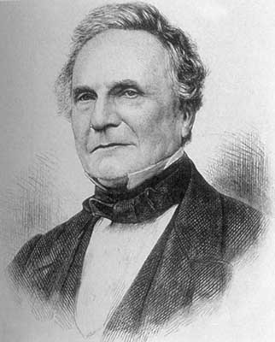
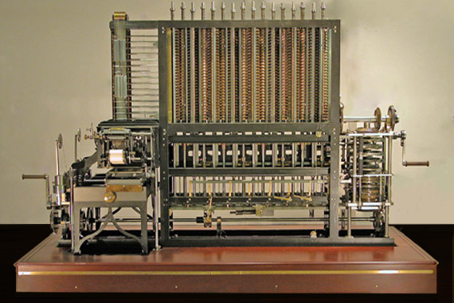
“As soon as the Analytical Engine exists, it will necessarily guide the future of science. Whenever any result is sought by its aid, the question will arise : 'By what course of calculation can these results be arrived at the machine in the shortest time?'”
- Charles Babbage (1864)

Slide 18
Kurt Godel
1906-1978
Greatest logician of the 20th century
Revolutionary work in the 1930s
Godel Incompleteness theorem
  In any (sufficiently powerful) mathematical system there are true statements that cannot be proven true within the system. (Some true things might never be known)
VonNeumann – computer architecture

Slide 19
Clay Institute Millennium Problems patterned after Hilbert
Poincare Conjecture (solved)
P vs NP (frequent 'solutions')
Navier-Stokes
Riemann Hypothesis
Birch & Swinnerton-Dyer Conjecture
Yang-Mills Theory
Hodge Conjecture
$1M prize

Slide 20
Strange Primality Test
Trial factoring (search)
  Old theorem (Fermat) a^(p-1) = 1 mod p
    For prime p and a < p
  Example p,a 7,2 ; 2^6 = 64, 64 % 7 = 1
  Counter example 15,2
    15 fails to have a property that we know prime numbers have
    Test for primality without factoring (search)
      Randomized, now deterministic

Slide 21
NP-completeness
Factoring problem → transformer → clique problem
The searching problems are linked
If you can solve clique without search, then you can solve factoring without search
  Other way is not known
  Any NP can be converted to clique

Slide 22
Some problems you can solve by searching, but you can't check quickly
Chess – who will win in optimal gameplay?
  Walk the whole tree for solution,
  Walk the whole tree for check
Optimal gameplay outside of NP

Slide 23
“Computer Science is a science of abstraction – creating the right model for thinking about a problem and devising the appropriate mechanizable technique to solve it.”
Aho & Ullman (1995)

Slide 24
The process of abstraction
You can solve problems by wiring up special purpose hardware (hand calculator)
Turing showed that you could abstract hardware configurations
Von Neumann showed that you could abstract away from the hardware (machine languages)
High level languages are an abstraction of low level languages (JAVA/C++ rather than SML)

Slide 25
The process of abstraction
Data structures are an abstractions in high level languages (“mystack.push(myobject)”)
So, now we can talk about solutions to whole problems
“Similar” problems with “similar” solutions constitute the next level of abstraction

Slide 26
Exercise
boolean a,b,c,d,e;
// insert code here
e = ((a && !b) || (c && d);
if(e)
System.out.println(“pass”);

Slide 27
Exercise
boolean a,b,c,d,e;
// insert code here
e = ((a && !b) || (c && d) && (!c || b) && !(!a == !c) || (d ^ a) ^ (b != d));
if(e)
System.out.println(“pass”);

Slide 28
Exercise
Assume you have project #2 done.
Write a Java method that takes a string expression and a boolean array and sets the array values to make the expression true.
How hard is this?

Slide 29
BAD NEWS FIRST
Some well formed problems are “Impossible”
  Formal term: undecidable
  Example: the “halting problem”
    Add a feature to the JAVA compiler to detect all infinite loops
    Take CSC280 for the proof
  Some things are “unknowable” (Heisnberg)

Slide 30
Some Definitions
Exponential time: you have to test every possibility
O(k^{n})
Polynomial time: you have some clever algorithm
O(n^{k}) Note even n¹⁰⁰ is better than exponential

Slide 31
P: A problem that can be solved quickly (in polynomial time) O(n^{c})
NP: A problem who’s solution can be checked for correctness in polynomial time.
NP-hard: A problem such that every problem in NP reduces to it. (Not in NP)
NP-complete (NPC): A problem that is both NP hard and in NP

Slide 32
The class of problems “P”
“P” stands for “Polynomial”
The class “P” is the set of problems that have polynomial time solutions
Some problems have solutions than run in O(n^{c}) time
testing for cycles, MWST, CCs, shortest path

Slide 33
The class of problems “P”
On the other hand, some problems seem to take time that is exponential O(2^{n}) or worse
TSP, tautology, tripartiteness

Slide 34
Guessing
Consider the “satisfiability” problem:
Given a boolean expression in n variables, is there are truth assignment that satisfies it (makes the expression true)?
(b1 || b2) && (!b1)
b1 ← false, b2 ← true
(!b1 && b2) && (b1 && !b2)
What if the number of variables got really high?

Slide 35
A “class/set” of problems
Satisfiability is one problem
The tautology is another problem
Given a boolean expression in n variables, is the expression true for all possible assignments?
(b1 || !b2) || (!b1 || b2)
Or are they the same problem?

Slide 36
Same problem?
Assume I have
public static boolean satisfiable(String expression)
How do I write
public static boolean tautology(String expression)

Slide 37
Same problem?
Assume I have
public static boolean satisfiable(String expression)
How do I write
public static boolean tautology(String expression) {
return !satisfiable(“!(“ + expression + “)”);
}

Slide 38
Same problem?
Assume I have
public static boolean tautology(String expression)
How do I write
public static boolean satisfiable(String expression)

Slide 39
Same problem?
Assume I have
public static boolean tautology(String expression)
How do I write
public static boolean satisfiable(String expression) {
return !tautology(“!(“ + expression + “)”);
}

Slide 40
So,
When we talk about “classes of problems” we are reasoning based on the understanding that there exist similar problems which have similar solutions
If we solve one, we solve ‘em all

Slide 41
The class NP
“NP” stands for “Nondeterministic Polynomial”
“Nondeterministic” a.k.a “guess”
A problem can be solved in nondetermistic polynomial time if:
given a guess at a solution for some instance of size n
we can check that the guess is correct in polynomial time (i.e. the check runs O(n^{c}))

Slide 42
P NP
NP
P
P ⊆ NP

Slide 43
NPC
NPC stands for “NP-complete”
Some problems in NP are also in P
-they can be solved as well as checked in O(n^{c}) time
Others, appear not to be solvable in polynomial time
There is no proof that they cannot be solved in polynomial time
But, we have the next best thing to such proof
A theory that says many of these problems are as hard as any in NP
We call these “NP-complete problems”

Slide 44
Not sure?
We work to prove equivalence of NPC problems
If we cold solve one of them in O(n^{c}) time then all would be solvable in polynomial time (P == NP)
What do we have?
Since the NP-complete problems include many that have been worked on for centuries, there is strong evidence that all NP-complete problems really require exponential time to solve.

Slide 45


Slide 46
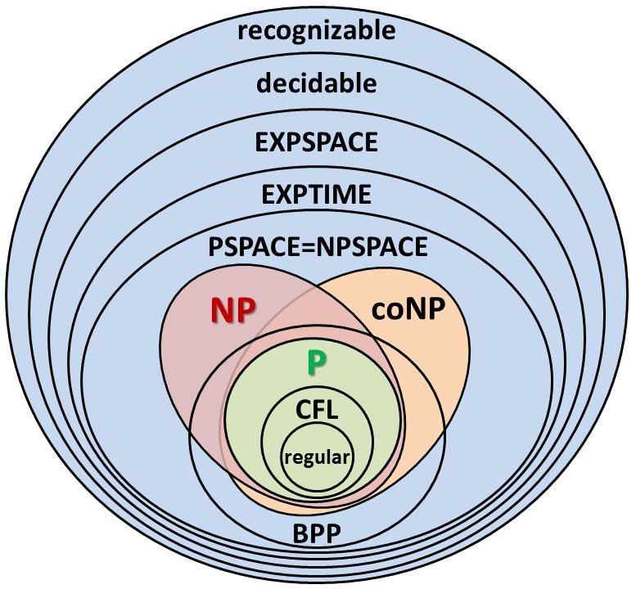

Slide 47
Reductions
The way a problem is proved NP-complete is to “reduce” a known NP-complete problem to it
We reduce a problem A to a problem B by devising a solution that uses only a polynomial amount of time (to convert the data?) plus a call to a method that solves B

Slide 48
Intuitively
Reduction is the process of showing that one problem is a “subset” (special case) of another.
  If you solve the “larger” problem, you solve smaller
Example
  You want to solve (A) “ax + b = 0”
  This is a subset of (B) “jx² + kx + m = 0”
  If you can solve (A) by setting j==0 and solving (B)

Slide 49
Difficulty
If it is “hard” to solve “ax + b = 0”
(for your kid brother, let’s say)
then is must be as hard or harder to solve “jx² + kx + m = 0”
In general, if your kid brother can’t solve
“ax + b = 0” then
he surely can’t solve “jx² + kx + m = 0”

Slide 50
Back to Graphs
By way of example of a class of problems consider
Cliques & Independent Sets in graphs

Slide 51
Cliques
A complete sub-graph of an undirected graph
A set of nodes of some graph that has every possible edge
The clique problem:
Given a graph G and an integer k, is there a clique of at least k nodes?

Slide 52
Example

Slide 53
Example
A
B
C
D
E
F
G
H

Slide 54
Example
A
B
C
D
E
F
G
H

Slide 55
Example
K == 4
ABEF
CGHD
A
B
C
D
E
F
G
H

Slide 56
Independent Set
Subset S of the nodes of an undirected graph such that there is no edge between any two members of S
The independent set problem
given a graph G and an integer k, is there an independent set with at least k nodes
(Application: scheduling final exams)
nodes == courses, edges mean that courses have one student in common.
Any guesses on how large the graph would be for UR?

Slide 57
Example independent set
K == 2
AC
AD
AG
AH
B(D,G,H)
Etc..
A
B
C
D
E
F
G
H

Slide 58
Colorability
An undirected graph is k-colorable if we can assign one of k colors to each node so tht no edge has both ends colored the same
Chromatic number of a graph = the least number k such that it is k-colorable
Coloring problem: given a graph G and an integer k, is G k-colorable?

Slide 59
Example: Chromatic number
A
B
C
D
E
F
G
H

Slide 60
Example: Chromatic number
A
B
C
D
E
F
G
H

Slide 61
Checking Solutions
Clique, IS, colorability are examples of hard to find solutions “find a clique of n nodes”
But, it’s easy (polynomial time) to check a proposed solution.

Slide 62
Checking
Check a propose clique by checking for the existence of the edges between the k nodes
Check for an IS by checking for the non-existence of an edge between any two nodes in the proposed set
Check a proposed coloring by examining the ends of all the edges in the graph

Slide 63
Same Problem Reductions
Clique to IS
Given a graph G and an integer k we want to know if there is a clique of size k in G
Construct a graph H with the same set of nodes as G and edge wherever G does not have edges
An independent set in H is a clique in G
Use the “IS” method on H and return it’s answer

Slide 64
Same Problem Reductions
IS to Clique
Given a graph G and an integer k we want to know if there is an IS of size k in G
Construct a graph H with the same set of nodes as G and edge wherever G does not have edges
An independent set in H is a clique in G
Use the “clique” method on H and return it’s answer

Slide 65
Example
A
B
C
D
E
G

Slide 66
Example
A
B
C
D
E
G

Slide 67
Example
A
B
C
D
E
G

Slide 68
Example
A
B
D
C
E
G

Slide 69
Example
A
D
C
B
E
G

Slide 70
Example
A
D
C
B
E
G

Slide 71
Example
A
D
C
B
E
G
A
B
C
D
E
G

