Slide 1
CSC 172
DATA STRUCTURES

Slide 2
END OF SEMESTER PRIORITES
Hand in last project
Take final exam
Check your grades

Slide 3
CHECK LAB & QUIZ GRADES
Contact your lab TAs
Contact grad TAs for projects
Contact WS leaders regarding quizzes
Contact TFP for unresolved issues
Speak before the final, or forever hold your peace

Slide 4
FINAL EXAM

Slide 5
FINAL EXAM
Tuesday April 28th
2pm-3:15pm
Regular Classroom
~10 questions (~9.5 min per question)
~24 topics choose 10 questions.

Slide 6
20 QUESTIONS
1. Proof by induction – simple series
(Section 1.2.5)
2. Prove closed form of a recurrence relation
(7.6.1, 10.2.1)

Slide 7
20 QUESTIONS
3. Compare the relative rates of growth (Big-Oh) of functions.
(2.1, 2.2, 2.3)
4. What is the Big-Oh of the following code?
(2.4)

Slide 8
20 QUESTIONS
5. What is the output of this code? – JAVA
(labs)
6. What is the output of this code? - C (pointers)
(labs - K&R)
7. What is the output of this code? – Lisp/scheme
(labs)

Slide 9
20 QUESTIONS
8. Write code to process a list, stack, or queue.
(Chapter 3)
9. Write code to process a tree.
(Chapter 4)

Slide 10
20 QUESTIONS
10. Insert delete keys in a BST/AVL tree
(4.3, 4.4)
11. Insert delete keys in a hash table
(Chapter 5)
12. Insert delete keys in a POT/heap
(Chapter 6)

Slide 11
20 QUESTIONS
13. Write some code to process a graph.
(Chapter 9)
14. Topologically sort a graph.
(9.2)

Slide 12
20 QUESTIONS
15. Show the steps in Dijkstra's (weighted shortest path) algorithm.
(9.3.2)
16. Show the steps in the Floyd-Fulkerson (Maxflow) algorithm.
(9.4)

Slide 13
20 QUESTIONS
17. Generate a Minimum Spanning Tree using Kruskal's algorithm
(9.5.2)
18. Explain the relationships P-NP-NPC (Essay question).
(9.7)

Slide 14
20 QUESTIONS
19. Show how Heapsort, Mergesort, Quicksort work.
(Chapter 7)
20. Generate a Huffman code / Lemple Ziv
(10.1.2)

Slide 15
20 QUESTIONS
21. Given a recursive method, modify it to use Dynamic programming.
(10.3)
22. Prove some property of a tree using structural induction.
( 4.3.5, 4.4, workshop)

Slide 16
20 QUESTIONS
23. Read or write code or show the steps of a process using randomized algorithms.
(10.4)
24. Read or write code or show the steps of a process using backtracking
( 10.5)

Slide 17
20 QUESTIONS
25. Demonstrate the steps in the Infix to Postfix algorithm and/or the postfix evaluation algorithm (or symbol checking).
(3.6, 3.7)

Slide 18
20 QUESTIONS
25. SEND IN A QUESTION!
-Great way to prepare!
-Give yourself an advantage!
-Save me time!
-Remember to include :
answer key
grading rubric

Slide 19
WHERE DO WE GO FROM HERE?

Slide 20
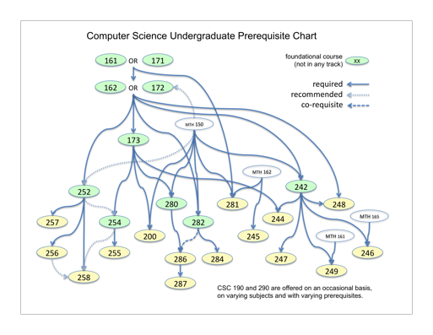

Slide 21
SOME INTERESTING COURSES
CSC131 Recreational Graphics (Summer)

Slide 22
SOME INTERESTING COURSES
CSC173 Formal Systems (Fall)
CSC190A Creative Computing (Fall)
CSC199 Social Implications of Computing (Fall)
CSC242 Artificial Intelligence (Spring)
CSC252 Computer Organization (Spring)
CSC212 Human Computer Interaction (Fall)
CSC282 Design of Algorithms (Fall)

Slide 23
GET A JOB
(you bum) or volunteer!

Slide 24
QUESTIONS

Slide 25
END OF CSC172
THANK YOU FOR
YOUR ATTENTION

