Slide 1
L1 Regularization (Lasso)
鄭力維

Slide 2
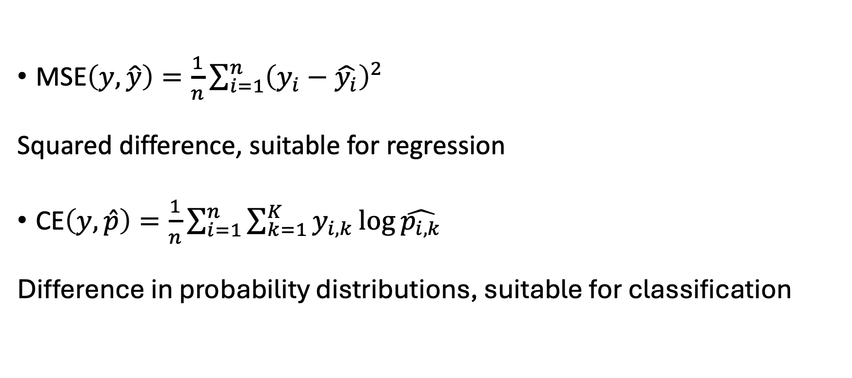
Loss function
$\text{MSE}\left(y,\hat{y}\right)=\frac{1}{n}\sum_{i=1}^{n}{{\left(y_{i}−\hat{y_{i}}\right)}^{2}}$
Squared difference, suitable for regression
$\text{CE}\left(y,\hat{p}\right)=\frac{1}{n}\sum_{i=1}^{n}{\sum_{k=1}^{K}{y_{i,k}}\log{\hat{p_{i,k}}}}$
Difference in probability distributions, suitable for classification

Slide 3
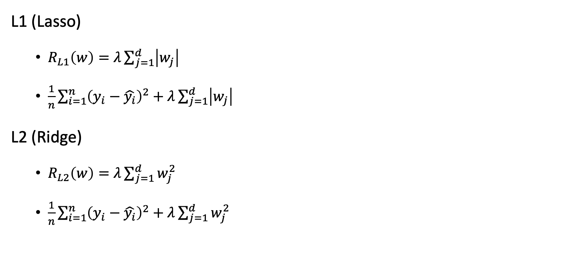
Regularization
L1 (Lasso)
$R_{L1}\left(w\right)=λ\sum_{j=1}^{d}{\left|w_{j}\right|}$
$\frac{1}{n}\sum_{i=1}^{n}{{\left(y_{i}−\hat{y_{i}}\right)}^{2}}+λ\sum_{j=1}^{d}{\left|w_{j}\right|}$
L2 (Ridge)
$R_{L2}\left(w\right)=λ\sum_{j=1}^{d}{w_{j}^{2}}$
$\frac{1}{n}\sum_{i=1}^{n}{{\left(y_{i}−\hat{y_{i}}\right)}^{2}}+λ\sum_{j=1}^{d}{w_{j}^{2}}$

Slide 4
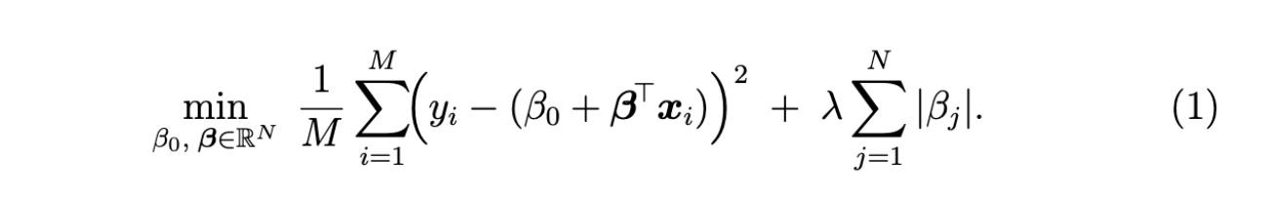
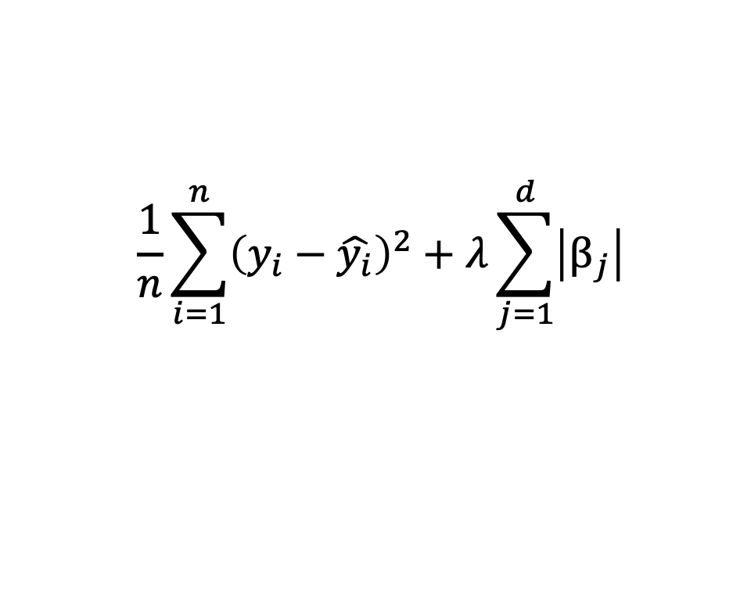
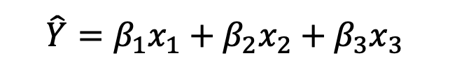
Lasso
$$\frac{1}{n}\sum_{i=1}^{n}{{\left(y_{i}−\hat{y_{i}}\right)}^{2}}+λ\sum_{j=1}^{d}{\left|β_{j}\right|}$$
$$\hat{Y}=β_{1}x_{1}+β_{2}x_{2}+β_{3}x_{3}$$

Slide 5
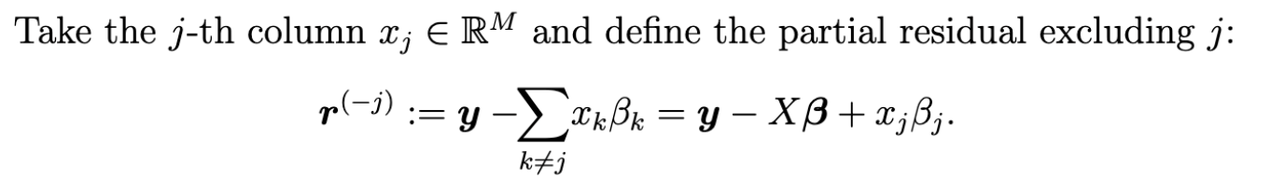
One dimensional supproblem (coordinate descent)

Slide 6
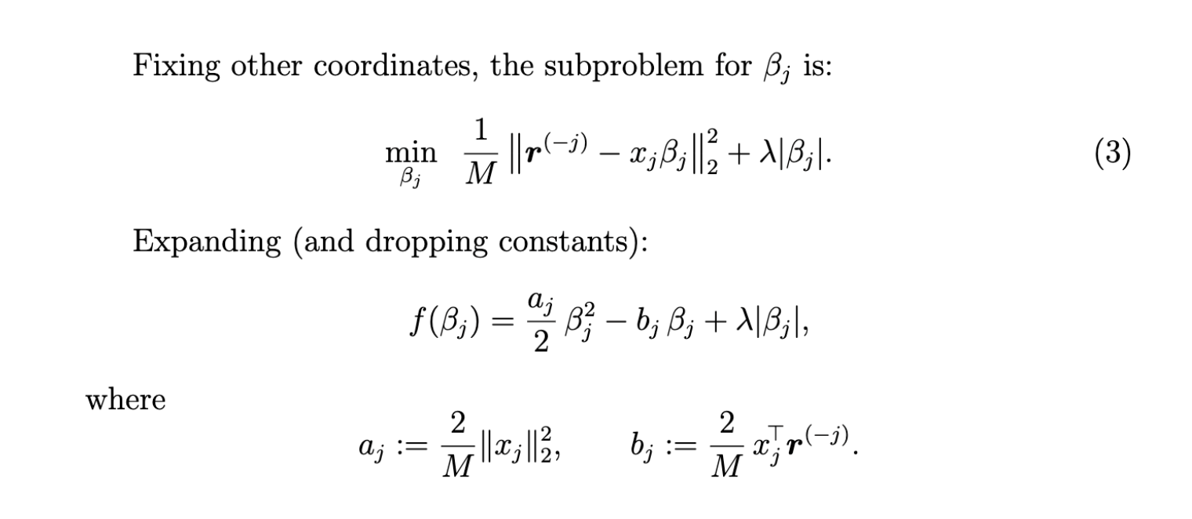
One dimensional supproblem

Slide 7
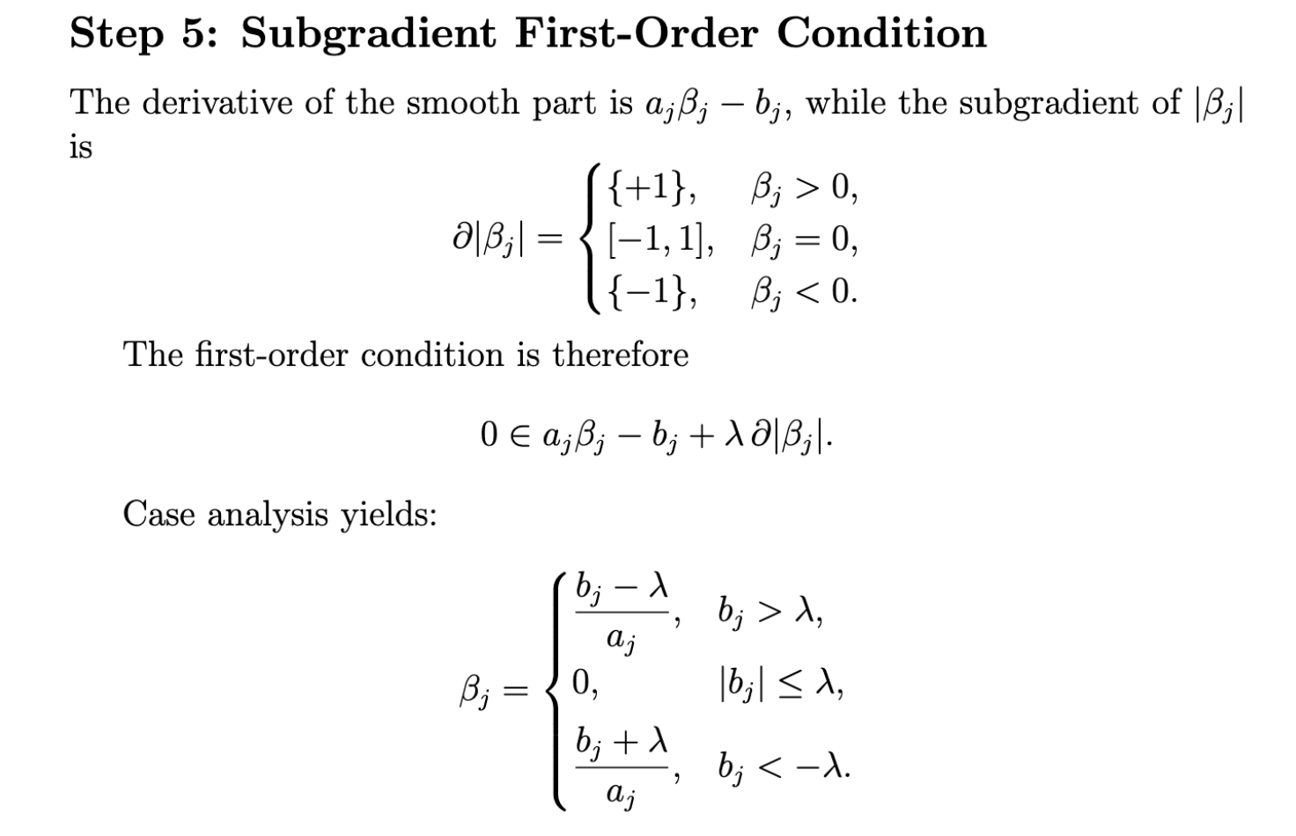
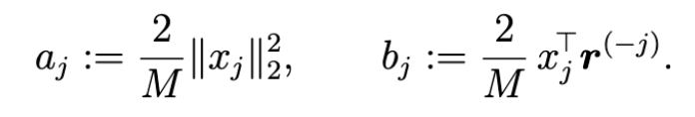

Slide 9
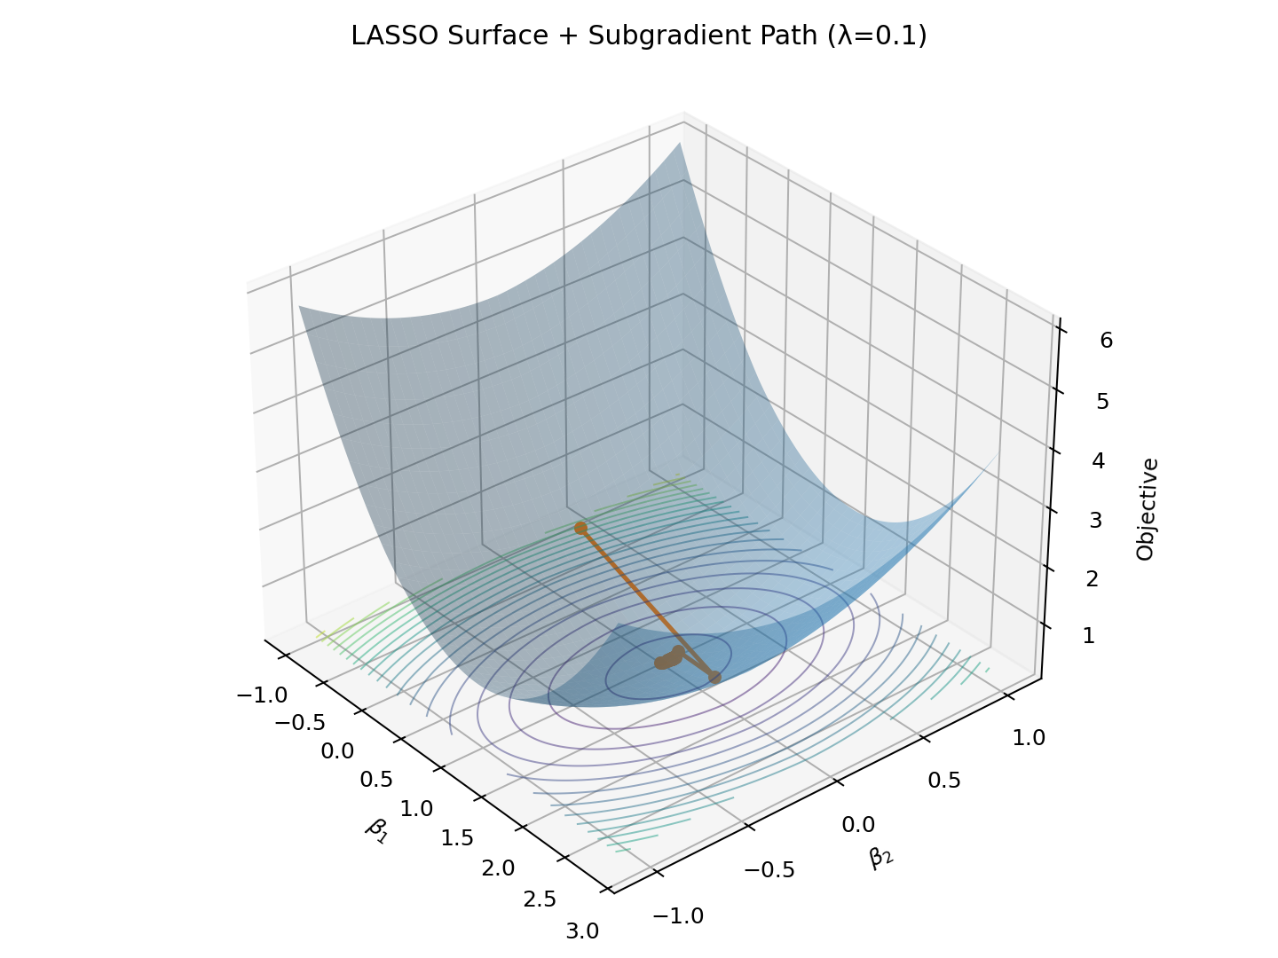
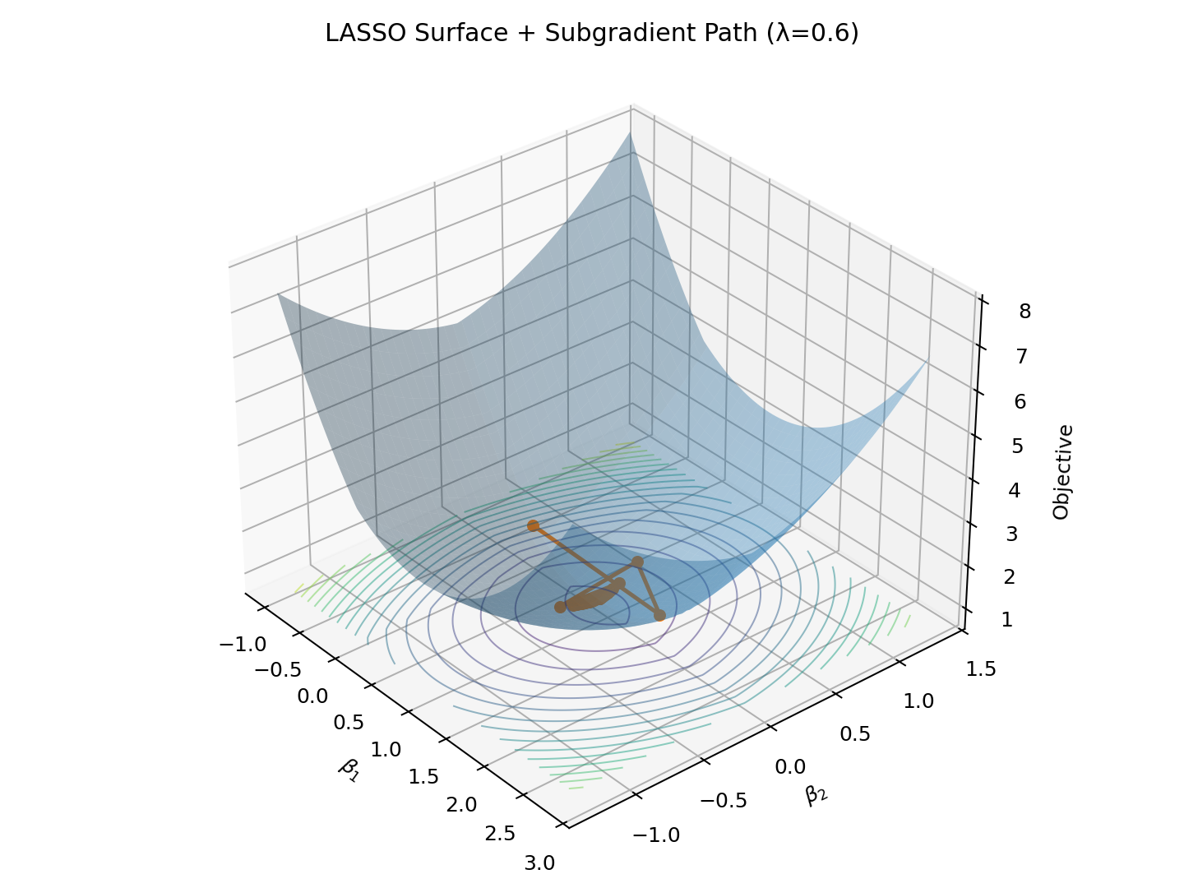
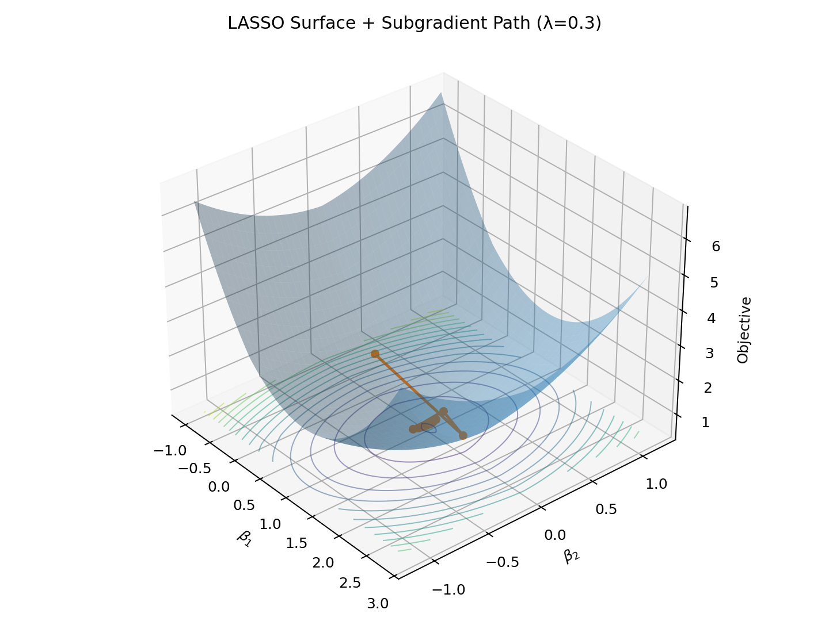
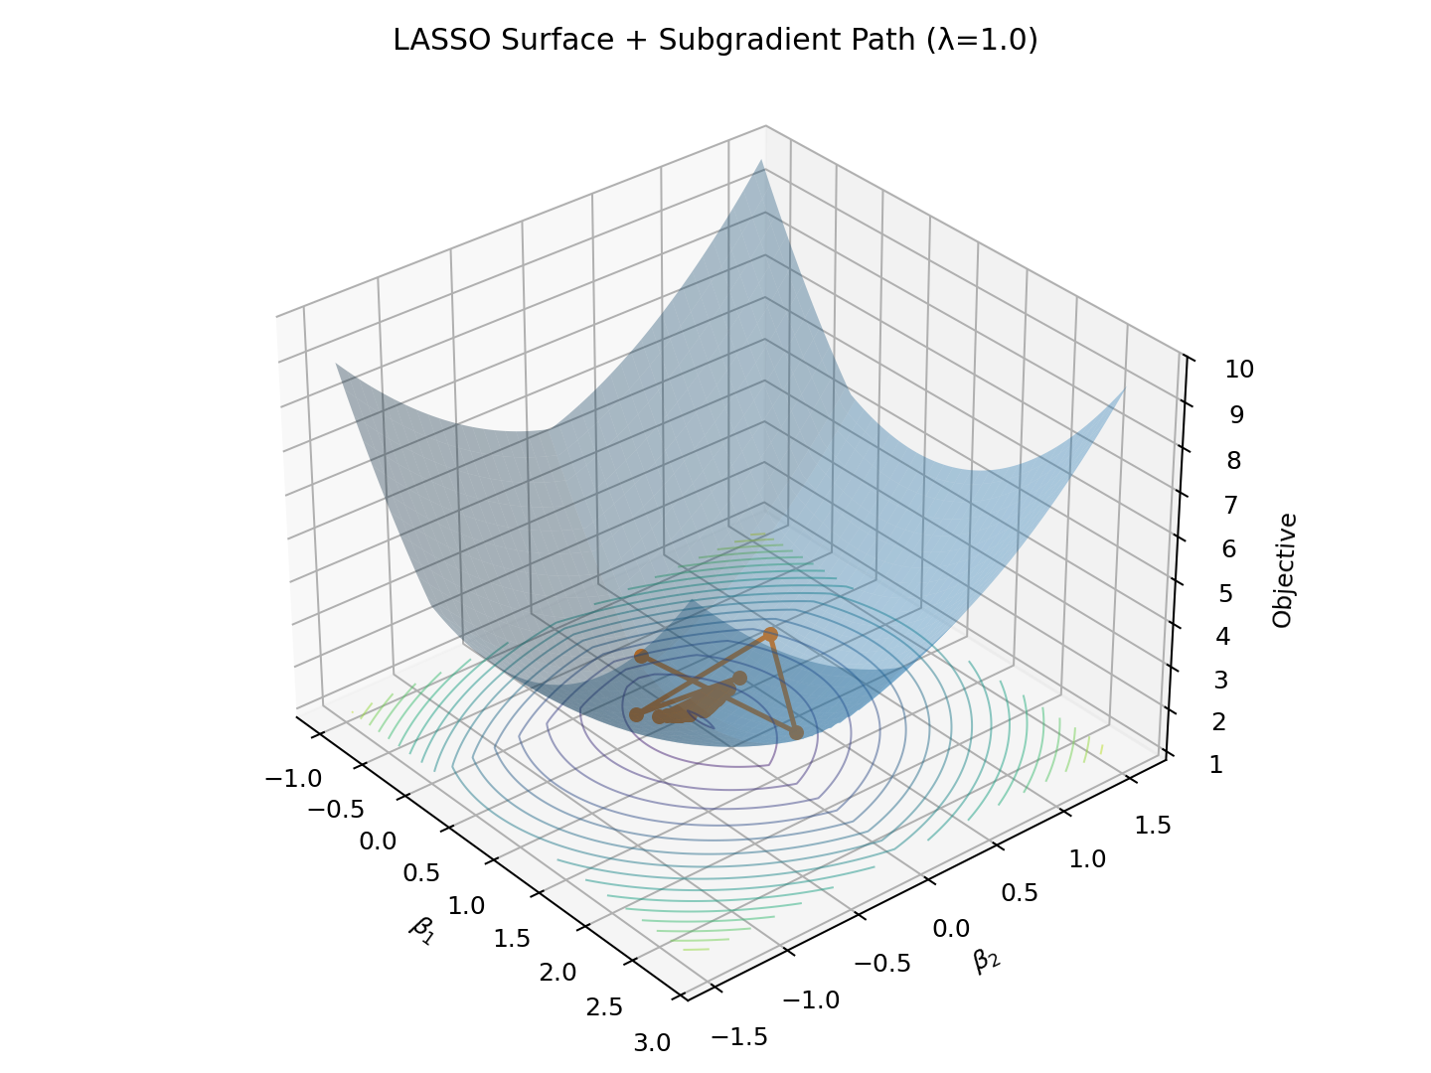

Slide 10
適用場景(Lasso)
Sparse dataset
p > n (小樣本）
好解釋性

Slide 11
不適用
特徵高相關性時，只會取一個，其他砍成0

