Slide 1
Finite Automata Based Password Validator
Theory of Automata
Diyorbek Ismoilov : 250487

Slide 2
Motivation & Problem Statement
Weak passwords cause serious security risks in real systems.
Registration/login forms must enforce password rules automatically.
We want a formal way to describe valid passwords, not just code.
Idea: model password rules using a Deterministic Finite Automaton (DFA).

Slide 3
Project Goals & Automata Concepts
Design a DFA that encodes a password policy.
Policy: length ≥ 6, at least one uppercase letter, at least one digit.
Use an alphabet of allowed characters (letters and digits).
Implement the DFA logic in Python and test it.

Slide 4
DFA Formal Model
Q: states represent three flags – hasUpper, hasDigit, lenOK.
q₀: start state where no conditions are satisfied yet.
F: accepting states where all three flags are satisfied.

Slide 5
State Intuition
Each state encodes what we have seen so far in the password:
q0 = (no uppercase, no digit, length < 6).
States where we have seen only uppercase or only digit.
States where length ≥ 6 but some conditions still missing.
Accepting state: seen uppercase, seen digit, length ≥ 6.

Slide 6
Transition Rules & JFLAP DFA
Input symbols in JFLAP: U (uppercase), L (lowercase), D (digit), X (forbidden).
Reading U: move to state where hasUpper = 1
Reading D: move to state where hasDigit =
After 6th symbol, we move to states where lenOK = 1.
Reading X or any disallowed character: go to a dead (rejecting) state.

Slide 7
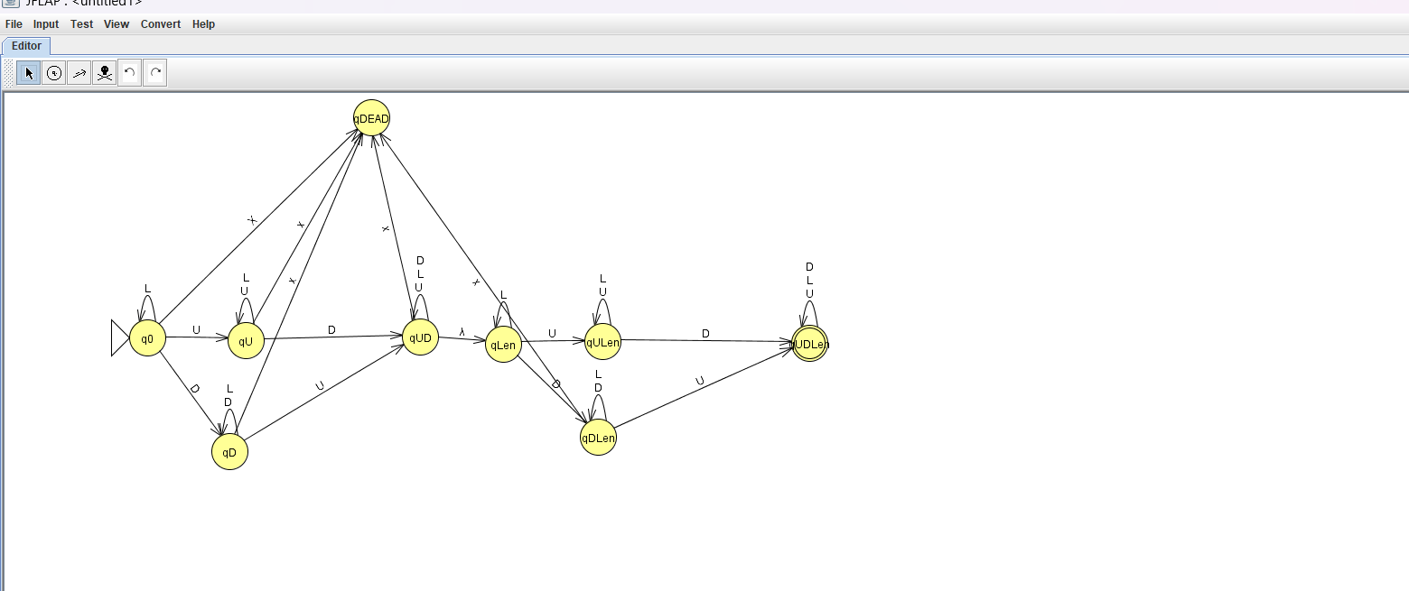
qU = seen uppercase only
qD = seen digit only
qUD = seen uppercase + digit
qLen = length => 6 but no uppercase and digit
qULen = length => 6, digit , but no uppercase
qUDLen = length => 6, uppercase , digit
qDead = dead state

Slide 8
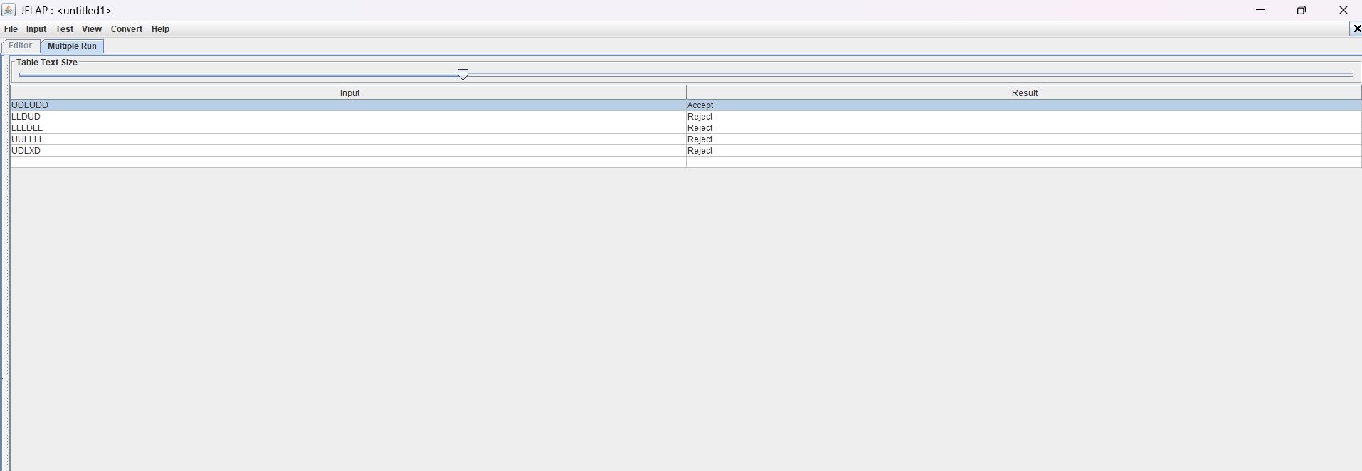

Slide 9
Accepted Language & Correctness
Language L: all strings that satisfy the password policy.
Length ≥ 6, at least one uppercase letter, at least one digit.
If DFA ends in an accepting state, all three conditions hold.
If a string satisfies all rules, the DFA eventually reaches an accepting state.

Slide 10
Python Implementation Overview
PasswordPolicy class stores policy: min length, require upper, require digit, alphabet.
DFAPasswordValidator simulates the DFA using three flags.
For each character: update flags and check if character is allowed.
Final state decides whether the password is accepted or rejected.
Program prints a clear message: valid or reason of invalidity.

Slide 11
Challenges & Possible Extensions
Challenge: designing states without making the DFA too large.
Challenge: mapping informal password rules to formal automata.
Extension: different policies for admin vs normal users.
Extension: allowing special symbols, extra checks (lowercase, no repeats).

Slide 12
Conclusion & Q&A
We used a DFA to formally define a secure password language.
JFLAP helped us visualise and verify the automaton step by step.
This project shows how automata theory can solve a real-world problem.

