Slide 1
GNU and GNOME
Free Software and Its Impact on the World

Slide 2


GNU Project
  Origins of Software Freedom
The GNU Project was launched to ensure that software users could run, study, modify, and share software freely.

Slide 3

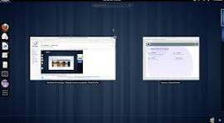
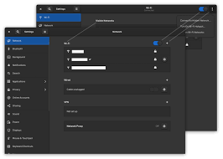

GNOME Desktop
  Human-Centered Design
GNOME focuses on simplicity, accessibility, and a distraction-free computing experience.

