Slide 1



BIWO-04 Numerical Methods
Module Coordinator: Prof. Dr. Uwe Reuter
Group Members:
Andre
Jose
Boril
Ozgur

Slide 2
Files
Main Program and Input
module.f90
main.f90
input_points.txt
Subroutines
sub_newton_inter.f90
sub_cubic_spline.f90
monte_carlo.f90
00_subroutine_det.f90
00_subroutine_inv.f90
bisection.f90
secant.90
regula_falsi.90
Output
data_f_r.txt
data_f_s.txt
plot_01.png
convergence.txt
reference.txt
plot_02.png
01_bisection_roots.txt
02_secant_roots.txt
03_regula_falsi_roots.txt

Slide 3
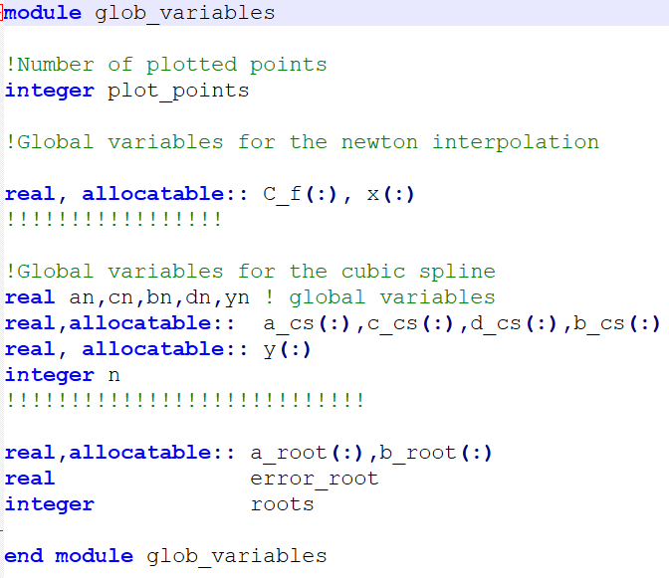
Module.f90
# of Plotting Points
Glob Variables for f_r
Glob Variables for f_s
# of Input Points
Domain for Task 3
Level of Accuracy
# of Roots

Slide 4
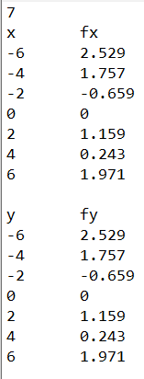
Input_points.txt
Number of Points – n
Headings
Input Points – x(n), z_r(n)
Empty Line for Readability
Remark:
The input of the points can be in any order or randomised. The main program has a loop for sorting the values from smallest to biggest on the x-axis and y-axis
Input Points – y(n), z_s(n)

Slide 5
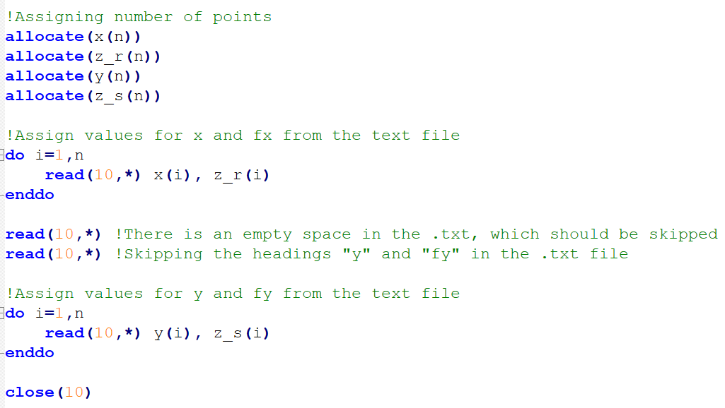
Main.f90
Allocation of Size and Assignment of Values

Slide 6
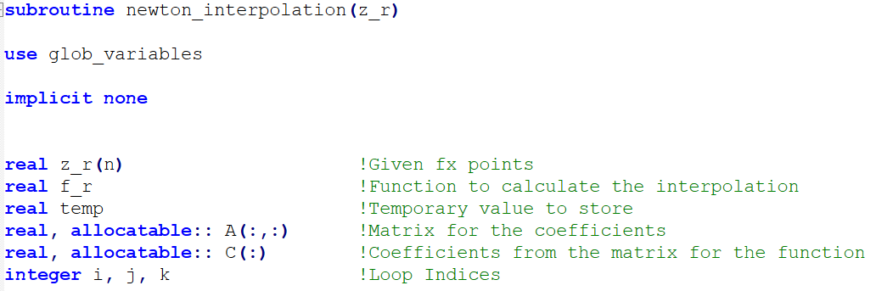
Sub_newton_inter.f90
Intro
Taking z_r values from main.f90
Triangular Matrix for the Coefficients
Coefficients Extracted from the Matrix

Slide 7
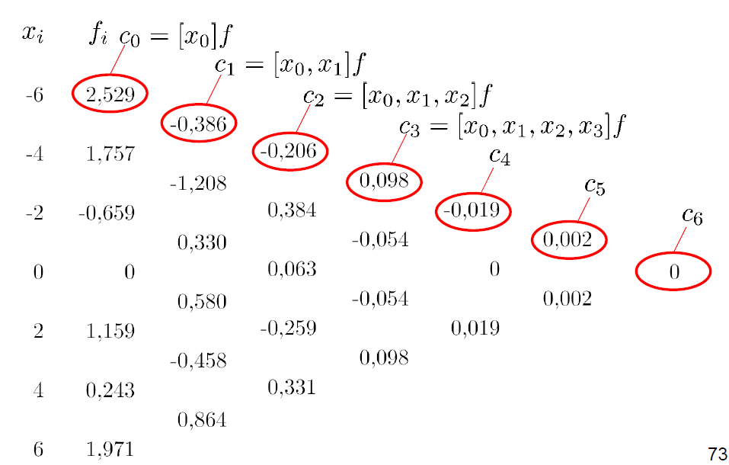
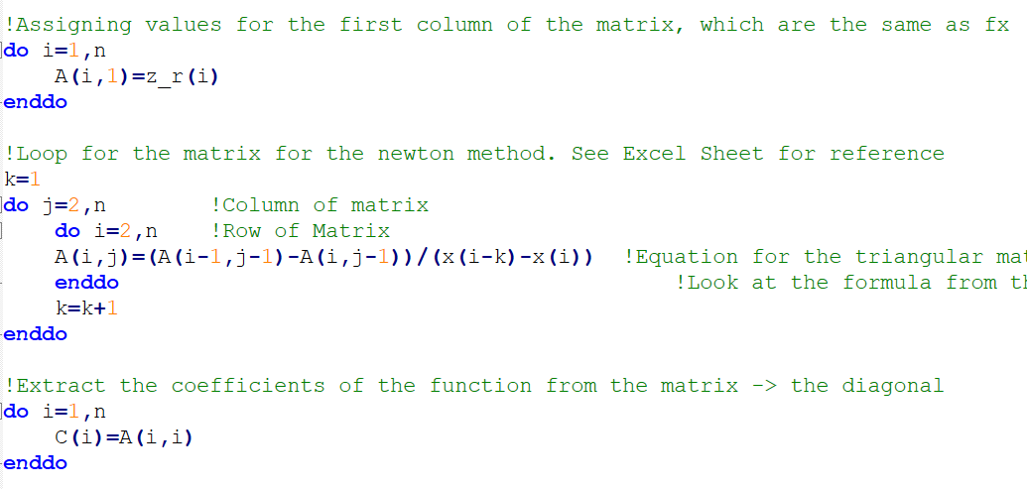
Sub_newton_inter.f90
Triangular Matrix and Coefficients
First Column are the values of z_r
Source: Numerical_Methods-Exercises.pdf
Integer for the Loop to Start From x1
Extracting the Diagonal

Slide 8
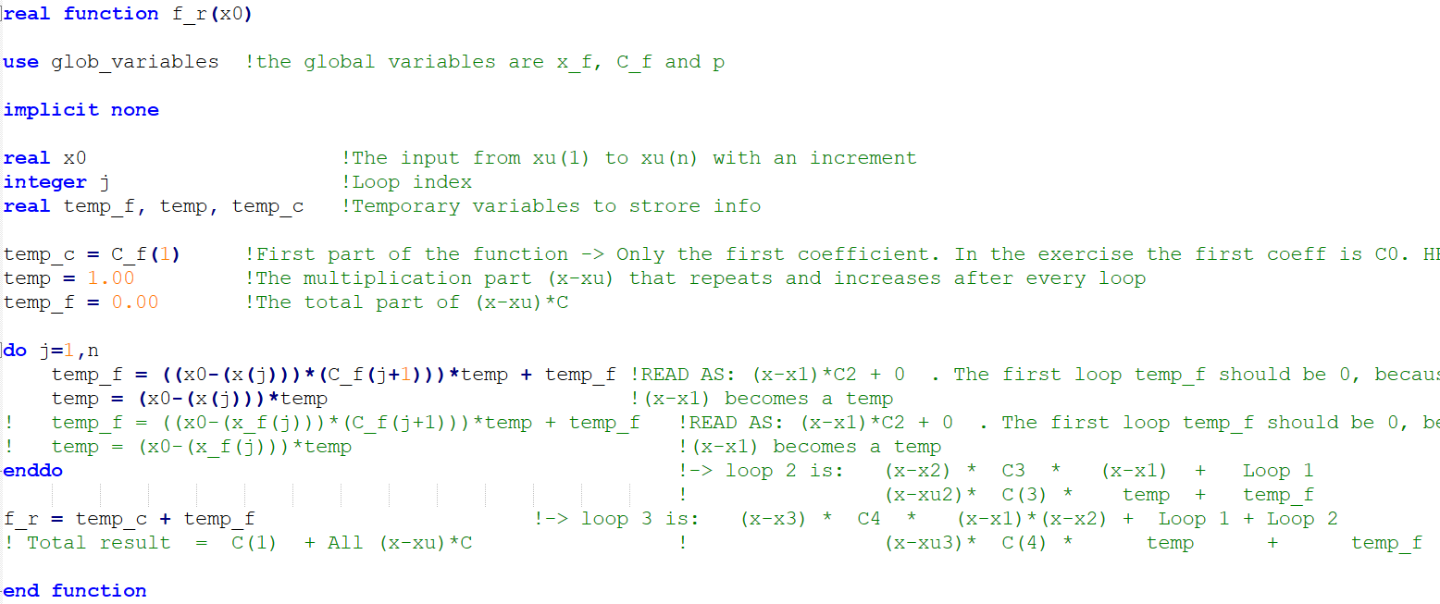
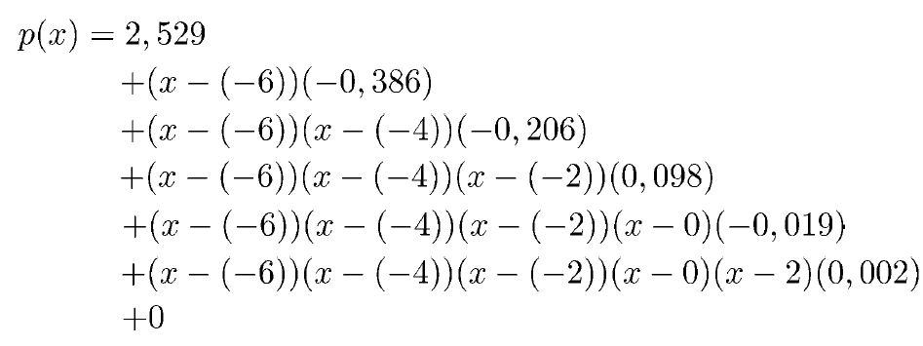
Sub_newton_inter.f90
Function f_r
Source: Numerical_Methods-Exercises.pdf

Slide 9
Sub_cubic_spline.f90
…

Slide 10

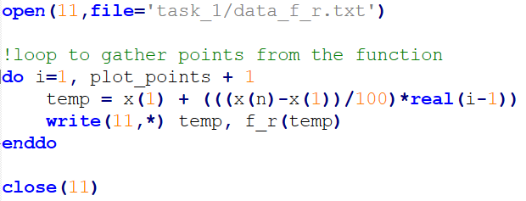
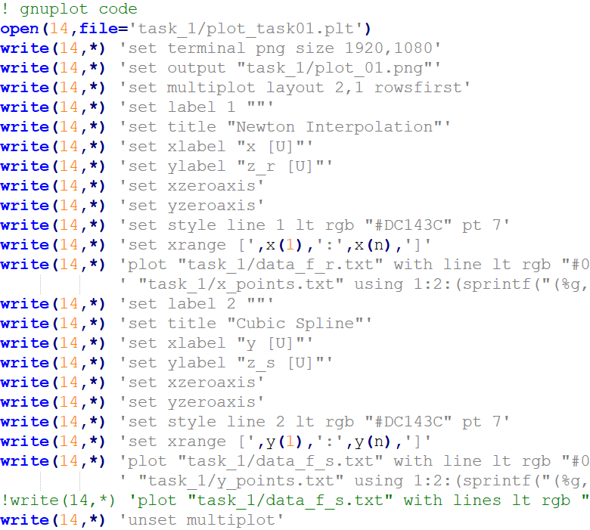
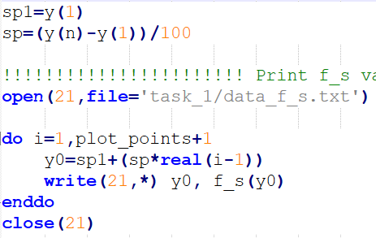
Main.f90
Main.f90
Plot of Task 1
Sub_newton_inter.f90
Main.f90
Output
data_f_r.txt
data_f_s.txt
Sub_cubic_spline.f90
Output
plot_01.png

Slide 11
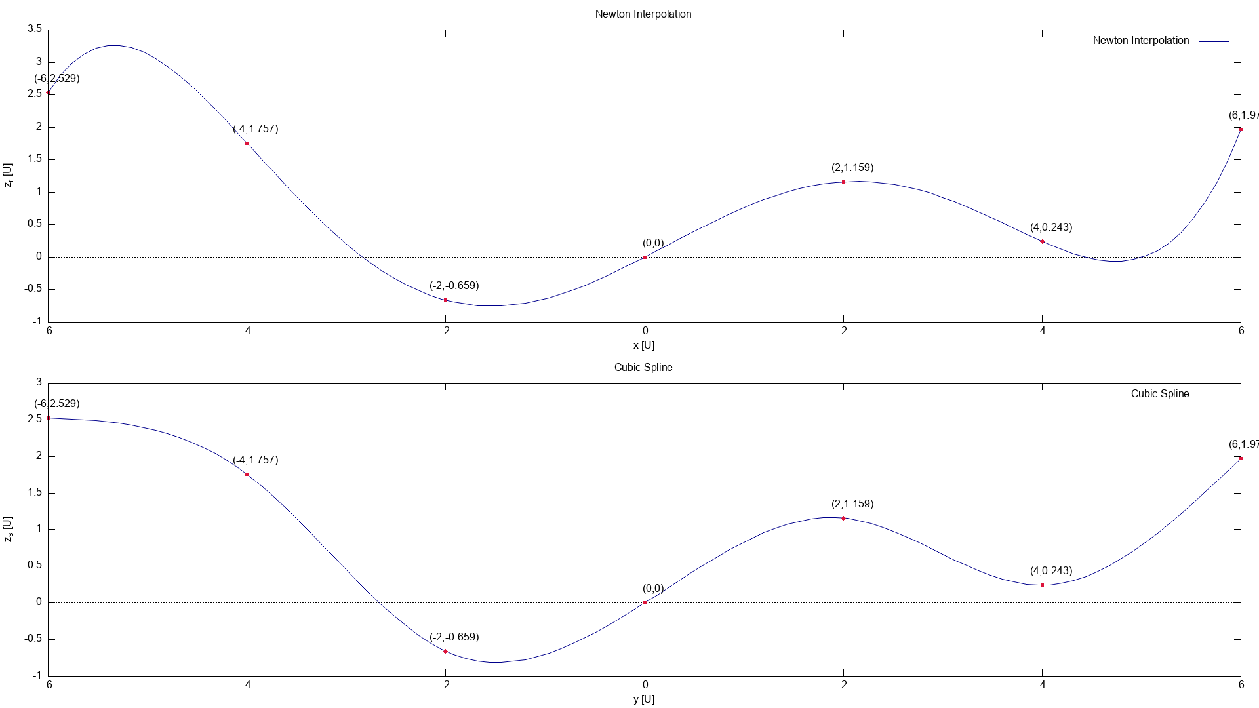
Plot_01.png

Slide 12
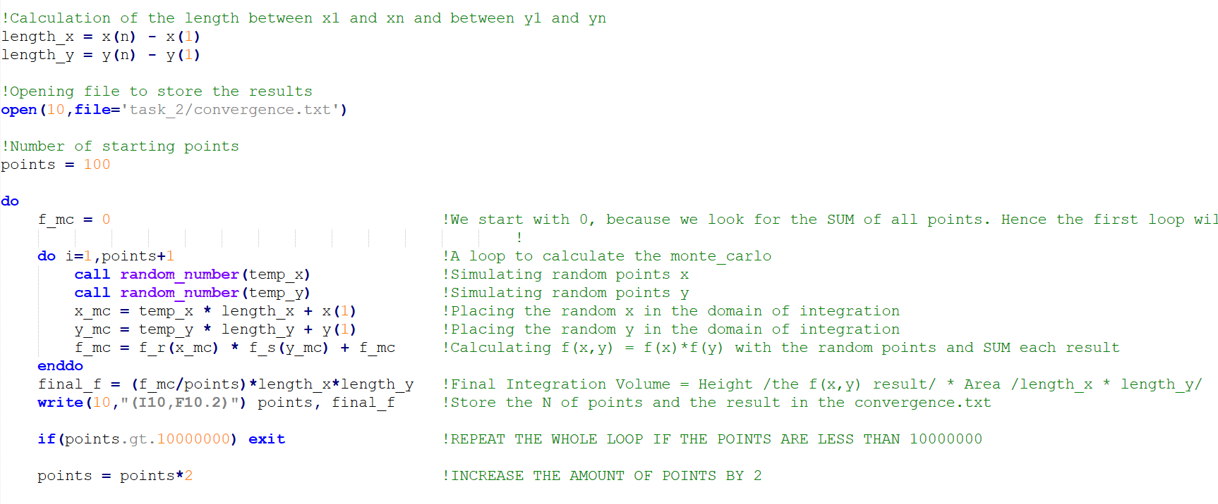
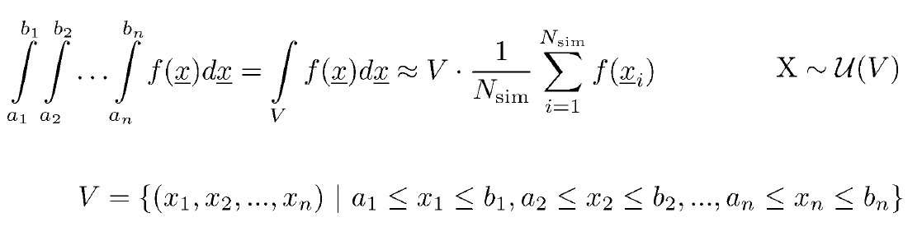
Monte_carlo.f90
Domain of Integration
Starting Simulation Points
Source: Numerical Methods - Lecture Notes_part_1.pdf
Calling RN for x and y
Plotting the RN in the domain
Calculating f_r * f_s
Calculating the integral
Great Limit to Show Convergence

Slide 13

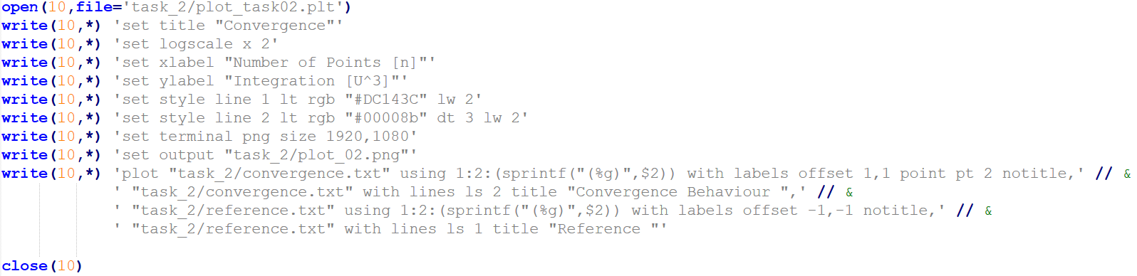
Main.f90
Plot of Task 2
Monte_carlo.f90
Monte_carlo.f90
Output
convergence.txt
reference.txt
Main.f90
Output
plot_02.png

Slide 14
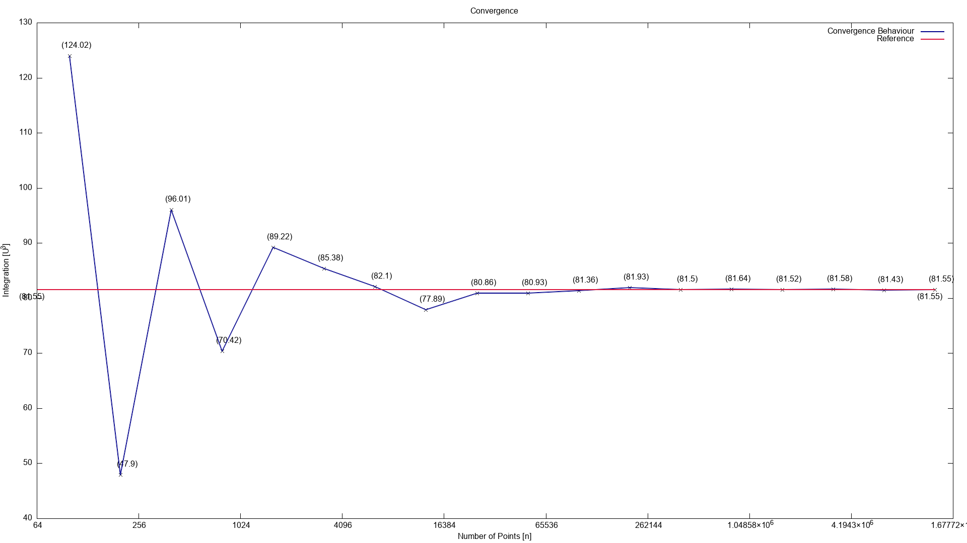
Plot_02.png

Slide 15
Sub_cubic_spline.f90
…

