Slide 1



BIWO-04 Numerical Methods
Module Coordinator: Prof. Dr. Uwe Reuter
Group Members:
Andre
Jose
Boril
Ozgur

Slide 2
Files
Main Program and Input
module.f90
main.f90
input_points.txt
Subroutines
sub_newton_inter.f90
sub_cubic_spline.f90
monte_carlo.f90
00_subroutine_det.f90
00_subroutine_inv.f90
Output
data_f_r.txt
data_f_s.txt
convergence.txt

Slide 3
Module.f90

Slide 4
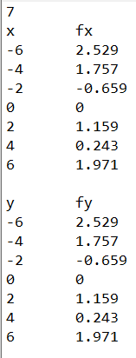
Input_points.txt
Number of Points – n
Headings
Input Points – x(n), z_r(n)
Empty Line for Readability
Remark:
The input of the points can be in any order or randomised. The main program has a loop for sorting the values from smallest to biggest on the x-axis and y-axis
Input Points – y(n), z_s(n)

Slide 5
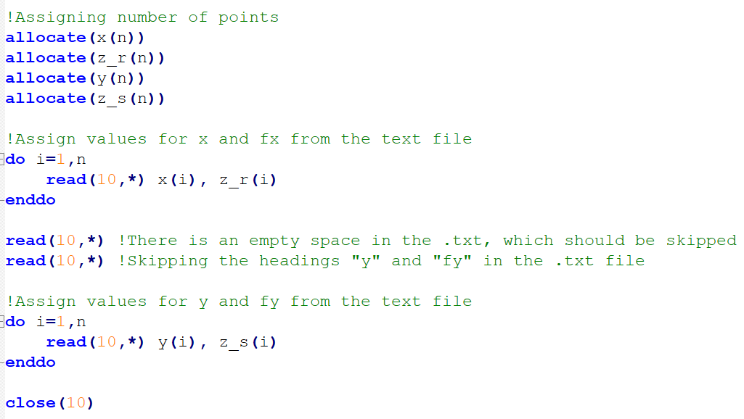
Main.f90
Allocation of Size and Assignment of Values

Slide 6
Main.f90
Plot of Task 2

Slide 7
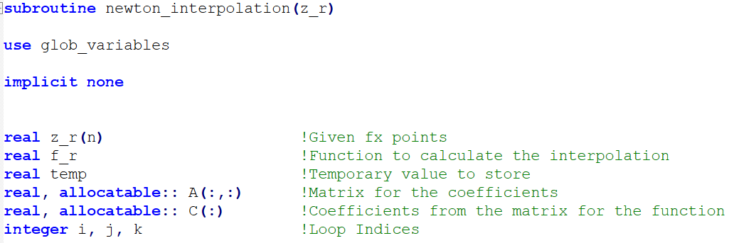
Sub_newton_inter.f90
Intro
Taking z_r values from main.f90
Triangular Matrix for the Coefficients
Coefficients Extracted from the Matrix

Slide 8
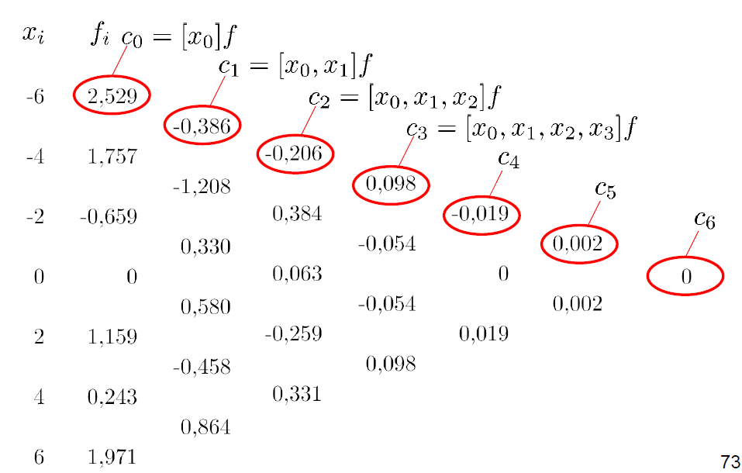
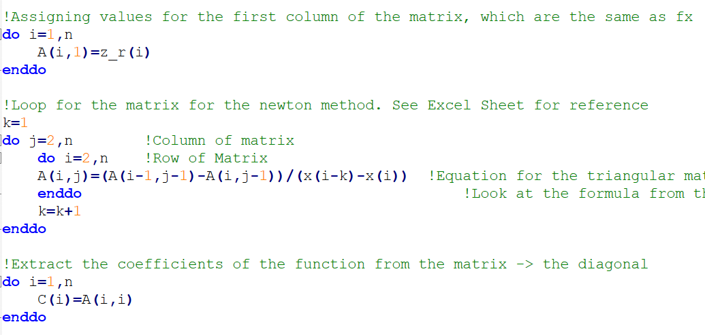
Sub_newton_inter.f90
Triangular Matrix and Coefficients
First Column are the values of z_r
Source: Numerical_Methods-Exercises.pdf
Integer for the Loop to Start From x1
Extracting the Diagonal

Slide 9
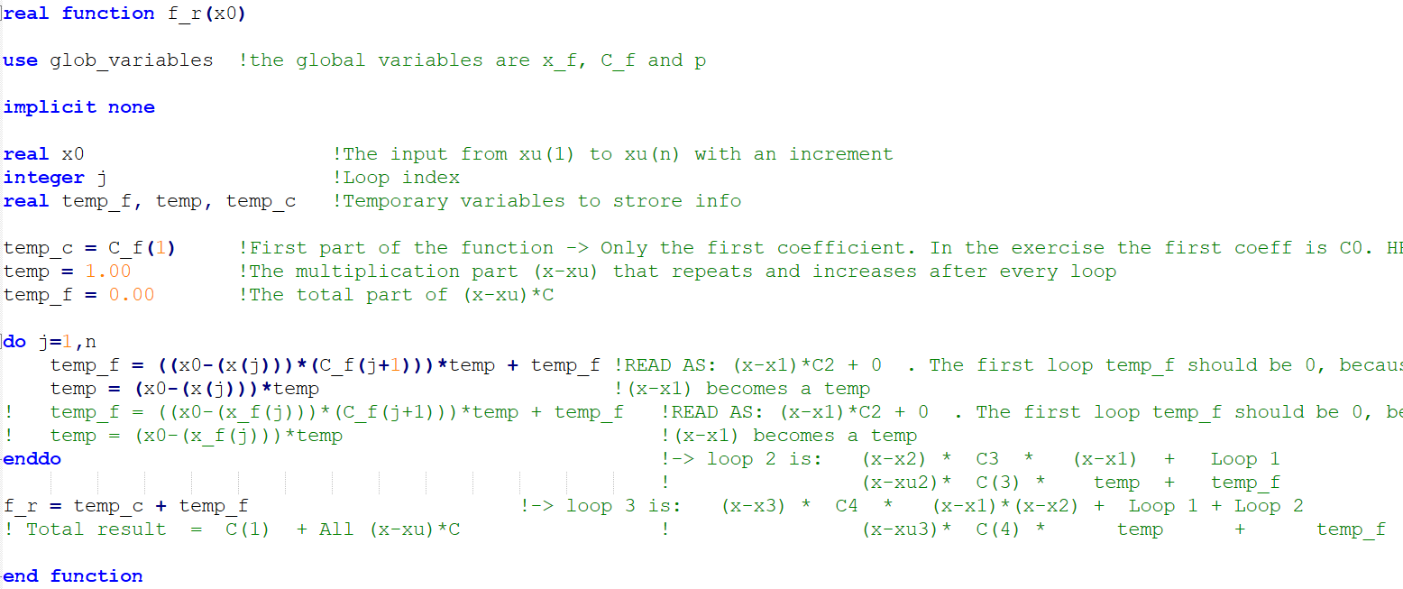
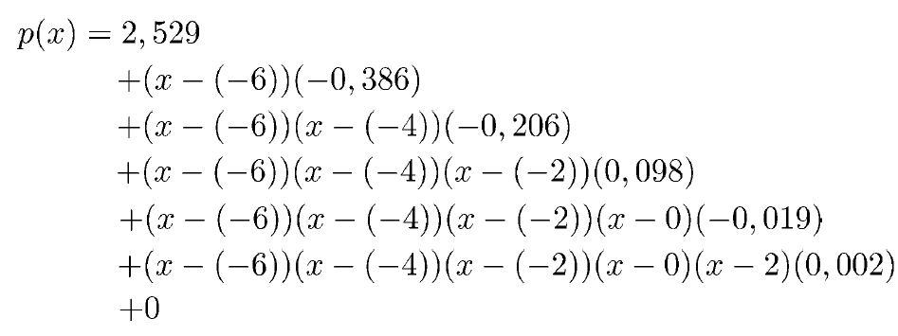
Sub_newton_inter.f90
Function f_r
Source: Numerical_Methods-Exercises.pdf

Slide 10
Sub_cubic_spline.f90
…

Slide 11
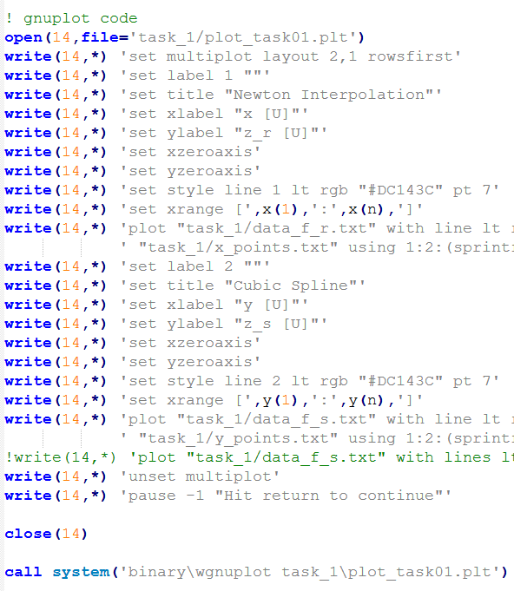
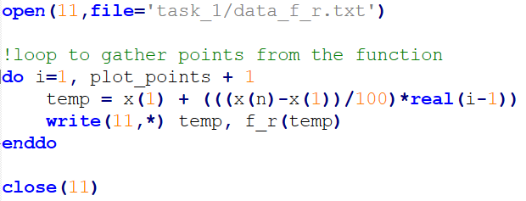
Main.f90
Plot of Task 1
Main.f90
Sub_newton_inter.f90
Output
data_f_r.txt
data_f_s.txt
Sub_cubic_spline.f90
Output
plot_01.jpg

Slide 12
Monte_carlo.f90
…

Slide 13

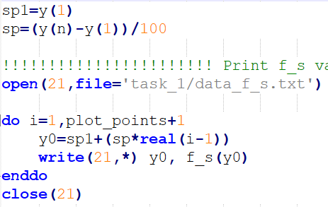
Main.f90
Main.f90
Plot of Task 2
Main.f90
Sub_newton_inter.f90
Output
data_f_r.txt
data_f_s.txt
Sub_cubic_spline.f90
Output
plot_01.jpg

