Slide 1

Hello World!
Welcome to BornHack 2020

Slide 2
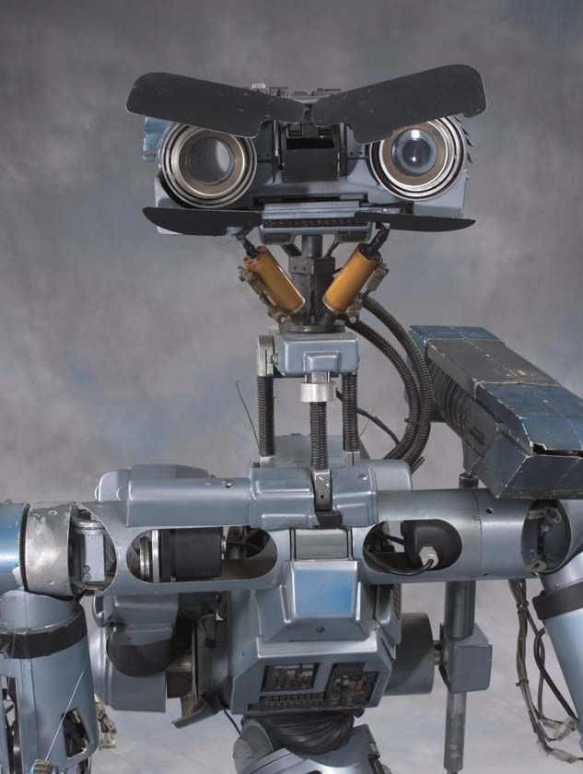
BornHack 5 Alive!

Slide 3

Build-up
Thanks to everyone who showed up early to help with the buildup!
We are not done, but most stuff works
Stuff that needs doing is put on the whiteboard by the infodesk
The venue will evolve during the week and this is very much intended! :-)

Slide 4
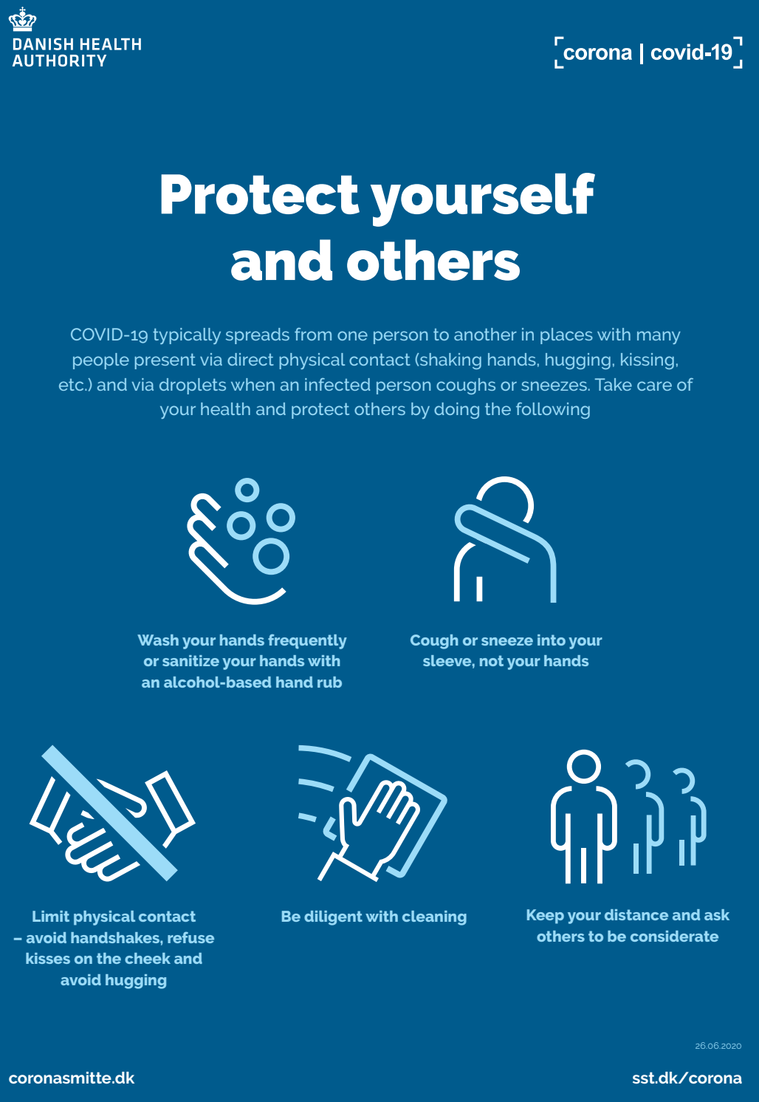
COVID-19 – Stay safe!
Bornhack takes place despite the COVID-19 virus, however, we take several precautions:
Reduced number of participants this year
Reduced number of people in the speakers tent
More cleaning (by pros)
Please spred out on the camping areas
Remember to practice social distancing, especially in food area, bar etc.
Wash your hands and use hand sanitiser frequently
Wear a mask, especially if leaving the venue
It is very important to follow these guidelines and the general directions of the Danish govt.

Slide 5
COVID-19 – Improve?
Do you have any idea on how to use technology for preventing contaigon?
Badge-hacking
Easy-to-make face shields
<your idea here>
Show your fellow participants your great ideas!
Hacker
Improved!

Slide 6
Code of Conduct
Our Code of Conduct is in effect on the venue and online
Read it at https://bornhack.dk/conduct/
Conduct team can be reached at conduct@bornhack.dk
For emergencies call +45 3155 0497

Slide 7
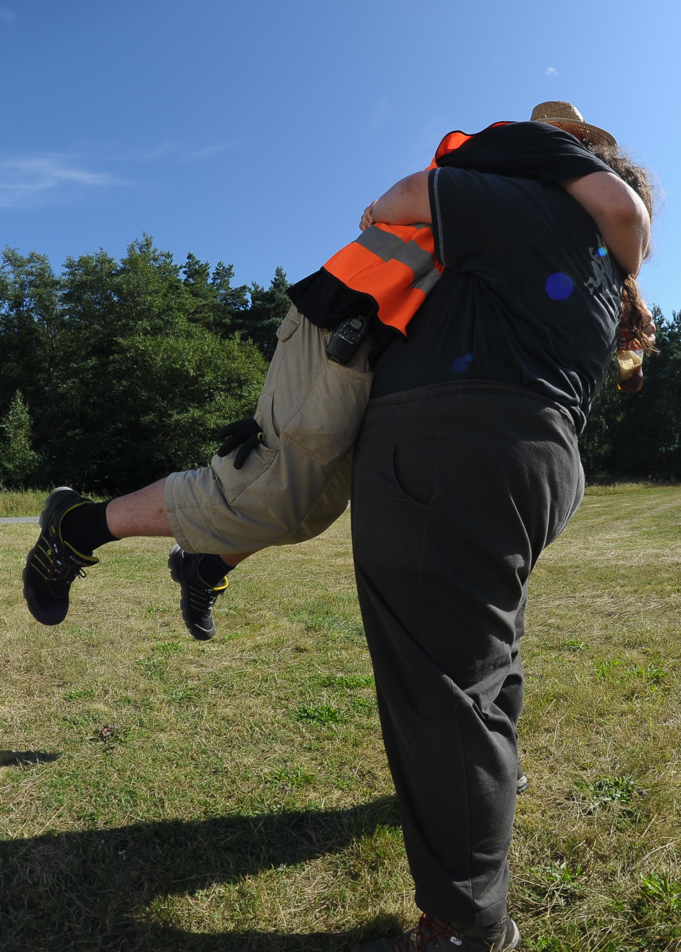
Thanks, dear dear volunteers!
Bornhack wouldn’t be possible without participants volunteering to help.
We still need help here and there, please consider lending a hand if you are near a volunteer who needs it.
You’ll meet a lot of excellent ppl doing so!

Slide 8
Sponsors
DKUUG
PROSA
LetsGo
CSIS
Spiir
ZibraLabs
Den Bornholmske Spritfabrik
Epson
Mikjaer Studios
Raymeon

Slide 9
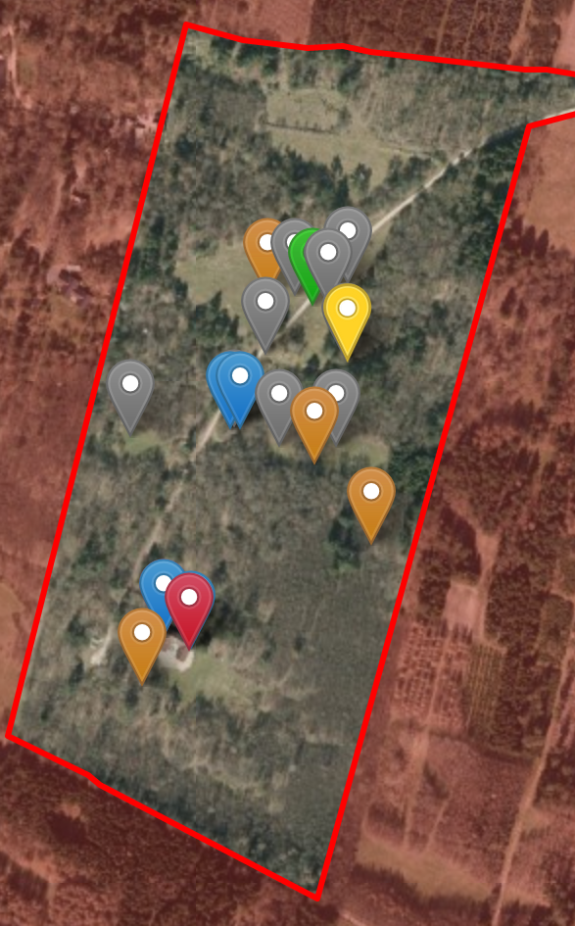
The Venue
Map https://bornhack.dk/bornhack-2020/facilities/
Protected nature: No digging!
Camping Areas
  General camping
  Noisy Area
  Nature Area
Speakers tent
Toilets & Showers
Water Faucets
Power POPs
Network POPs
Parking Area
Fireplaces
Orga village (also organiser re-charging area)

Slide 10
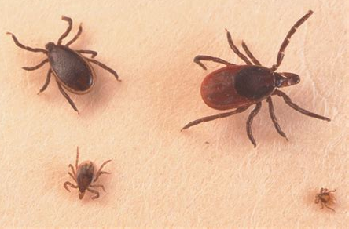
Ticks
...also remember the ticks!
Be aware that ticks might be in the area
Check yourselves daily
Small chance of TBE

Slide 11

Infodesk
The infodesk can help with questions, wristbands, and much more
It is also the place to pick up merch
Open at least from 10-12 and from 16-18, also other times
Also sells beverages
Needs more people

Slide 12
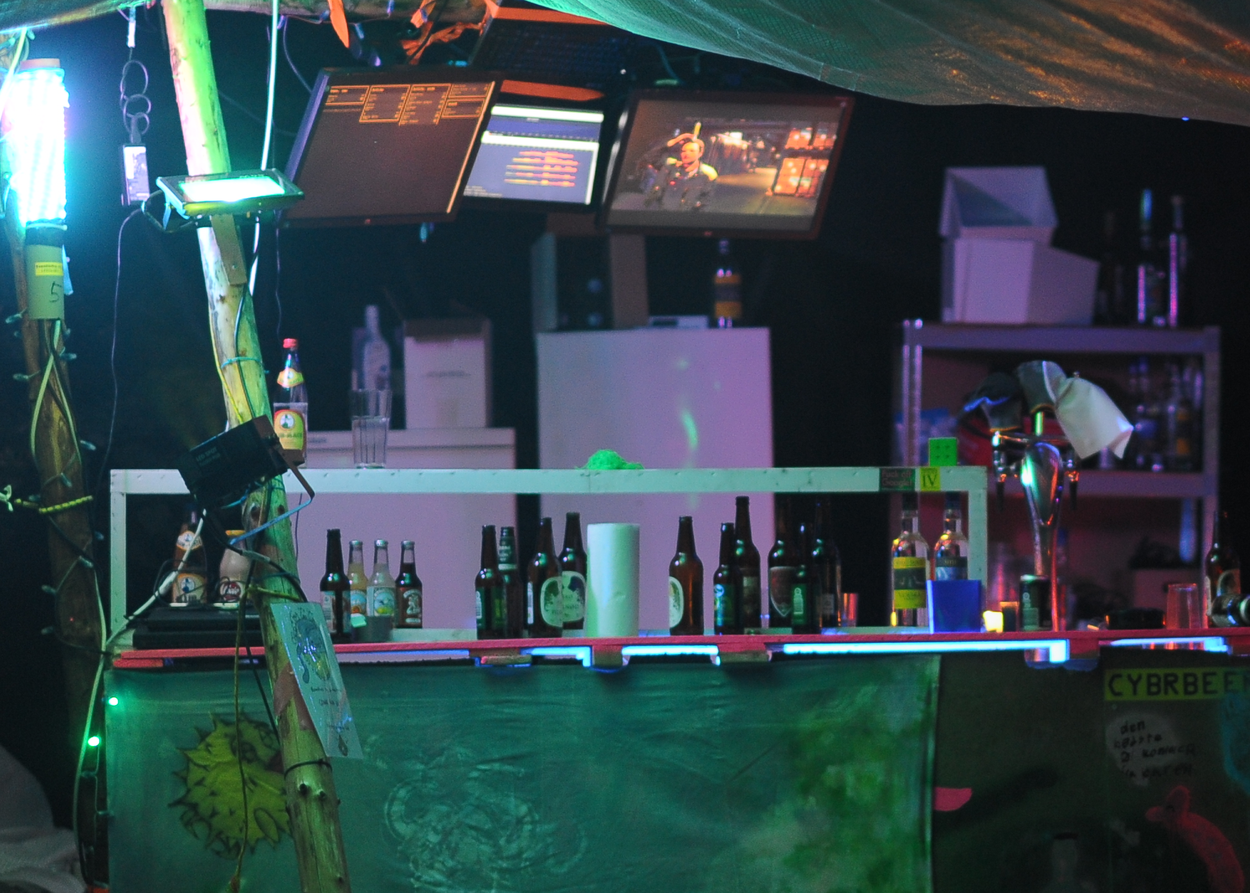

WIP Bar
Please use the Bar, we need the profits to make the economy of this thing work
We have a wide selection of,e.g., beer, booze and !
Last round at 01:50
No more alcohol sale after 02:00
Attention!
plz2note

Slide 13
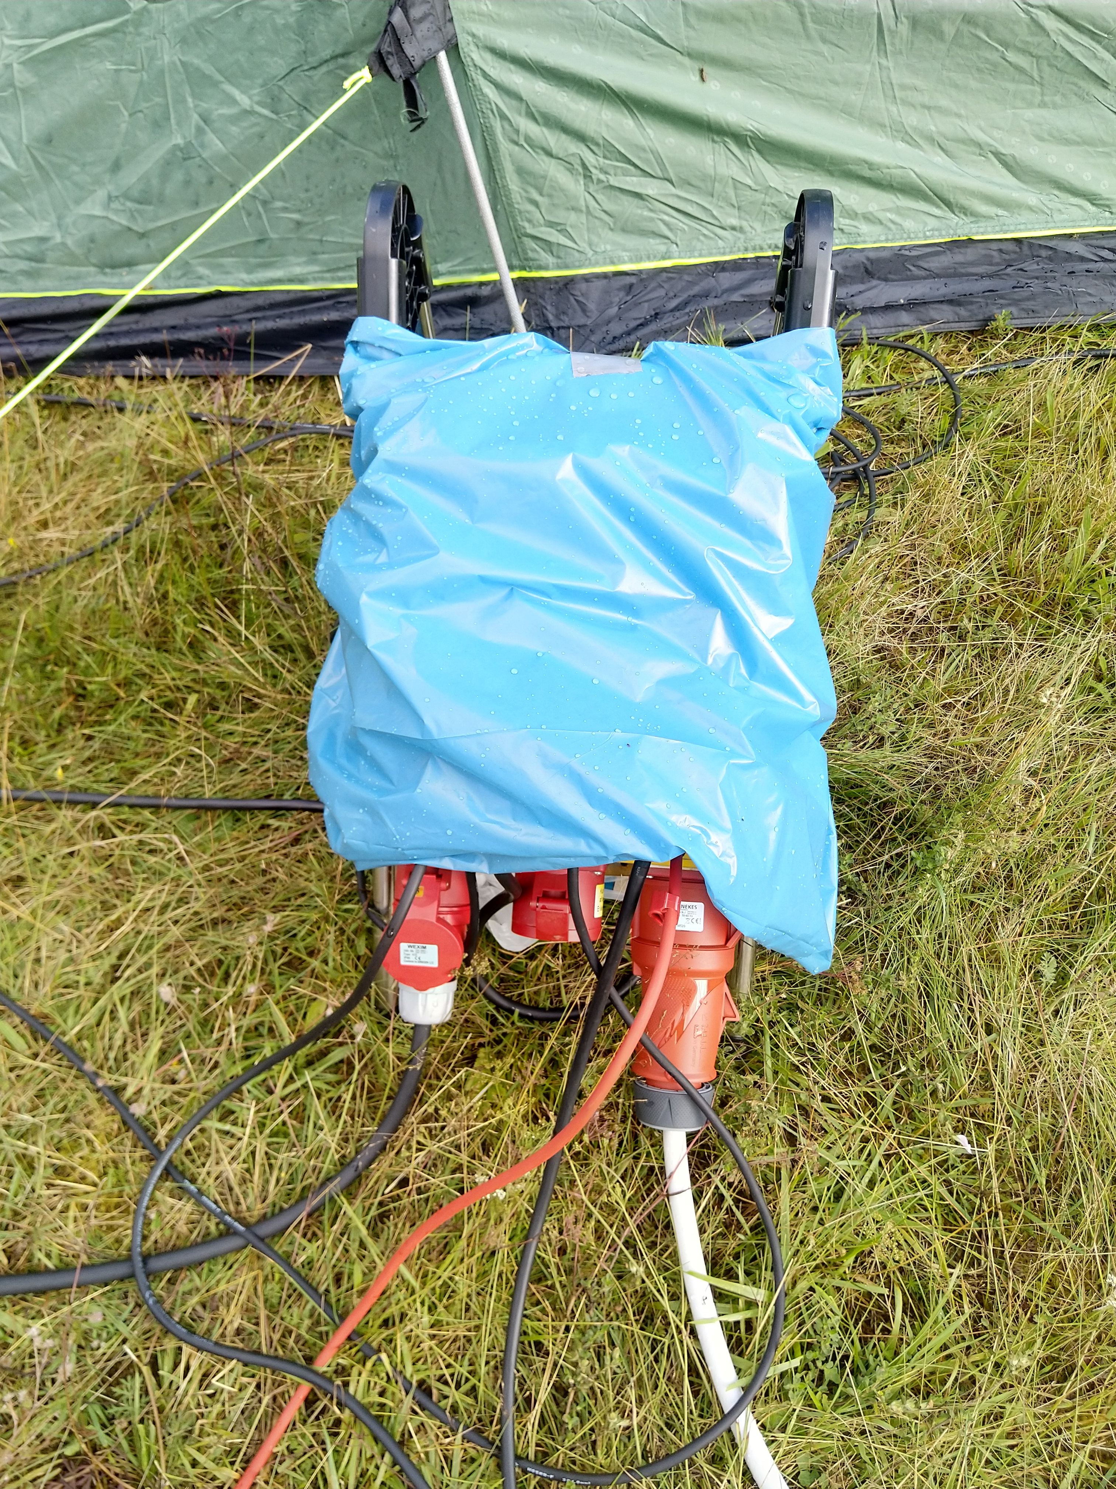
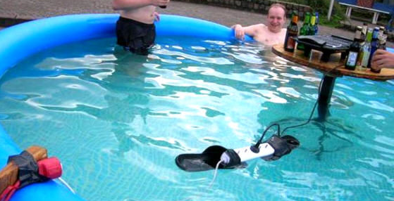
Powah
Power has been distributed all over the camping areas (see the venue-map)
Help yourself
Keep the power hubs covered so they are protected by the rain
If you see a power hub without cover please fix it or notify an organiser (QR)
Good
Not so good

Slide 14
Network
Get wired network hookup by leaving one end of your cable by a network POP and it will be connected soon
3 wifi SSIDs:
  bornhack
  bornhack-802.1x
  bornhack-nat
Use more bandwidth!
Uplink
Around 500 meter temporary fiber
Uplink fiber goes to Global Connect Gelsted POP
Is terminated at BornFiber in Høje Tåstrup (AS24800)
Is routed to the Internet via TDC (AS3292)
2001:678:9ec::/48 (perm) and 151.216.8.0/21 (temp) allocated at ripe, routed in AS208647

Slide 15
Thrash / Bottles / Cans
Try to minimise waste
Each waste point has:
  One bin for plastic bottles and cans with vat
  One bin for glass bottles with vat
  Two bins for thrash
If you see a full bin please use the QR codes to submit feedback, or inform the infodesk

Slide 16
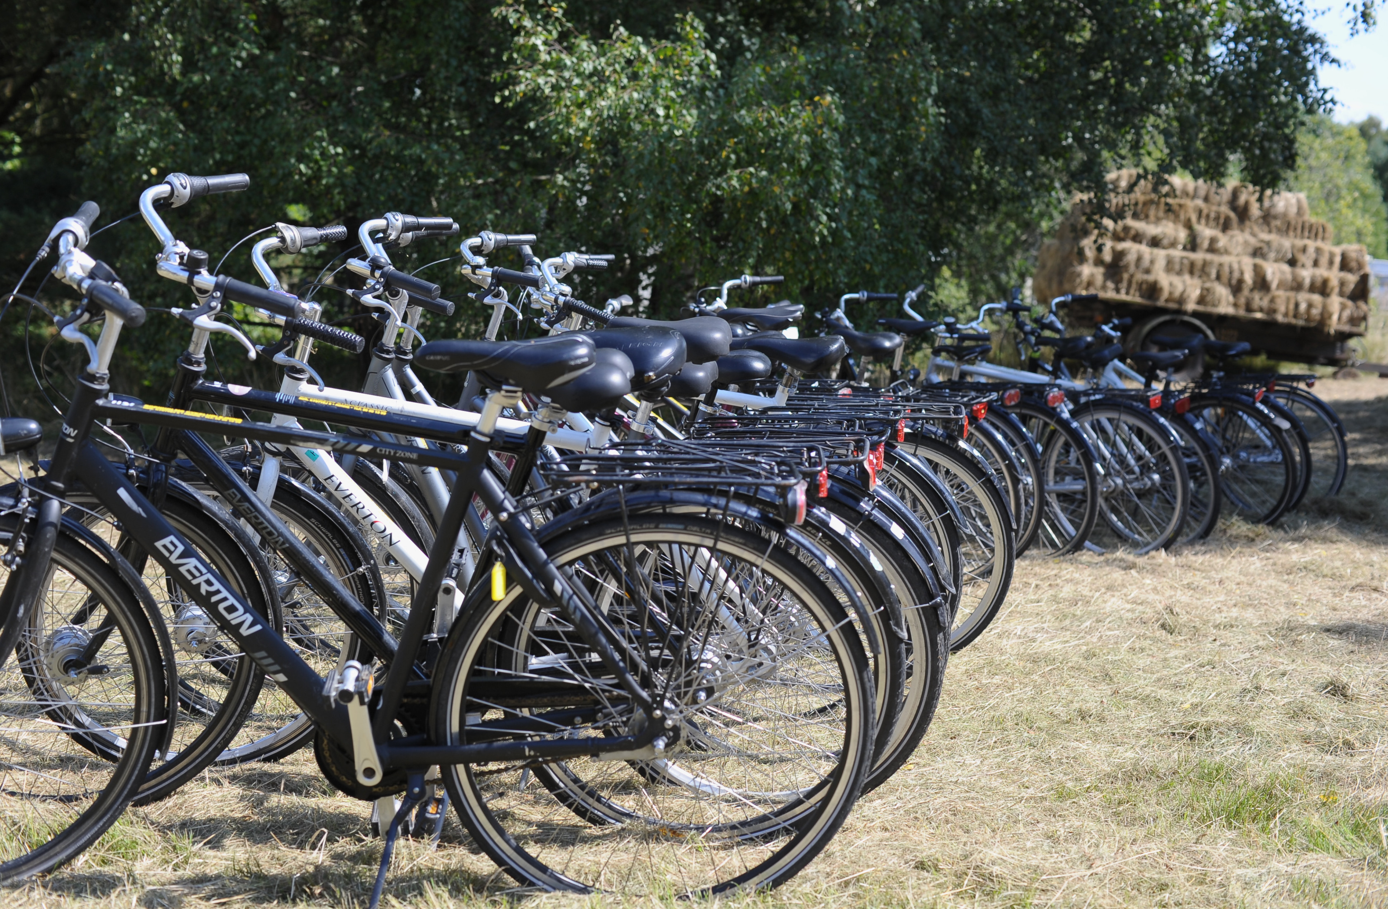
Bicycles
The infodesk has bicycles you are welcome to borrow for free
They come with helmets, locks, lights, and even bags.
Different sizes available
There is a trailer too

Slide 17
HAX
Custom BornHack currency
Only payment option for alcohol
1 HAX == 1 DKK
Can be bought at the infodesk, at the bar or online in our webshop
Can be used at the infodesk, food vendors and in the bar

Slide 18

Teams
Several teams still need members
Info
Video
Bar
Food Area
Sanitation (SHIT)
Go to https://bornhack.dk/bornhack-2020/teams

Slide 19
CERT
Orange vests
Anything from splinters to serious situations
Heartstarter in Infodesk
First aid kits in Infodesk, speakers tent, food area, workshop/cabin area
CERT team meet&greet during lunch tomorrow – 12:30 in the workshop rooms

Slide 20
Photo team
Will wear orange wests
Must (and will) ask for permission to take pictures, unless they know the preferences of all the photographed people.
Everybody is welcome to ask the photographers to see their pictures, if they will make sure that they are not visible in them

Slide 21
Merch & Badges
We still have some merch available in the webshop, get them while you can
Merchandise will be available in the infodesk Friday after 12:00
Badges will be available Wednesday from 10:00
Remember to attend (virtually or in person) the badge talk tomorrow at 13:00-14:00

Slide 22
Anything I forgot?
This space is intentionally left blank in case I remember something while talking
...

