Slide 1

Hello World!
Welcome to BornHack 2021

Slide 2
Code of Conduct
Our Code of Conduct is in effect on the venue and online
Read it at https://bornhack.dk/conduct/
Do not take pictures without the permission of everyone in the pic
Conduct team can be reached at conduct@bornhack.dk
For emergencies call +45 3155 0497

Slide 3
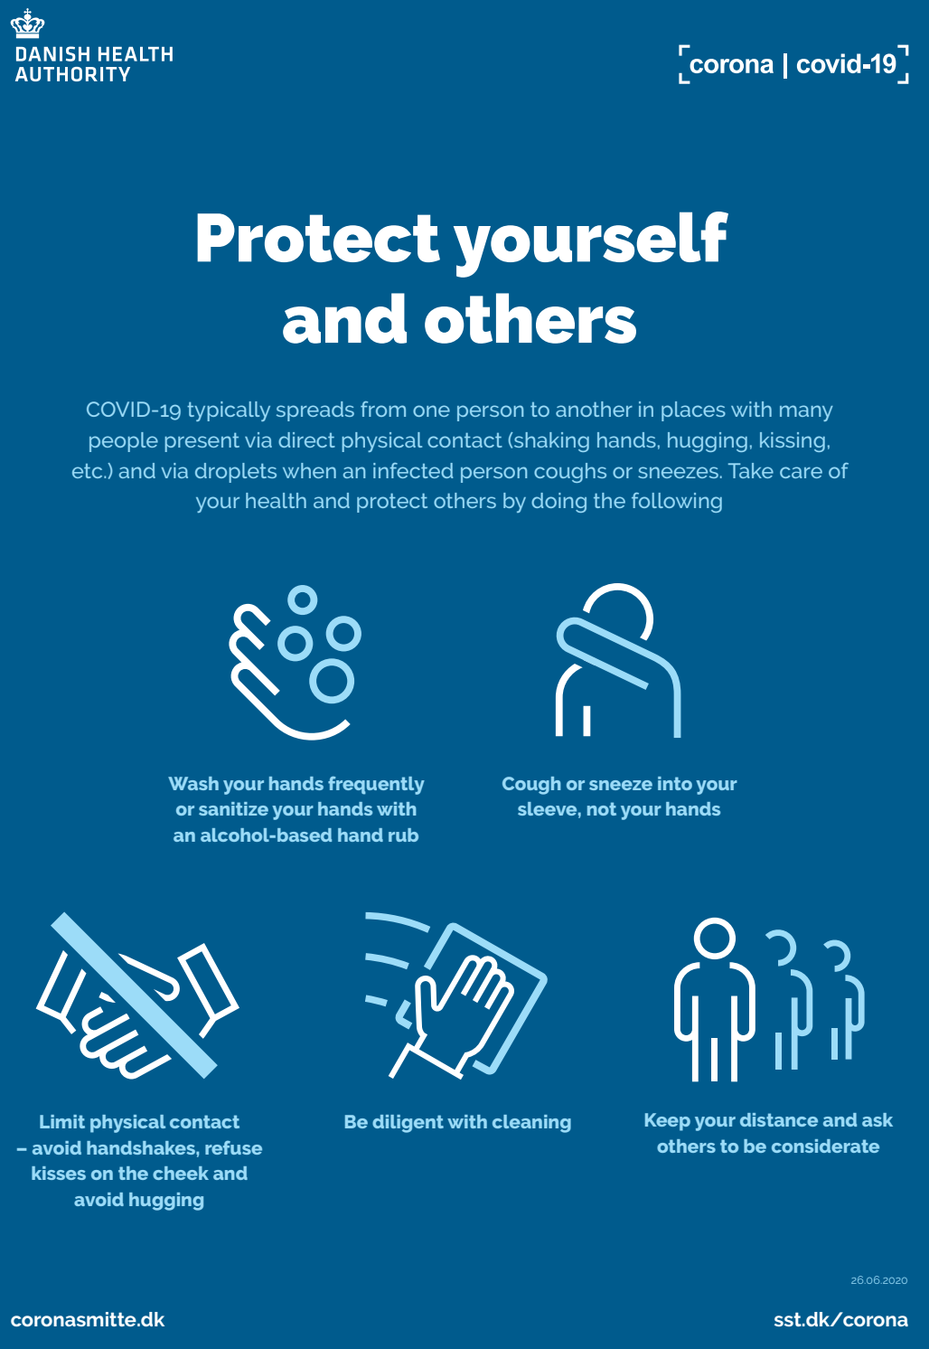
COVID-19 – Stay safe!
Bornhack takes place in spite of the ongoing COVID-19 virus, however, like last year we take several precautions:
Reduced number of people in the speakers tent
More cleaning (by pros)
Remember to practice social distancing, especially in food area, bar etc.
Wash your hands, and use hand sanitiser frequently
It is very important to follow these guidelines and the general directions of the Danish govt.

Slide 4
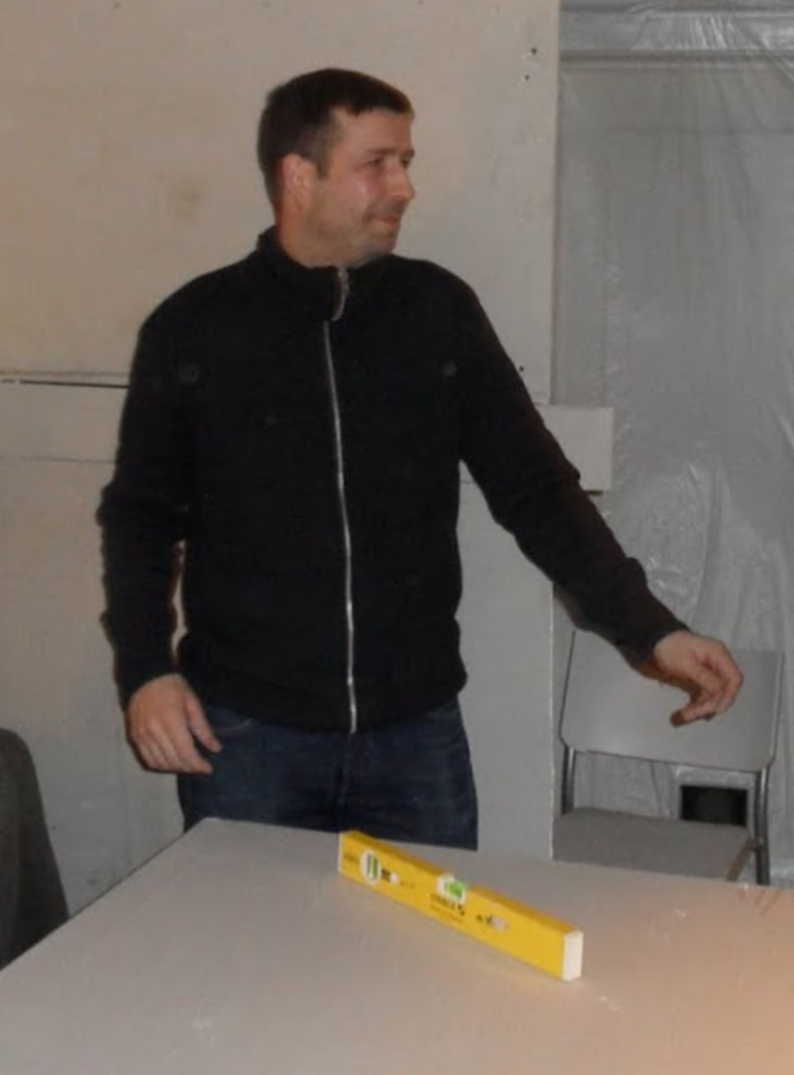
We Lost a Friend This Year :(
Thomas Gransee Jensen
1973-2021
Thanks for everything!

Slide 5
Build-up
Thanks to everyone who showed up early to help with the buildup! Give the buildup volunteers a big round of applause, and maybe buy them a beer in the bar.
Small tasks that still needs doing is put on the whiteboard by the infodesk
Let us know if you see something wrong!
The venue will evolve during the week, BornHack is always a work in progress.

Slide 6
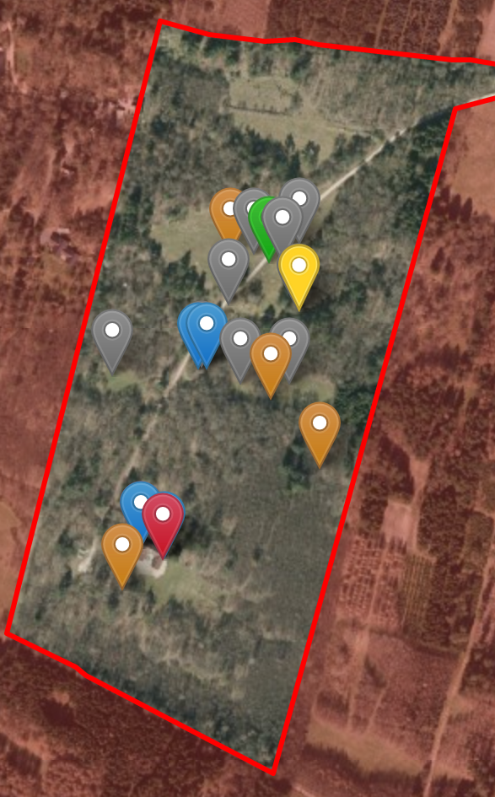
The Venue
Map https://bornhack.dk/bornhack-2021/facilities/
Protected nature: No digging!
Camping Areas
  General camping
  Noisy Area
  Nature Area
Speakers tent
Toilets & Showers
Water Faucets
Power POPs
Network POPs
Parking Area
Fireplaces
Orga village (also organiser re-charging area)

Slide 7
Infodesk
The infodesk can help with questions, wristbands, HAX, and much more
It is also the place to pick up merch
Open from 10-14 and from 16-20
Also sells Mate
Needs more people, team meeting friday 09:30 and saturday 09:30

Slide 8
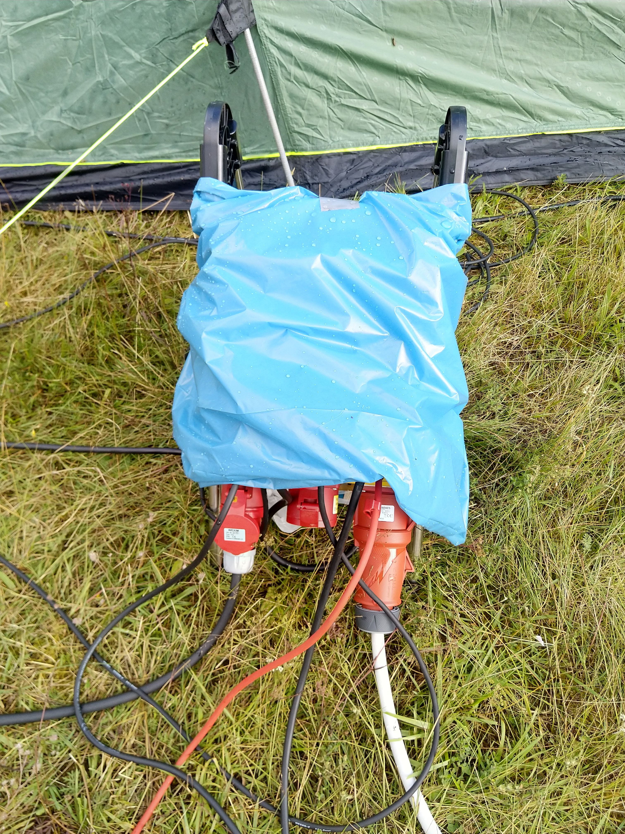
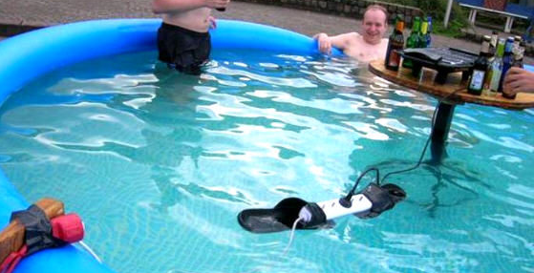
Powah
Power has been distributed all over the camping areas (see the venue-map)
Help yourself
Keep the power hubs covered so they are protected by the rain
If you see a power hub without cover please fix it or notify an organiser
Good
Not so good

Slide 9
Network
Get wired network hookup by leaving one end of your cable by a network POP and it will be connected soon
3 wifi SSIDs:
  bornhack
  bornhack-802.1x
  bornhack-nat
Use more bandwidth! 3 gigabits this year!
Uplink
Around 500 meter temporary fiber
Uplink fiber goes to Global Connect Gelsted POP
Is terminated at Fiberby in Høje Tåstrup
2001:678:9ec::/48 (perm) and 151.216.8.0/21 (temp) allocated at ripe, routed in our AS208647

Slide 10

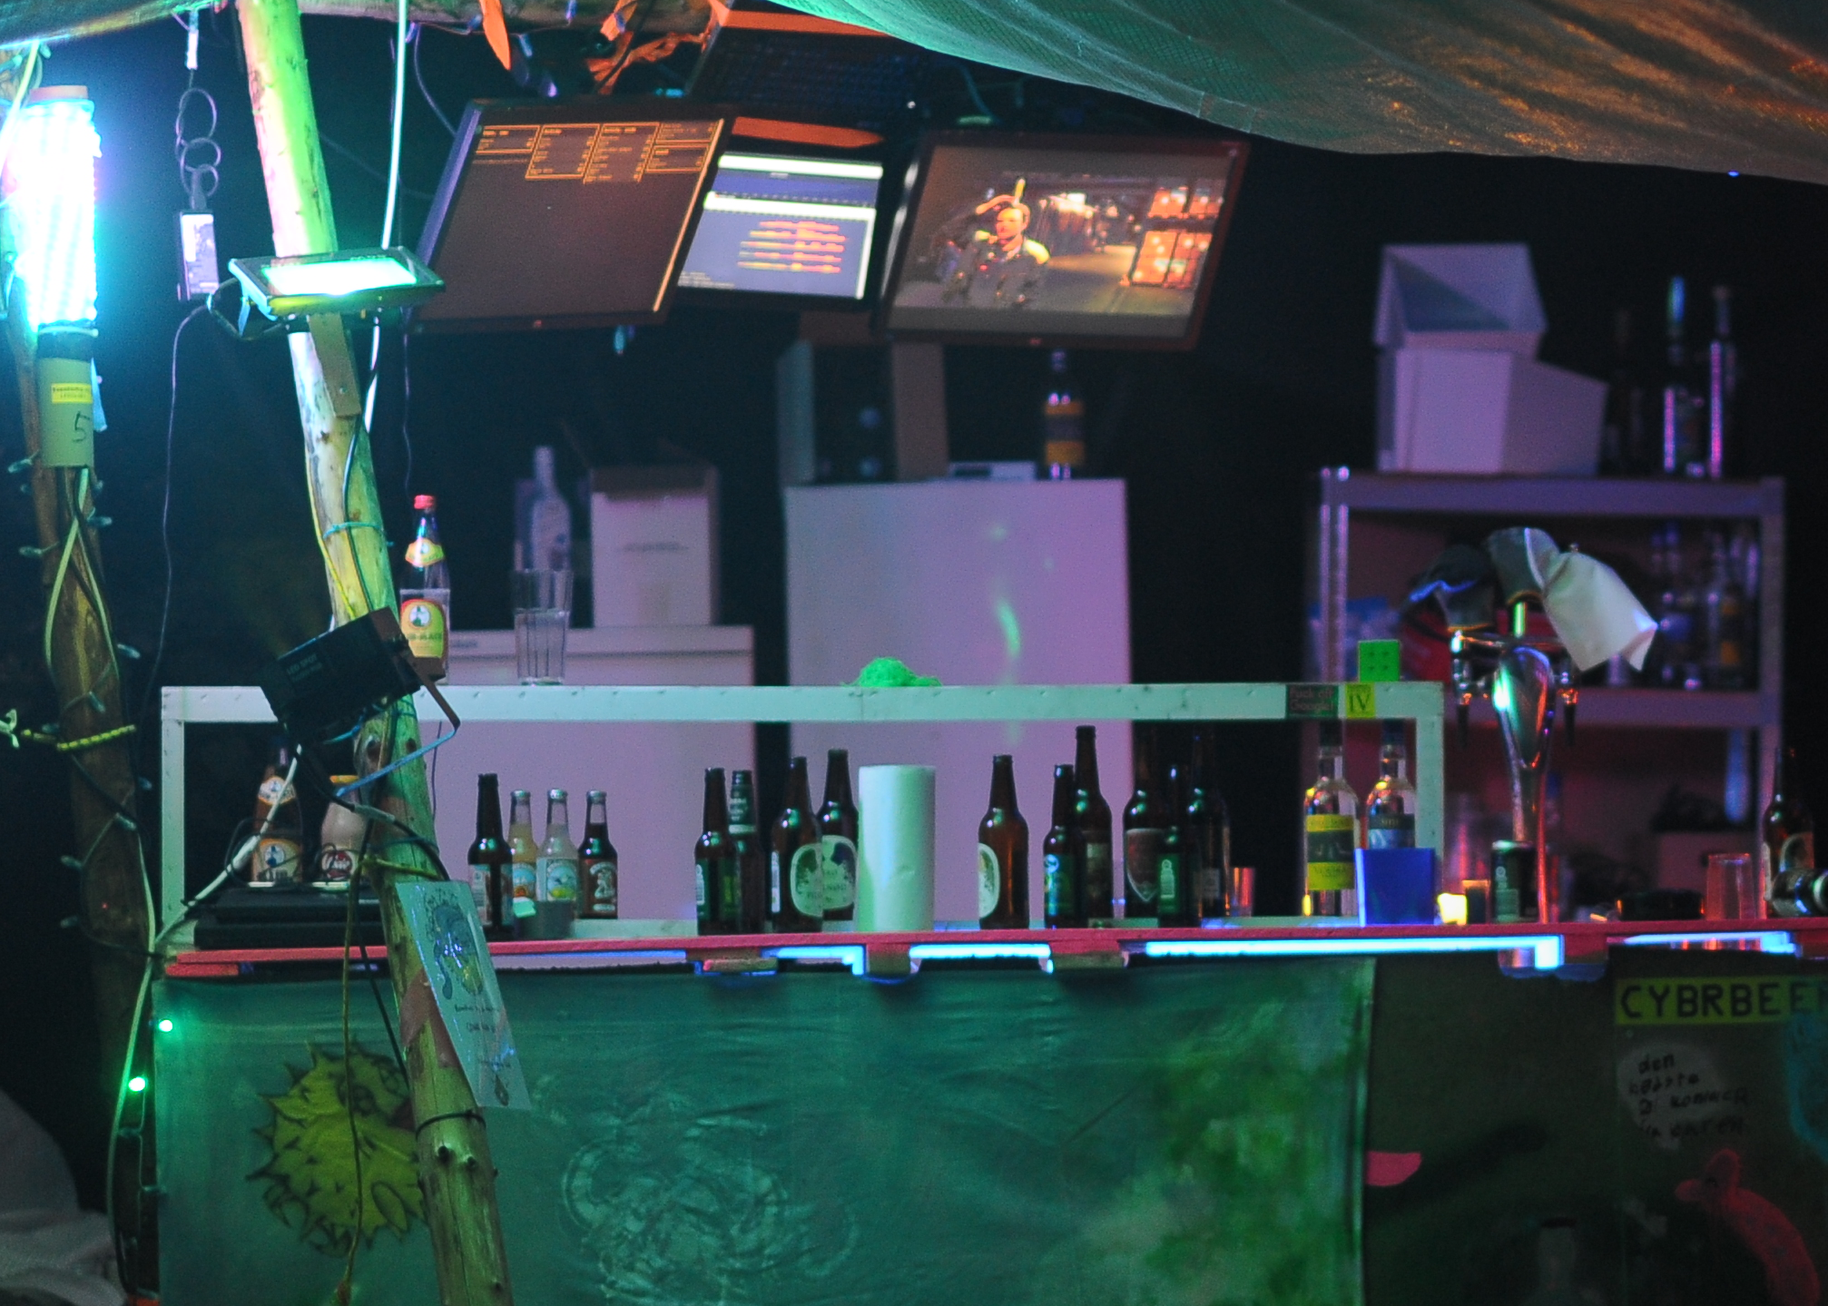
WIP Bar
Please use the Bar, we need the profits to make the economy of this thing work
We have a selection craft beer, booze,
Last round at 01:50

Slide 11
Thrash / Bottles / Cans
Try to minimise waste
Each waste point has two regular thrash cans
And a plastic box for glass bottles with deposit
For cans and plastic bottles with deposit use the white cardboard boxes placed at some thrash points (4 total)
If you see a full bin please tell infodesk

Slide 12
Sponsors
DKUUG
PROSA
LetsGo
Aiia
ZibraLabs
Den Bornholmske Spritfabrik
Epson
Mikjaer Studios
Raymeon

Slide 13
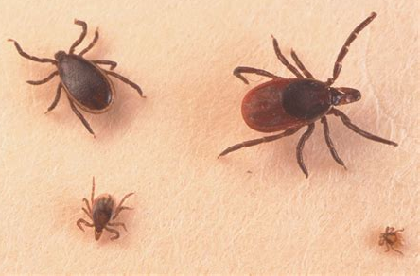
Ticks
...also remember the ticks!
Be aware that ticks might be in the area
Check yourselves daily
Small chance of TBE

Slide 14
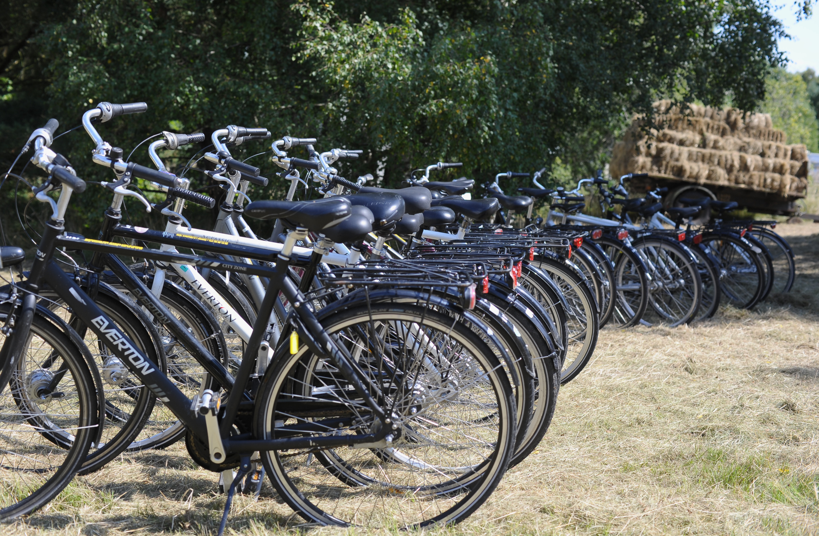
Bicycles
The infodesk has bicycles you are welcome to borrow for free
They come with helmets, locks, lights, and even bags.
Different sizes
And trailers too

Slide 15
HAX
Custom BornHack currency
Only payment option for alcohol
1 HAX == 1 DKK
Can be bought at the infodesk, at the bar or online in our webshop
Can be used at the infodesk, food vendor and in the bar

Slide 16
Merch & Badges
We still have some merch available in the webshop, get them while you can
Merchandise is available in the infodesk (with a few exceptions)
Remember to attend (virtually or in person) the badge talk tomorrow friday at 11:00-12:00

Slide 17

Volunteering and Teams
Several teams still need members:
Info
Video (friday 12:00)
Bar
Food Area
Sanitation (SHIT)
Go to https://bornhack.dk/bornhack-2021/teams/

Slide 18
CERT
Orange vests
Anything from splinters to serious situations
Heartstarter in Infodesk
First aid kits in Infodesk, speakers tent, food area, workshop/cabin area
CERT team meet&greet during lunch tomorrow friday at 12:30 in the workshop rooms

Slide 19
Photo team
Will wear orange wests
Must (and will) ask for permission to take pictures, unless they already know the preferences of all the photographed people.
Everybody is welcome to ask the photographers to see their pictures, if they will make sure that they are not visible in them
Meeting friday 10:00 at the workshop rooms

Slide 20
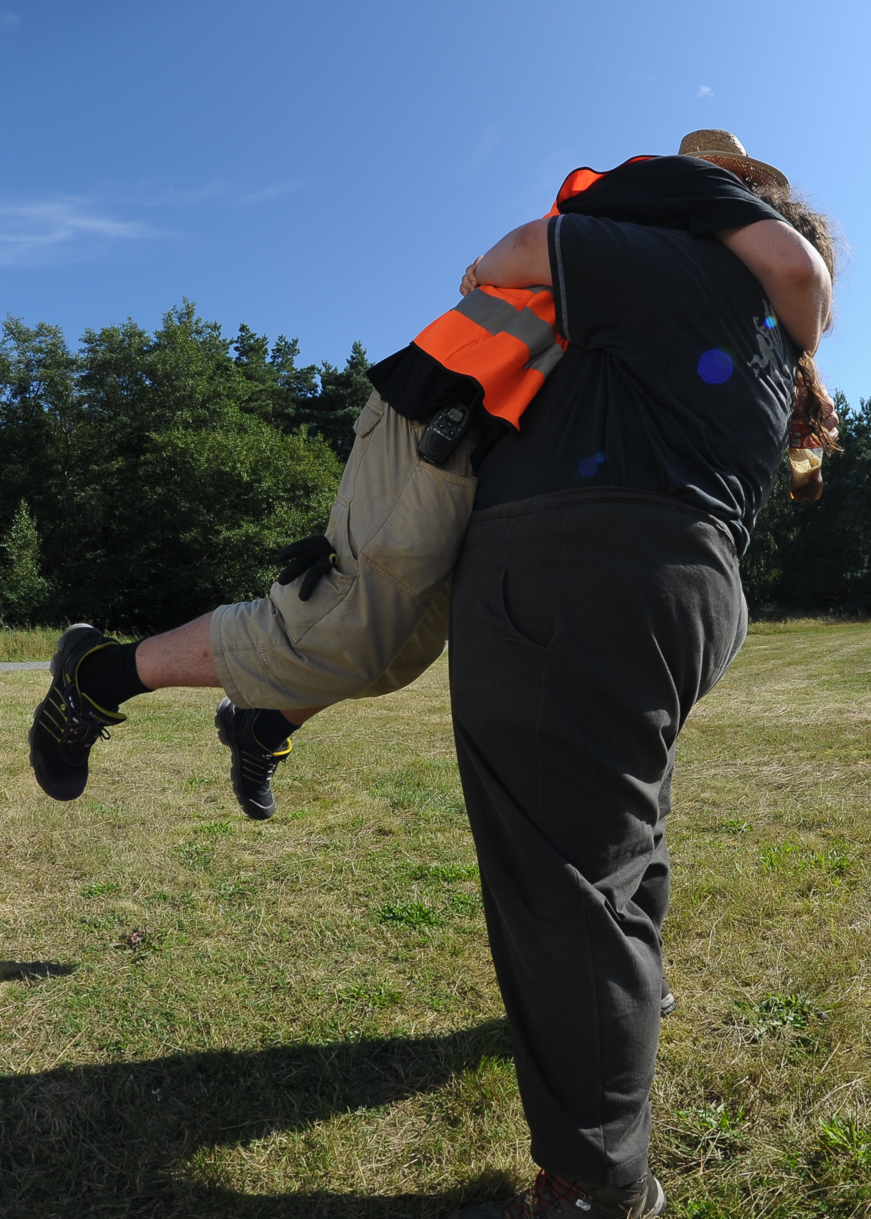
Thanks, dear dear volunteers!
Bornhack wouldn’t be possible without participants volunteering to help.
We still need help here and there, please consider lending a hand if you are near a volunteer who needs it.
You’ll meet a lot of excellent ppl doing so!

Slide 21
Anything I forgot?
This space is intentionally left blank in case I remember something while talking
...

