Slide 1

State of the Network
BornHack 2018
NOC Team
noc@bornhack.org

Slide 2
Important stuff
So, we think you should know!
We do NOT collect data for “fun” (or profit)
We respect your privacy
NO packet captures, except for solving problems
We dont even have central mirror port for sniffing pre-configured – none done in 2018 :-D
NO IDS or traffic analysis, not even netflow, only SNMP
DHCPD has the MAC addresses, use mac changer
WiFi controller has MAC addresses, use mac changer
Note: Upstream ISP required by law to do some logging in DK

Slide 3
Preparations
Before getting here, we did:
Asked RIPE NCC for IPv4, IPv6 and AS number
Asked Bornfiber Peter Krupl for assistance in configuring uplink, thank you Peter
Gathered some devices, cables, found the ones from last year
Created a NOC team on the BornHack page
We had a great team this year :-)

Slide 4
Hardware used
Core switching Juniper EX3300
Core routing Juniper SRX220 with selective stateless filtering
PoPs made with boxes from the BRK municipality
Wired Brocade switches in PoPs Three series and OLD,
SSH needs insecure config to connect
Wifi Ruckus handled by John from Zibra Wireless, THANKS!
Service VMs on a laptop

Slide 5
Major problems
Beginning:
DHCP floods, ARP floods, duplicates
AP=> switchport misconfiguration and wirelessly uplinked APs
Power outages, rain and water
Fiber converter, fried by thunder
We got around to making the 802.1x – except does not work on Windows :-(

Slide 6
Minor problems
Some users report they are disconnected
Hard to diagnose when standing with a beer
Will perhaps do a NOC support desk next year?
GeoIP puts us in Netherlands,
always a problem for temp networks

Slide 7
Succes and achivements
Built a network spanning 350m from North1 PoP to South1 speakertent
9 PoPs including the core room with server hosting
Put out MORE than 1km of network cable to connect main sites, achievement unlocked :-) around 900m fiber, rest copper
Provided a reasonable stable network with some people reporting 8ms/800Mbps/800Mbps speedtest to Copenhagen at times – wired network
Provided PBX network for DECT, Klondike
Provided OHM Led network again for Eightdot

Slide 8
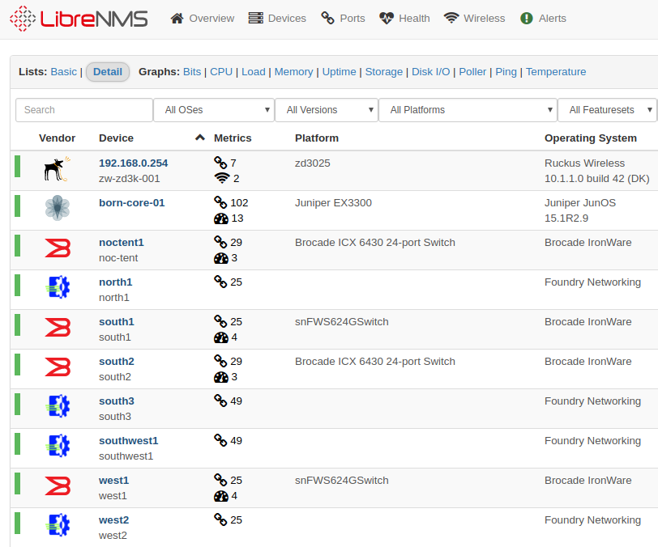
LibreNMS switches

Slide 9
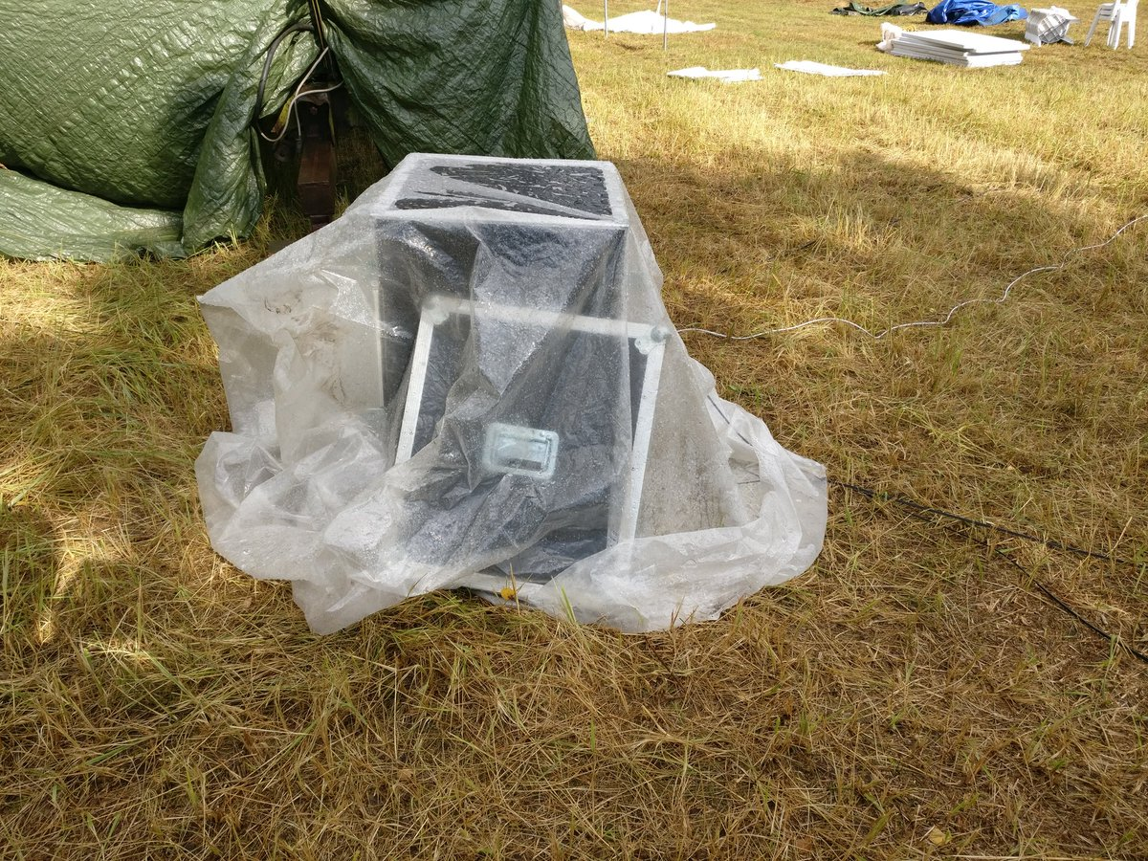
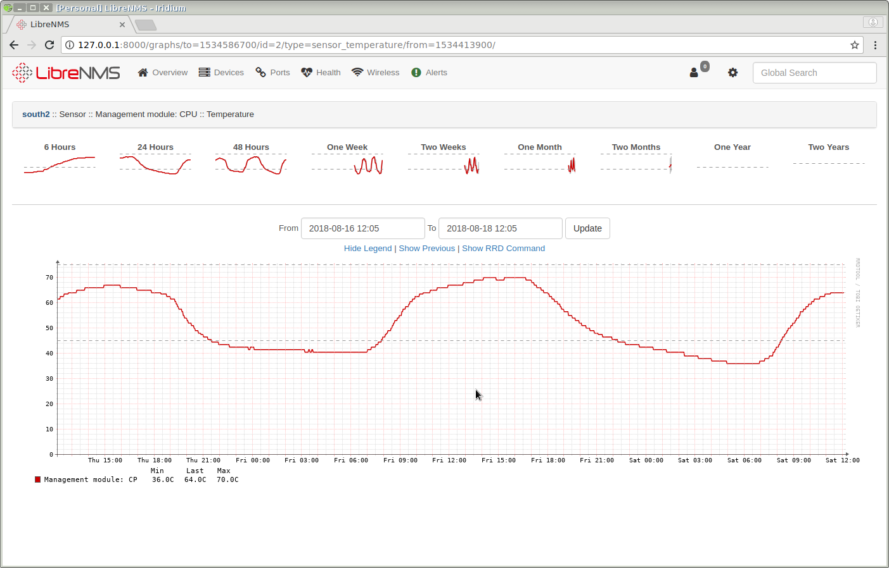
PoPs / datenklos
Yup, it said 70 degrees celcius in one PoP

Slide 10
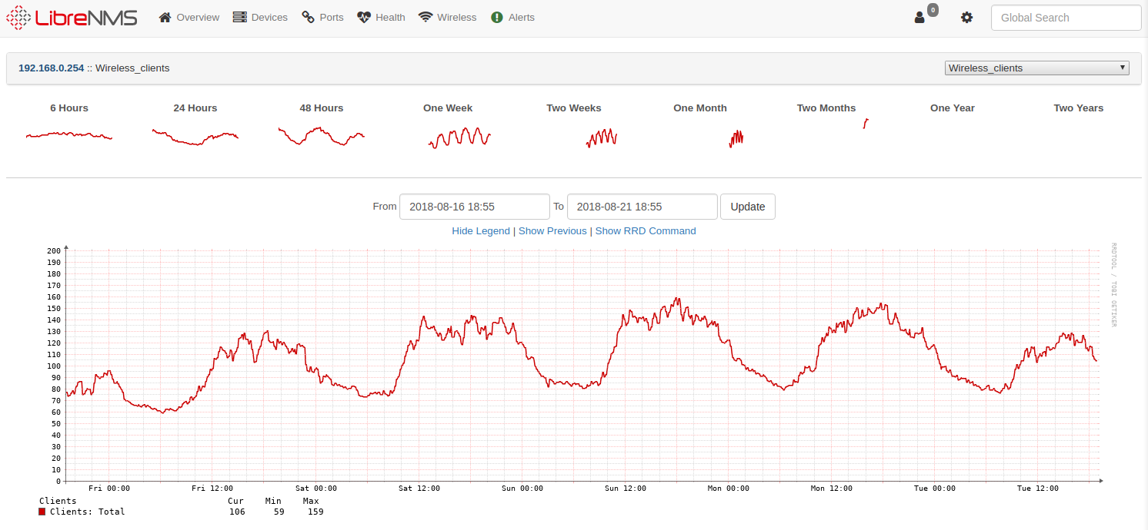
Wireless Clients
Maximum of about 165 concurrent clients

Slide 11
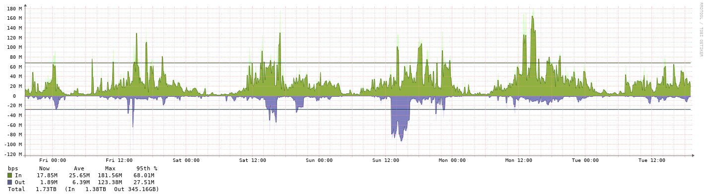
Bandwidth
Regular usage is not high, averaged over 5 minutes.

Slide 12
Lessons learned
Second year, was not prepared enough
Third year, had a lot of hands moving boxes out into field
Project requires less hard core network people – 2 is enough – and we have a Github repo with main configs :-D
NOC Helpdeskers would be appriciated, maybe next year do support hour
Goal next year, have 2x network people, +5 NOC support
AND again have a person or group doing the wifi
Bring more fiber converters, one fried and cheap

Slide 13
Conclusion
We did it, there was a pretty stable network
We got tents connected
We provided services to others

Slide 14
Some software tools used
OpenBSD conserver
http://conserver.com/ - serial connections
LibreNMS for stats – autodiscover yay!
https://www.librenms.org/
RANCID for gathering configs
Oxidized for getting config from devices
https://github.com/ytti/oxidized
Plus usual suspects, tcpdump, wireshark, ping, nmap, traceroute

