Slide 1
CheerMeApp
The Cheerios – UCF Coding Bootcamp
Notes:
According to recent psychological research one of the main causes of many psychological problems is the habit of emotional avoidance -- the attempt to avoid negative emotions-- WHICH appears to be a reasonable thing. After all, negative emotions don't feel good, and they are often linked in our minds to negative events that we want to avoid.. or forget.
And we get accustomed with that fleeting relief (right?), that avoidance can provide. Long term, however, it can become a bigger problem.
Actions > habits > behaviors >personalities

Slide 2


Emotional Acceptance
CheerMeApp is a face recognition application that looks at our expressions and gives us music based on mood. CheerMeApp utilizes 2 API’s….
Face++: Real-time Face Recognition resource with Leading Accuracy
Free Music Archive: Digital repository for music that wants to be shared, with more than 100,000 free and legal tracks
Acknowledging your emotional state, as a staple of good psychological and physiological well-being.
http://psychcentral.com/
https://www.psychologytoday.com/
Notes:
It’s important to recognize your emotional state, and CheerMeApp does just that.
The appreciation of music is tied to the ability to process its underlying structure and predict what will occur next in the song (rhythm). What if you could organize your emotions as they come, through the power of music? Not only analyze emotion, but direct it, and with time, better control it.

Slide 3
DEMO
Notes:
http://www.hdwallpaperspulse.com/wp-content/uploads/2012/10/baby_image.jpg
https://s-media-cache-ak0.pinimg.com/236x/93/b7/c3/93b7c38004215853eb6a2b0e9bc984e4.jpg
Class group pic to slack

Slide 4
Process Flow
Notes:
Multiple faces get a average value

Slide 5
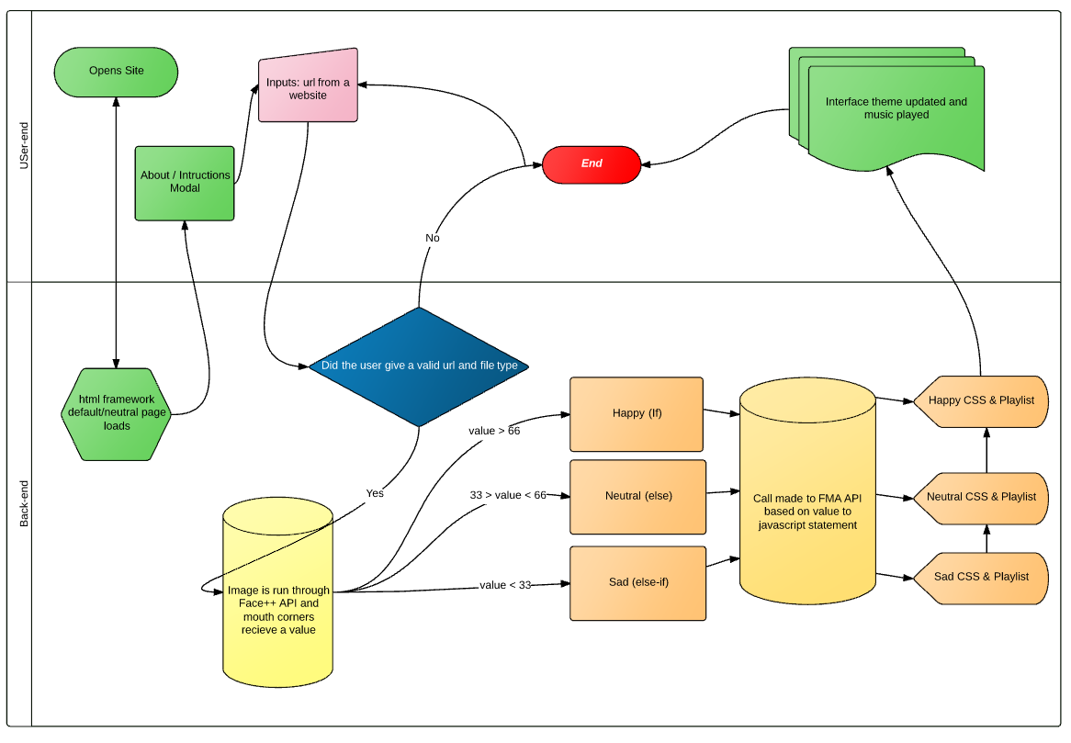

Slide 6
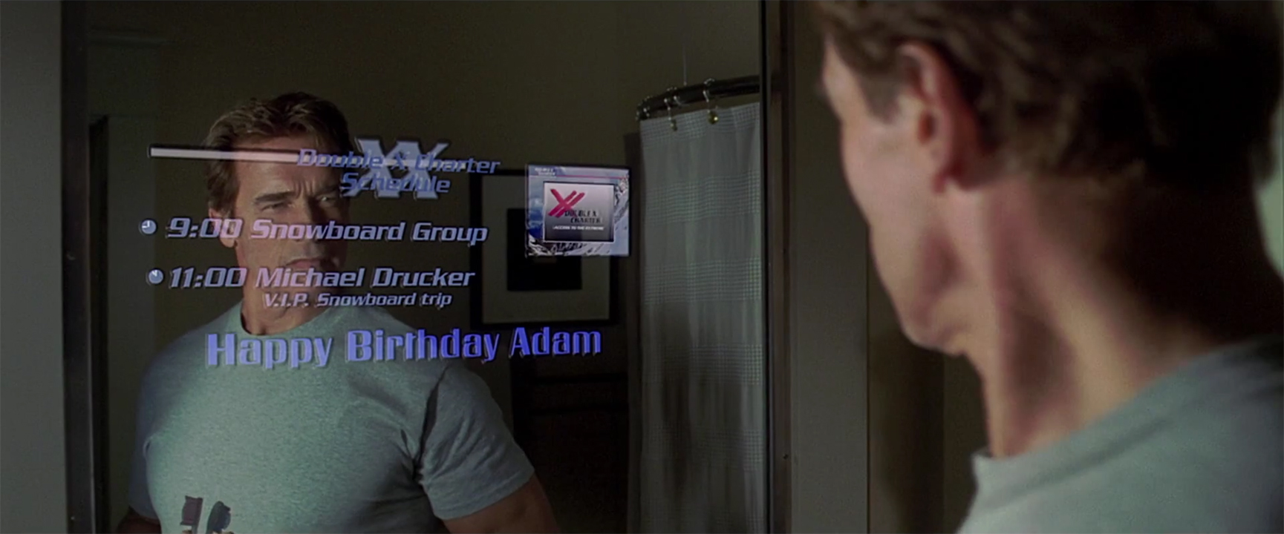


CheerMeApp has many enhancement opportunities like…
Software
Users can utilize their favorite Spotify playlists, or log into their own, and assign corresponding moods.
Option to have image obtained from local storage; their device’s camera
Hardware
Using SmartMirror technology with an integrated camera and speaker, users can have a unique experience to their daily prep routines.
Now playing… “Terminator 2 Theme”

