Slide 1
Supplementary Material
Rongzhong

Slide 2
The program reads in the experimental image and converts every pixel’s brightness to gray scale ranging from 0 to 255 (black to white). After applying certain threshold, only the bright pixels for fibers will remain in the image. We specify one fiber by clicking at its starting and ending point. The program will find the central points along the fiber automatically. The raw sequence of central points are fitted by polynomials of a + b x^-1 + c x^-0.5 + d x + e x^2 + f x^3 + g x^4. Note that unlike general fitting purpose, we don’t need to predict the curve outside the sample points’ range. As long as we connect the sample points with a smooth curve, we can calculate its length using the fitting function.

Slide 3
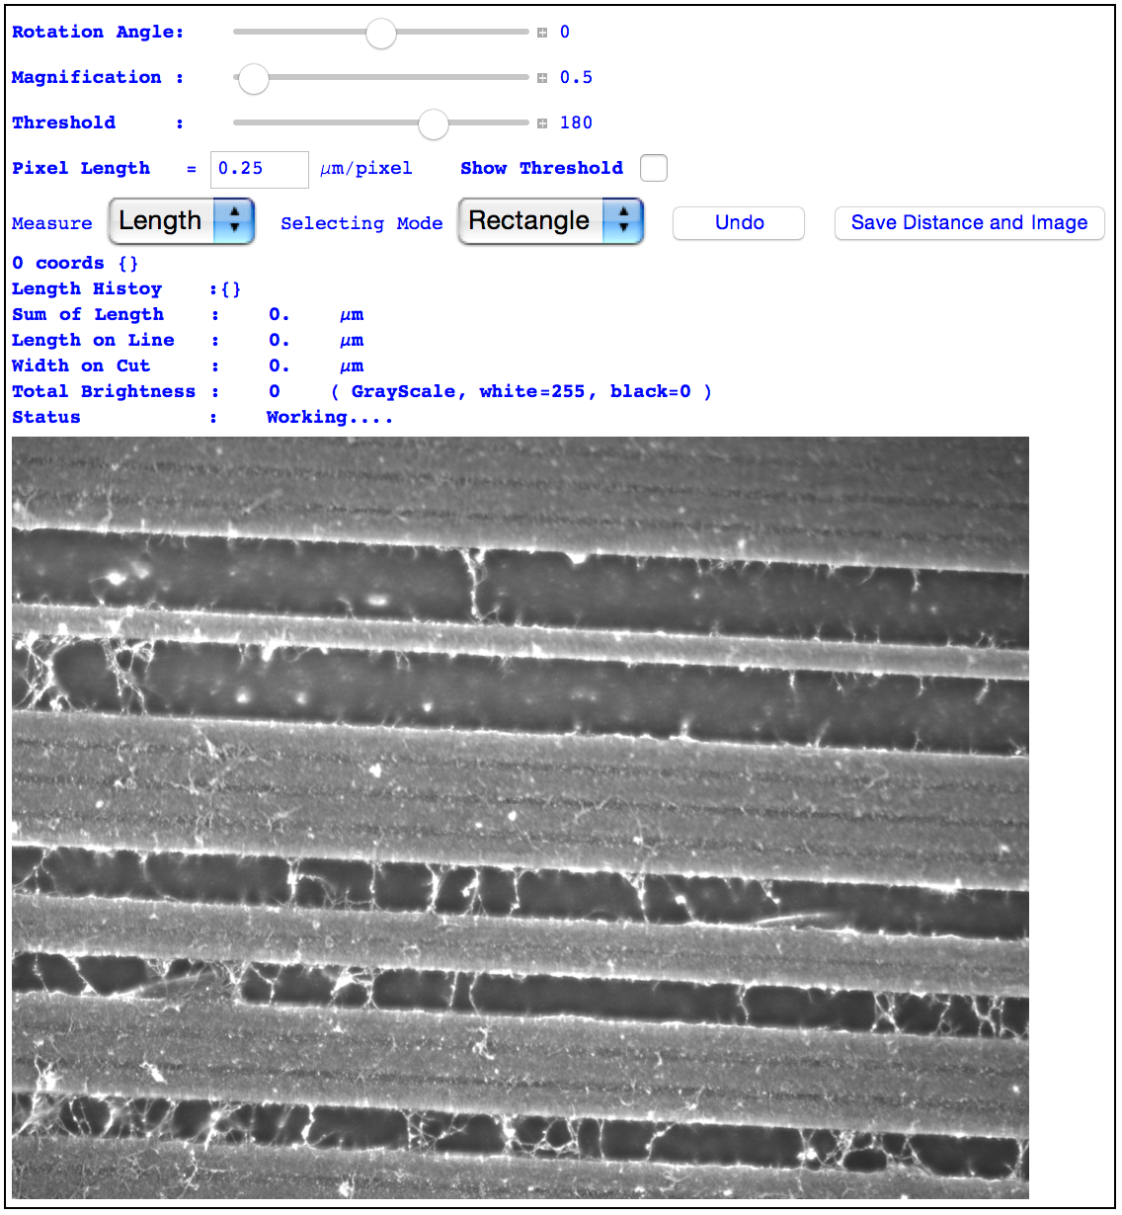
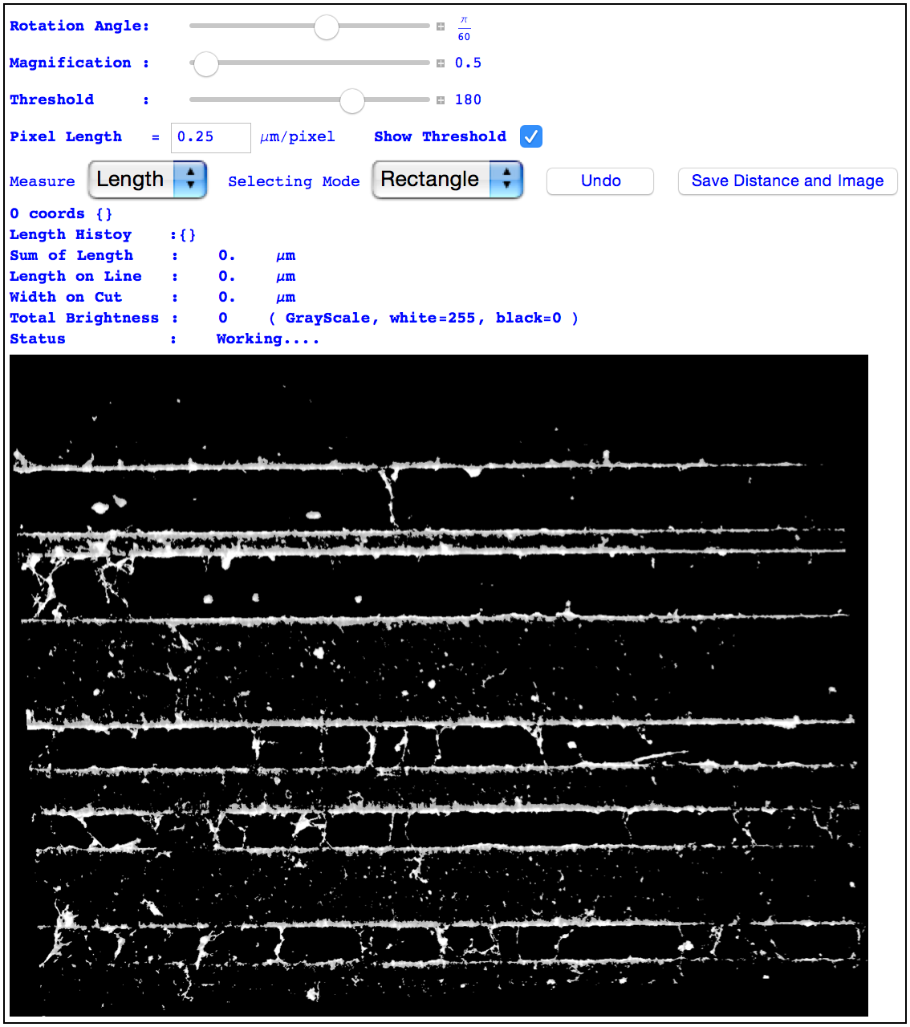

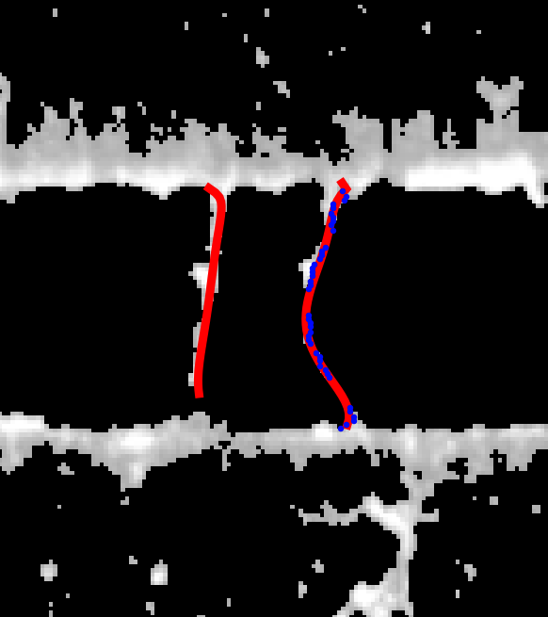
Figure. Algorithm for measuring fiber length.
A B
C D

Slide 4
Caption A
The control panel of the measuring tool. It provides the functionality to straighten, magnify, threshold and measuring the graphical elements. The current configuration shows one of our raw experimental image.

Slide 5
Caption B
The image is first straightened in horizontal direction. Then a brightness threshold is applied to remove noise and only show the bright pixels of fibers and their supporting grids.

Slide 6
Caption C
The fiber is selected by clicking the diagonal points of its smallest rectangular cover. The path of the fiber is automatically detected and calculated using our algorithm. The history of selection and lengths are saved in the program’s database.

Slide 7
Caption D
The magnified yellow region of Figure C. The blue dots shows the middle points of each row of current selection region. The red curve is their polynomial fitting. The length along the curve is first calculated in pixels, then converted to a real length unit.

