Slide 1


AI & the Future
Artificial Intelligence · Generative AI · Agents · Vibe Coding

Slide 2
OVERVIEW
Session Overview
1. Welcome & Introduction
2. Ice Breaker & Quiz
3. How we got here — from Machine Learning to Agents
4. Generative AI & using it responsibly
5. Vibe Coding — what & why
6. Interactive Q&A & demos
7. Hands‑on Vibe Coding session
8. Showcase & wrap‑up

Slide 3




YOUR HOSTS
Team Members
RP
Ranjan Patalasingh
Principal AI Engineer
MM
Muhammed Miah
Senior AI Engineer
FH
Farhad Hussain
Senior AI Engineer
KC
Kelvin Chan
Data Scientist
CK
Chaitanya Katukuri
Engineering Lead, ML
KK
Krishna Konduru
Data Engineer

Slide 4
Ice Breaker & Quiz

Slide 5



WARM UP
Let's Break the Ice!
Quick‑fire round — shout your answer!
What AI tool have you used in the last week?
Name one thing you think AI cannot do (yet).
If you could build any app with AI, what would it be?
What do you most want to learn today?

Slide 6

CHALLENGE
Quiz
Fast facts
Fastest correct answer earns more points

Slide 7
Machine Learning, Generative AI & Agents

Slide 8
THE BIG IDEA
What if you could build a website just by describing it?
No tutorials. No experience needed. Just your ideas.

Slide 9
THE JOURNEY
How We Got Here — From Learning to Doing
AI evolved in three big leaps — each one unlocked the next.
The Analyst
Machine Learning & Deep Learning · ~2010s
Learns from data, recognises patterns, makes predictions. Classifies what already exists.
Spotify recommendations, FaceID, spam filters.
The Creator
LLMs & Generative AI · ~2018–2022
Understands language, then starts generating new things — text, images, code, music.
ChatGPT writing an essay,
Midjourney generating artwork.
The Doer
Agents · ~2024
AI that can act autonomously — browses the web, runs code, plans multi-step tasks.
GitHub Copilot building features for you.
The Payoff — Vibe Coding (~2025)

Slide 10
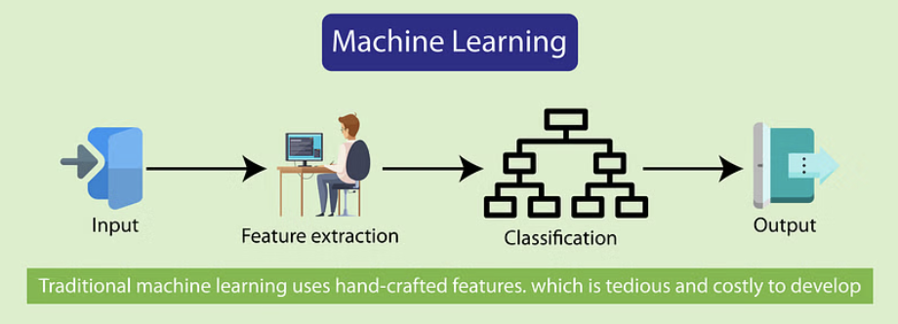
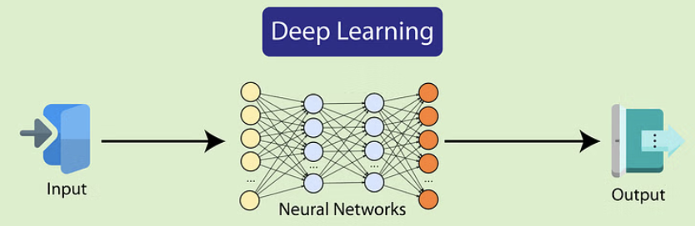
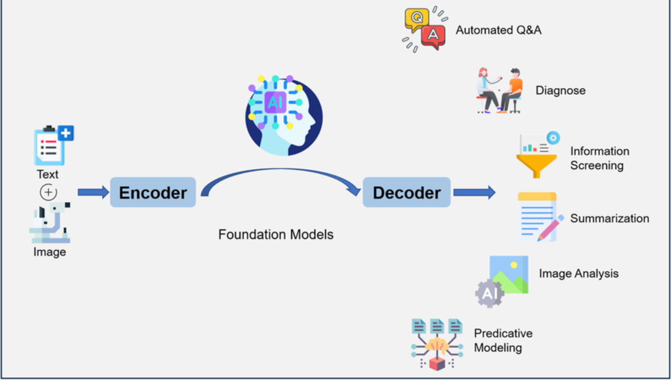
2010s
ML, Deep Learning and LLM
Machine learning is a subset of artificial intelligence that enables systems to learn from data without being explicitly programmed.
Deep learning is a subset of machine learning that uses neural networks to analyze data.
Large language models are a type of Deep Learning model specifically designed for natural language processing tasks.

Slide 11
IN THE WILD
Generative AI — Where You See It Today
How it works
Tools you might already know
You write a prompt
Describe what you want in plain language
Text & Chat
ChatGPT, Claude, Gemini, Grok
Images & Video
GPT Image, Midjourney, Google Veo
The model processes it
Breaks your words into tokens and predicts what comes next
Code Generation
GitHub Copilot, Cursor, Claude Code
Audio & Music
ElevenLabs, Suno, Udio
You get the output
Text, an image, code, audio, or video
⚠ Hallucination warning
Generative AI can confidently produce wrong answers. It sounds right, reads right, but it's made up. Always verify.

Slide 12
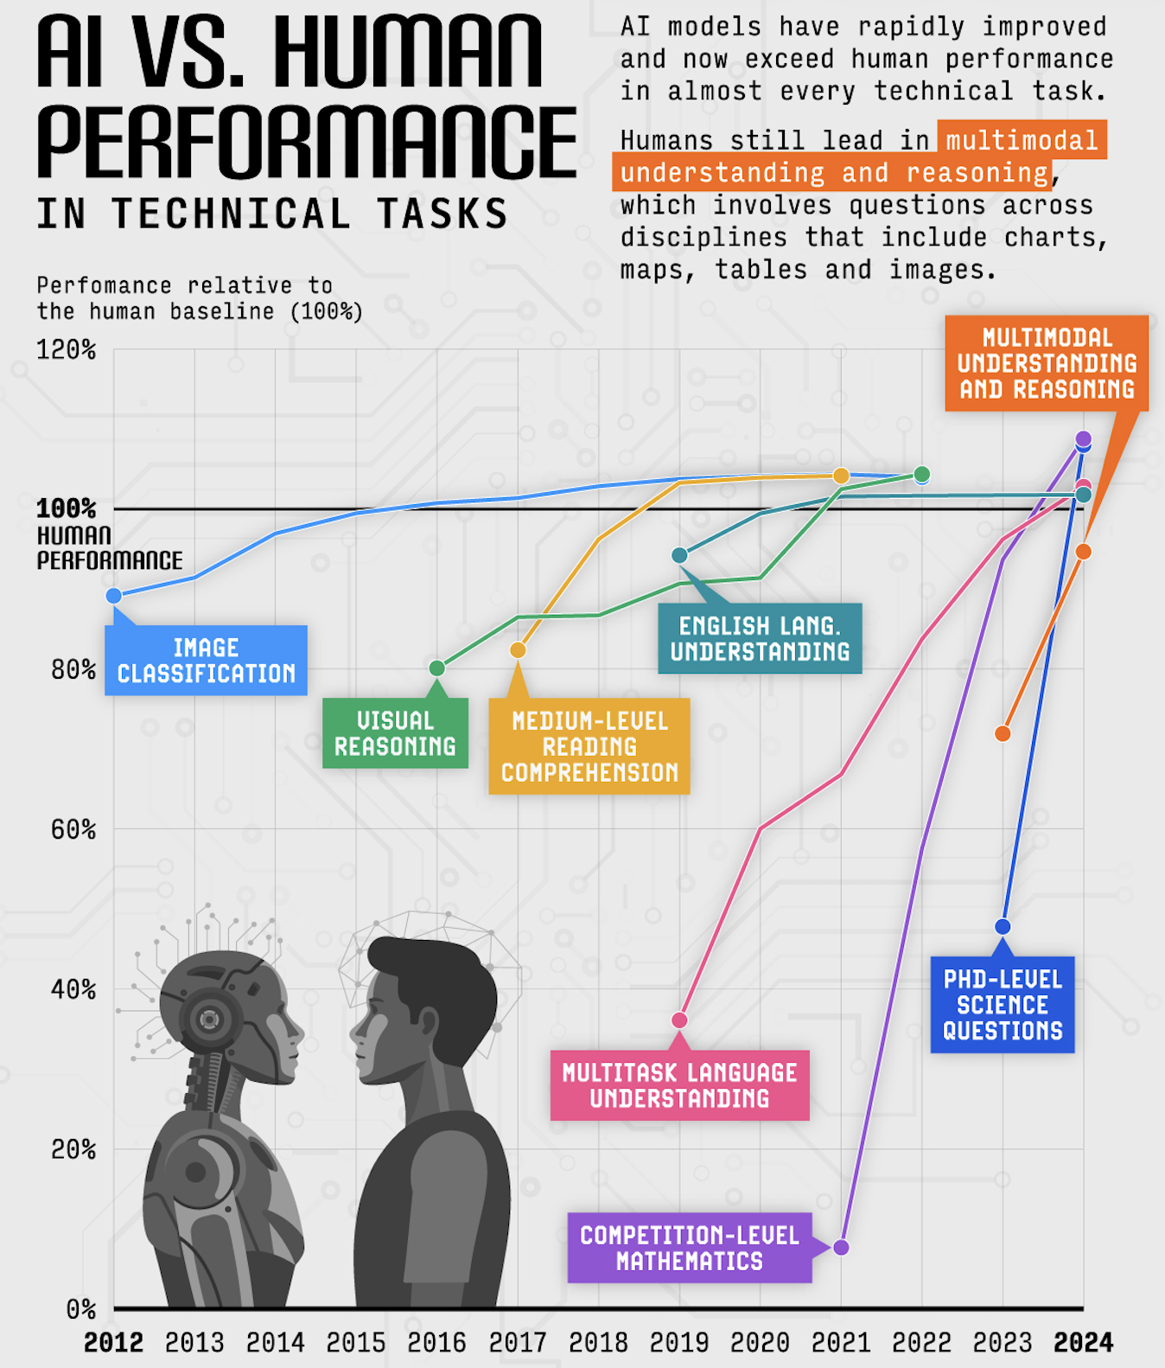
BENCHMARKS
Humans VS
Artificial Intelligence
This infographic tracks how AI performance has evolved relative to human baseline (100%) across several technical domains from 2012 to 2024.
Image Classification
Visual Reasoning & Medium-Level Reading Comprehension
English Language Understanding
Multitask Language Understanding
Competition-Level Mathematics
PhD-Level Science Questions
Multimodal Understanding & Reasoning

Slide 13
Vibe Coding

Slide 14
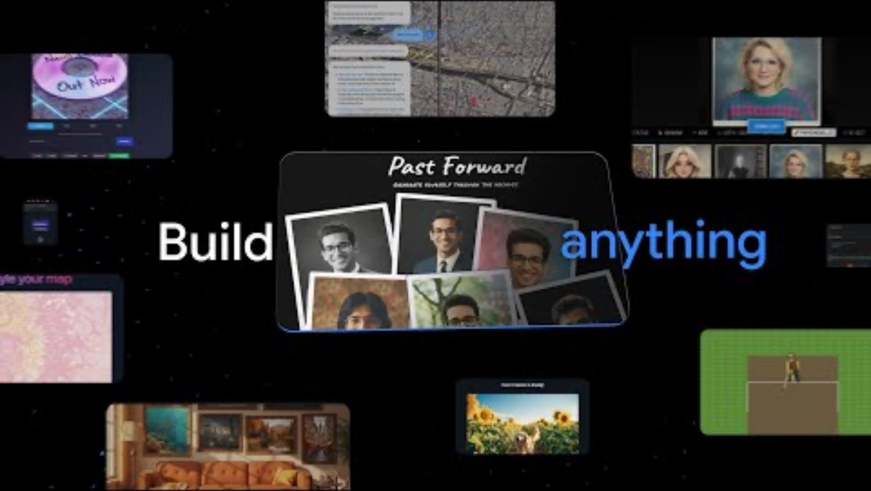
THE IDEA
What is Vibe Coding?
You describe
Tell AI what you want in plain English
AI builds
GitHub Copilot writes the code for you
You see results
Open the browser and watch it come to life

Slide 15




WHY IT MATTERS
Why Vibe Coding Matters
Traditional coding
Write every line manually
Debug from scratch
Steep learning curve
No syntax memorisation needed
Describe ideas in plain English
Iterate in seconds, not hours
See results in your browser almost immediately
Learn by doing
Read & edit AI-generated code to understand how it works
Vibe coding
Describe → review → refine
AI helps find & fix issues
Low barrier to entry
Ideal for prototypes & side projects
Go from idea to working thing fast

Slide 16
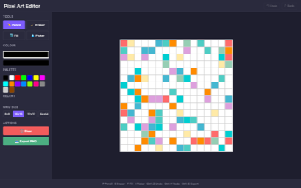
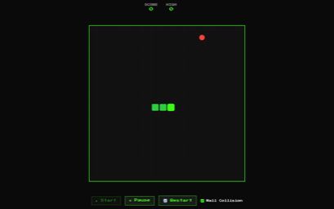
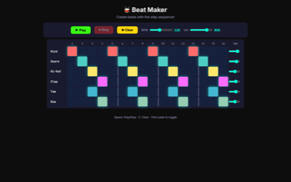
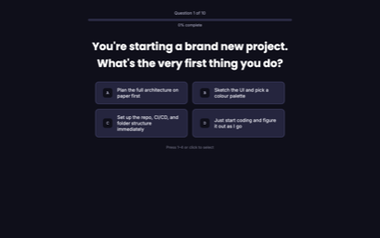
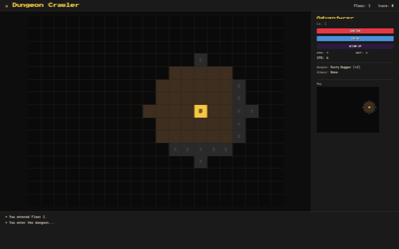
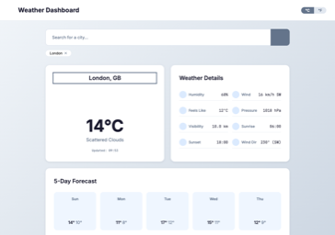
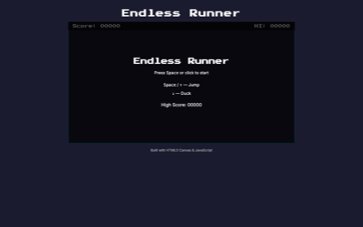
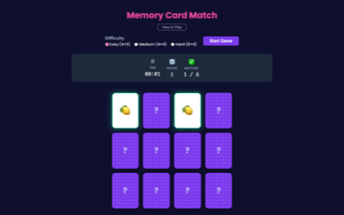
WHAT'S POSSIBLE
People have already built all of this
Pixel Art Editor
Snake Game
Beat Maker
Personality Quiz
Dungeon Crawler
Weather Dashboard
Endless Runner
Memory Match
All built by describing ideas in plain English — no coding experience needed.

Slide 17
ASK US ANYTHING
Interactive Q&A & Live Demo
Got questions? Curious about something? Now's the time — ask us anything!

Slide 18
Hands‑on Vibe Coding

Slide 19
LET'S GO!
Quick tips before you start
🎯 Be specific
"Add a red button that plays a drum sound" works way better than "make it cool"
🧱 Build step by step
Start simple, then keep adding. Don't try to describe everything at once.
🧪 Experiment!
Nothing can break permanently. Just try things and see what happens.

Slide 20
YOUR TURN
Hands‑On: Build Something Today!
Project ideas (or choose your own!)
1. Pick your idea
Choose a starter or dream up your own
🧠 Quiz generator
Build a web quiz on any topic you love
🍳 Recipe recommender
Type ingredients, get a recipe
2. Build with AI
Describe what you want in plain English
📚 Study planner
AI that schedules A-Level revision
🗣️ Chatbot persona
A bot that talks like a historical figure
3. Test & fix
See results, tweak, iterate
4. Demo to the group
Show off what you built!
🎮 Mini game
Text-based adventure or number guessing game
🌍 Climate dashboard
Visualise climate data with charts and facts

Slide 21
FINALE
Showcase & Wrap‑Up
Each group: 60–120 seconds to demo what you built.
Key takeaways
AI is a tool
The human with the best questions wins
Analyst → Creator → Doer
The Analyst recognises → the Creator generates → the Doer acts — each built on the last
Vibe coding
Lets you ship ideas without years of training

Slide 22
WARNING & RISKS

Slide 23




STAY SHARP
Use AI Responsibly
AI is powerful — but it's not perfect. Here are things to watch out for:
Deepfakes
AI can create convincing fake images, audio, and video of real people
Bias
AI learns from human data — so it can repeat unfair patterns and stereotypes
Misinformation
AI-generated text can sound authoritative even when it's completely wrong
Copyright
AI may generate content that's too similar to someone else's work
Notes:
Content Moderation
Uncontrollable changes

Slide 24
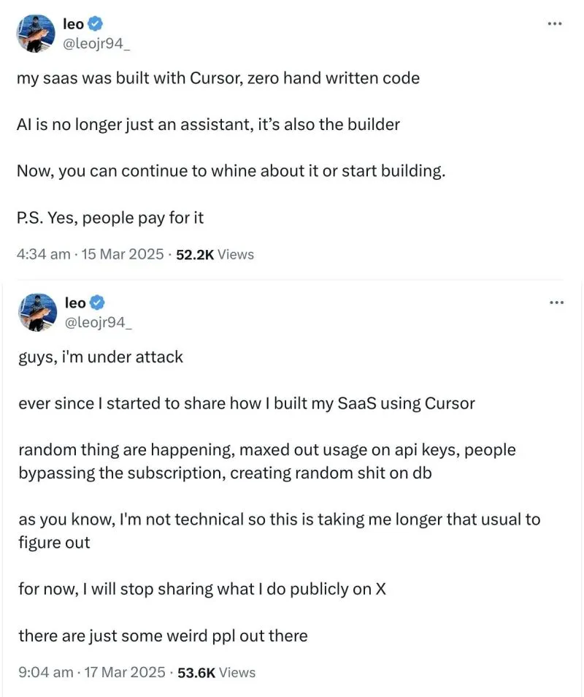
WARNING
Pitfalls of Vibe Coding
Security Risks
Vibe-coding can lead to hidden vulnerabilities, exposing systems to potential threats and compromising security.
Maintainability Challenges
Incremental prompting typically results in poorly structured code, making debugging, extending, or refactoring difficult.
Compliance Issues
Coding without proper understanding may bypass regulations, leading to compliance problems and legal risks.

Slide 25
Thank You
Now go build something amazing! 🚀

