Slide 1
Variant types
SNPs/SNVs . . . Single Nucleotide Polymorphism/Variation
ACGTTTAGCAT ACGTTCAGCAT
MNPs . . . Multi-Nucleotide Polymorphism
ACGTCCAGCAT ACGTTTAGCAT
Indels . . . short insertions and deletions
ACGTTTAGCA-TT ACGTT-AGCAGTT
SVs . . . Structural Variation
A A A A
A A
B C B
C
D C B C
C
B
C B
B

Slide 2
Some terminology
The goal is to determine the genotype at each position in the genome
Genotype
in the broad sense . . . genetic makeup of an organism
in the narrow sense . . . the combination of alleles at a position
Reference and alternate alleles - R and A Diploid organism
two chromosomal copies, three possible genotypes
RR .. homozygous reference genotype
RA .. heterozygous
AA .. homozygous alternate
Reference genome:
A G A C T T G G C C C C C T C C C C A T T C A A G G T C T T C
A G A C T T G G C C C C A T C C C C A T T C C A G G T C T T C
A G A C T T G G C T C C C T C C C C A T T C C A G G T C T T C
Sequenced genome:
 | C/C | A/C | C/C
 | R R | A R | A A
VCF notation ... | 0/0 | 1/0 | 1/1
Alternate allele dosage ... | 0 | 1 | 2

Slide 3
Germline vs somatic mutation
Germline mutation
heritable variation in the germ cells
Somatic mutation
variation in non-germline tissue, tumors. . .
Germline variant calling
expect the following fractions of alternate alleles in the pileup:
0.0 for RR genotype (plus sequencing errors)
1.0 for AA (plus sequencing errors)
0.5 for RA (random variation of binomial sampling)
Somatic
any fraction of alt AF possible - subclonal variation, admixture of normal cells in tumor sample
A G A C T T G G C T C C C T C C C C A T T C
A G A C T T G G C T C C C T C C C C A T T C C A
A G A C T A G G C C C C C A C C C C A T T C C A G G A C T T G G C C C C C T C C C C A T T C A A G G T C T T G G C T C C C T C C C C A T T C C A G G T C T T
G C T C C C A C C C A A T T C C A G G T C T T C
C C C T C C C C A T T C C A G G T C T T C
T C C C C A T T C C A G G T C C T C
A G A C T T G G C C C C C T C C C C A T T C A A G G T C T T C
Aligned reads
Reference seq

Slide 4
Naive variant calling
Use fixed allele frequency threshold to determine the genotype
A G A C T T G G C T C C C T C C C C A T T C
A G A C T T G G C T C C C T C C C C A T T C C A
A G A C T A G G C C C C C A C C C C A T T C A A G G A C T T G G C T C C C T C C C C A T T C C A G G T C T T G G C T C C C T C C C C A T T C C A G G T C T T G C C C C C A C C C A A T T C A A G G T C T T C
C C C A C C C C A T T C C A G G T C T T C T C C C C A T T C C A G G T C C T C
A G A C T T G G C C C C C T C C C C A T T C A A G G T C T T C
Aligned reads
Reference seq
Allelic counts Predicted dosage
R : 3 3 4 4 5 4 5 6 6 2 7 7 7 5 8 8 8 7 8 8 8 8 2 7 6 6 5 5 3 4 3
A : 0 0 0 0 0 1 0 0 0 4 0 0 0 3 0 0 0 1 0 0 0 0 5 0 0 0 0 0 1 0 0
0 0 0 0 0 0 0 0 0 1 0 0 0 1 0 0 0 0 0 0 0 0 1 0 0 0 0 0 1 0 0
alt AF |  | genotype
[0, 0.2) | RR | .. | homozygous | reference
[0.2, 0.8] | RA | .. | herezogyous
(0.8, 1] | AA | .. | homozygous | variant

Slide 5
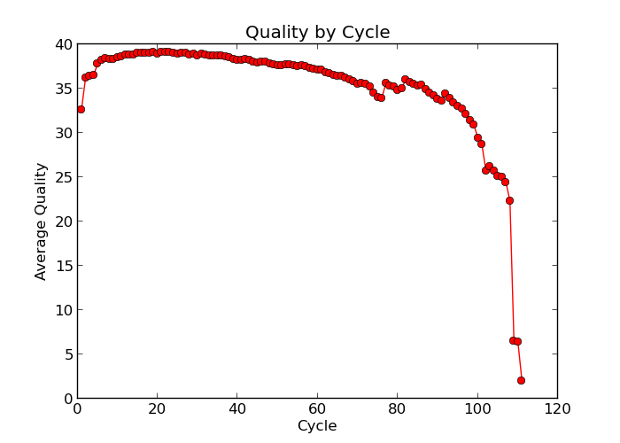
Naive variant calling
Use fixed allele frequency threshold to determine the genotype
A G A C T T G G C T C C C T C C C C A T T C
A G A C T T G G C T C C C T C C C C A T T C C A
A G A C T A G G C C C C C A C C C C A T T C A A G G A C T T G G C T C C C T C C C C A T T C C A G G T C T T G G C T C C C T C C C C A T T C C A G G T C T T G C C C C C A C C C A A T T C A A G G T C T T C
C C C A C C C C A T T C C A G G T C T T C T C C C C A T T C C A G G T C C T C
A G A C T T G G C C C C C T C C C C A T T C A A G G T C T T C
Low base quality
Reference seq
Allelic counts Predicted dosage
R : 2 3 4 4 5 2 5 6 6 2 7 6 7 5 8 7 8 7 8 8 8 8 2 7 6 6 5 5 3 3 3
A : 0 0 0 0 0 1 0 0 0 4 0 0 0 3 0 0 0 1 0 0 0 0 5 0 0 0 0 0 0 0 0
0 0 0 0 0 1 0 0 0 1 0 0 0 1 0 0 0 0 0 0 0 0 1 0 0 0 0 0 0 0 0
1) Filter base calls by quality
e.g. ignore bases Q<20
Phred quality score
Q = −10 log₁₀ Perr
Quality | Error probability | Accuracy
10 (Q10) | 1 in 10 | 90%
20 (Q20) | 1 in 100 | 99%
30 (Q30) | 1 in 1000 | 99.9%
40 (Q40) | 1 in 10000 | 99.99%

Slide 6
Naive variant calling
Use fixed allele frequency threshold to determine the genotype
A G A C T T G G C T C C C T C C C C A T T C
A G A C T T G G C T C C C T C C C C A T T C C A
A G A C T A G G C C C C C A C C C C A T T C A A G G A C T T G G C T C C C T C C C C A T T C C A G G T C T T G G C T C C C T C C C C A T T C C A G G T C T T G C C C C C A C C C A A T T C A A G G T C T T C
C C C A C C C C A T T C C A G G T C T T C T C C C C A T T C C A G G T C C T C
A G A C T T G G C C C C C T C C C C A T T C A A G G T C T T C
Low base quality
Low mapping quality
Reference seq
Allelic counts Predicted dosage
R : 1 2 3 3 4 2 4 4 4 0 5 4 5 5 6 5 6 6 6 6 6 6 0 5 4 4 4 4 2 3 3
A : 0 0 0 0 0 0 0 0 0 4 0 0 0 1 0 0 0 1 0 0 0 0 5 0 0 0 0 0 0 0 0
0 0 0 0 0 0 0 0 0 2 0 0 0 0 0 0 0 0 0 0 0 0 2 0 0 0 0 0 0 0 0
1) Filter base calls by quality
e.g. ignore bases Q<20
alt AF |  | genotype
[0, 0.2) | RR | .. | homozygous | reference
[0.2, 0.8] | RA | .. | herezogyous
(0.8, 1] | AA | .. | homozygous | variant
Filter reads with low mapping quality Problems:
undercalls hets in low-coverage data
throws away information due to hard quality thresholds
Gives no measure of confidence

Slide 7

Real life calling models
More sophisticated models apply a statistical framework
Likelihood
Prior
Posterior
Normalization
to determine:
1. the most likely genotype g ∈ {RR, RA, AA} given the observed data D
g = argmax P (G|D)
G
2. and the genotype quality
30
25
20
15
10
5
Q=-10log₁₀[1-P(G|D)]
Q = −10 log₁₀[1 − P (G|D)]
Q
0
0.0 0.2 0.4 0.6 0.8 1.0
P(G|D)

Slide 8

Important terms you may encounter
Genotype likelihoods
which of the three genotypes RR, RA, AA is the data most consistent with?
calculated from the alignments, the basis for calling
takes into account:
base calling errors
mapping errors
statistical fluctuations of random sampling
local indel realignment (base alignment quality, BAQ)
Prior probability
how likely it is to encounter a variant base in the genome?
some assumptions are made
allele frequencies are in Hardy-Weinberg equilibrium
P(RA) = 2f (1 − f ), P(RR) = (1 − f )², P(AA) = f ²
can take into account genetic diversity in a population

Slide 9
Variant calling example
Inputs
alignment file
reference sequence
Outputs
VCF or BCF file
Example
bcftools mpileup -f ref.fa aln.bam | bcftools call -mv
Tips
bcftools mpileup
increase/decrease the required number (-m) and the fraction (-F) of supporting reads for indel calling
the -Q option controls the minimum required base quality (30)
BAQ realignment is applied by default and can be disabled with -B
streaming the uncompressed binary BCF (-Ou) is much faster than the default text VCF
bcftools call
decrease/increase the prior probability (-P) to decrease/increase sensitivity
General advice
take time to understand the options
play with the parameters, see how the calls change

Slide 10
Factors to consider in calling
Many calls are not real, a filtering step is necessary
False calls can have many causes
contamination
PCR errors
sequencing errors
homopolymer runs
mapping errors
repetitive sequence
structural variation
alignment errors
false SNPs in proximity of indels
ambiguous indel alignment

Slide 11
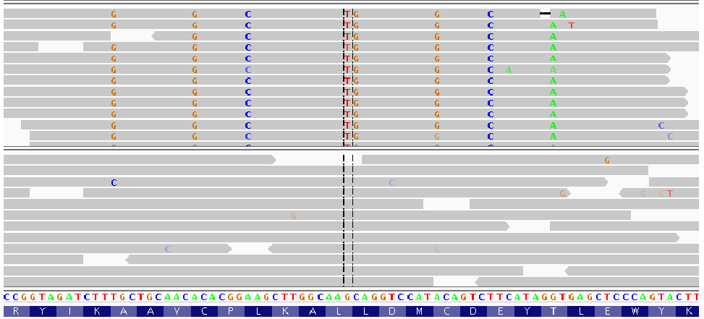
Mapping errors
Q: RNA-seq (top) and DNA data (bottom) from the same sample has been mapped onto the reference genome. Can you explain the novel SNVs?

Slide 12
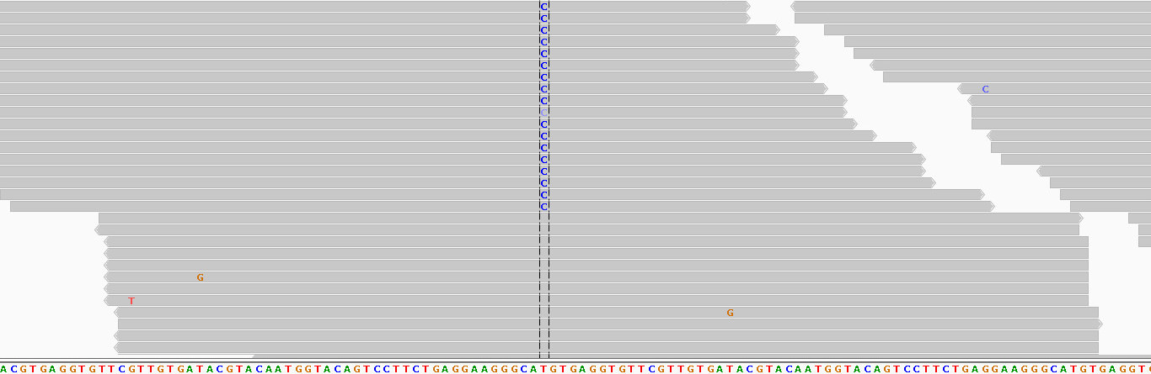
Strand bias
Q: Is this a valid call?

Slide 13
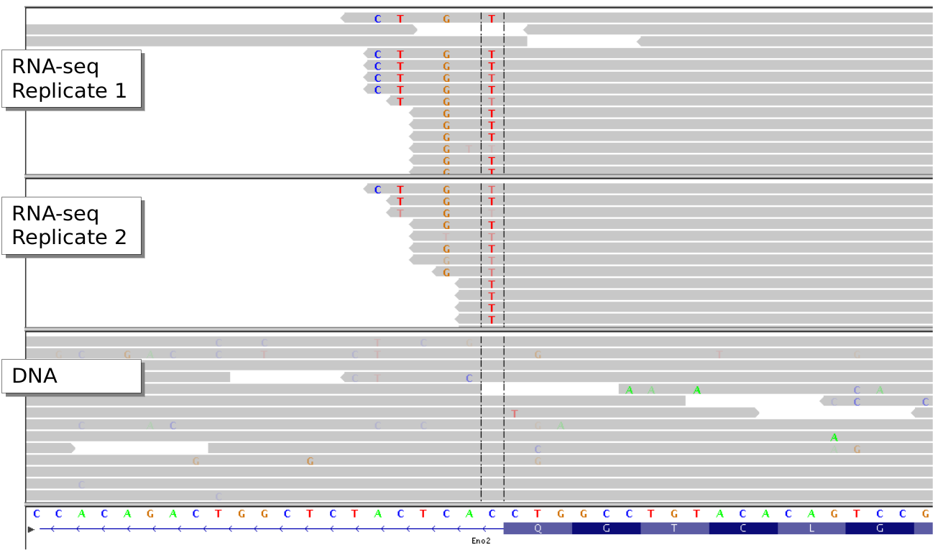
Variant distance bias
Q: Can you explain what happened here?

Slide 14
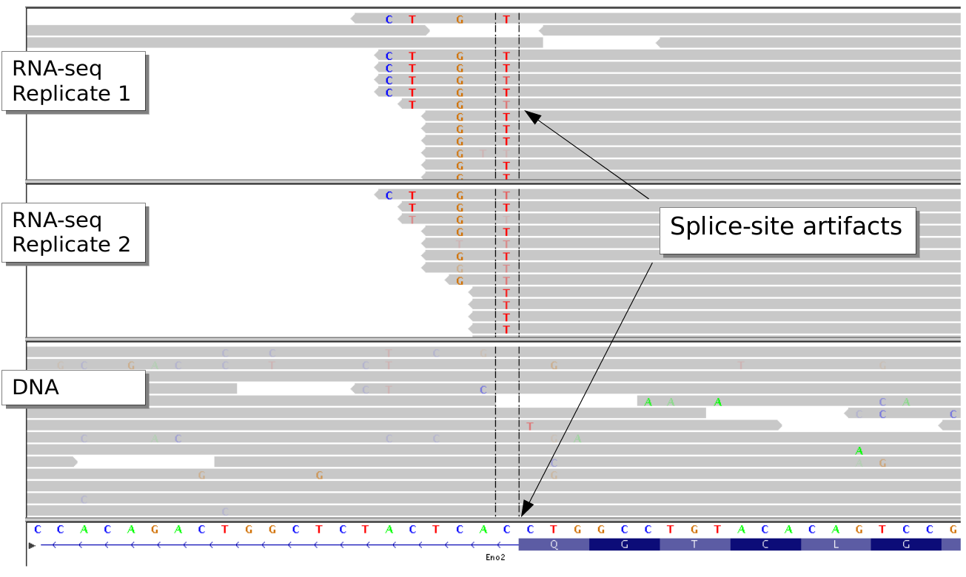
Q: Can you explain what happened here?
A: Processed transcript with introns spliced out.

Slide 15
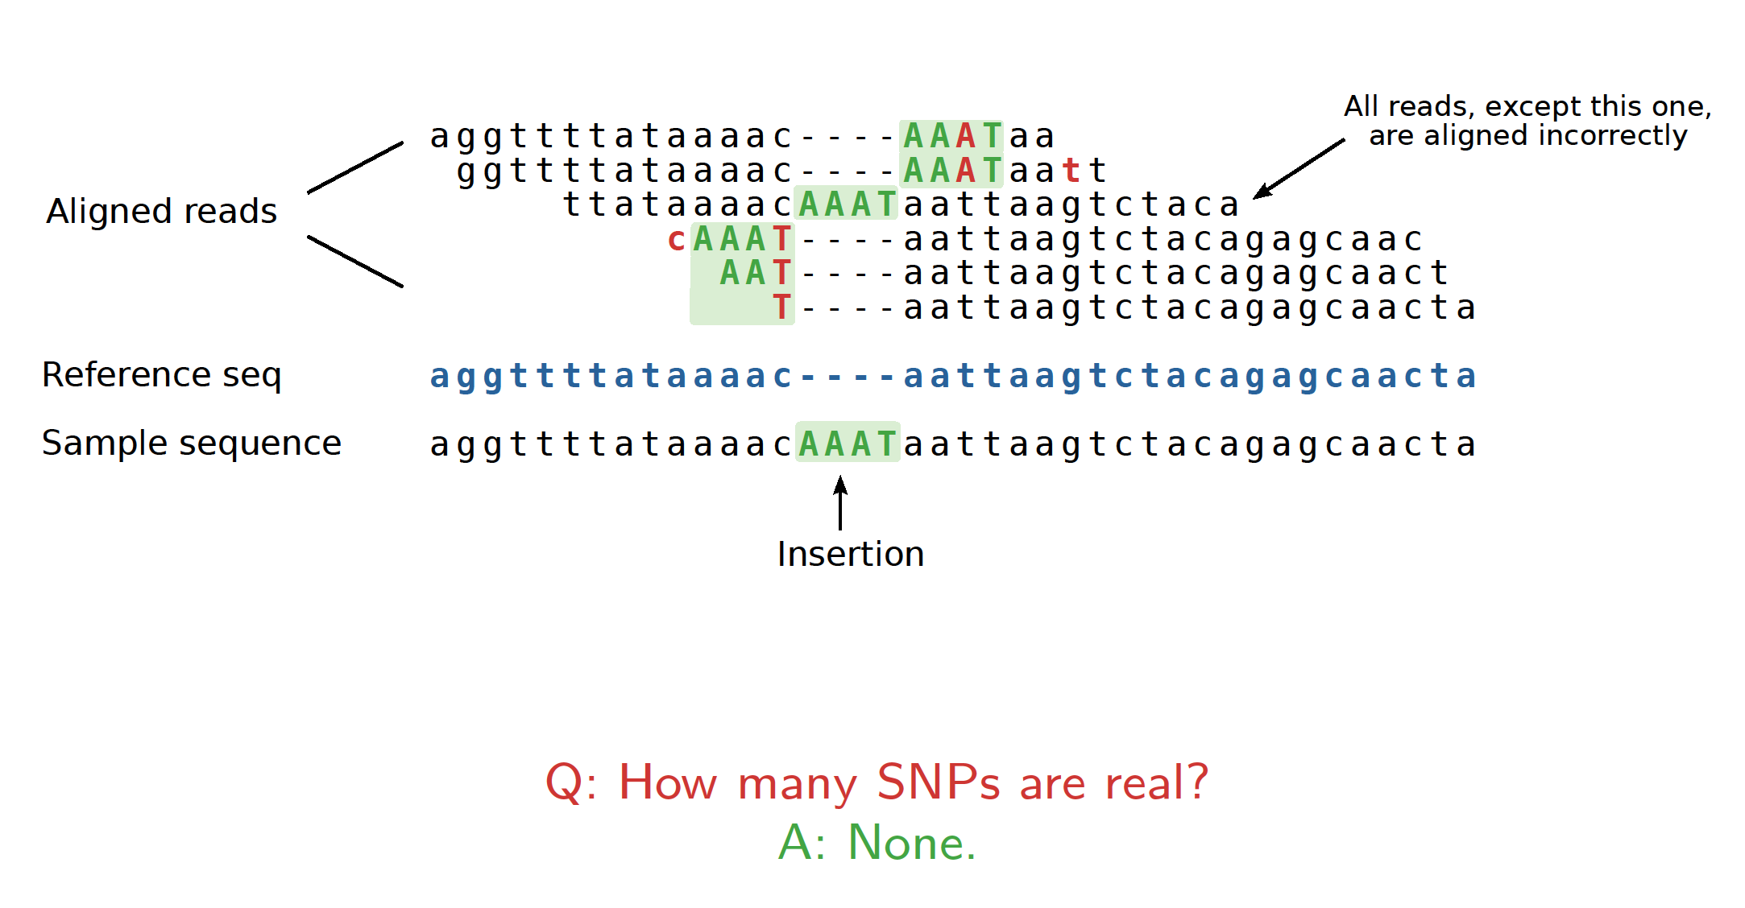
False SNPs caused by incorrect alignment
Pairwise alignemnt artefacts can lead to false SNPs
multiple sequence alignment is better, but very expensive
instead: base alignment quality (BAQ) to lower quality of misaligned bases

Slide 16
How to estimate the quality of called SNPs?
Transitions vs transversions ratio, known as ts/tv
transitions are 2-3× more likely than transversions
purines
adenine
A
Transitions
G
guanine
Transversions
Transversions
C
Transitions
T
pyrimidines
cytosine
thymine

Slide 17
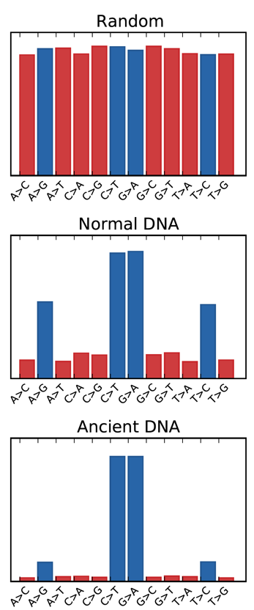
How to estimate the quality of called SNPs?
Transitions vs transversions ratio, known as ts/tv
transitions are 2-3× more likely than transversions
purines
adenine
A
Transitions
G
guanine
Transversions
Transversions
C
Transitions
T
pyrimidines
cytosine
thymine

Slide 18
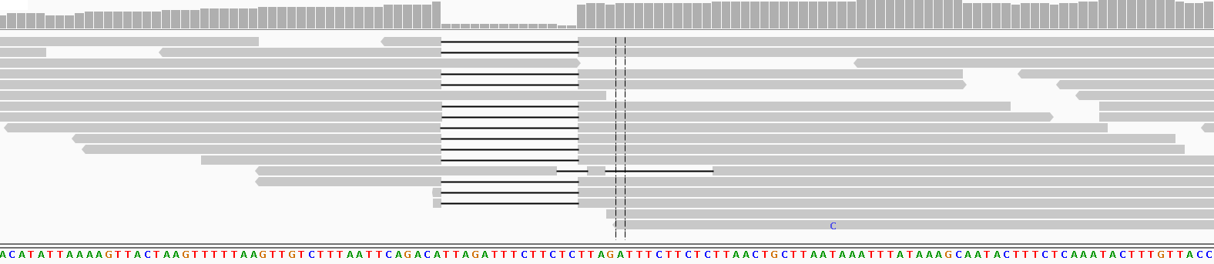
Indel calling challenges
The sequencing error rate is elevated in microsatellites
Low reproducibility across callers
37.1% agreement between HapCaller, SOAPindel and Scalpel
Narzisi et al. (2014) Nat Methods, 11(10):1033
Reads with indels are more difficult to map and align
the aligner can prefer multiple mismatches rather than a gap
indel representation can be ambiguous
CTTTAATTCAGACATTAGATTTCTTCTC
CTTTAATTCAGACATTAGATTTCTTCTCTTA
CTTTAATTCAGACA--------------TTAGATTTCTTCTCTTAACTGCTT CTTTAATTCAGACATTAGATTTCTTC---TA-----------TTAACTGCTT
CTTTAATTCAGACATTAGATTTCTTCTCTTAGATTTCTTCTCTTAACTGCTT

Slide 19
Indel calling challenges
The sequencing error rate is elevated in microsatellites
Low reproducibility across callers
37.1% agreement between HapCaller, SOAPindel and Scalpel
Narzisi et al. (2014) Nat Methods, 11(10):1033
Reads with indels are more difficult to map and align
the aligner can prefer multiple mismatches rather than a gap
indel representation can be ambiguous
CTTTAATTCAGACA~~~~~~~~~~~~~~TTAGATTTCTTCTC
CTTTAATTCAGACA~~~~~~~~~~~~~~TTAGATTTCTTCTCTTA
CTTTAATTCAGACA--------------TTAGATTTCTTCTCTTAACTGCTT CTTTAATTCAGACA~~~~~~~~~~~~~~TTAGATTTCTTCTATTAACTGCTT
CTTTAATTCAGACATTAGATTTCTTCTCTTAGATTTCTTCTCTTAACTGCTT

Slide 20
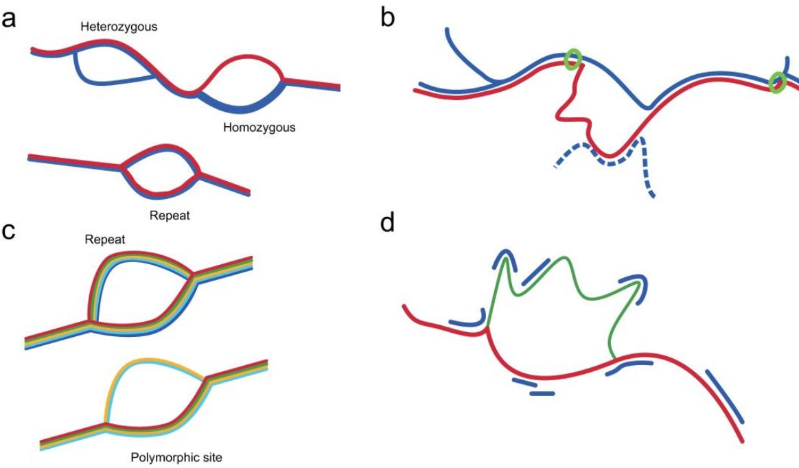
Future of variant calling
Current approaches
rely heavily on the supplied alignment, but aligners see one read at a time
largely site based, do not examine local haplotype and linked sites
Local de novo assembly based variant callers
call SNPs, indels, MNPs and small SV simultaneously
can remove alignment artefacts
eg GATK haplotype caller, Scalpel, Octopus
Variation graphs
align to a graph rather than a linear sequence
Iqbal et al (2012) Nat Genet 44(2):226

