Slide 1
Introduction to Natural Language Toolkit (NLTK)
Elika Bozorgi
Ayda Farhadi

Slide 2
NLTK
NLTK is a platform used for building Python programs to work with human language data for applying in statistical natural language processing (NLP).
It contains text processing libraries for tokenization, parsing, classification, stemming, tagging and semantic reasoning. It also includes graphical demonstrations and sample data sets as well as accompanied by a cook book and a book which explains the principles behind the underlying language processing tasks that NLTK supports.

Slide 3
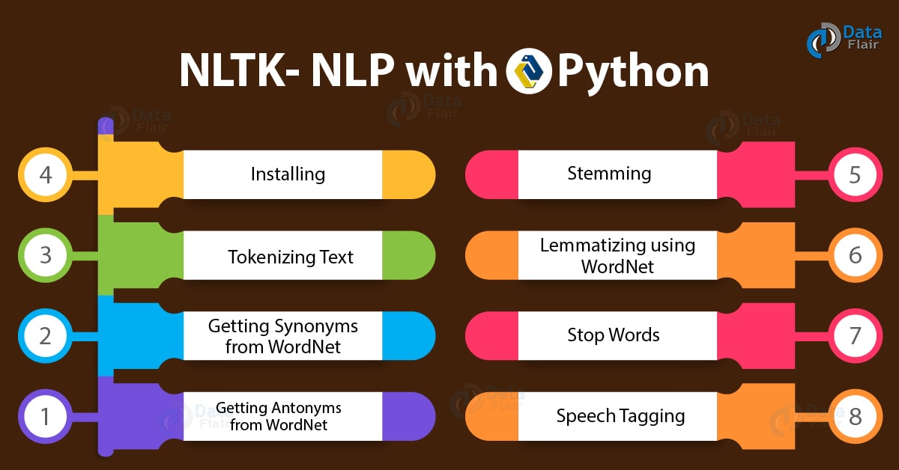

Slide 4
Purpose of usage:
It has been used by variety of different computer scientists esp. In the field on NLP(Natural language processing), and other related fields, such as artificial intelligence and machine learning.

Slide 5
Who can use NLTK?
It is suitable for everyone, for engineers, researches, students and industry users.
It is a free open source project used on windows, Mac and Linux.
It has also been used as a teaching tool, as an individual studying tool, as a platform for prototyping and building research systems.

Slide 6
How to Install NLTK?
On mac
Install NLTK: run pip install -U nltk
Test installation:run python then type import nltk
On Windows:
Install NLTK:http://pypi.python.org/pypi/nltk
Test installation: Start>python35, then type import nltk

Slide 7
Text mining:
Tokenization
Stop_words
Part of Speech Tagging
Sentiment analysis
Text classification

Slide 8
NLTK Tokenize Text
NLTK demo on Google Colab
https://colab.research.google.com/drive/1eINZvmRCn4tR00VMDdDSOe96VIFHfyQT#scrollTo=Xwa6HCHV0wPq

Slide 9
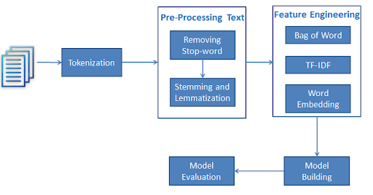
Text classification:

