Slide 1
The Student’s Guide to Apache Spark
Xiurong Lin, Ryan Borowicz, Jayanti Trivedi, Abhishek Devarakonda
12/14/16

Slide 2
Agenda
Project Background
Spark ML
SparkR
Spark Plotly Visualization
Lessons Learned

Slide 3
Project Background
Initial Plan
Spark Streaming via meetup API
Modified Plan
Overall Spark Tutorial with focus on modules not extensively covered in class
Utilizing different datasets depending on the task (meetup included)
Final Product
Tutorial covering all of the different Spark modules
Working implementations of Spark SQL, Spark ML, and SparkR
Also tested Spark Streaming

Slide 4

Spark ML

Slide 5
Spark ML Overview
Benefits
Ability to utilize single platform for big data problems
Growing user community and documentation
Limitations
Limited set of algorithms
Lacking in certain features
No cost-sensitive modeling
Lack of Python support for dimension reduction
Comparison to Rapid Miner and Sci-Kit-Learn
SparkML has familiar interface for users of Sci-Kit-Learn
Found pipeline structure to be more intuitive in SparkML
SparkML lacks all of the functionality of Sci-Kit-Learn

Slide 6
Spark ML Pipeline
Load
Transformer
Estimator
Pipeline
Evaluator
Load Data
Convert to DataFrame
Normalize
Feature Selection
Dimension Reduction (PCA)
Vector Assembler
Text Processing (Tokenizer, StopWordsRemover)
Classification
Regression
Clustering
Collaborative Filtering
Tree Ensembles
Transformers
Parameter Grid Tuning
Cross-Validation
Estimator
Evaluator
Metrics
Visuals
6

Slide 7
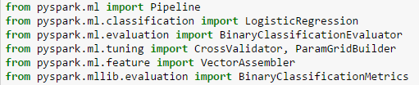

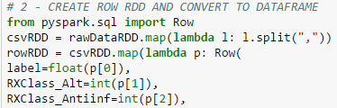
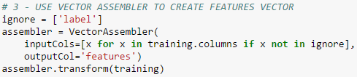
Patient Classification Demo – Logistic Regression
Load and Convert
Transform

Slide 8

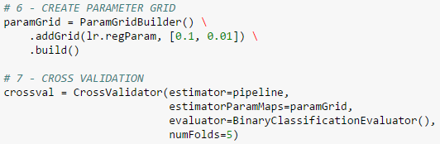
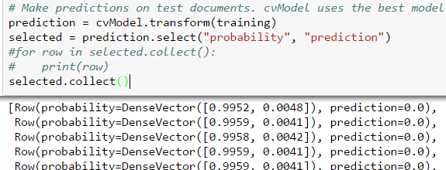
Patient Classification Demo – Logistic Regression
Estimate
Pipeline
Evaluate

Slide 9
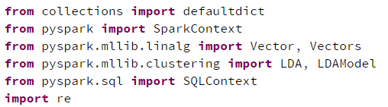
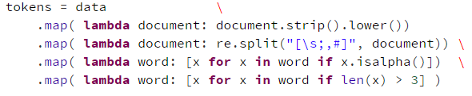
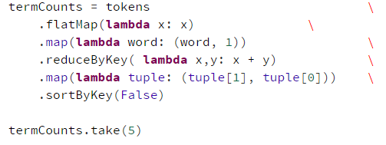
Meetup Topic Model
Load and Convert
Transform

Slide 10
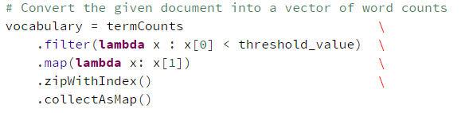

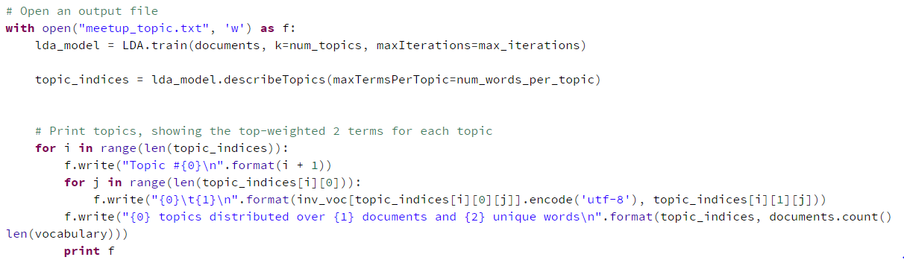
Meetup Topic Model
Transform
Write File

Slide 11
Spark R

Slide 12
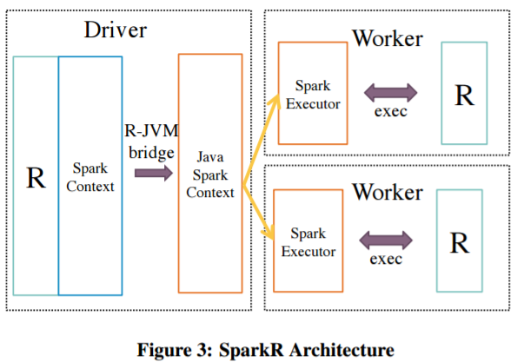
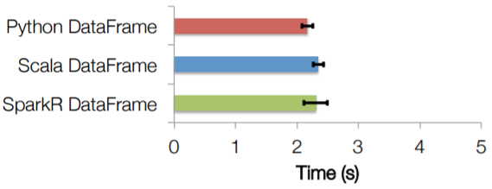
Spark R Overview
Benefits
Performance improvements
Familiarity for R users
Limitations
Currently working on integration with SparkML
Currently includes a small subset of overall R functionality and libraries
Comparison to R
Dramatic speed improvements on large datasets
Similar interface working off Spark DataFrames

Slide 13
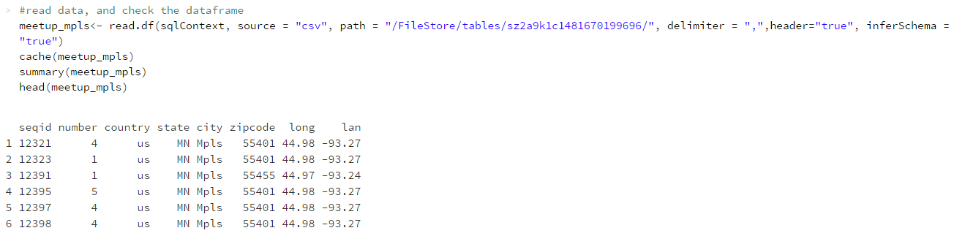
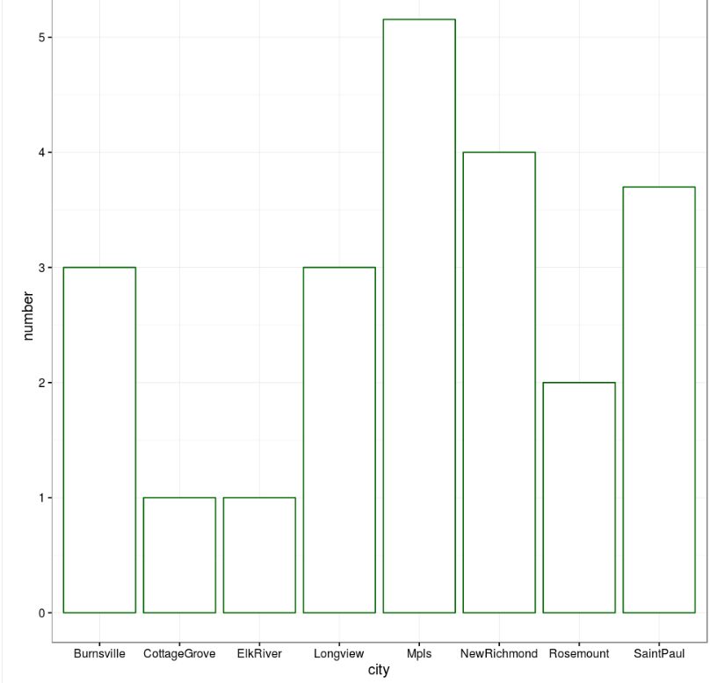
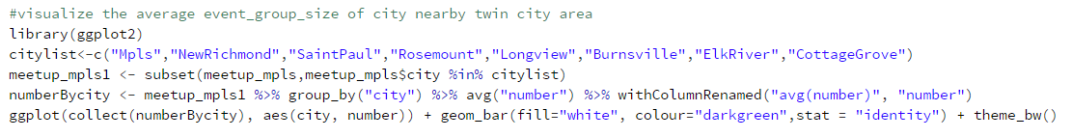
SparkR Meetup Demo – Load & Visualize

Slide 14
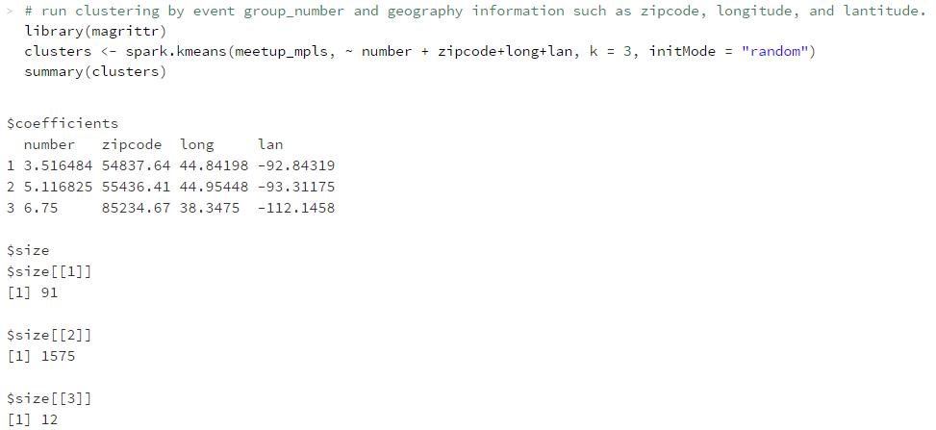
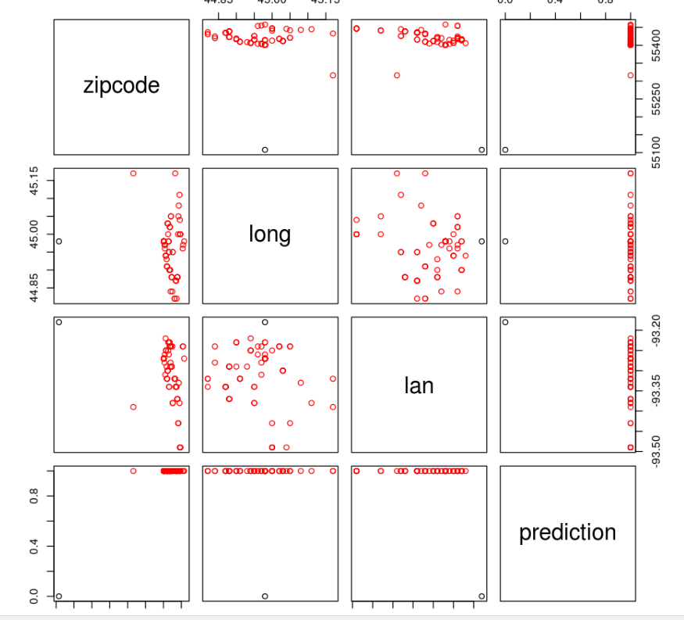
SparkR Meetup Demo – Clustering

Slide 15

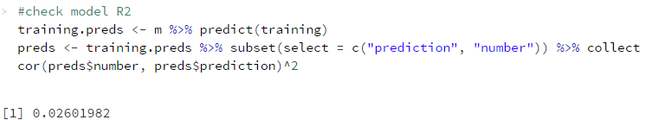
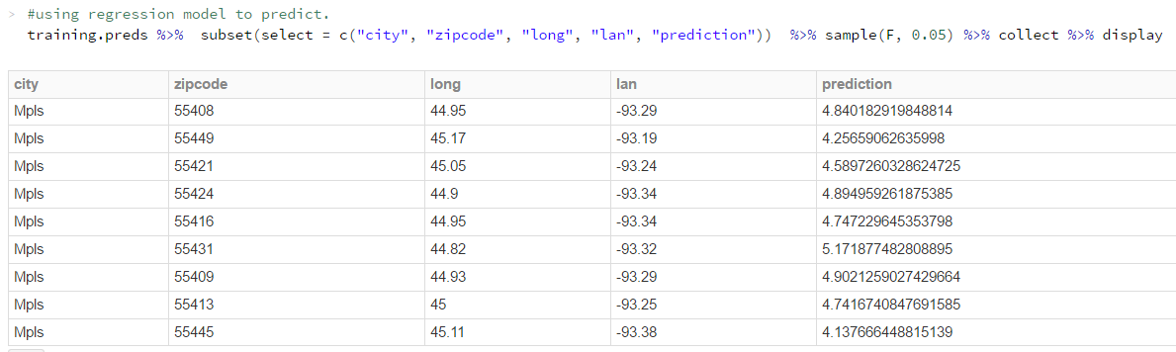
SparkR Meetup Demo – Regression
TRAIN & FIT
EVALUATE
PREDICT

Slide 16
Spark Plotly Visualization

Slide 17
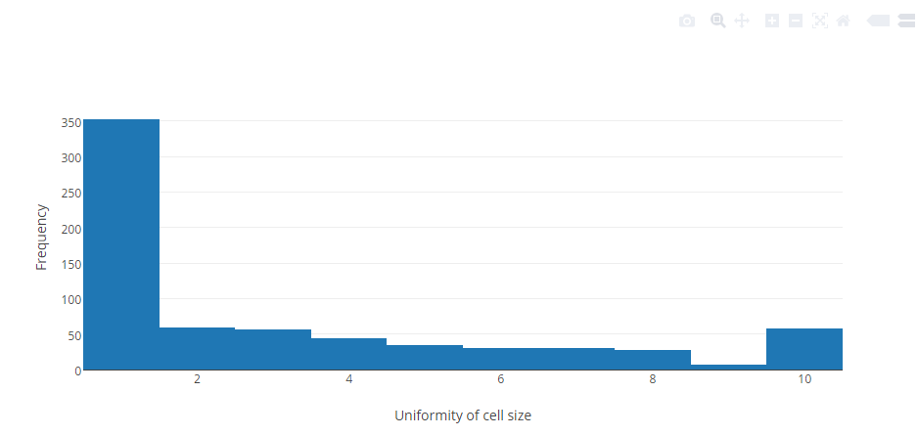
Plotly Visualization
Benefits
Amazing way of creating interactive graphs inside Ipython notebook
Plots can be hosted and shared easily
Signup on plotly website
API key will be generated
Connect with pyspark
Plotted histogram using Wisconsin Breast
cancer dataset from UCI public datasets

Slide 18
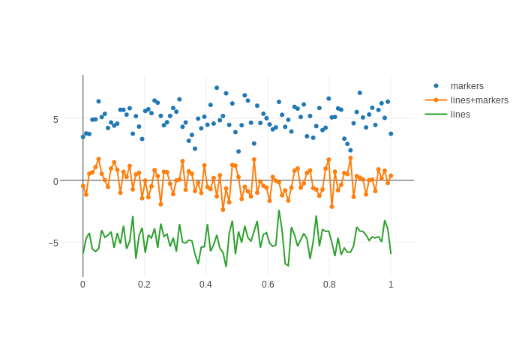
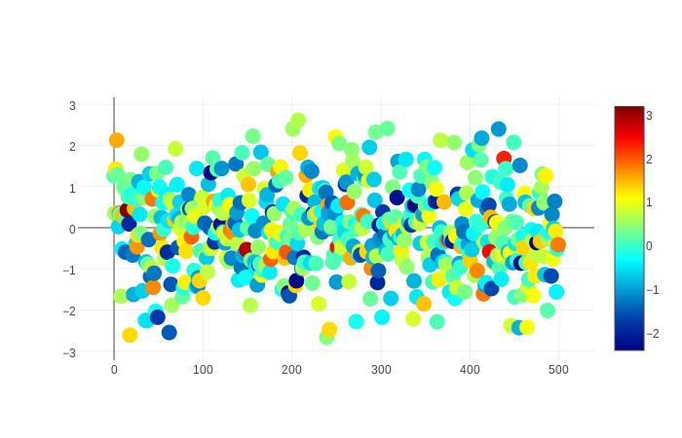
Line and Scatter Plots
Scatter Plots
Line Graphs

Slide 19
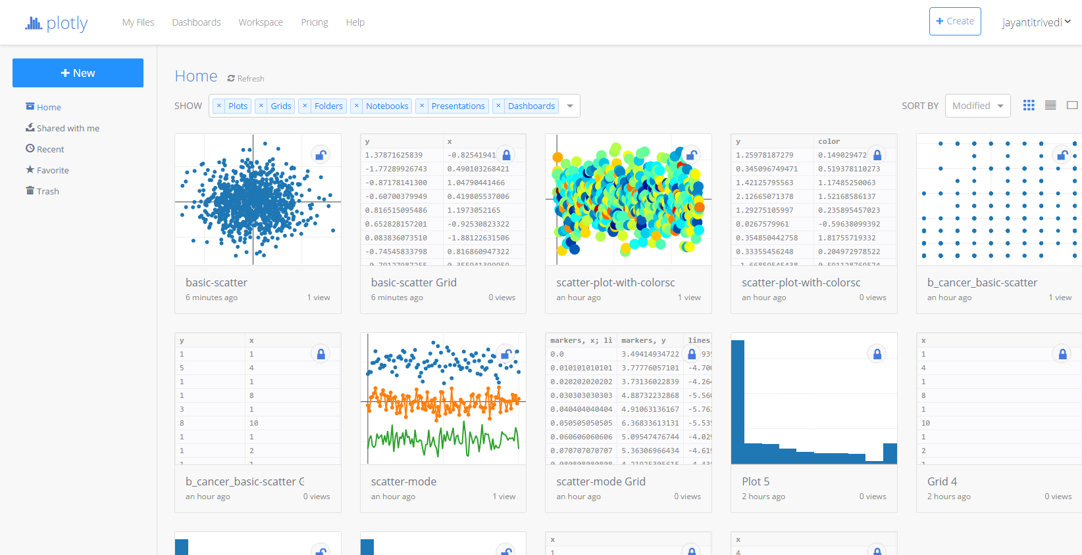
Sharable and editable from anywhere
Graphs can be saved on the Plotly website and directly edited from there
Graphs can also be shared to multiple platforms
Plots can be collaboratively edited

Slide 20


Lessons Learned
Spark can address a variety of use cases
Increasingly integrated with existing products (Python, R, etc.)
Web resources are limited due to being a new product – opportunity for students
Broad topics with lack of clear definition
Ensure technical infrastructure is in place prior to project start
Merging code from different sources without proper tracking

Slide 21
Questions?

