Slide 1

2017 Data Analytics Competition: National Park Exploration
Team
Lavanya Basava Raju
Ryan Borowicz
STATCON
4/15/17

Slide 2



Agenda
Data Preprocessing and Feature Selection
Exploratory Data Analysis and Visualization
Predictive Modeling

Slide 3
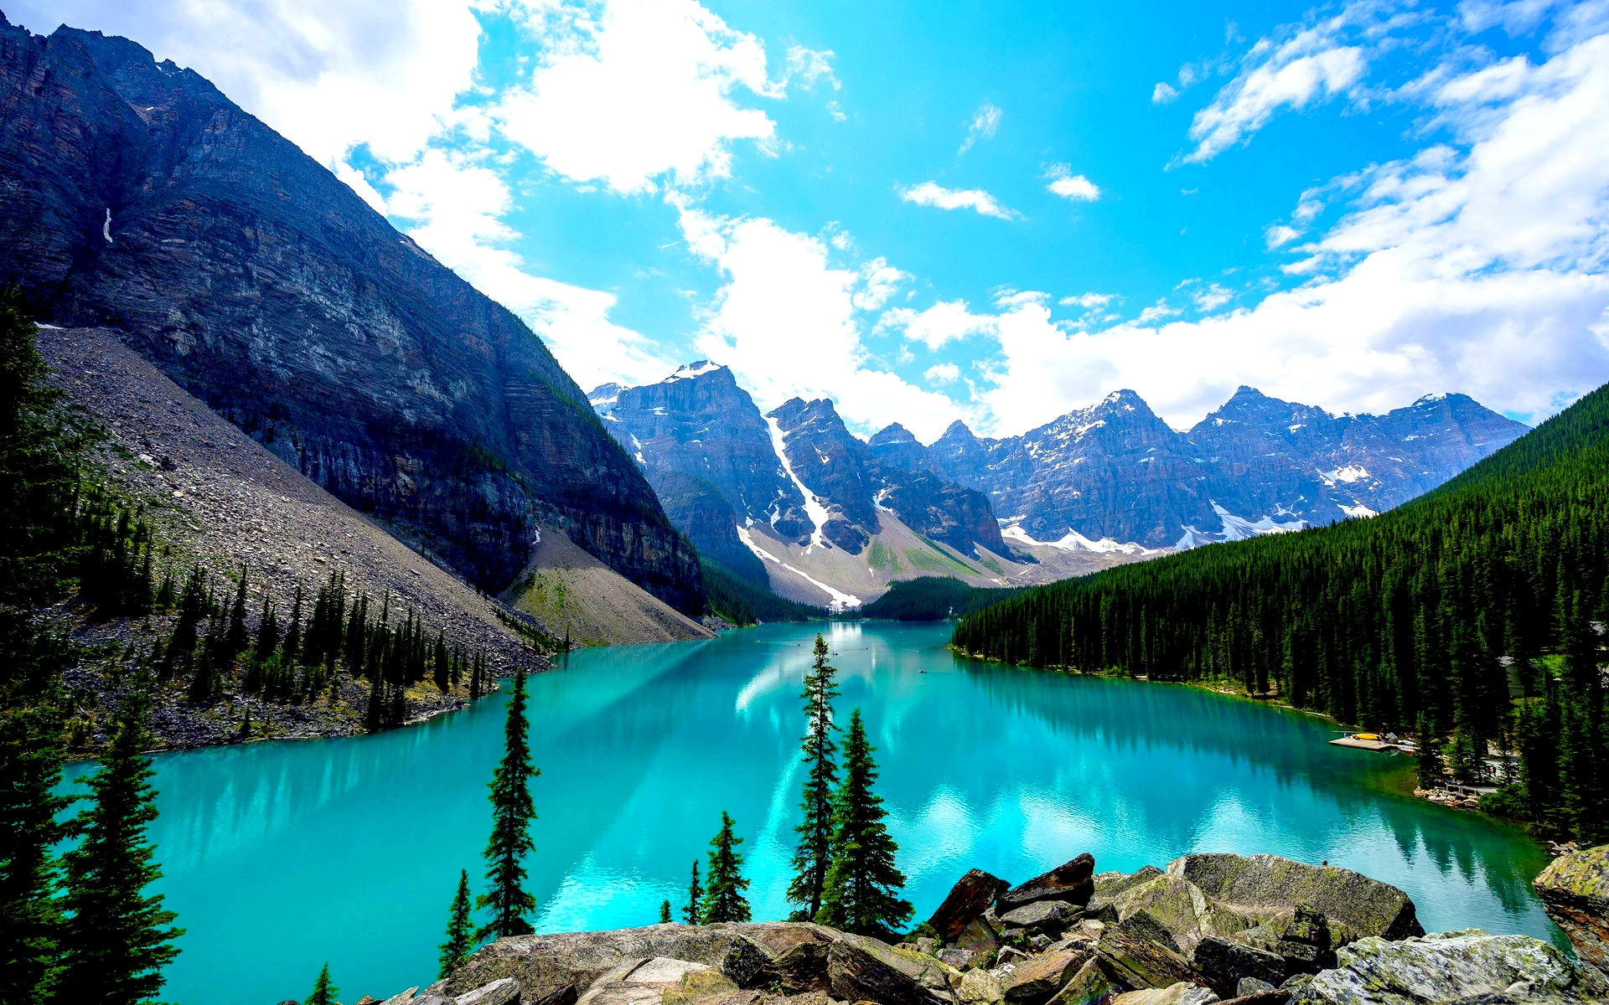
Data Preprocessing and Feature Selection

Slide 4
Data Preprocessing and Feature Selection
Feature Creation
Identifying the state and latitude/longitude coordinates using geocode package in R
Region – mapped from state
Year, Month, Day – Broken out from Year
Temperature Variation – Avg Max – Avg Min Temp
Removed variables
LowestTemperature(F), HighestTemperature(F), WarmestMinimumTemperature(F), ColdestMaximumTemperature(F), Max 24hrPrecipitation(In) Max 24hrSnowfall(In)

Slide 5
Exploratory Data Analysis and Visualization

Slide 6
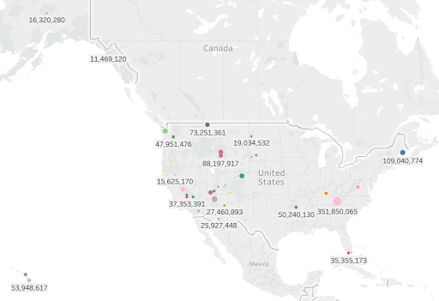
National Park Recreational Visits Map

Slide 7
Recreational Visits are Highest During the Summer Months from June to August

Slide 8
The Busiest Months for the Majority of Parks are July and August
March
July
August
Everglades National Park
Saguaro National Park
Badlands National Park
Biscayne National Park
Bryce Canyon National Park
Denali National Park and Preserve
Glacier Bay National Park and Preserve
Glacier National Park
Grand Canyon National Park
Grand Teton National Park
Great Smoky Mountains National Park
Haleakala National Park
Hot Springs National Park
Kings Canyon National Park
Mammoth Cave National Park
Mesa Verde National Park
Petrified Forest National Park
Redwood National and State Parks
Rocky Mountain National Park
Theodore Roosevelt National Park
Wind Cave National Park
Yellowstone National Park
Acadia National Park
Arches National Park
Crater Lake National Park
Hawaii Volcanoes National Park
Lassen Volcanic National Park
Mount Rainier National Park
Olympic National Park
Sequoia National Park
Yosemite National Park
Zion National Park
April
Death Valley National Park
Joshua Tree National Park
May
Canyonlands National Park
Capitol Reef National Park
October
Shenandoah National Park

Slide 9
Attributes impacting park visitation
Overall
Total Precipitation
Total Snowfall
Tent Campers
Gasoline Cost
RV Campers
Precipitation
CPI
Backcountry Campers
Gasoline Cost
Gasoline Cost
CPI
Fuel Cost
CPI
Away from Home Food Cost
Gasoline Cost
Fuel Cost
Unemployment Rate
Fuel Cost
Away from Home Food Cost
CPI
Unemployment

Slide 10

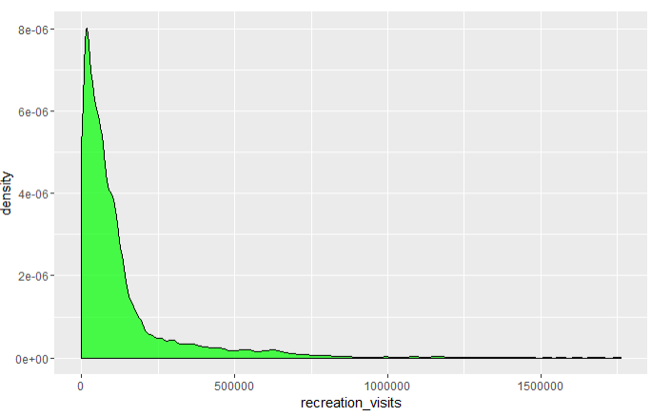
Categorizing Recreational Visits by Distribution
Recreation visits
> 100,000 visits indicates high

Slide 11
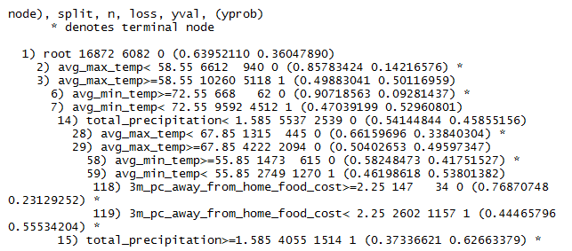
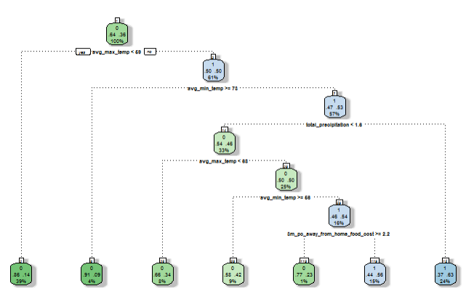
Weather Variables Impact the Volume of Recreational Visits

Slide 12
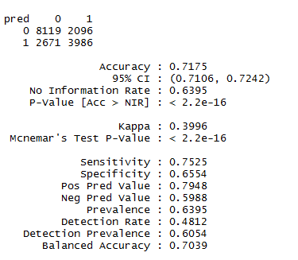
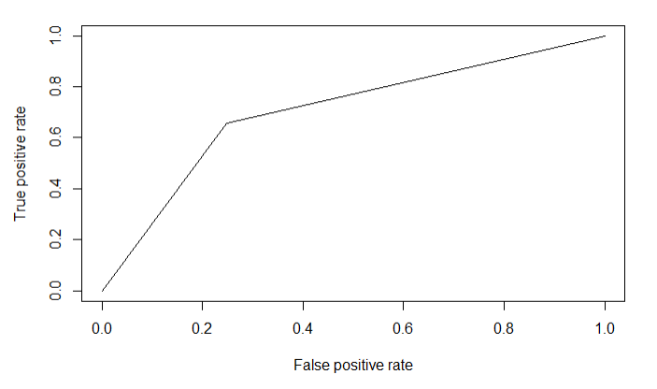
Evaluating Decision Tree Results

Slide 13
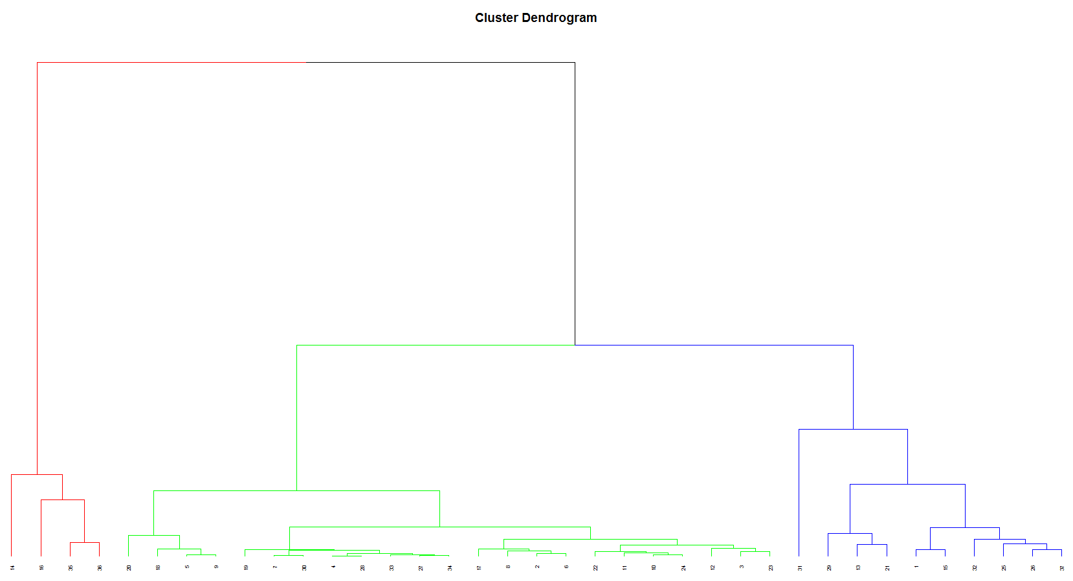
Identifying the Number of Clusters

Slide 14
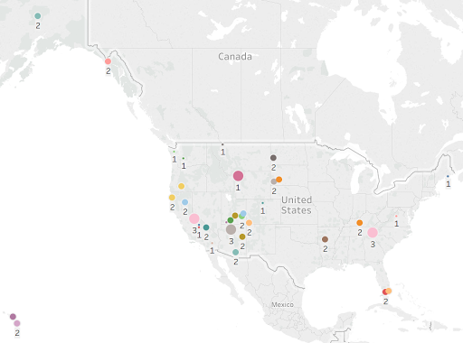
Clustering by Volume of Recreational Visitors
Three Clusters
Cluster 1 (11 parks)
Medium Volume
Cluster 2 (22 parks)
Low Volume
Cluster 3 (4 parks)
High Volume
* Based on volume of visitors attending park

Slide 15
Questions

Slide 16
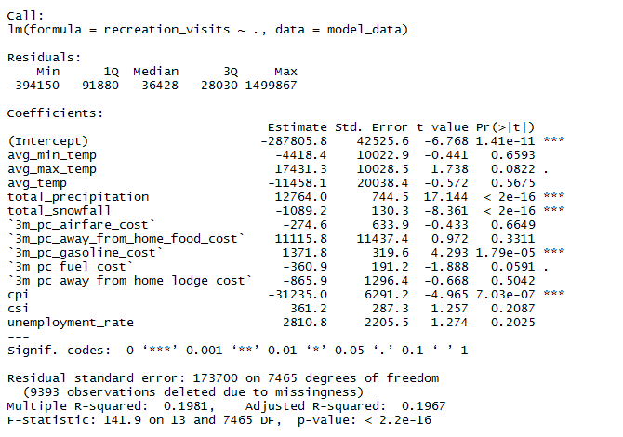
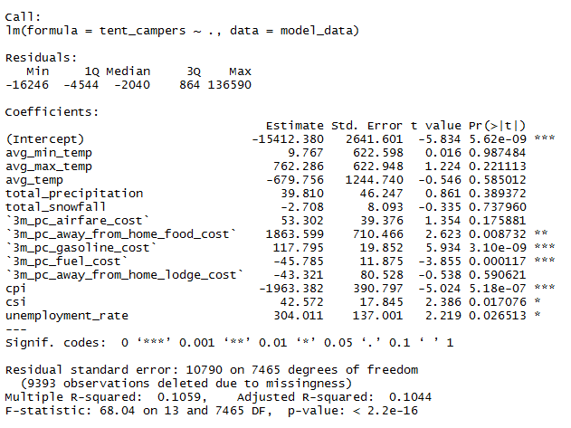
Recreational Visits & Tent Campers
* Recreational Visits
* Tent Campers

Slide 17
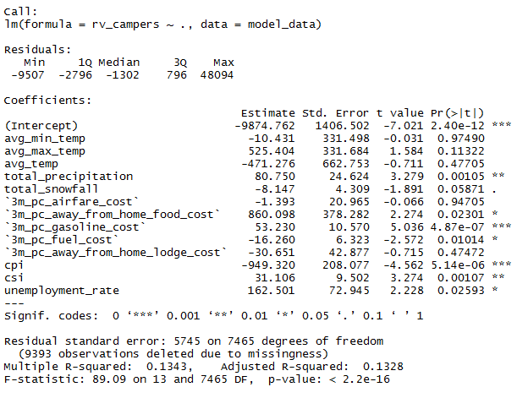
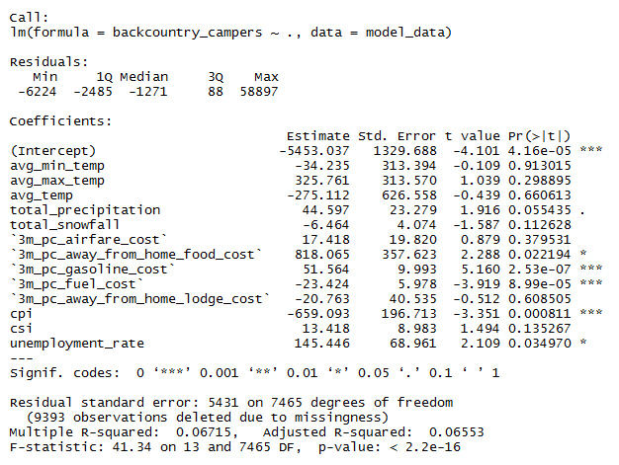
RV Campers & Backcountry Campers
* RV Campers
* Backcountry Campers

Slide 18
 | recreation_visits
recreation_hrs | 0.83
concessioner_lodging | 0.48
concessioner_camping | 0.35
tent_campers | 0.61
rv_campers | 0.66
backcountry_campers | 0.57
avg_min_temp | 0.21
avg_max_temp | 0.32
avg_temp | 0.27
temp_fluctuation | 0.35
total_precipitation | -0.03
total_snowfall | -0.18
3m_pc_airfare_cost | 0.01
3m_pc_away_from_home_food_cost | 0.03
3m_pc_gasoline_cost | 0.08
3m_pc_fuel_cost | 0.00
3m_pc_away_from_home_lodge_cost | -0.03
cpi | -0.03
csi | 0.01
unemployment_rate | -0.01

Slide 19
