Slide 1
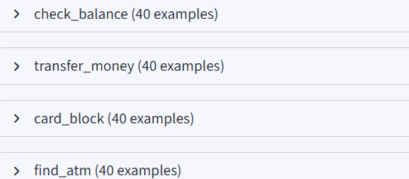
BankBot AI Chatbot for Banking FAQs
MILESTONE-1
Enable the chatbot to understand user intent from natural language queries
Extract key entities required for banking operations
Form the foundation for dialogue management and backend actions
Ensure reliable interpretation of user requests before execution
Key Intents Defined

Slide 2
Check Balance – User queries account balance
Transfer Money – User initiates fund transfer
Card Block – User requests card blocking
Find ATM – User searches for nearby ATMs
                Intent Design Strategy
Included variations in language, tone, and phrasing
Covered both formal and informal queries
Ensured intent separation to avoid overlap
Collected realistic user utterances
Entity Recognition
Amount – Money involved in transactions
Account Type – Savings/ current
Date- Transaction or request timing
Location- ATM or branch search

Slide 3
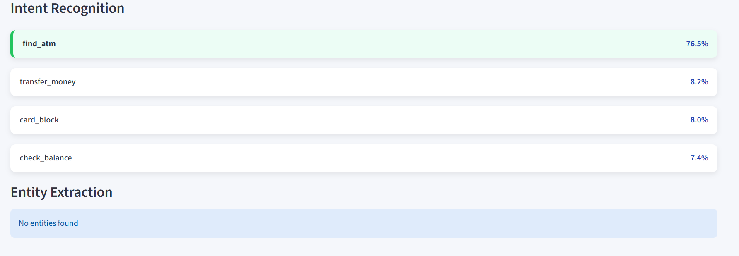
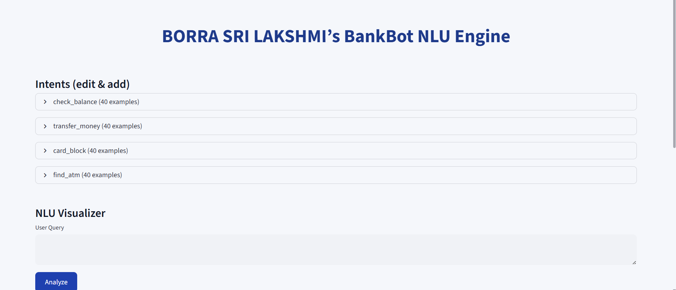
NLU Visualizer

Slide 4
MILESTONE-2
Response Handling & Dialogue Flow
Control conversation flow after intent recognition
Handle multi-step banking operations
Generate accurate and secure system responses
Manage errors, fallback scenarios, and casual interactions
Improve overall user experience and reliability
Money Transfer Dialogue Flow
User selects Transfer Money
System verifies login status
Displays current account balance
Collects receiver account number
Collects transfer amount
Verifies password
Confirms transaction
Updates balance and displays success message

Slide 5
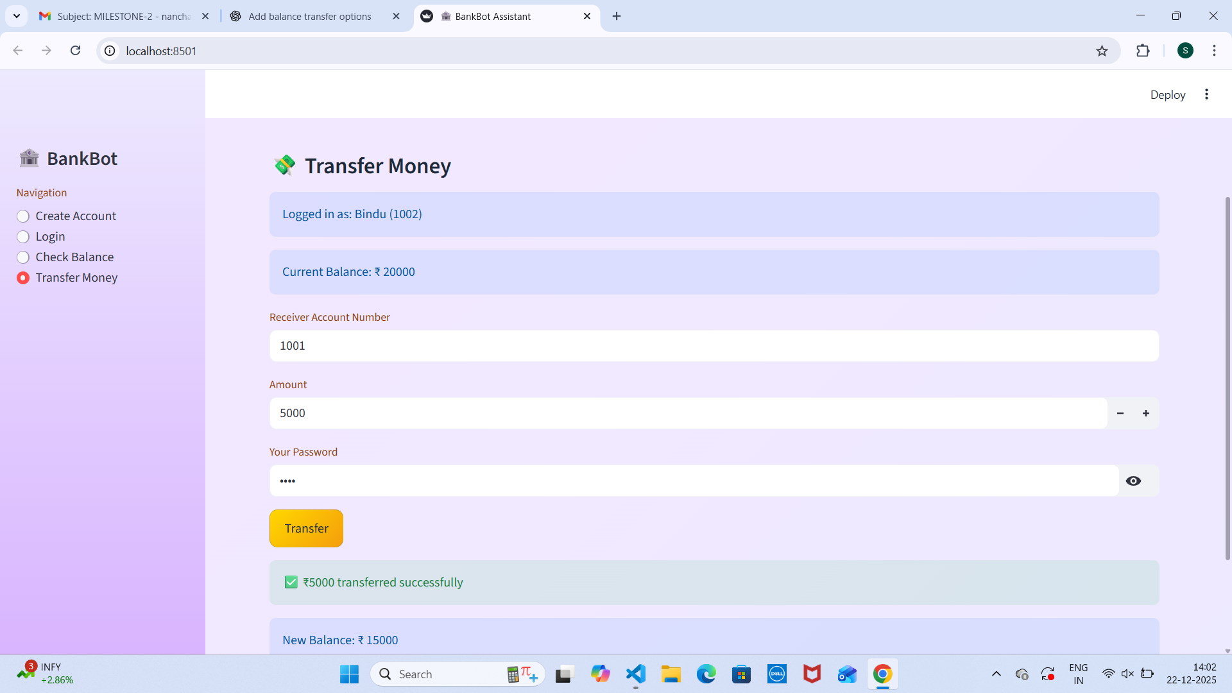

Slide 6
MILESTONE-3
UI Integration & Chat Interface
Provide an intuitive and user-friendly chat interface.
Enable real-time interaction with the chatbot.
Integrate frontend UI with backend NLU and dialogue engine.
Handle user errors and edge cases gracefully.
Improve overall user experience and accessibility.
Chat Interface Design
Simple and clean chatbot screen
Text input box for user queries
Send button for message submission
Sidebar navigation for banking actions
Responsive layout for better usability

Slide 7
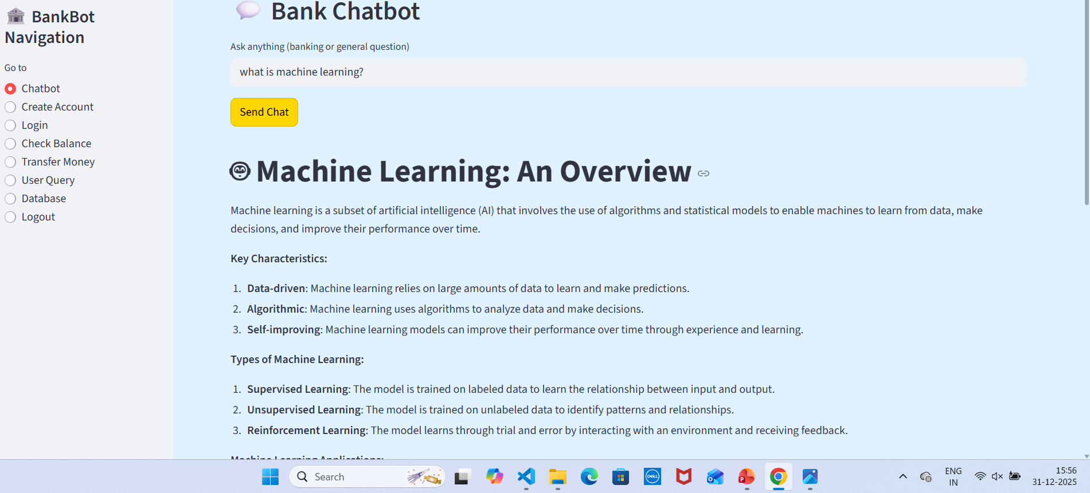
Navigation & User Flow
Chatbot

Slide 8
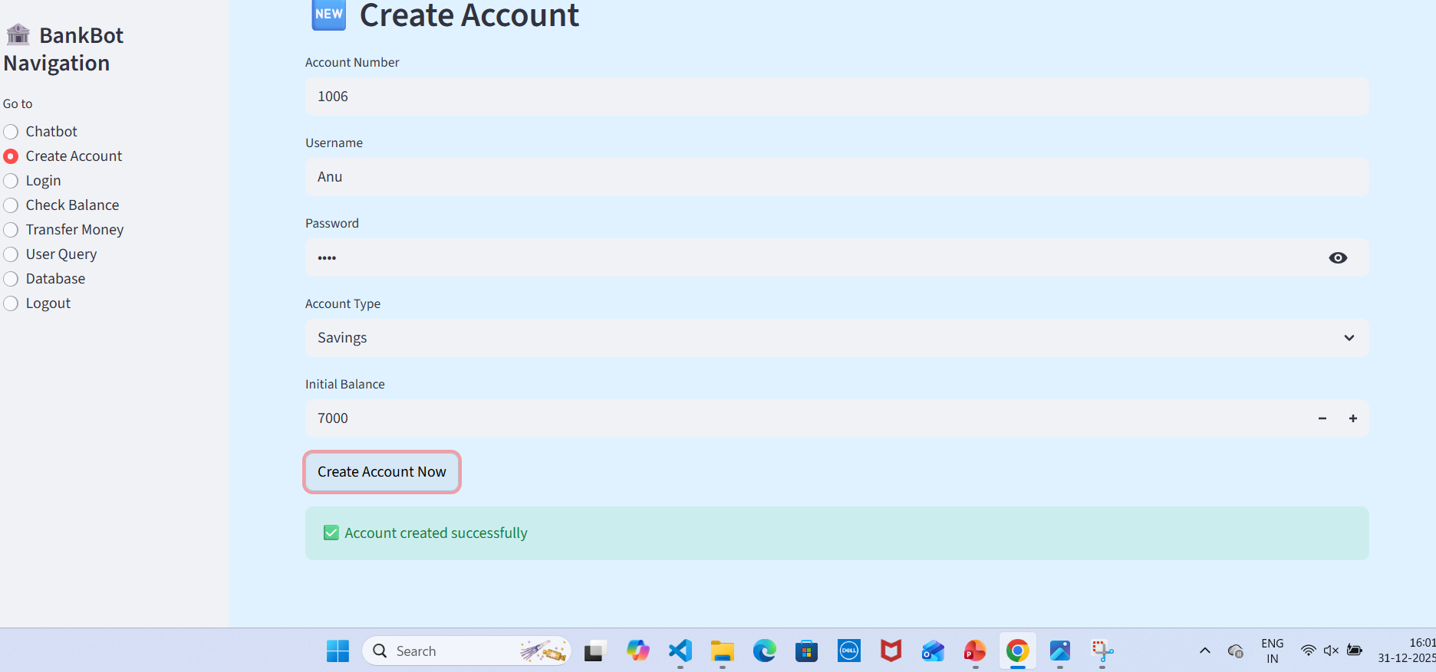
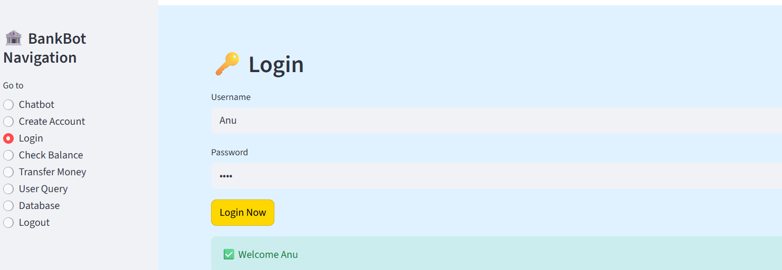
Create Account
Login

Slide 9
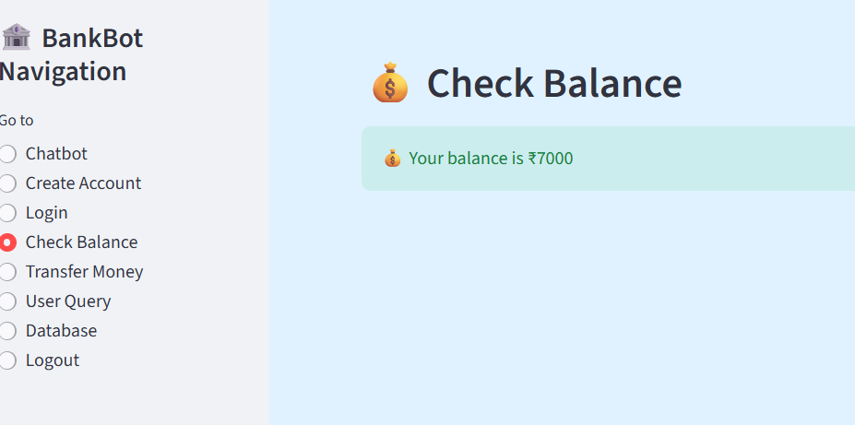
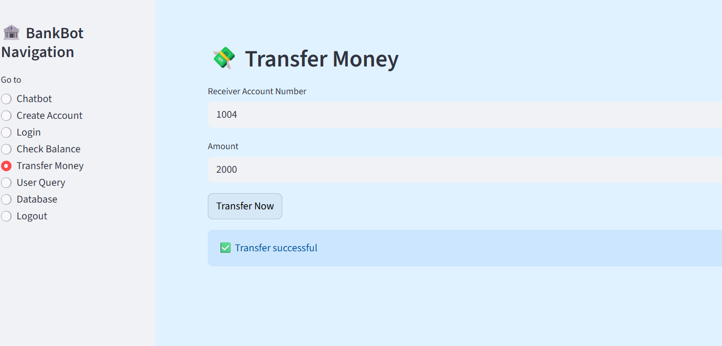
Check Balance
Transfer Money

Slide 10
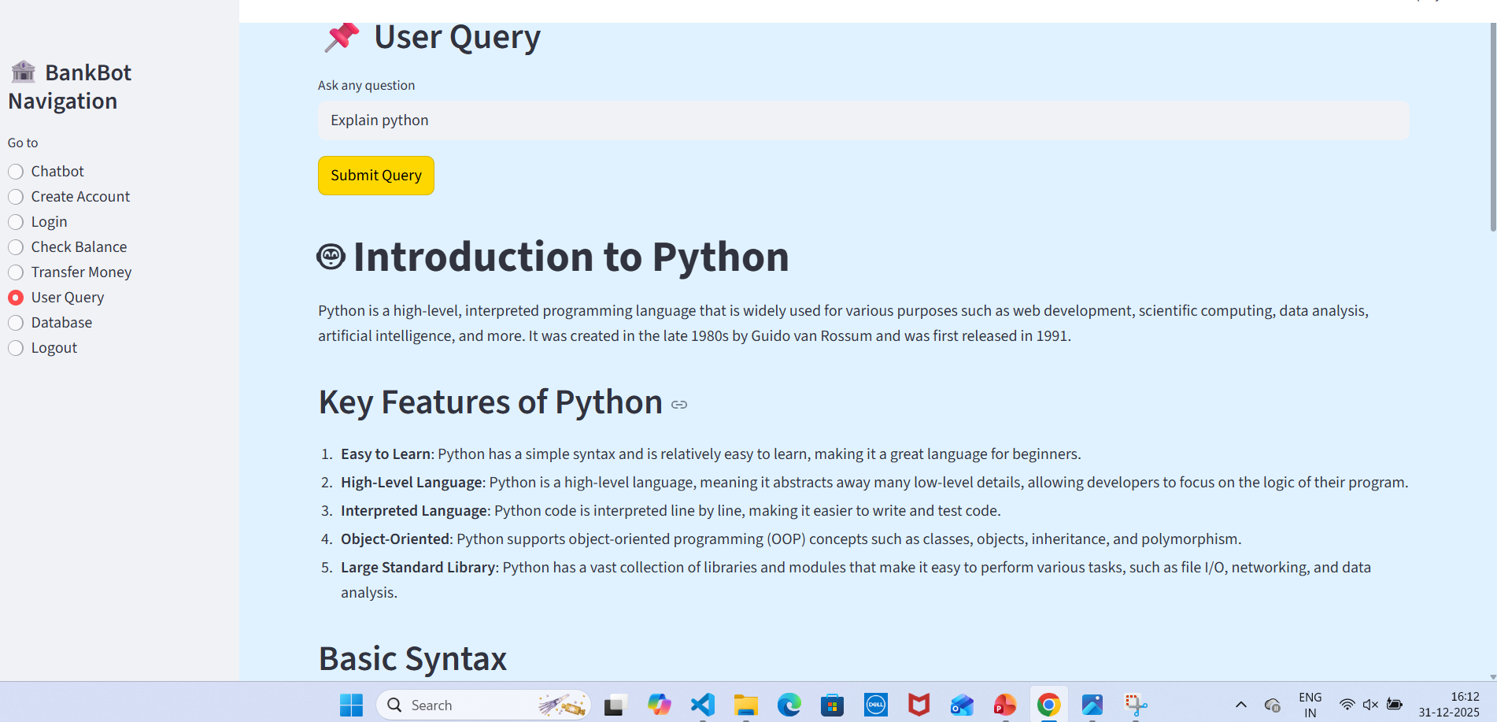
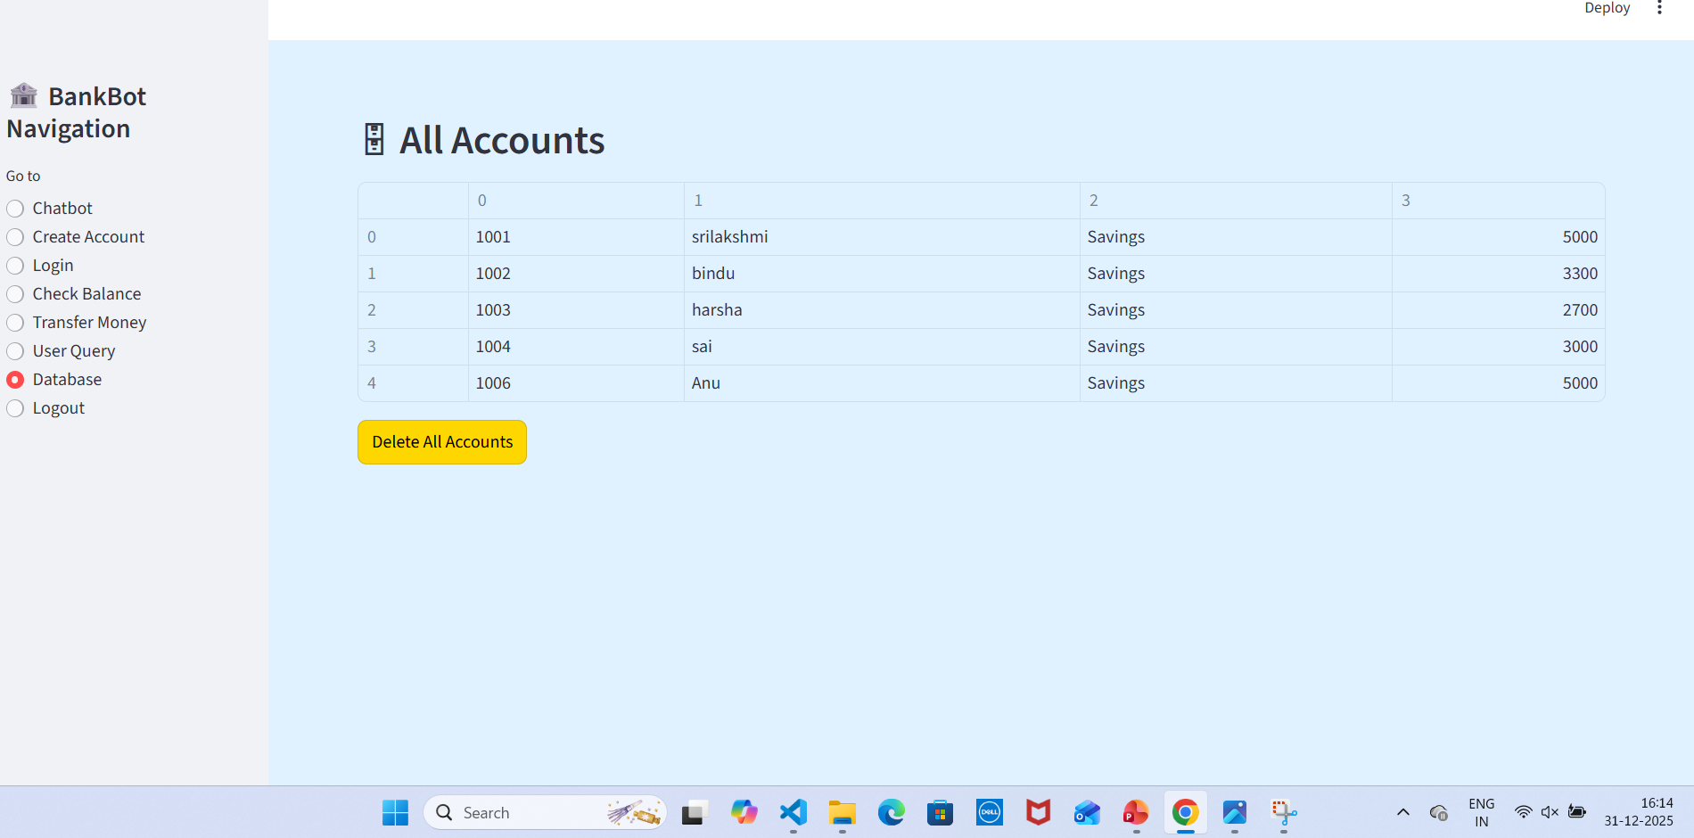
User Query
Database

Slide 11
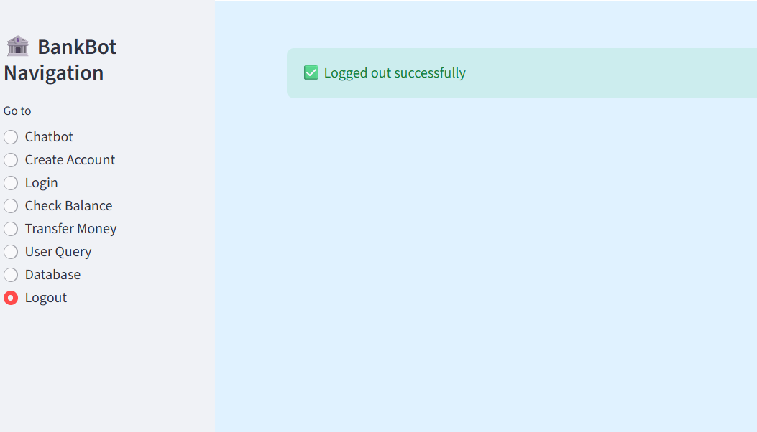
Logout

Slide 12
BankBot Admin Project
Milestone-4
What is BankBot?
AI-powered banking assistant for queries and customer support.
Purpose of Admin Panel:
Manage intents & knowledge base.
Test chatbot queries.
Monitor analytics & user interaction
Project Objectives
Provide a user-friendly interface for bank staff/admins.
Add, edit, and delete intents and knowledge base articles.
Test chatbot with real user queries.
View analytics & confidence levels for each intent.
Export analytics data to PDF reports.

Slide 13
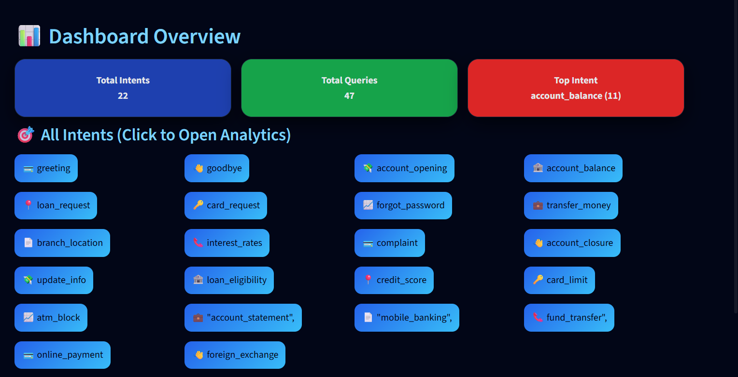
Tools & Technologies
Frontend: Streamlit (Python)
Backend & Storage: JSON files for intents, knowledge base, and analytics.
NLP & AI: TF-IDF vectorizer + Cosine similarity for intent detection.
Visualization: Altair charts (line, bar, donut)
PDF Export: ReportLab library
Python Libraries: pandas, sklearn, datetime, json, reportlab
Features – Admin Panel
Dashboard Overview
  Total Intents, Total Queries, Top Intent.
  Interactive colored cards and intent buttons.

Slide 14
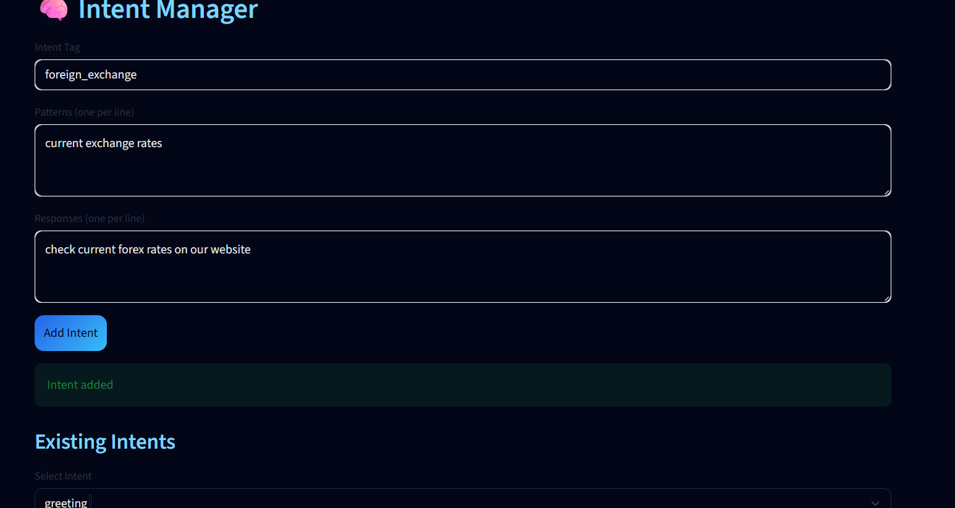
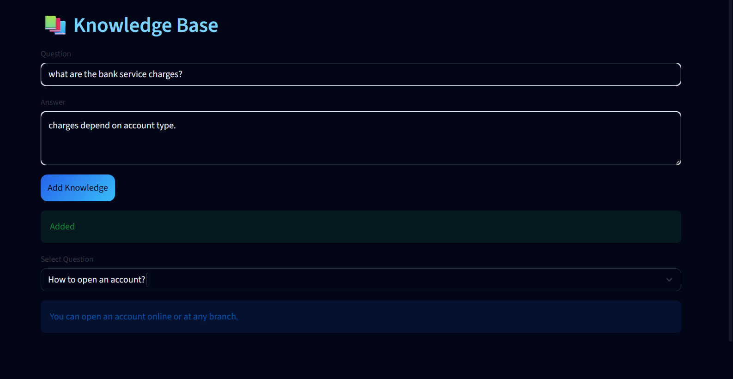
2.Intent Manager:
Add, edit, view intents
3.Knowledge Base:
Add questions & answers

Slide 15
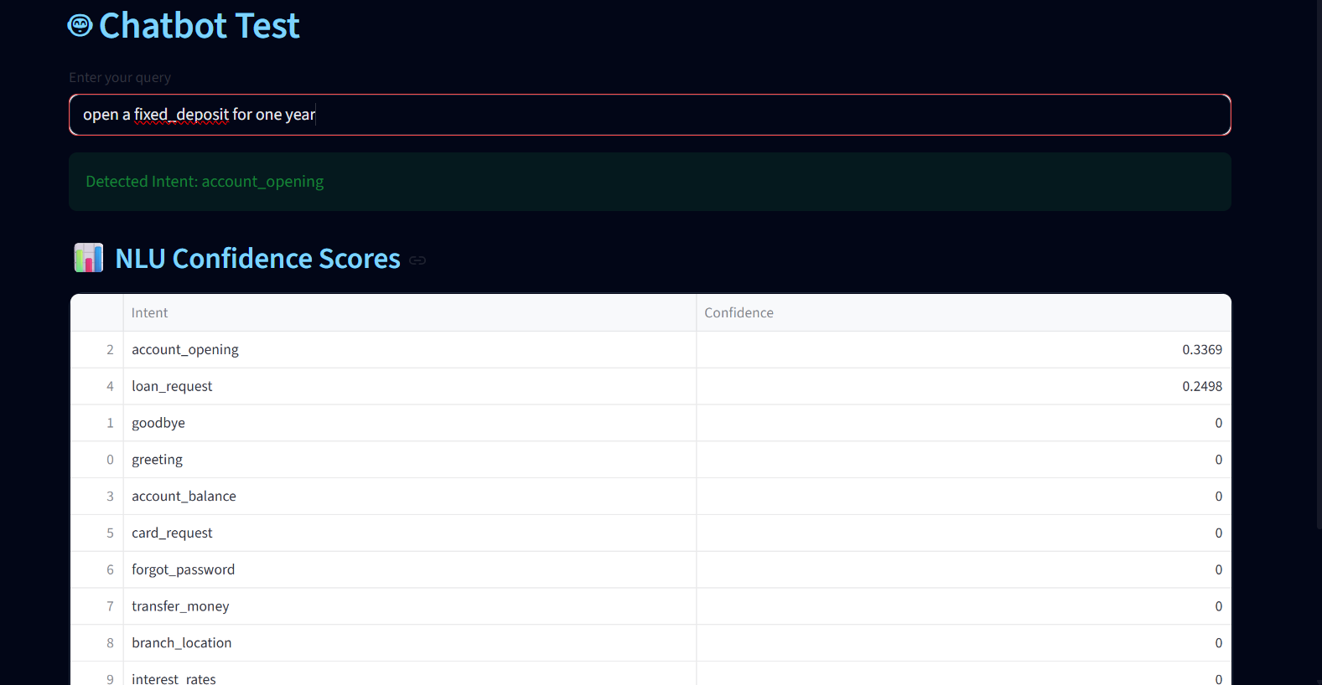
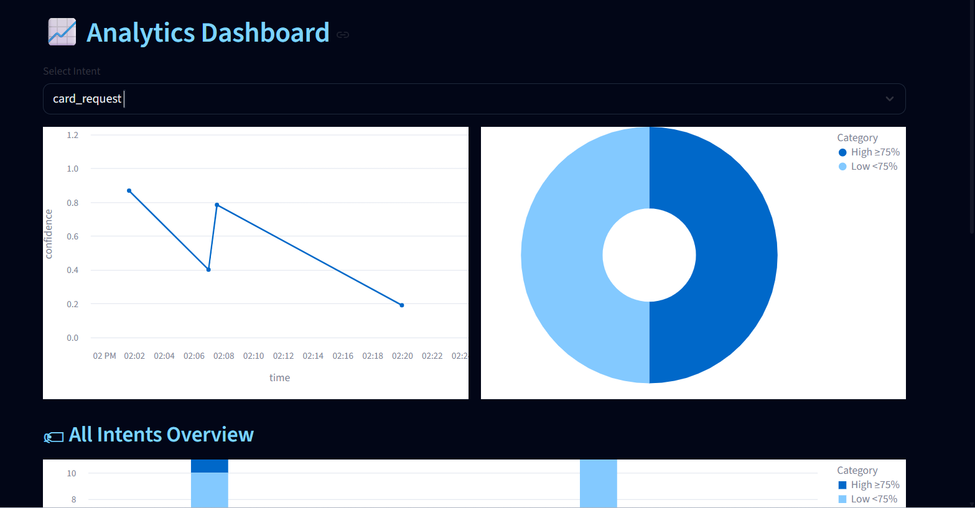
3.Chatbot Test:
Input queries & see NLU scores
4.Analytics:
Interactive charts, donuts, line charts

Slide 16
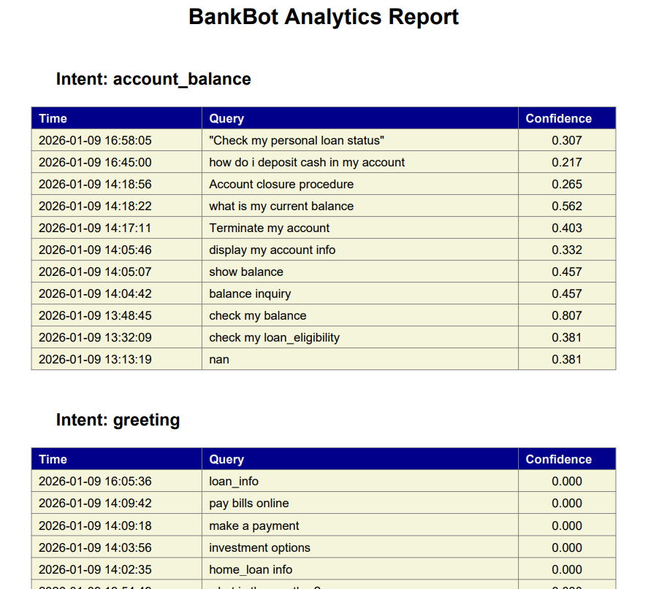
5.Export PDF:
Download reports in table format5.

