Slide 1


OKACOGNET: Understanding functional connectivity in resting state: a network based approach
Jaime Gomez-Ramirez
Biomedical Engineering Laboratory,
Okayama University

Slide 2
OKACOGNET
Context
Approach
Results
Future works

Slide 3
Context
Objective
Graph Analysis to study fMRI resting-state functional connectivity
Approach
Use network theory (graph) to study global connectivity in the human brain
Benefit
Understand functional significance of resting-state
Quantitative study of human brain global connectivity
Potential application to network characterisaton of AD,MCI etc. in early detection and prognosis

Slide 4
Context
Challenges:
A different approach to the Stimulus-Task
No goal oriented or external stimulus, but study brain dynamics in resting state
Quantify Endogeous brain activity

Slide 5
Approach ICA
OKACOGNEW follows 2 Approaches :
Independent Component Analysis ICA
Graph-based

Slide 6
Approach ICA
24 healthy subjects in resting state
Independent Component Analysis ICA
Use GIFT (Matlab toolbox that implements multiple algorithms for ICA)
ICA is model-free in contrast with GLM
ICA-based studies allow to simultaneously decompose into several maps, providing a set of components in which resting state networks can be studied.
ICA doesn’t require predefined ROI or the identification of seed voxel location.

Slide 8
Approach ICA
We have found a network of 20 nodes related to DMN:
LCaS(30) LFG(37) RFG(37) LIPL(40) RSupraMarginal(40) RMTG(37) LSupraMarginal(22) RPCC(23) RIPL(40) LPCU(7) RPCU(23) LPCC(23) RMFG(9) RSFG(8) LSTG(48) LMFG(9) RACC(32) RTP(38) L(para)Hipp(20) RMPFG(10) LMPFG(10)
Notes:
Brodmann's cytologically defined regions of the brain.

Slide 9
Approach graph-based
DATA: 23 healthy subjects in resting state
OBJECTIVE Functional brain networks at temporal scale
STEPS:
Preprocessing: (no smooth)

Slide 10
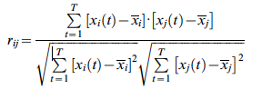
Whole brain parcelated in 90 areas using AAL (prior anatomical atlas)
Calculate mean time series of each region using Pearson correlation
X(t) t=1:172

Slide 11
Calculate mean time series of each region using Pearson correlation
We obtain correlation matrix M(90,90)

Slide 12
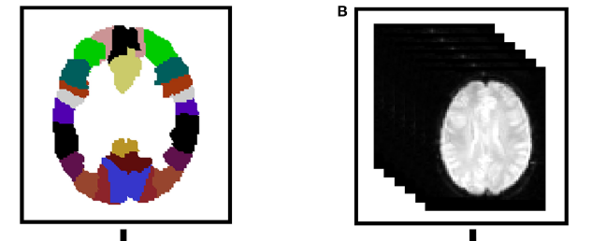
We have related these Broadmann obtained in R-fMRI data (right) areas with Brain ATLAS AAL (left)
Notes:
The results showed that the resting-state brain network was modularly configured and optimally organized into five modules: somatosensory/motor and auditory, vision, attention, default-mode, and limbic/paralimbic and sub-cortical systems

