Slide 1
Random Walks on Graphs:
An Overview
Purnamrita Sarkar

Slide 2
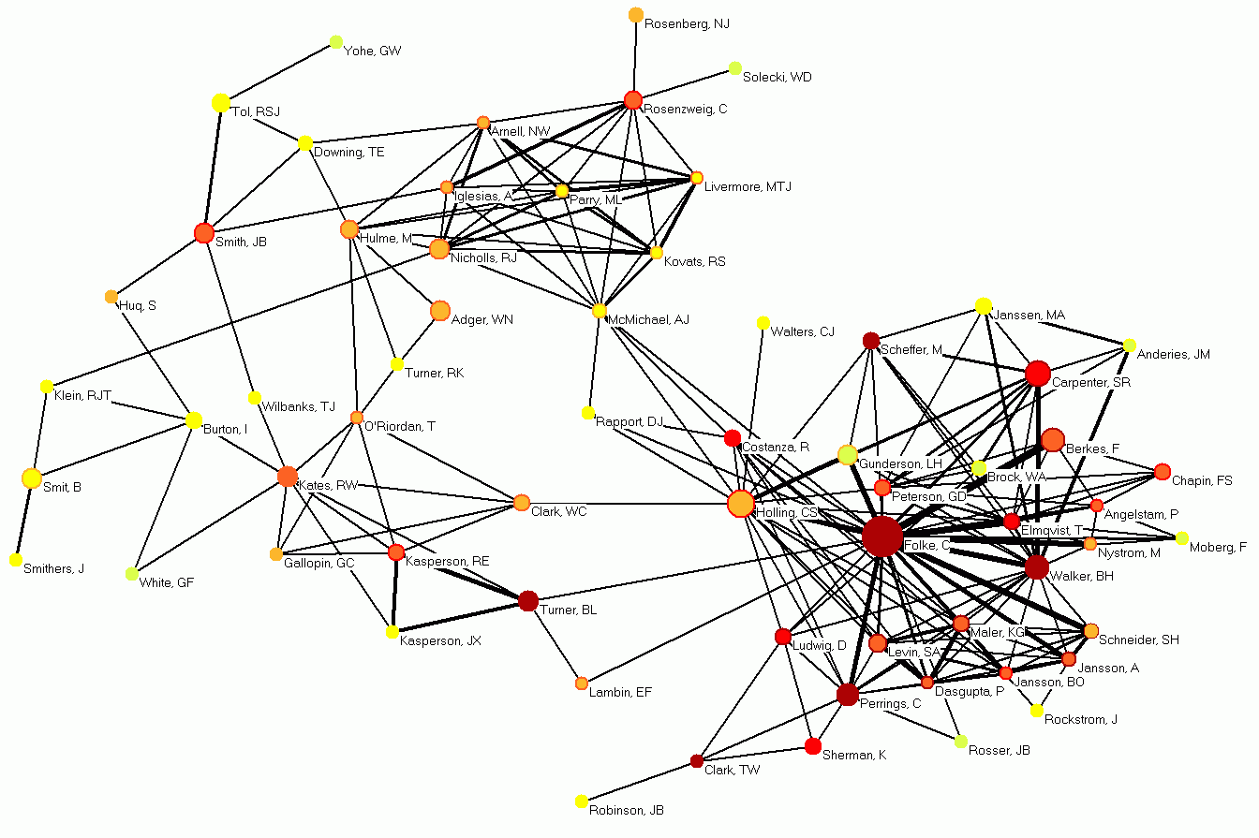
Motivation: Link prediction in social networks
?

Slide 3

Motivation: Basis for recommendation

Slide 4
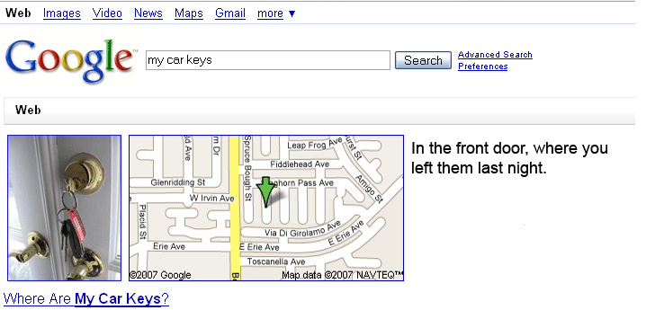

Motivation: Personalized search

Slide 5
Why graphs?
The underlying data is naturally a graph
  Papers linked by citation
  Authors linked by co-authorship
  Bipartite graph of customers and products
  Web-graph
  Friendship networks: who knows whom

Slide 6
What are we looking for
Rank nodes for a particular query
  Top k matches for “Random Walks” from Citeseer
  Who are the most likely co-authors of “Manuel Blum”.
  Top k book recommendations for Purna from Amazon
  Top k websites matching “Sound of Music”
  Top k friend recommendations for Purna when she joins “Facebook”

Slide 7
Talk Outline
Basic definitions
  Random walks
  Stationary distributions
Properties
  Perron frobenius theorem
  Electrical networks, hitting and commute times
    Euclidean Embedding
Applications
  Pagerank
    Power iteration
    Convergencce
  Personalized pagerank
  Rank stability

Slide 8
Definitions
nxn Adjacency matrix A.
  A(i,j) = weight on edge from i to j
  If the graph is undirected A(i,j)=A(j,i), i.e. A is symmetric
nxn Transition matrix P.
  P is row stochastic
  P(i,j) = probability of stepping on node j from node i
  = A(i,j)/∑_{i}A(i,j)
nxn Laplacian Matrix L.
  L(i,j)=∑_{i}A(i,j)-A(i,j)
  Symmetric positive semi-definite for undirected graphs
  Singular

Slide 9


Definitions
Adjacency matrix A
Transition matrix P
1
1
1
1/2
1
1
1
1/2

Slide 10

What is a random walk
t=0
1
1/2
1
1/2

Slide 11
What is a random walk
t=0
t=1
1
1
1/2
1/2
1
1
1/2
1/2

Slide 12

What is a random walk
t=0
t=1
1
1
1/2
1/2
1
1
1/2
1/2
t=2
1
1/2
1
1/2

Slide 13
What is a random walk
t=0
t=1
1
1
1/2
1/2
1
1
1/2
1/2
t=2
t=3
1
1/2
1
1
1/2
1
1/2
1/2

Slide 14
Probability Distributions
x_{t}(i) = probability that the surfer is at node i at time t
x_{t+1}(i) = ∑_{j}(Probability of being at node j)*Pr(j->i) =∑_{j}x_{t}(j)*P(j,i)
x_{t+1} = x_{t}P = x_{t-1}*P*P= x_{t-2}*P*P*P = …=x₀ P^{t}
What happens when the surfer keeps walking for a long time?

Slide 15
Stationary Distribution
When the surfer keeps walking for a long time
When the distribution does not change anymore
  i.e. x_{T+1} = x_{T}
For “well-behaved” graphs this does not depend on the start distribution!!

Slide 16
What is a stationary distribution?
Intuitively and Mathematically

Slide 17
What is a stationary distribution?
Intuitively and Mathematically
The stationary distribution at a node is related to the amount of time a random walker spends visiting that node.

Slide 18
What is a stationary distribution?
Intuitively and Mathematically
The stationary distribution at a node is related to the amount of time a random walker spends visiting that node.
Remember that we can write the probability distribution at a node as
  x_{t+1} = x_{t}P

Slide 19
What is a stationary distribution?
Intuitively and Mathematically
The stationary distribution at a node is related to the amount of time a random walker spends visiting that node.
Remember that we can write the probability distribution at a node as
  x_{t+1} = x_{t}P
For the stationary distribution v₀ we have
  v₀ = v₀ P

Slide 20
What is a stationary distribution?
Intuitively and Mathematically
The stationary distribution at a node is related to the amount of time a random walker spends visiting that node.
Remember that we can write the probability distribution at a node as
  x_{t+1} = x_{t}P
For the stationary distribution v₀ we have
  v₀ = v₀ P
Whoa! that’s just the left eigenvector of the transition matrix !

Slide 21
Talk Outline
Basic definitions
  Random walks
  Stationary distributions
Properties
  Perron frobenius theorem
  Electrical networks, hitting and commute times
    Euclidean Embedding
Applications
  Pagerank
    Power iteration
    Convergencce
  Personalized pagerank
  Rank stability

Slide 22
Interesting questions
Does a stationary distribution always exist? Is it unique?
  Yes, if the graph is “well-behaved”.
What is “well-behaved”?
  We shall talk about this soon.
How fast will the random surfer approach this stationary distribution?
  Mixing Time!

Slide 23
Well behaved graphs
Irreducible: There is a path from every node to every other node.
Irreducible
Not irreducible

Slide 24
Well behaved graphs
Aperiodic: The GCD of all cycle lengths is 1. The GCD is also called period.
Periodicity is 3
Aperiodic

Slide 25
Implications of the Perron Frobenius Theorem
If a markov chain is irreducible and aperiodic then the largest eigenvalue of the transition matrix will be equal to 1 and all the other eigenvalues will be strictly less than 1.
  Let the eigenvalues of P be {σ_{i}| i=0:n-1} in non-increasing order of σ_{i} .
  σ₀ = 1 > σ₁ > σ₂ >= ……>= σ_{n}

Slide 26
Implications of the Perron Frobenius Theorem
If a markov chain is irreducible and aperiodic then the largest eigenvalue of the transition matrix will be equal to 1 and all the other eigenvalues will be strictly less than 1.
  Let the eigenvalues of P be {σ_{i}| i=0:n-1} in non-increasing order of σ_{i} .
  σ₀ = 1 > σ₁ > σ₂ >= ……>= σ_{n}
These results imply that for a well behaved graph there exists an unique stationary distribution.
More details when we discuss pagerank.

Slide 27
Some fun stuff about undirected graphs
A connected undirected graph is irreducible
A connected non-bipartite undirected graph has a stationary distribution proportional to the degree distribution!
Makes sense, since larger the degree of the node more likely a random walk is to come back to it.

Slide 28
Talk Outline
Basic definitions
  Random walks
  Stationary distributions
Properties
  Perron frobenius theorem
  Electrical networks, hitting and commute times
    Euclidean Embedding
Applications
  Pagerank
    Power iteration
    Convergencce
  Personalized pagerank
  Rank stability

Slide 29
Proximity measures from random walks
b
a
How long does it take to hit node b in a random walk starting at node a ? Hitting time.
How long does it take to hit node b and come back to node a ? Commute time.

Slide 30
Hitting and Commute times
b
a
Hitting time from node i to node j
  Expected number of hops to hit node j starting at node i.
  Is not symmetric. h(a,b) > h(a,b)
  h(i,j) = 1 + Σ_{kЄnbs(A)} p(i,k)h(k,j)

Slide 31
Hitting and Commute times
b
a
Commute time between node i and j
  Is expected time to hit node j and come back to i
  c(i,j) = h(i,j) + h(j,i)
  Is symmetric. c(a,b) = c(b,a)

Slide 32
Relationship with Electrical networks^{1,2}
Consider the graph as a n-node
resistive network.
Each edge is a resistor of 1 Ohm.
Degree of a node is number of
neighbors
Sum of degrees = 2*m
  m being the number of edges
Random Walks and Electric Networks , Doyle and Snell, 1984
The Electrical Resistance Of A Graph Captures Its Commute And Cover Times, Ashok K. Chandra, Prabhakar Raghavan, Walter L. Ruzzo, Roman Smolensky, Prasoon Tiwari, 1989

Slide 33
Relationship with Electrical networks
3
Inject d(i) amp current in
each node
Extract 2m amp current from
node j.
Now what is the voltage
difference between i and j ?
2
3
4
i
j
2
16
2

Slide 34
Relationship with Electrical networks
3
Whoa!! Hitting time from i to j is exactly the voltage drop when you inject respective degree amount of current in every node and take out 2*m from j!
2
3
4
i
j
2
16
2

Slide 35
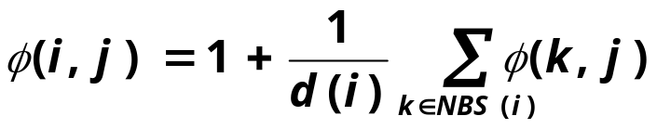
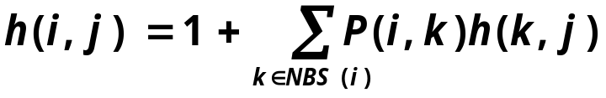
Relationship with Electrical networks
Consider neighbors of i i.e. NBS(i)
Using Kirchhoff's law
d(i) = Σ_{kЄNBS(A)} Φ(i,j) - Φ(k,j)
Oh wait, that’s also the definition of hitting time from i to j!
3
2
3
1Ω
4
i
j
2
1Ω
16
2

Slide 36
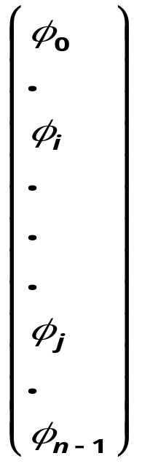
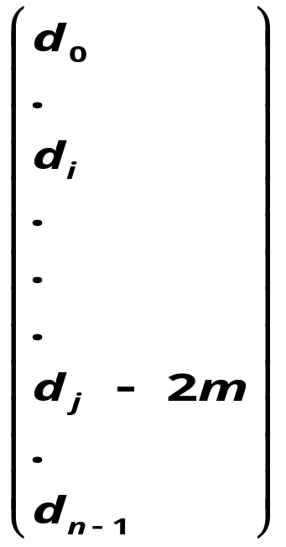
Hitting times and Laplacians
-1
d_{i}
-1
-1
=
-1
d_{j}
-1
L
h(i,j) = Φ_{i}- Φ_{j}

Slide 37
Relationship with Electrical networks
16
i
j
h(i,j) + h(j,i)
16
1
c(i,j) = h(i,j) + h(j,i) = 2m*R_{eff}(i,j)
The Electrical Resistance Of i Graph Captures Its Commute And Cover Times, Ashok K. Chandra, Prabhakar Raghavan,
Walter L. Ruzzo, Roman Smolensky, Prasoon Tiwari, 1989

Slide 38
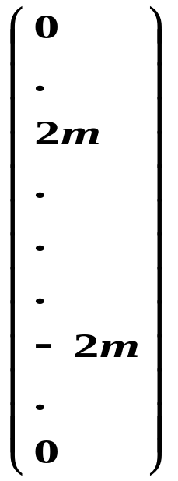
Commute times and Lapacians
-1
d_{i}
-1
-1
=
-1
d_{j}
-1
L
C(i,j) = Φ_{i} – Φ_{j}
= 2m (e_{i} – e_{j}) ^{T}L⁺ (e_{i} – e_{j})
= 2m (x_{i}-x_{j})^{T}(x_{i}-x_{j})
x_{i} = (L⁺)^{1/2} e_{i}

Slide 39
Commute times and Laplacians
Why is this interesting ?
Because, this gives a very intuitive definition of embedding the points in some Euclidian space, s.t. the commute times is the squared Euclidian distances in the transformed space.¹
1. The Principal Components Analysis of a Graph, and its Relationships to Spectral Clustering . M. Saerens, et al, ECML ‘04

Slide 40
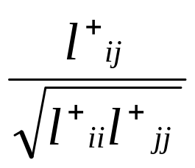
L⁺ : some other interesting measures of similarity¹
L⁺_{ij} = x_{i}^{T}x_{j} = inner product of the position vectors
L⁺_{ii} = x_{i}^{T}x_{i} = square of length of position vector of i
Cosine similarity
1. A random walks perspective on maximising satisfaction and profit. Matthew Brand, SIAM ‘05

Slide 41
Talk Outline
Basic definitions
  Random walks
  Stationary distributions
Properties
  Perron frobenius theorem
  Electrical networks, hitting and commute times
    Euclidean Embedding
Applications
  Recommender Networks
  Pagerank
    Power iteration
    Convergencce
  Personalized pagerank
  Rank stability

Slide 42
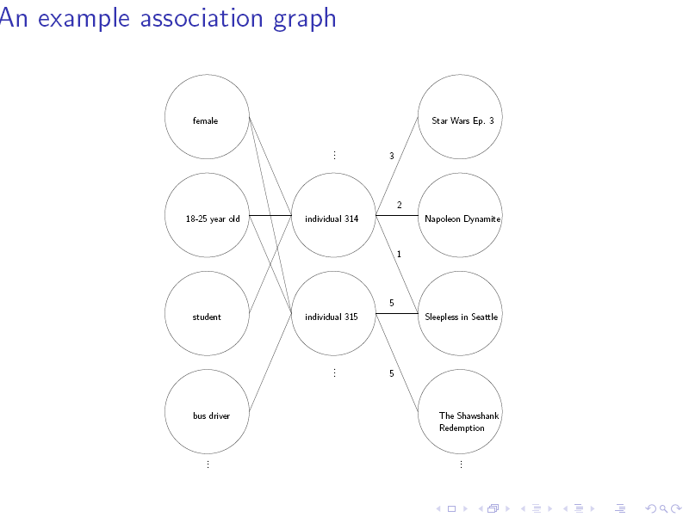
Recommender Networks¹
1. A random walks perspective on maximising satisfaction and profit. Matthew Brand, SIAM ‘05

Slide 43
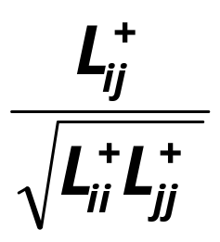
Recommender Networks
For a customer node i define similarity as
  H(i,j)
  C(i,j)
  Or the cosine similarity
Now the question is how to compute these quantities quickly for very large graphs.
  Fast iterative techniques (Brand 2005)
  Fast Random Walk with Restart (Tong, Faloutsos 2006)
  Finding nearest neighbors in graphs (Sarkar, Moore 2007)

Slide 44
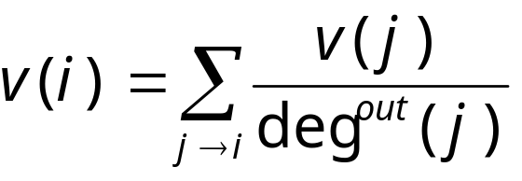
Ranking algorithms on the web
HITS (Kleinberg, 1998) & Pagerank (Page & Brin, 1998)
We will focus on Pagerank for this talk.
  An webpage is important if other important pages point to it.
  Intuitively
  v works out to be the stationary distribution of the markov chain corresponding to the web.

Slide 45
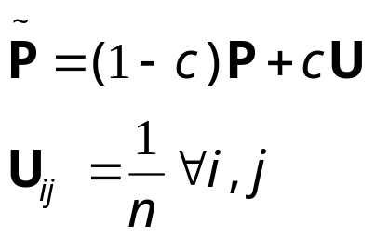
Pagerank & Perron-frobenius
Perron Frobenius only holds if the graph is irreducible and aperiodic.
But how can we guarantee that for the web graph?
  Do it with a small restart probability c.
At any time-step the random surfer
  jumps (teleport) to any other node with probability c
  jumps to its direct neighbors with total probability 1-c.

Slide 46
Power iteration
Power Iteration is an algorithm for computing the stationary distribution.
  Start with any distribution x₀
  Keep computing x_{t+1} = x_{t}P
  Stop when x_{t+1} and x_{t} are almost the same.

Slide 47
Power iteration
Why should this work?
Write x₀ as a linear combination of the left eigenvectors {v₀, v₁, … , v_{n-1}} of P
Remember that v₀ is the stationary distribution.
x₀ = c₀v₀ + c₁v₁ + c₂v₂ + … + c_{n-1}v_{n-1}

Slide 48
Power iteration
Why should this work?
Write x₀ as a linear combination of the left eigenvectors {v₀, v₁, … , v_{n-1}} of P
Remember that v₀ is the stationary distribution.
x₀ = c₀v₀ + c₁v₁ + c₂v₂ + … + c_{n-1}v_{n-1}
c₀ = 1 . WHY? (slide 71)

Slide 49

Power iteration
v₀ v₁ v₂ ……. v_{n-1}
1 c₁ c₂ c_{n-1}

Slide 50
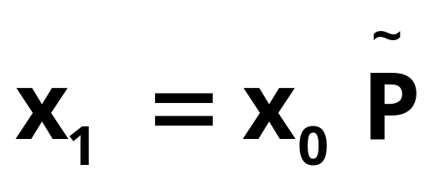
Power iteration
v₀ v₁ v₂ ……. v_{n-1}
σ₀ σ₁c₁ σ₂c₂ σ_{n-1}c_{n-1}

Slide 51
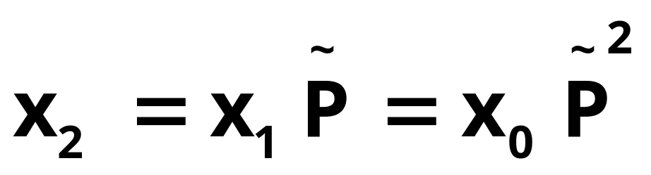
Power iteration
v₀ v₁ v₂ ……. v_{n-1}
σ₀² σ₁²c₁ σ₂²c₂ σ_{n-1}²c_{n-1}

Slide 52
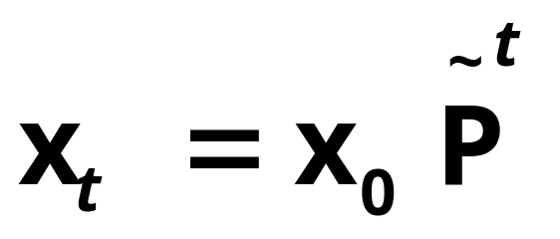
Power iteration
v₀ v₁ v₂ ……. v_{n-1}
σ₀^{t} σ₁^{t} c₁ σ₂^{t} c₂ σ_{n-1}^{t} c_{n-1}

Slide 53
Power iteration
σ₀ = 1 > σ₁ ≥…≥ σ_{n}
v₀ v₁ v₂ ……. v_{n-1}
1 σ₁^{t} c₁ σ₂^{t} c₂ σ_{n-1}^{t} c_{n-1}

Slide 54

Power iteration
σ₀ = 1 > σ₁ ≥…≥ σ_{n}
v₀ v₁ v₂ ……. v_{n-1}
1 0 0 0

Slide 55
Convergence Issues
Formally ||x₀P^{t} – v₀|| ≤ |λ|^{t}
  λ is the eigenvalue with second largest magnitude
The smaller the second largest eigenvalue (in magnitude), the faster the mixing.
For λ<1 there exists an unique stationary distribution, namely the first left eigenvector of the transition matrix.

Slide 56
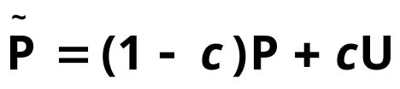

Pagerank and convergence
The transition matrix pagerank uses really is
The second largest eigenvalue of can be proven¹ to be ≤ (1-c)
Nice! This means pagerank computation will converge fast.
1. The Second Eigenvalue of the Google Matrix, Taher H. Haveliwala and Sepandar D. Kamvar, Stanford University Technical Report, 2003.

Slide 57

Pagerank
We are looking for the vector v s.t.
r is a distribution over web-pages.
If r is the uniform distribution we get pagerank.
What happens if r is non-uniform?

Slide 58
Pagerank
We are looking for the vector v s.t.
r is a distribution over web-pages.
If r is the uniform distribution we get pagerank.
What happens if r is non-uniform?
Personalization

Slide 59

Personalized Pagerank^{1,2,3}
The only difference is that we use a non-uniform teleportation distribution, i.e. at any time step teleport to a set of webpages.
In other words we are looking for the vector v s.t.
r is a non-uniform preference vector specific to an user.
v gives “personalized views” of the web.
1. Scaling Personalized Web Search, Jeh, Widom. 2003
2. Topic-sensitive PageRank, Haveliwala, 2001
3. Towards scaling fully personalized pagerank, D. Fogaras and B. Racz, 2004

Slide 60
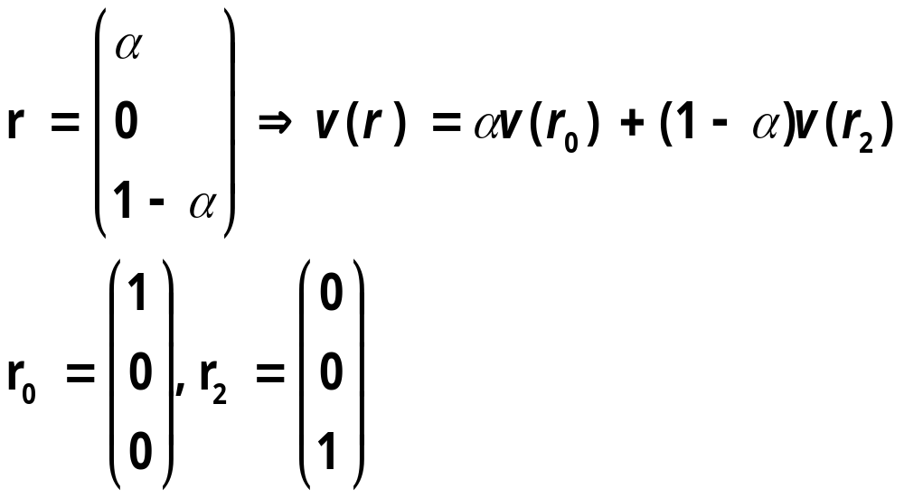
Personalized Pagerank
Pre-computation: r is not known from before
Computing during query time takes too long
A crucial observation¹ is that the personalized pagerank vector is linear w.r.t r
Scaling Personalized Web Search, Jeh, Widom. 2003

Slide 61
Topic-sensitive pagerank (Haveliwala’01)
Divide the webpages into 16 broad categories
For each category compute the biased personalized pagerank vector by uniformly teleporting to websites under that category.
At query time the probability of the query being from any of the above classes is computed, and the final page-rank vector is computed by a linear combination of the biased pagerank vectors computed offline.

Slide 62
Personalized Pagerank: Other Approaches
Scaling Personalized Web Search (Jeh & Widom ’03)
Towards scaling fully personalized pagerank: algorithms, lower bounds and experiments (Fogaras et al, 2004)
Dynamic personalized pagerank in entity-relation graphs. (Soumen Chakrabarti, 2007)

Slide 63
Personalized Pagerank (Purna’s Take)
But, whats the guarantee that the new transition matrix will still be irreducible?
Check out
  The Second Eigenvalue of the Google Matrix, Taher H. Haveliwala and Sepandar D. Kamvar, Stanford University Technical Report, 2003.
  Deeper Inside PageRank, Amy N. Langville. and Carl D. Meyer. Internet Mathematics, 2004.
As long as you are adding any rank one (where the matrix is a repetition of one distinct row) matrix of form (1^{T}r) to your transition matrix as shown before,
  λ ≤ 1-c

Slide 64
Talk Outline
Basic definitions
  Random walks
  Stationary distributions
Properties
  Perron frobenius theorem
  Electrical networks, hitting and commute times
    Euclidean Embedding
Applications
  Recommender Networks
  Pagerank
    Power iteration
    Convergence
  Personalized pagerank
  Rank stability

Slide 65
Rank stability
How does the ranking change when the link structure changes?
The web-graph is changing continuously.
How does that affect page-rank?

Slide 66
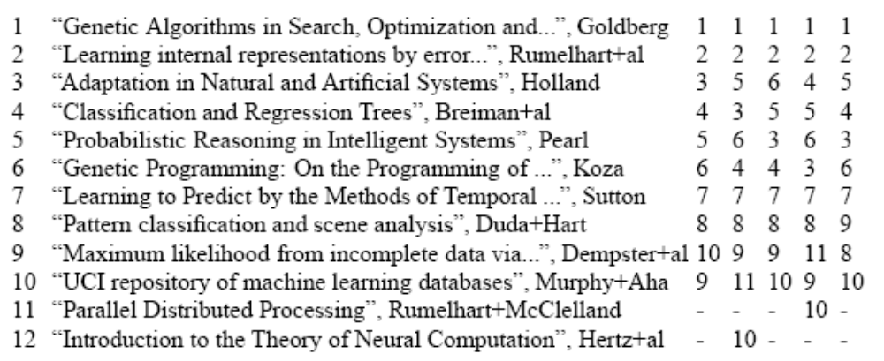
Rank stability¹ (On the Machine Learning papers from the CORA² database)
Rank on 5 perturbed datasets by deleting 30% of the papers
Rank on the entire database.
Link analysis, eigenvectors, and stability, Andrew Y. Ng, Alice X. Zheng and Michael Jordan, IJCAI-01
Automating the contruction of Internet portals with machine learning, A. Mc Callum, K. Nigam, J. Rennie, K. Seymore, In Information Retrieval Journel, 2000

Slide 67
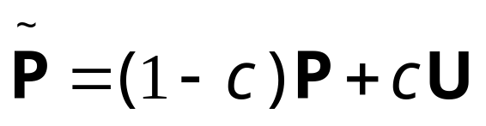
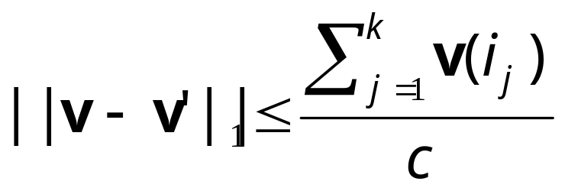
Rank stability
Ng et al 2001:
Theorem: if v is the left eigenvector of . Let the pages i₁, i₂,…, i_{k} be changed in any way, and let v’ be the new pagerank. Then
So if c is not too close to 0, the system would be rank stable and also converge fast!

Slide 68
Conclusion
Basic definitions
  Random walks
  Stationary distributions
Properties
  Perron frobenius theorem
  Electrical networks, hitting and commute times
    Euclidean Embedding
Applications
  Pagerank
    Power iteration
    Convergencce
  Personalized pagerank
  Rank stability

Slide 69
Thanks!
Please send email to Purna at
psarkar@cs.cmu.edu with questions,
suggestions, corrections ☺

Slide 70
Acknowledgements
Andrew Moore
Gary Miller
  Check out Gary’s Fall 2007 class on “Spectral Graph Theory, Scientific Computing, and Biomedical Applications”
  http://www.cs.cmu.edu/afs/cs/user/glmiller/public/Scientific-Computing/F-07/index.html
Fan Chung Graham’s course on
  Random Walks on Directed and Undirected Graphs
  http://www.math.ucsd.edu/~phorn/math261/
Random Walks on Graphs: A Survey, Laszlo Lov'asz
Reversible Markov Chains and Random Walks on Graphs, D Aldous, J Fill
Random Walks and Electric Networks, Doyle & Snell

Slide 71
Convergence Issues¹
Lets look at the vectors x for t=1,2,…
Write x₀ as a linear combination of the eigenvectors of P
x₀ = c₀v₀ + c₁v₁ + c₂v₂ + … + c_{n-1}v_{n-1}
c₀ = 1 . WHY?
Remember that 1is the right eigenvector of P with eigenvalue 1, since P is stochastic. i.e. P*1^{T} = 1^{T}. Hence v_{i}1^{T} = 0 if i≠0.
1 = x*1^{T} = c₀v₀*1^{T} = c₀ . Since v₀ and x₀ are both distributions
1. We are assuming that P is diagonalizable. The non-diagonalizable case is trickier, you can take a look at Fan Chung Graham’s class notes (the link is in the acknowledgements section).

