Slide 1
Computer Project 2
Mariam Borshkova

Slide 2
General information about Audio Interpolation
Audio interpolation is a method of making digital audio sound better than it really is. These days, almost every digital playback device uses interpolation to improve your listening experience. And with computers ever increasing in speed, it's now possible to use software implementations as well without a serious decrease in performance.

Slide 3
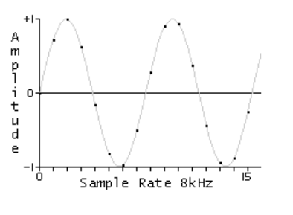
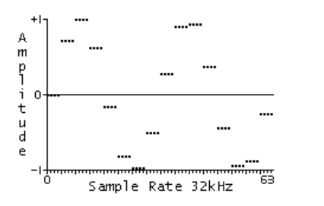
How does it works?
As a sound wave enters an ADC samples are taken at timed intervals. Higher sample rates produce better recordings, but also use more memory. So, despite the drawbacks of lower quality, people sometimes use lower sample rates to conserve space.
The following is a 1046Hz sine wave being sampled at 8kHz. The black dots represent the samples.
For this example, our sound source is sampled at 8kHz, but our output device is set to 32kHz. To play back the 8kHz source, we can send each sample four times
ADC -> analog to digital converter

Slide 4
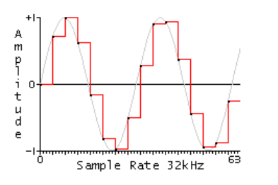
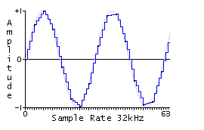
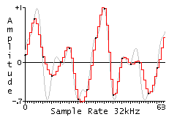
This works effectively, but if we look at the actual sound wave being output, we see that there is a vague resemblance to the original. Also notice the hard edges after each sample. This is what gives lower sampled audio that static sound.
What interpolation does is instead of repeating each sample it creates new samples between the originals. Thus a smoother wave form is output. There are different methods that can be used, but the easiest is linear interpolation. This method takes two samples and creates new samples between them that change at an even rate.
Cubic interpolation is basically an algorithm that tries to reproduce a more natural waveform by "bending" the interpolated points around the original samples. I won't go into the details of the mathematics of how it works, but you've probably seen this method before. Almost all graphic and drawing programs have a spline tool where you lay down points that are then connected by means of a curving line. This same method can be applied to audio by using the samples as points on a plane.

Slide 5
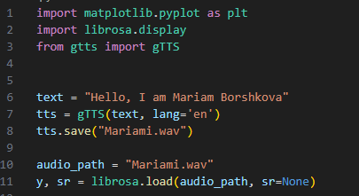

Interpolation, Sound wave
Our first task is: write text and convert it to speech.

Slide 6
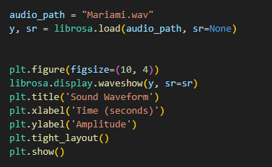
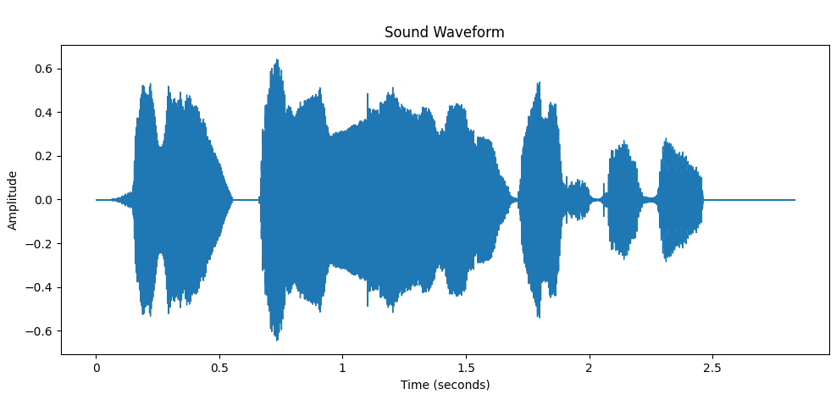
Plot wav file

Slide 7
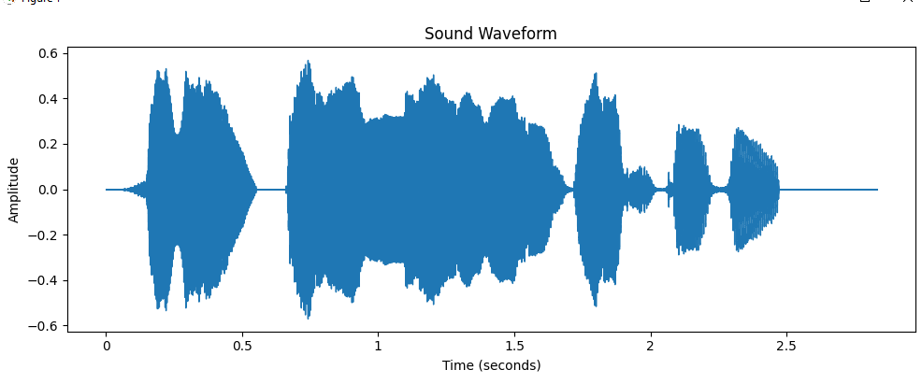
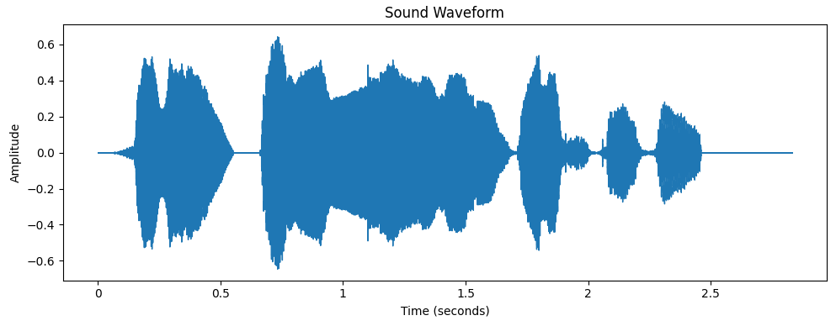
20 milisecond
90 milisecond

Slide 8
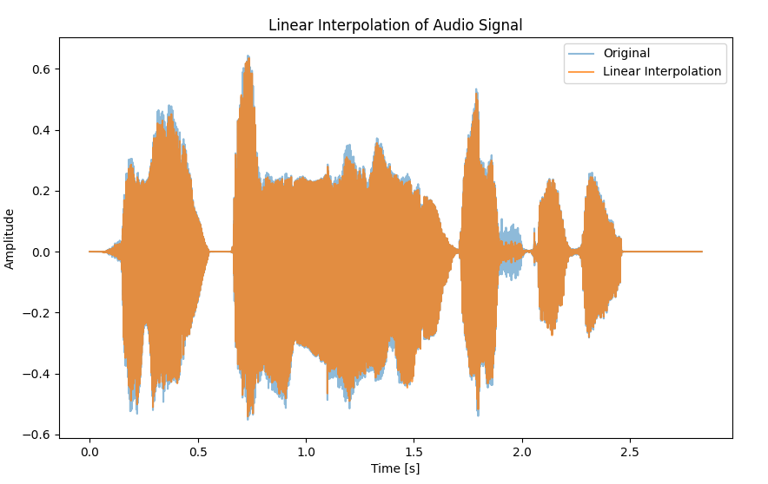
Linear interpolation
Used in simple resampling tasks where computational efficiency is critical.
Suitable for real-time applications where low latency is important.

Slide 9
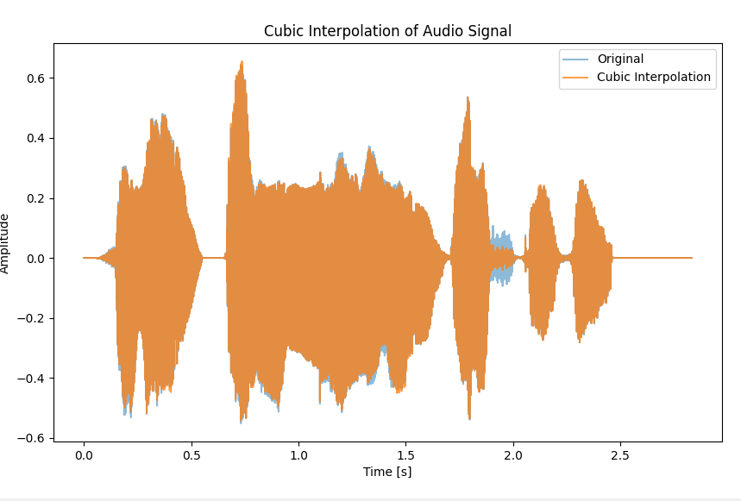
Cubic interpolation
Provides better quality for audio resampling compared to linear interpolation.
Used in situations where a balance between quality and computational cost is needed.

Slide 10
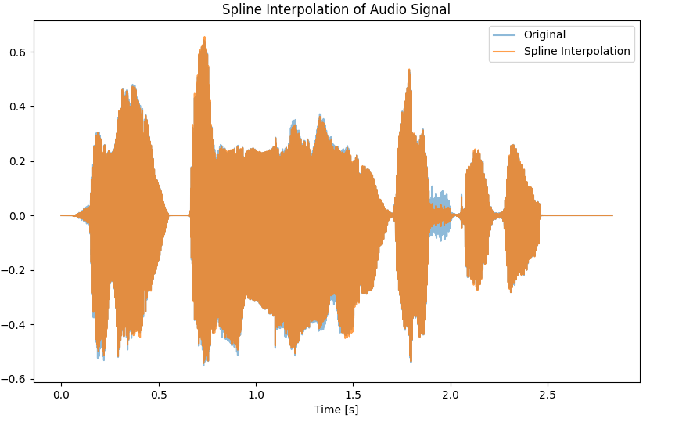
Spline interpolation
Provides high-quality interpolation, suitable for high-fidelity audio processing tasks.
Used in high-quality resampling, pitch shifting, and time-stretching algorithms.
More computationally intensive compared to linear and cubic interpolation

Slide 11
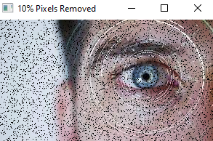
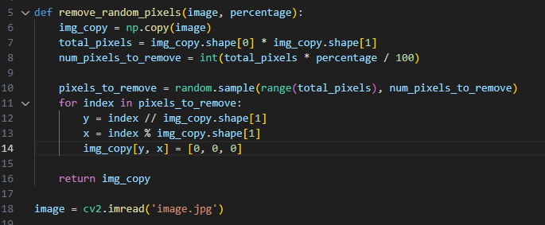
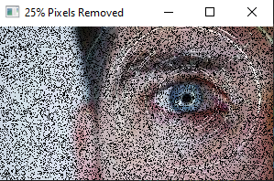
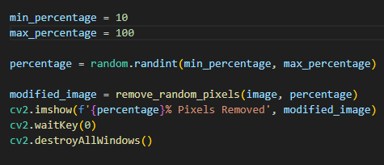
Remove Pixels randomly

Slide 12
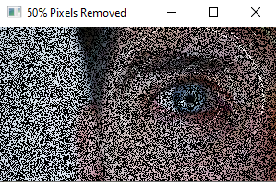
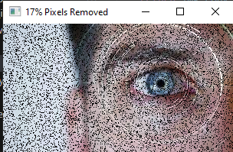
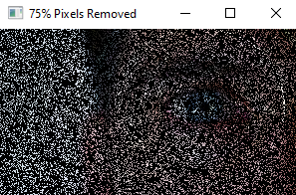
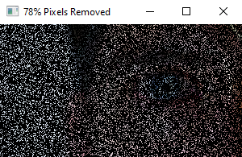

Slide 13

Radial Basis function
The Radial Basis Function method can be used not only for reconstruction of a surface from scattered data but for reconstruction of damaged images, filling gaps and for restoring missing data in images, too. The basic idea of reconstruction algorithm with RBF and very interesting results from reconstruction of images damaged by noise are presented. Feasibility of the RBF method for image processing is demonstrated.
1) Gaussian radial basis function (GRBF) for interpolation. RBF interpolation works by constructing a weighted sum of radial basis functions centered at known data points (in this case, the coordinates of known pixels) to estimate the values at unknown points (missing pixels). The interpolation function is typically defined as:
ϕ is the radial basis function, w_i​ are the weights associated with each data point.

Slide 14
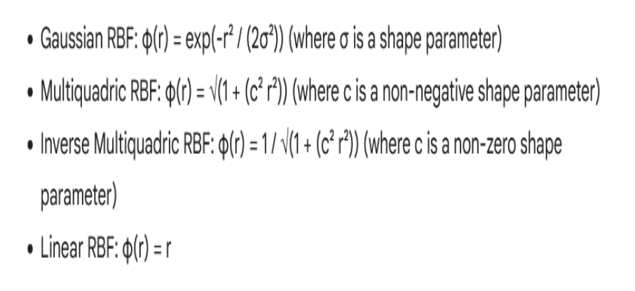

Slide 15
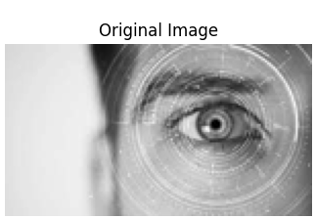
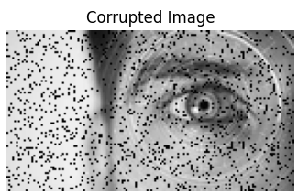
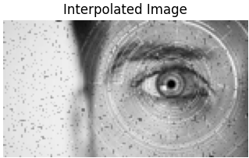
Gaussian function for the Radial Basis Function interpolation.
simulating missing pixels, and then applying interpolation to fill in the missing values.
There is one problem*

Slide 16
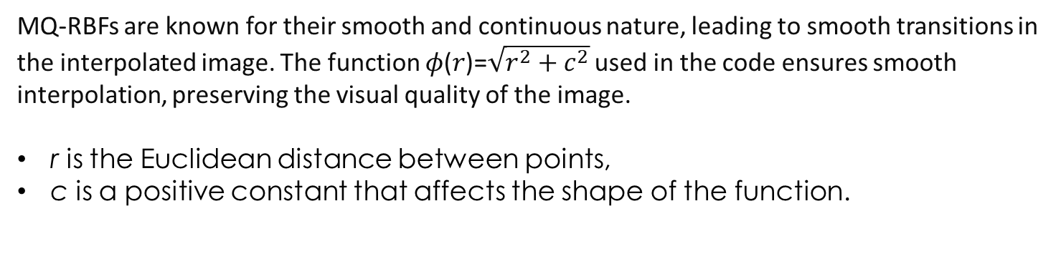
Multiquadric Radial Basis Function
It is considered an important tool for interpolating multidimensional scattered data. Its ability to handle arbitrarily scattered data, to easily generalize to several space dimensions, and to provide spectral accuracy have made it popular in various applications.
MQ-RBFs are known for their smooth and continuous nature, leading to smooth transitions in the interpolated image. The function 𝜙(𝑟)=$\sqrt{r^{2}+c^{2}}$ used in the code ensures smooth interpolation, preserving the visual quality of the image.
r is the Euclidean distance between points,
c is a positive constant that affects the shape of the function.

Slide 17
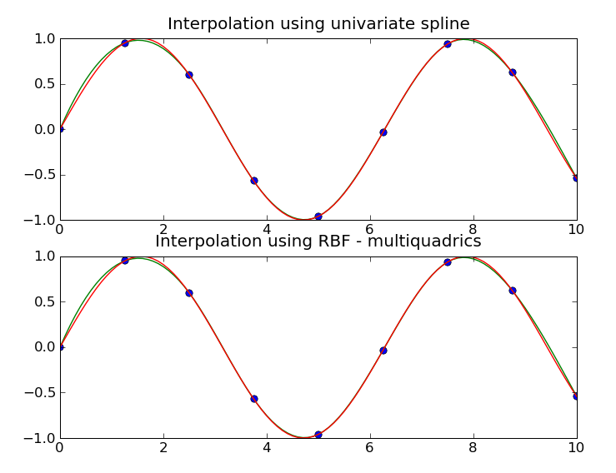
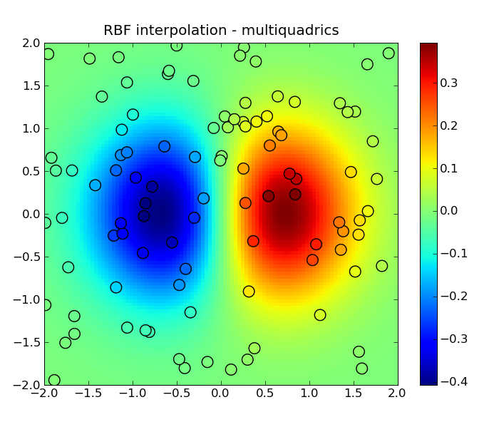
1D example
2D example
https://scipy.github.io/old-wiki/pages/Cookbook/RadialBasisFunctions.html

Slide 18
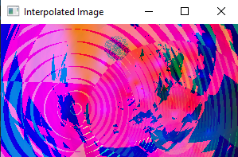
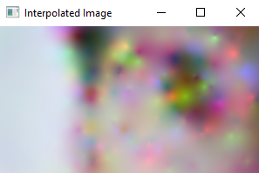
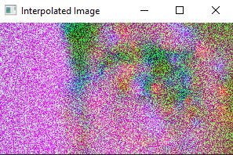

Slide 19
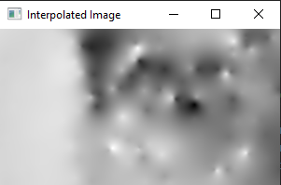
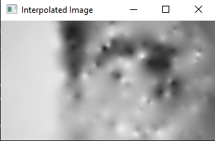
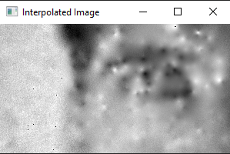
Custom Multiquadric RBF Interpolation

Slide 20
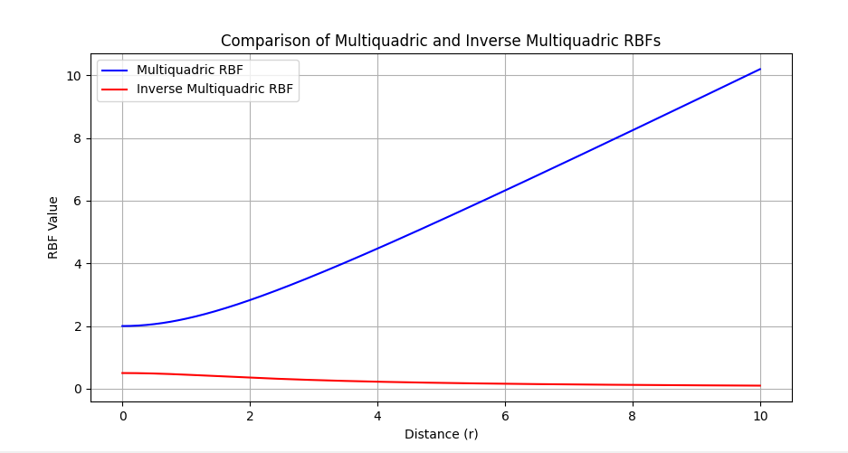
At small distances (𝑟 close to 0), both functions are relatively strong. The multiquadric function starts at 𝑐, while the inverse multiquadric starts at 1/a𝑐​.
Multiquadric: The function value grows with distance. This means that the influence of each point spreads out and increases over a larger area, leading to smoother transitions in the interpolated surface.
Inverse Multiquadric: The function value decays with distance. The influence of each point quickly diminishes as you move away from it, allowing for more detailed and localized interpolation.

Slide 21
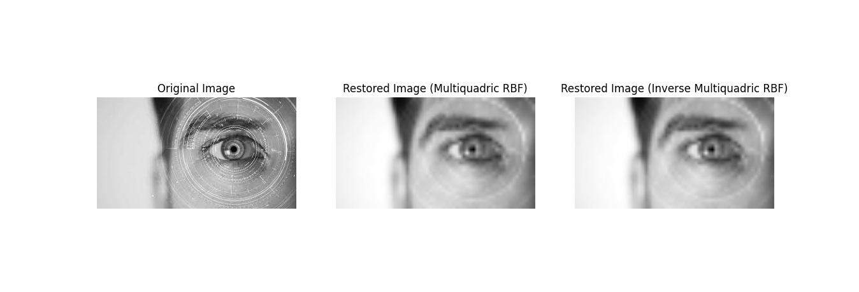
SciPy RBF Interpolation with Downsampling

