Slide 1
Multimodal Image - Text Retrieval System
CLIP-like Architecture on Flickr30k
Authors:
Balazs Vincze
Bertalan Tóth

Slide 2
Project Goal
The goal of this project is to build a multimodal system that retrieves relevant images based on a text query.
The main challenge is combining visual information (images) and textual information (natural language).
We aim to learn a shared representation space where images and texts with similar meaning are close to each other.

Slide 3
Classical Approach from the Project Description
The project description suggests a classical multimodal pipeline:
  CNN for image feature extraction
  Word embeddings + RNN (LSTM/GRU) for text
  Fusion of both branches
  Softmax-based classification
This approach works well for fixed-category classification tasks.

Slide 4
Why We Deviated from the Classical Approach
Our task is not to predict a fixed class label.
Instead, we want to answer:
  “Which images best match a given text description?”
This is better modeled as a retrieval and ranking problem, not strict classification.
Therefore, we adopted a CLIP-style retrieval approach, which better fits the task.

Slide 5

High-Level System Overview
The system consists of two independent neural networks:
  An image encoder
  A text encoder
Both encoders map their inputs into a shared embedding space.
Similar images and texts are close in this space.

Slide 6
Dataset: Flickr30k
Images are resized and normalized before being fed into the model.
We use a pre-trained EfficientNet as the image encoder.
The classification head is removed.
The CNN outputs a fixed-length visual feature vector.
We use the Flickr30k dataset, which contains:
  Images
  Multiple natural-language captions per image
  Each training sample is a single image - caption pair.
This dataset is well suited for multimodal learning.

Slide 7

Image Processing Branch (CNN)
Images are resized and normalized before being fed into the model.
We use a pre-trained EfficientNet as the image encoder.
The classification head is removed.
The CNN outputs a fixed-length visual feature vector.

Slide 8
Text Processing Branch (BERT)
Text input is tokenized using a BERT tokenizer.
A pre-trained BERT model processes the full sentence.
The [CLS] token output is used as the sentence representation.
BERT replaces the need for a separate RNN-based text encoder.
Images are resized and normalized before being fed into the model.
We use a pre-trained EfficientNet as the image encoder.
The classification head is removed.
The CNN outputs a fixed-length visual feature vector.

Slide 9

Projection Head and Shared Embedding Space
CNN and BERT outputs are not directly comparable.
A projection head is applied to both:
  Linear transformation
  L2 normalization
This maps both modalities into the same embedding space.

Slide 10

Training with Contrastive Learning
The model is trained using contrastive learning.
Matching image - text pairs are pulled closer together.
Non-matching pairs are pushed apart.
This implicitly uses a softmax-based decision within each batch.

Slide 11

Why There Is No Classical Classification Layer
The model does not predict predefined class labels.
Instead, it ranks images based on similarity to the text.
Each image acts as a dynamic “class” during retrieval.
This is equivalent to implicit classification over candidates.

Slide 12

Image Embedding Index
Image embeddings are computed offline after training.
All image embeddings are stored in an index file.
During inference:
  The CNN is not executed
  Only text processing is required
This significantly improves performance.

Slide 13

Inference Pipeline
User enters a text query.
The text is encoded using BERT.
Similarity scores are computed against all image embeddings.
The system retrieves the top-k most relevant images.

Slide 14
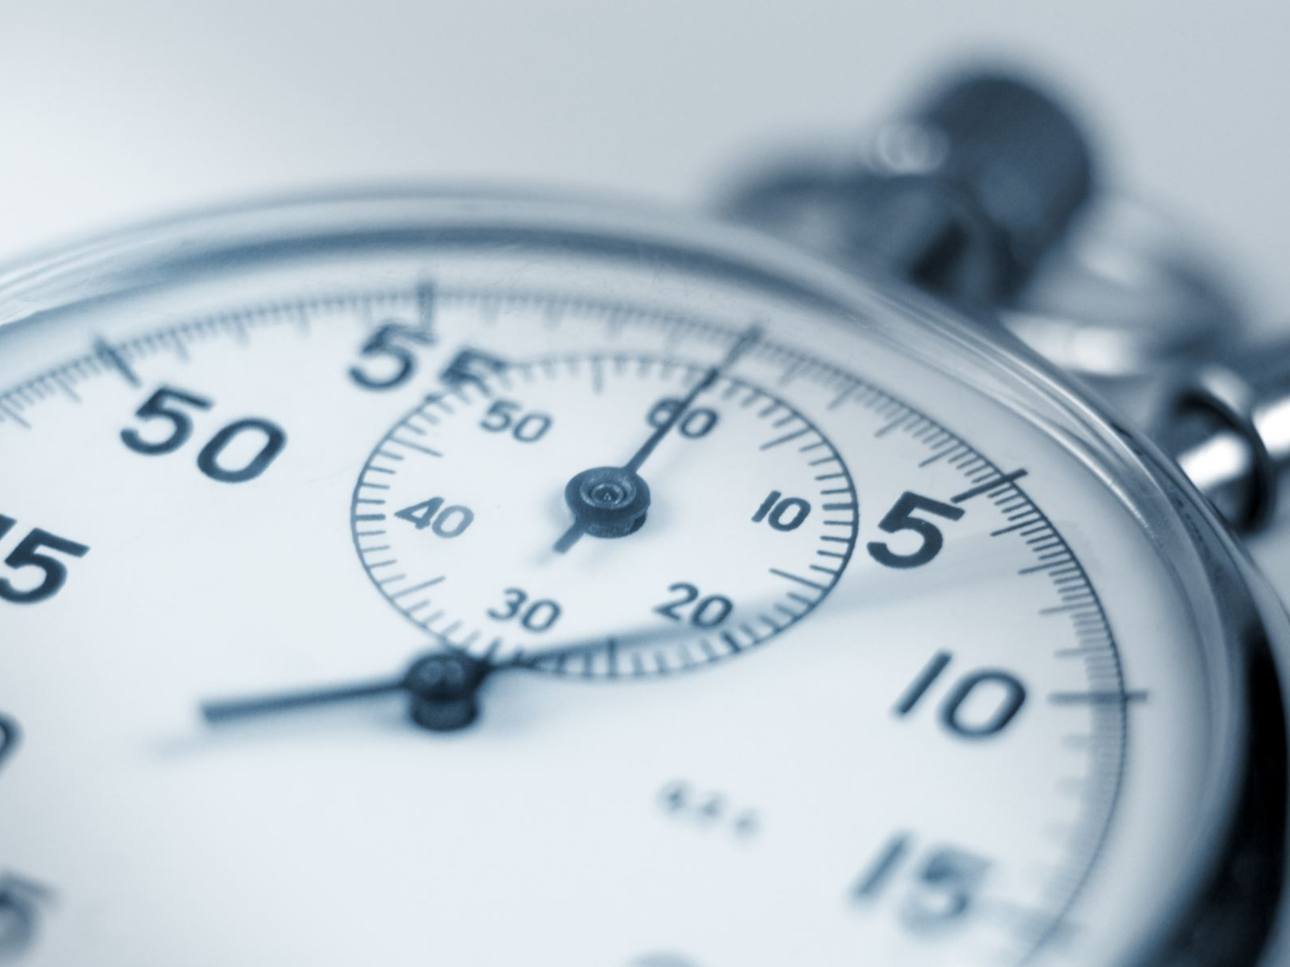
Softmax-Based Ranking Output
Similarity scores are converted into softmax-normalized values.
Softmax is applied only to the top-5 results.
This does not change the ranking.
It provides interpretable percentage-based relevance scores.

Slide 15
Model Tuning and Optimization
We built a modern multimodal retrieval system.
The approach differs from classical classification but solves the same problem more effectively.
The system is efficient, scalable, and interpretable.
The project demonstrates the strengths of joint image - text representation learning.
Pre-trained models were fine-tuned on the dataset.
Hyperparameters were tuned empirically using validation data.
Regularization is applied via:
  Dropout layers in pre-trained models
  Weight decay in the optimizer
Full cross-validation was avoided due to computational cost.

Slide 16
Summary and Conclusions
We built a modern multimodal retrieval system.
The approach differs from classical classification but solves the same problem more effectively.
The system is efficient, scalable, and interpretable.
The project demonstrates the strengths of joint image - text representation learning.

