Slide 1

Music Recommender Project
Brian Ortiz

Slide 2
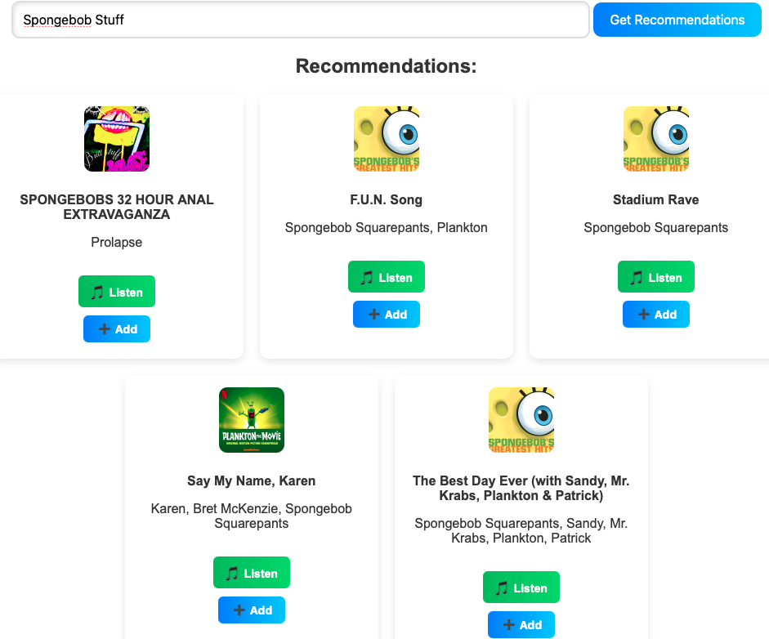
Beginner Full-Stack project that uses Spotify API to let users input an Artist or Song they might enjoy and get similar results/recommendations from that input
Back-End Involves MySQL through XAMPP, where user data and playlists are stored
Data includes
Passwords
Email
ID#
Playlists
Songs
Search History
Notes:
Bottom Picture:
Felt the user passwords should be more safely secured in the database
So decided to use bcrypt which is widely used for password protection by hashing user passwords
Its basically just a popular hashing library that prevents plaintext password storage by using the salting algorithm

Slide 3
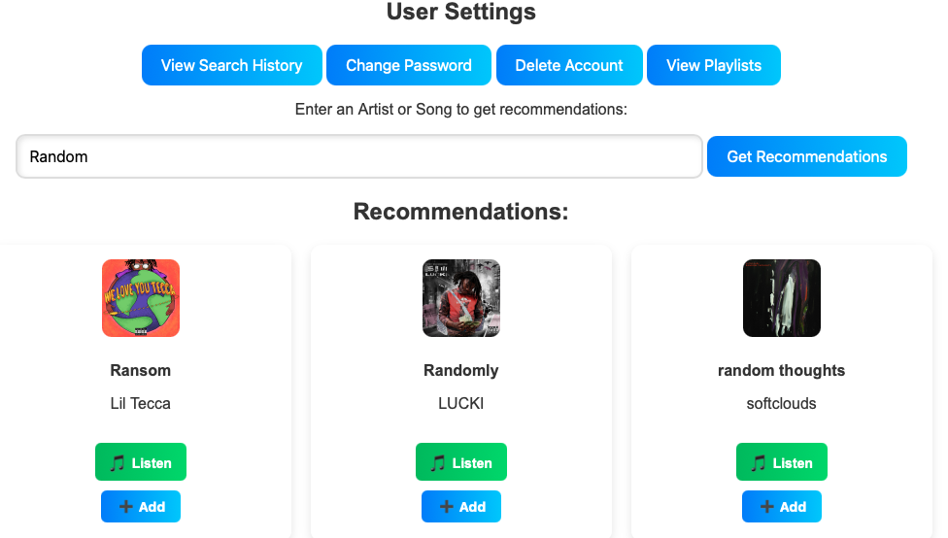
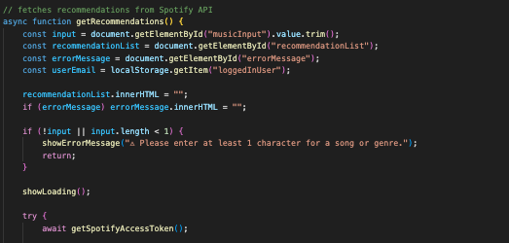

Most Functionality on one main page
Provides an alternative to manually attaining new Spotify Tokens
Used Basic html to provide users with a darker contrast to fight bright coloring
Notes:
Front-End Features: (HTML, CSS, and JS)
The UI options include changing your password, viewing your search history, deleting your account, and viewing or creating playlists
Recommended Songs come with the Artist, features (if any), and a photo of the album along with a direct link to the Spotify web where you can play the song
‘Add’ option that allows to Add to your playlist
Recommendation Fetching
Triggered when user clicks the get recommendations button
Grabs user input
Validates it
Retrives the spotify access token
And in later code uses that token to fetch song recommendations based on the user input
API Integration
Access Token (bottom picture) is a function that securely fetches a new Spotify access token and stores it with an expiry, this allows for communication with the actual Spotify API without having to re-authenticate each time

Slide 4
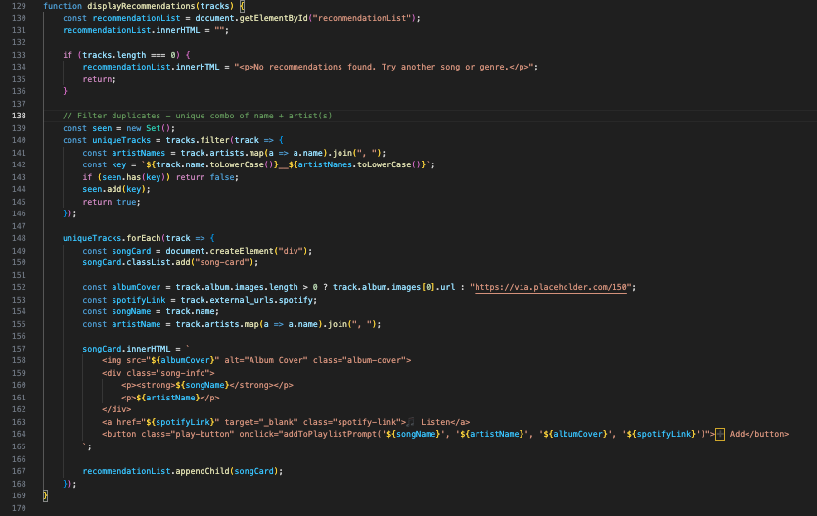
Notes:
This code here essentially helps in displaying the actual recommendations fetched from the Spotify API
It renders music track results in the UI based on the data that was retrieved and takes in track objects and creates HTML styled cards to display each song, while also ensuring that no duplicate songs appear since the Spotify API does that
Summary
Essentially this code here connects the backend Spotify track data to the UI to again ensure to duplicate entries
Lines 130-131 clears the previous list of songs to avoid stacking results on each new search
Lines 133-136 simply displays an error message if Spotify wasn’t able to find any tracks
*Lines 139-146 handles the duplicate logic. So This block removes any duplicates songs by tracking combinations of song names + the artist
The ‘Set’ keeps track of what’s already been shown to avoid any redundant or duplicate results
Lines 149-150 A div is created for each unique song, and styled with the song-card class
Lines 152-155
albumCover – uses first available album image or falls back to a placeholder
spotifyLink - an external link to the Song on spotify
songName and ArtistName – feature the song name and any features on the track
Lines 157-166
Builds the Track Card using template literals… It includes a Spotify link that opens in a new tab and an “Add” button that allows our other function to open a modal and allow saving the track to the userPlaylist
Line 167: Adds the fully constructed track card to the recommendations section in the HTML

Slide 5
Summary and Demo
Used HTML/CSS to structure and style UI, modals, forms, and layout
JavaScript to handle the interactions, API requests to Spotify
NodeJS & Express to create the backend server logic, manage the routes, and handle the user authentication (necessary to utilize the program)
MySQL to store the user data, playlists, and search history; also perform queries for CRUD operation such as (Create users, Read user Info, Update user password, and delete an account entirely)
Used Bcrypt to hash password in the database so user data (password) isn’t so naked

