Slide 1


Assessment of the
Statistical Impedance Field Method
for the Analysis of the RTN Amplitude
in Nanoscale MOS Devices
G. Torrente*, N. Castellani*, A. Ghetti☨ , C. Monzio Compagnoni*,
A. Lacaita*, A. S. Spinelli* and A. Benvenuti☨
* Politecnico di Milano, Milano, Italy
☨ Micron Technology Inc., Process R&D, Agrate Brianza, Italy
Notes:
<numero>
<numero>
<numero>

Slide 2
Outline
Introduction
Statistical Impedance Field Method (sIFM) for the analysis of the amplitude of RTN fluctuations
Comparison between sIFM and conventional MC results
Conclusions
Notes:
<numero>
<numero>
<numero>

Slide 3
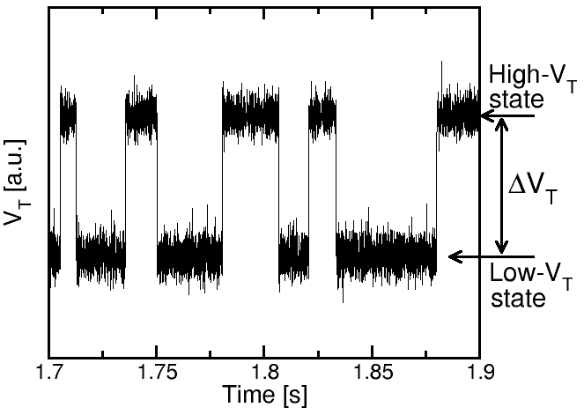
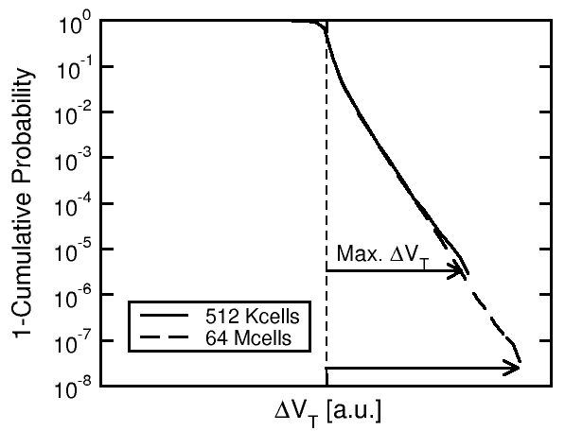
Random Telegraph Noise
RTN is a fluctuation of device V_{T} (or I_{D}) between two definite levels
Technology scaling has been increasing the amplitude of RTN fluctuations giving rise to a wider statistical distribution

Slide 4
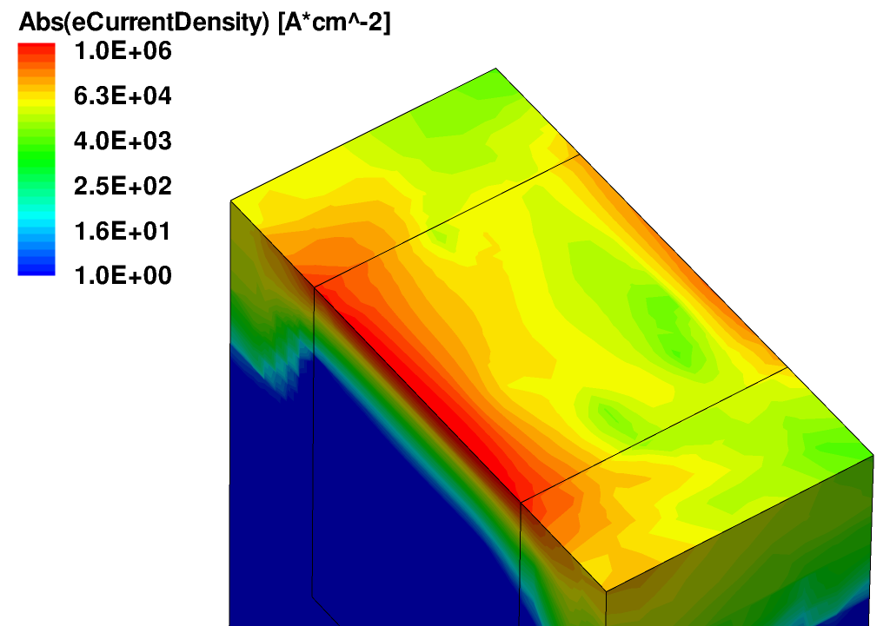
Statistical RTN effect
τ
Low ΔV_{T}
c
source
τ
e
High ΔV_{T}
Gate
SiO
Substrate
drain
2
The fluctuation is due to a carrier capture/emission mechanism at the SiO₂/Si interface
The RTN amplitude is the result of trap capability to stop the percolative path
RTN now represents a major reliability issue
Notes:
<numero>

Slide 5
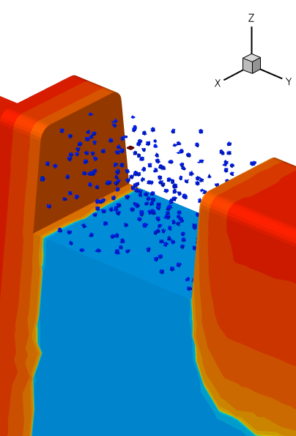
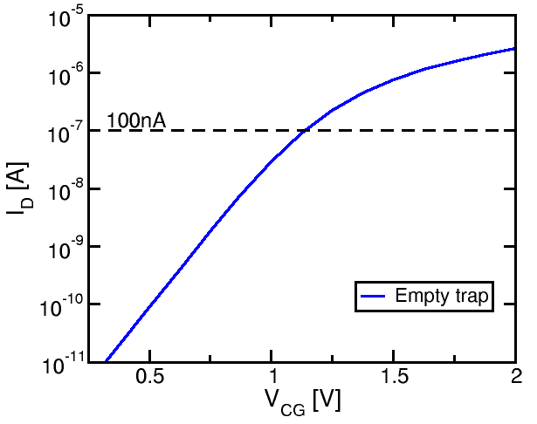
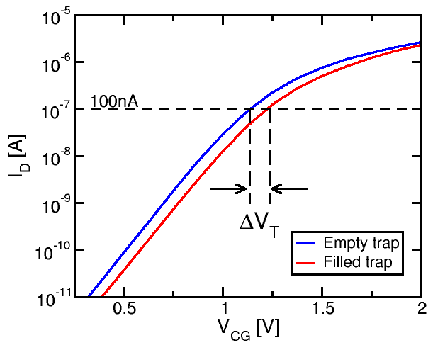
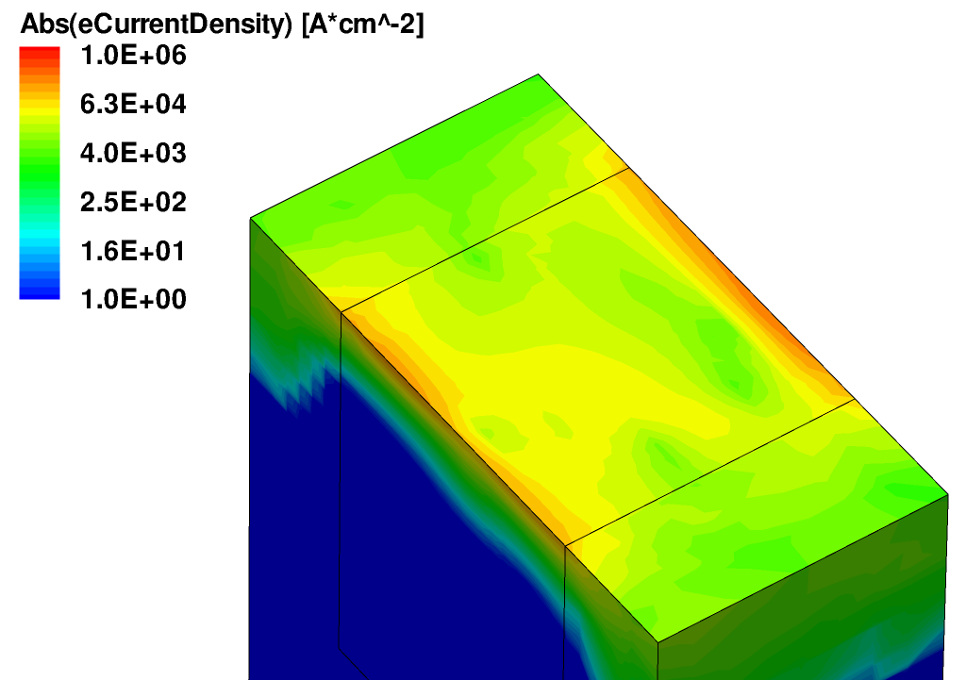
Conventional RTN MC scheme
V_{G}
V_{G}
Numerical implementation of a random atomistic doping configuration
Poisson/DD
solution
Random placement of a charge –q over the channel
Poisson/DD
solution
The computational burden is proportional to the number of samples
Notes:
<numero>
<numero>

Slide 6
Statistical Impedance Field Method
Motivation: reducing the computational loads
Hypothesis: treating the variability sources as a small perturbation of Poisson/DD solution
Approximation: linear approximation of Poisson/DD equations around a reference condition
Thesis: treating the effects of variability sources through the Green Functions approach
Notes:
<numero>
<numero>

Slide 7
Statistical Impedance Field Method
Literature: neutral V_{T} statistics
This work: neutral V_{T} statistics + RTN amplitude, using
  sIFM-doping: atomistic doping as perturbation of the continuous doping case (with neutral and charged trap)
  sIFM-trap: trapped charge as perturbation of the atomistic doping
Notes:
<numero>
<numero>

Slide 8
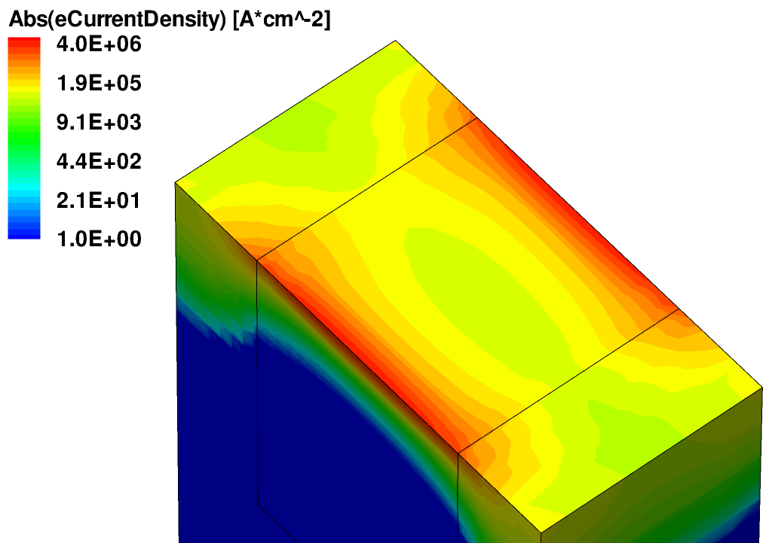
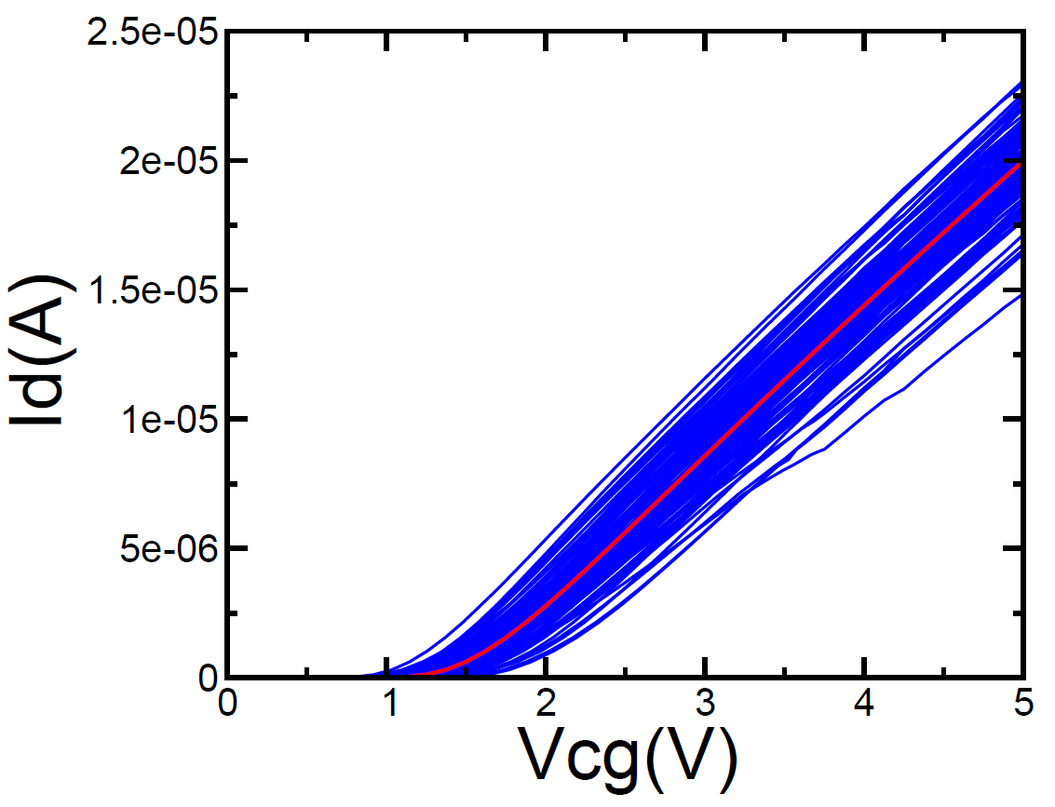
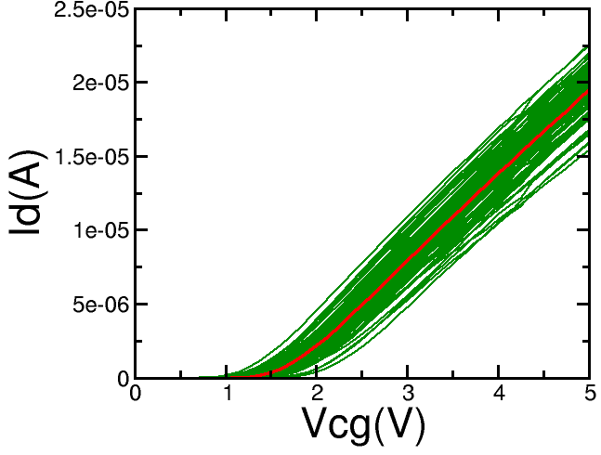
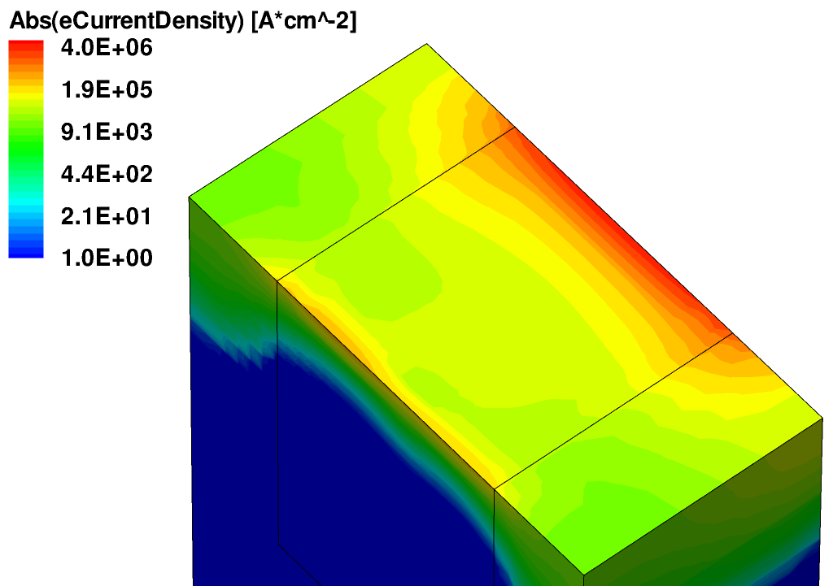
1- The sIFM-doping scheme
Iter. over doping cases
Continuous
doping
device
Calculation of δI
for the k-th doping
configuration:
Iter. over bias points
Iter. over trap positions
Random
placement of
a charge –q
at the channel
surface
Iter. over doping cases
Calculation of δI
for the k-th doping
configuration:
Iter. over bias points

Slide 9
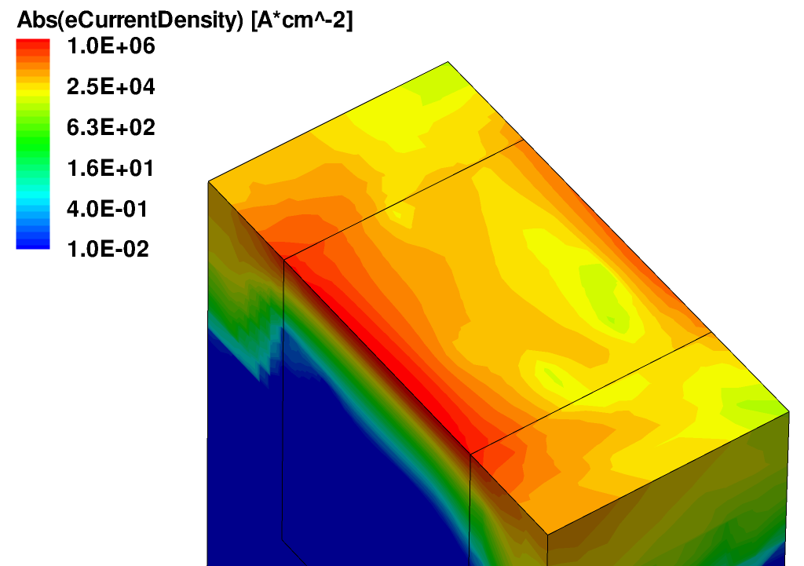
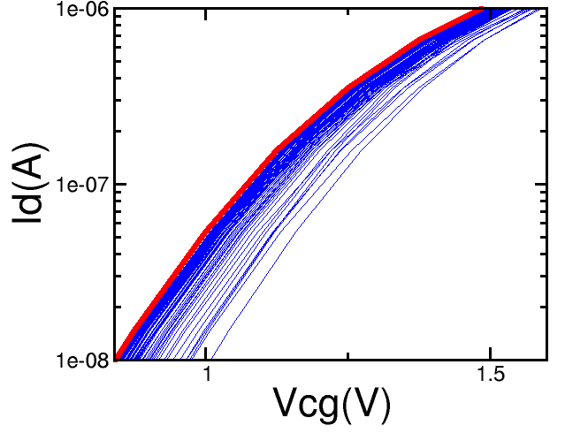
2- The sIFM-trap scheme
Iter. over trap positions
Random
configuration of
atomistic doping
Calculation of δI
for the i-th trap:
Iter. over bias points
Iter. over doping cases

Slide 10
Computational load comparison
Given:
  N_{dop} atomistic doping configurations
  N_{trap} trap positions per cell
Any simulation set gives a statistical ensamble of N_{dop} x N_{trap} elements
Reference MC
sIFM-doping
sIFM-trap
N_{dop}x(N_{trap}+1) Poisson/DD solutions
(N_{trap}+1) Poisson/DD solutions
(N_{dop}) Poisson/DD solutions
Notes:
<numero>
<numero>

Slide 11
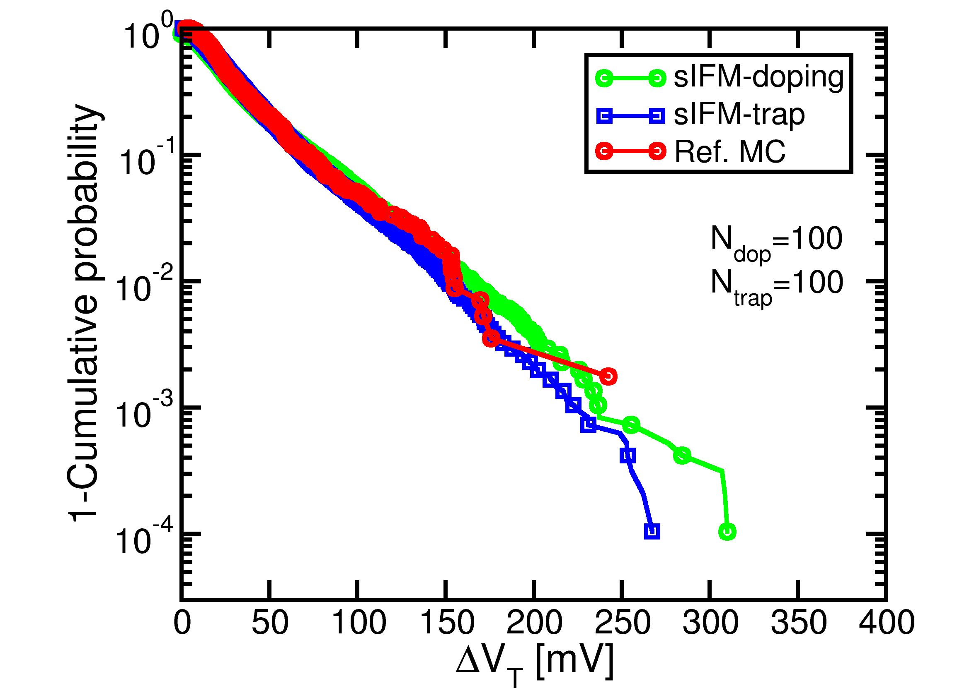
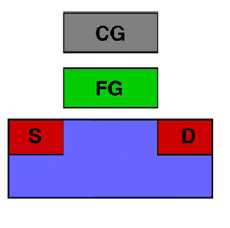
Statistical dispersion of ΔV_{T}
W=L=32nm
t_{ox}=8nm
N_{a}=2x10¹⁸cm⁻³
Both of the sIFM schemes are able to reproduce the reference MC statistics
Reduced computational burdens allow to explore lower probability ranges
Notes:
<numero>
<numero>

Slide 12
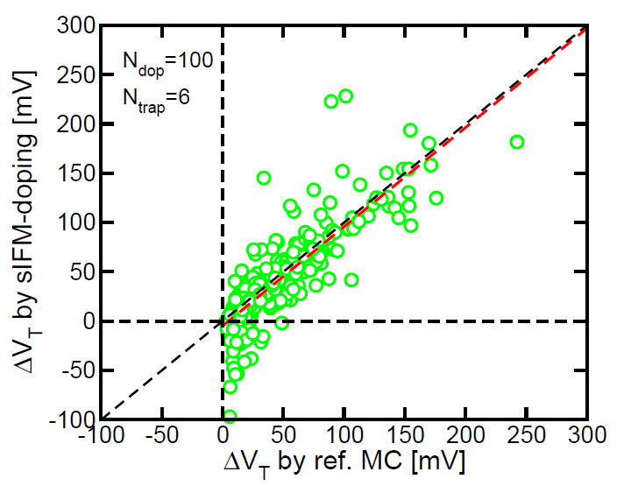
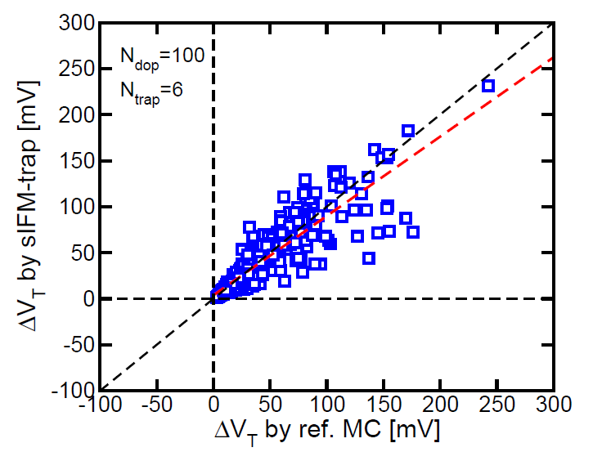
A more in-depth analysis
ρ=0.90
ρ=0.86
A point by point comparison between MC and sIFM methods shows a non-negligible discrepancy in the results
Unphysical negative ΔV_{T} may occur using sIFM-doping method
Correlation values are calculated omitting unphysical points
Notes:
<numero>

Slide 13
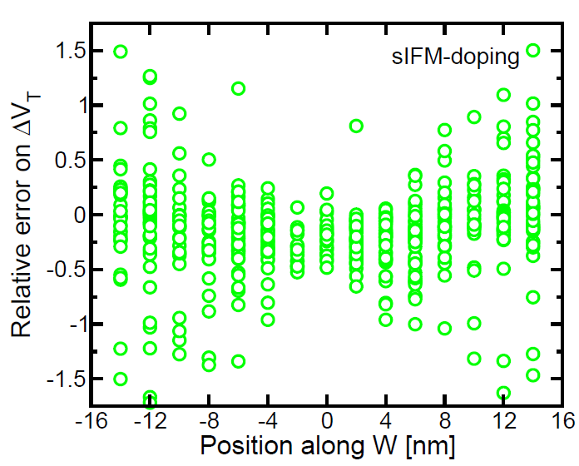
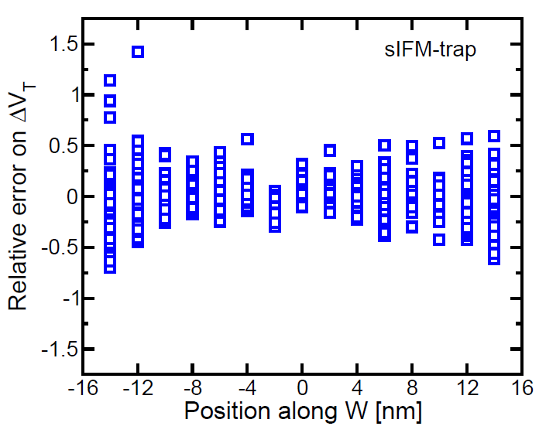
Role of trap position
Largest errors using sIFM schemes occur when the RTN trap is placed close to cell edges
Dispersion is symmetric over the average value
ΔV_{T} estimation errors compensate each other in a statistical analysis
Notes:
<numero>
<numero>

Slide 14
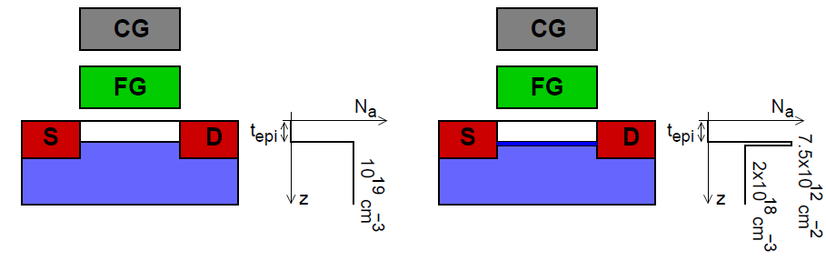
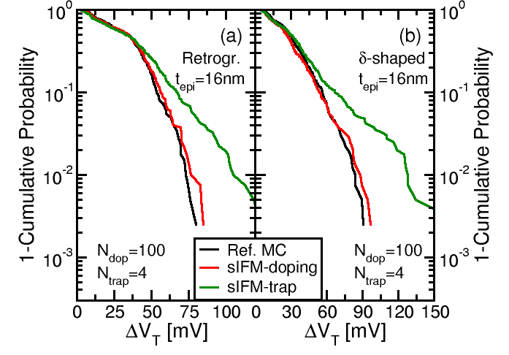
Vertically non-uniform dopings
(a)
(b)
In some cases sIFM schemes maybe inaccurate also for ΔVT statistics
  The sIFM-trap is not very inaccurate
  The sIFM-doping is very good
Notes:
<numero>
<numero>

Slide 15
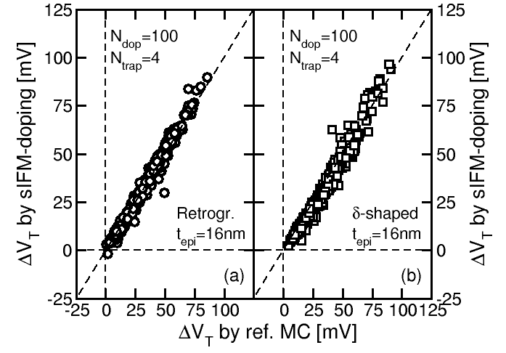
Vertically non-uniform dopings
(a)
(b)
Dopants are far from the channel surface
sIFM-doping scheme is accurate also looking at the single MC samples
Notes:
<numero>
<numero>

Slide 16
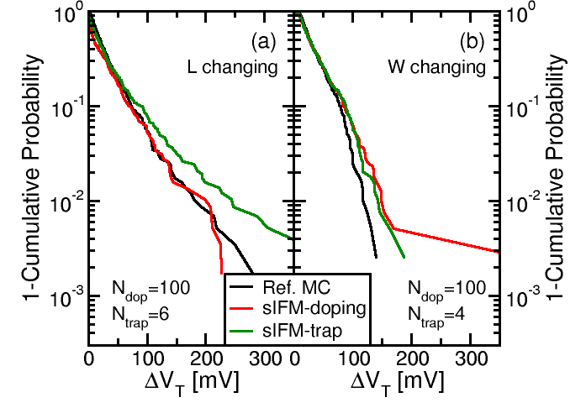
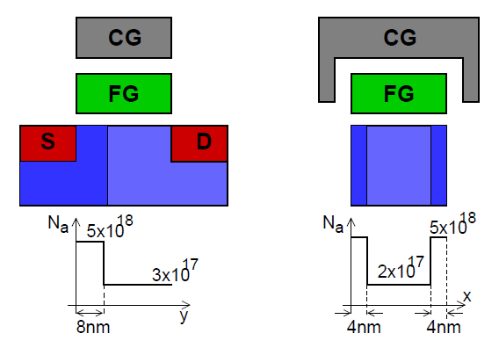
Laterally non-uniform dopings
(a) (b)
Changing the doping profile along W methods are equivalent
A change in the doping profile along L modifies percolation paths
sIFM-doping better describes these last effects
Notes:
<numero>
<numero>

Slide 17
Conclusions
The sIFM methods are a good compromise between accuracy and computational burdens allowing to explore lower probability ranges
sIFM methods are able to reproduce with a good accuracy statistical quantities
Performing a point by point comparison between sIFM results and MC reference, a non-negligible discrepancy occurs
In case of nonuniform doping profiles the accuracy of the sIFM methods should be evaluated case by case

Slide 18
Thank you for your attention
Niccolo’ Castellani,
Ph.D. Student, Politecnico di Milano, Milano (Italy)
ncastellani@elet.polimi.it
Notes:
<numero>
<numero>
<numero>

Slide 19
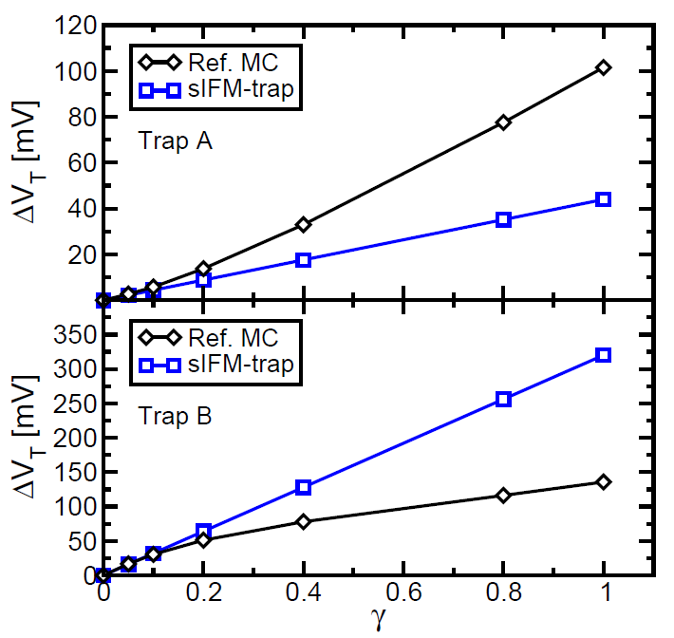
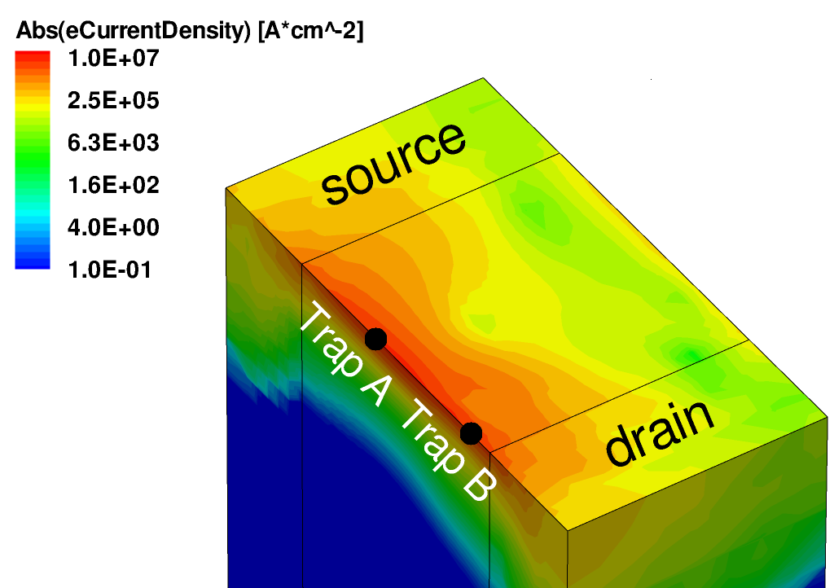
Effects of linearization
Inaccuracies of the sIFM schemes come from the linear approximations involved in the method
Notes:
<numero>
<numero>

Slide 20
I_{D}-V_{G} of the highest sIFM-doping ΔV_{T}
The sIFM methods fail to reproduce filled trap I_{D}-V_{G}
The sIFM-doping method also fails to reproduce neutral I_{D}-V_{G} curve
Atomistic doping cannot be considered as a small perturbation
Notes:
<numero>

Slide 21
Remarks on ΔV_{T} dispersion
Thanks to lower computational burdens sIFM methods are useful to extend statistics to lower probability ranges
sIFM-trap:
  is computationally faster
  shows a better agreement with MC reference
  does not introduce errors in neutral I_{D}-V_{G} calculation
Notes:
<numero>
<numero>

Slide 22
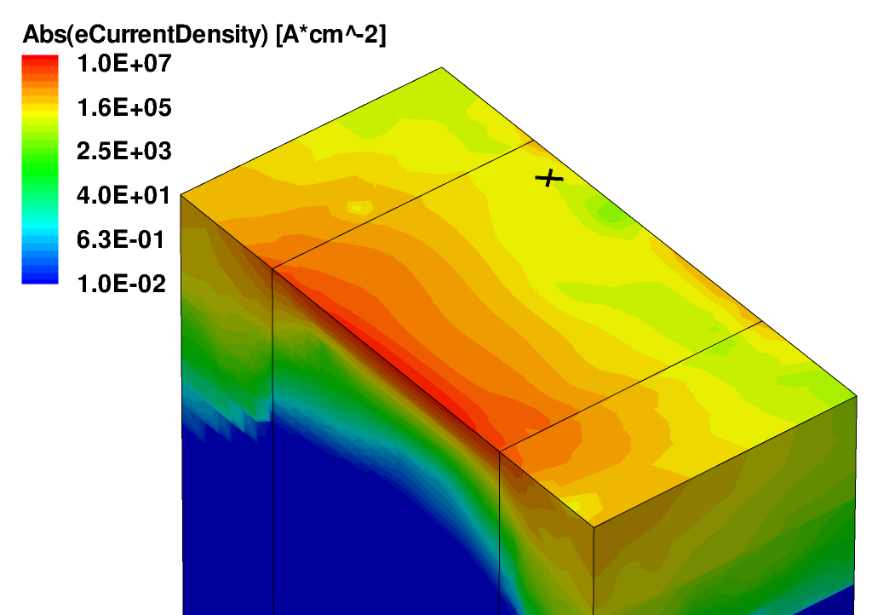
Results: RTN, Uniform doping
Empty trap
Filled trap
ΔVt_MC | 6,4 mV
ΔVt_sIFMdop | -66,7 mV
Ref. MC
sIFM-doping
Notes:
/prj/NEWtcad_users-data/ise_db/torrente_db/slIFM_Flash/sl_IFM_trap_RTN_drog_uniforme
/prj/NEWtcad_users-data/ise_db/torrente_db/slIFM_Flash/sl_IFM_RTN_drog_uniforme
/prj/NEWtcad_users-data/ise_db/torrente_db/slIFM_Flash/MC_RTN_drog_uniforme

